Slide 1
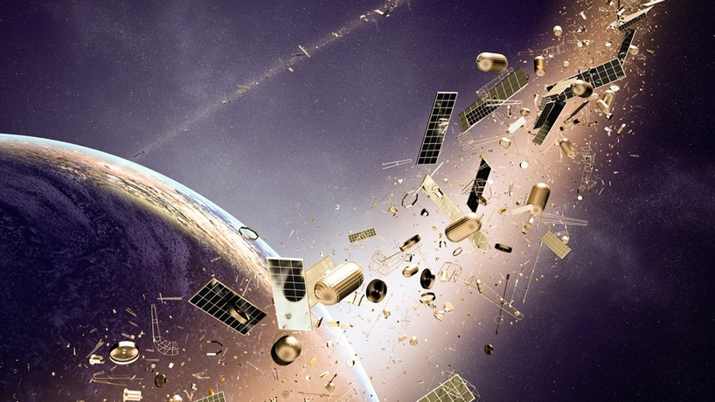
Armageddon?
Near-Earth Orbit Objects and Space Junk

Slide 2
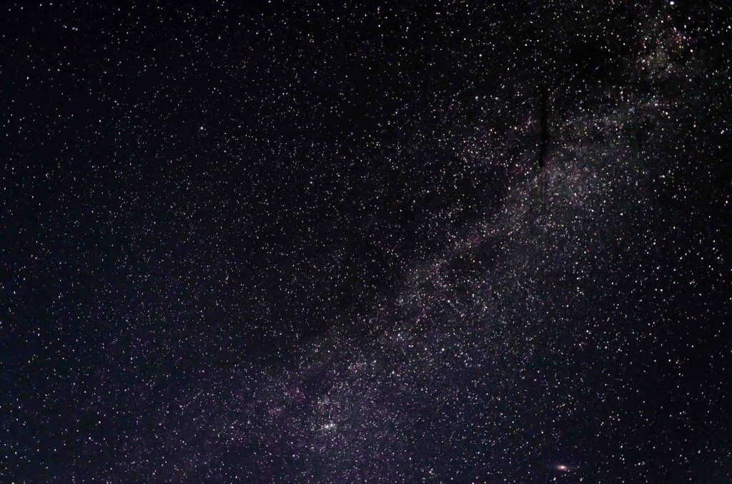
Project Objective
We used data from both NASA and SpaceTrack.org to gain an understanding of the threats presented to life on Earth from collisions with both natural and manmade space objects.

Slide 3
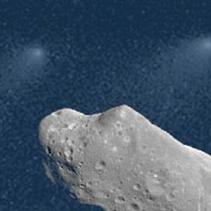
Near Earth Orbit Objects
“NEOs are comets and asteroids that have been nudged by the gravitational attraction of nearby planets into orbits that allow them to enter the ‘Earth’s ‘neighborhood.’”

Slide 4
Hypotheses
Null: Since a collision with an object >100m in diameter occurs roughly once every 10,000 years, the threat is small and thus not worth paying any attention to.
Alternate: A collision with an object >100m could cause massive loss of life, therefore ongoing efforts to discover and track these objects may prove important in preventing a future catastrophe.

Slide 5
Methodology
To determine how often NEO’s present a true threat to life on Earth, we analyzed two sets of provided by CNEO:
Historical NEO data 1/1/1900 – 10/20-2020
Future NEO paths 10/21/2020 – 12/31/2200

Slide 6
Defining NEO Threat Parameters
We set the following parameters NEOs that present a real threat
Diameter > 100 meters – capable of causing, at minimum, a regional catastrophe
Minimum Distance Approach < 1 Lunar Distance (LD) unit – the distance from the Earth to the Moon

Slide 7
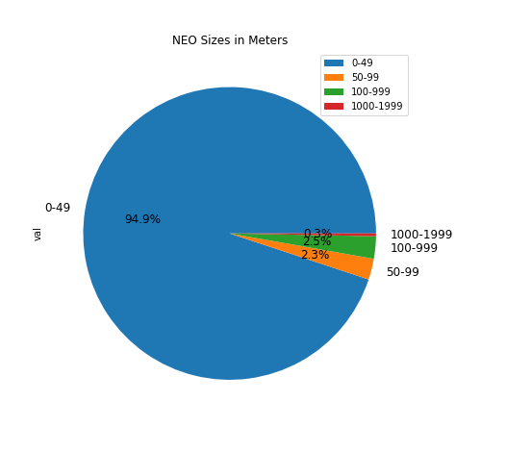
Frequency of NEO Threats 1900-2020

Slide 8
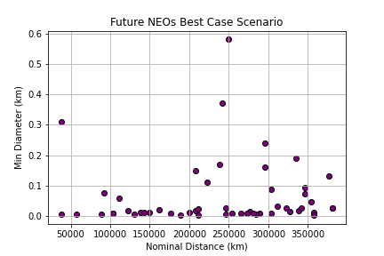
NEO Threats 2021 to 2200

Slide 9
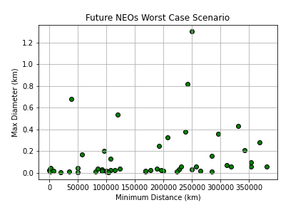
NEO Threats 2021 to 2200

Slide 10
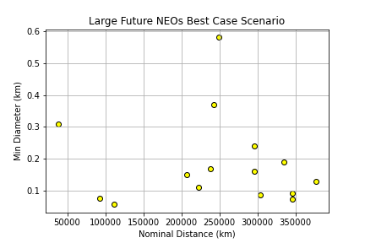
NEO Threats 2021 to 2200

Slide 11
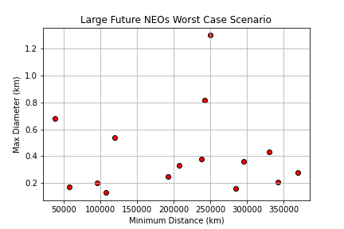
NEO Threats 2021 to 2200

Slide 12
Conclusions
Only about 1/3 of potentially damaging NEO’s have been detected.
Though a catastrophic collision is unlikely in our lifetimes, it is worthwhile to continue efforts to search and track NEOs.

Slide 13
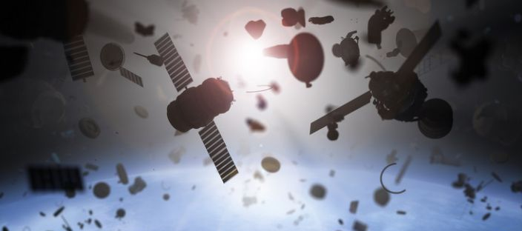
Space: The Next Frontier Garbage Dump

Slide 14
Space Junk Facts
There are more than 150 million pieces of cataloged space junk
Space junk is comprised of manmade items including rocket boosters, obsolete satellites.
Space junk presents little to no danger to life on Earth, but it does present a hazard to the International Space Station and commercial and government satellites orbiting the Earth.

Slide 15
What is the principal source of large orbital debris? Satellite explosions and collisions. Prior to 2007, the principal source of debris was from explosions of old launch vehicle upper stages left in orbit with stored energy sources, e.g., residual propellants and high pressure fluids. The intentional destruction of the Fengyun-1C weather satellite by China in 2007 and the accidental collision of American and Russian communications satellites in 2009 greatly increased the number of large debris in orbit and now represent one-third of all cataloged orbital debris.

Slide 16
Hypotheses
alternative hypothesis: If countries with the highest gdp produce the most space trash then wealthier economies correlate with space trash production. null hypothesis: If countries with the highest gdp do not produce the most space trash then wealthier economies correlate with space trash production. Since the end of “The Space Age,” has the amount of space junk increased or decreased?
alternative hypothesis: If the space race produced more space trash, then there should be an increase of trash before the 1975. null hypothesis: If the space race did not put more space trash, then there shouldn’t an increase of junk before the 1975's.

Slide 17
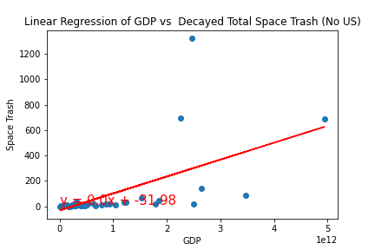
Biggest Space Litterbugs

Slide 18
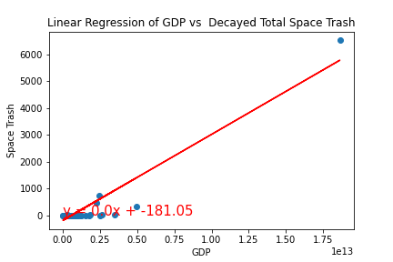

Biggest Space Litterbugs? We’re Number One!!!

Slide 19
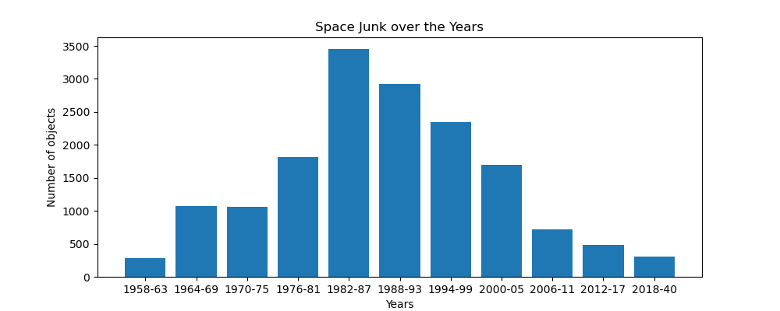
Space Age = More Junk
PLACEHOLDER OUTPUT LINE GRAPH OF SPACE JUNK OVER THE LAST SIX DECADES SHOWING THE CORRELATION OF SPACE JUNK TO THE DAWN AND END OF THE SPACE AGE

Slide 20
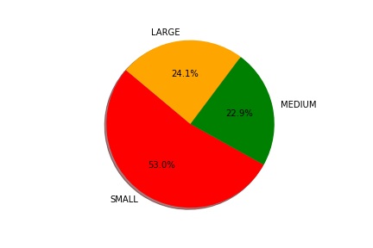
Space Age = More Junk

Slide 21
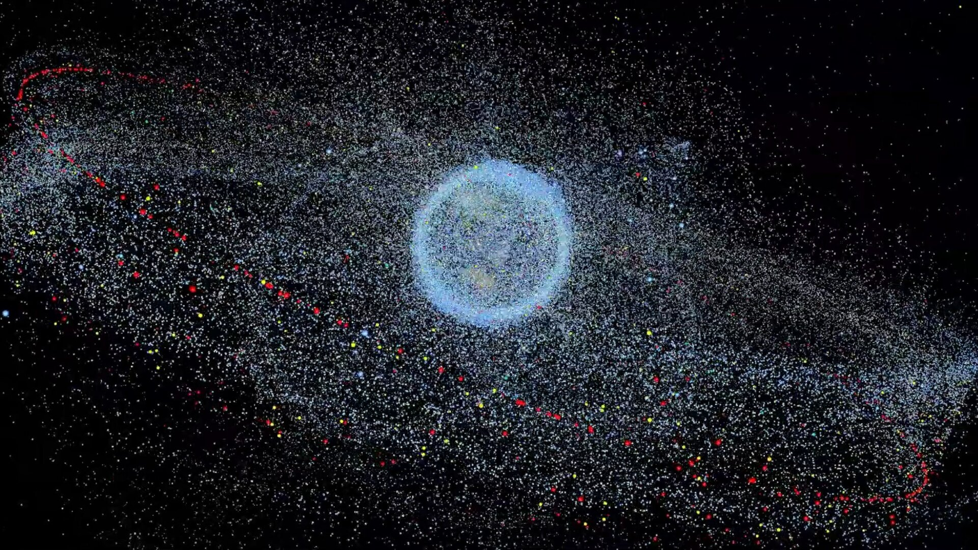
Earth’s Rings
*Source: Author Mike Wall
*Source: European Space Agency,
https://www.esa.int/ESA_Multimedia/Videos/2019/02/Distribution_of_space_debris_in_orbit_around_Earth

Slide 22

Questions

