Slide 1
Armageddon?
Near-Earth Orbit Objects and Space Junk

Slide 2
Project Objective
We used data from both NASA and SpaceTrack.org to gain an understanding of the threats presented to life on Earth from collisions with both natural and manmade space objects.

Slide 3
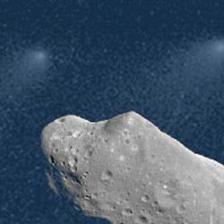
Near Earth Orbit Objects
“NEOs are comets and asteroids that have been nudged b the gravitational attraction of nearby planets into orbits that allow them to enter the Earth’s ‘neighborhood.’”

Slide 4
Hypotheses
Null: Since a collision with an object >100m in diameter occurs roughly once every 10,000 years, the threat is small and thus not worth paying any attention to.
Alternate: A collision with an object >100m could cause massive loss of life, therefore ongoing efforts to discover and track these objects may prove important in preventing a future catastrophe.

Slide 5
Methodology
To determine how often NEO’s present a true threat to life on Earth, we analyzed two sets of provided by CNEO:
Historical NEO data 1/1/1900 – 10/20-2020
Future NEO paths 10/21/2020 – 12/31/2200

Slide 6
Defining NEO Threat Parameters
We set the following parameters NEOs that present a real threat
Diameter > 100 meters – capable of causing at minimum aregional catastrophe
Minimum Distance Approach < 1 Lunar Distance (LD) unit – the distance from the Earth to the Moon

Slide 7
Frequency of NEO Threats 1900-2020
PLACE HOLDER. INSERT 1900-2020 CHART THAT KEVIN WILL PRODUCE AS AN OUTPUT

Slide 8
NEO Threats 2021 to 2200
PLACEHOLDER – AARON’S OUTPUT CHART SHOWING THREATENING NEOS OVER THE NEXT 180 YEARS

Slide 9
Conclusions
About 8,000 near-Earth objects capable of wiping out an area the size of a state have been detected.*
Scientists believe another 17,000 are still undetected.*
Though a catastrophic collision is unlikely in our lifetimes, it is worthwhile to continue efforts to search and track NEOs.
*Source: Author Mike Wall Article title: About 17,000 Big Near-Earth Asteroids Remain Undetected: How NASA Could Spot Them Website title: Space.com URL: https://www.space.com/40239-near-earth-asteroid-detection-space-telescope.html

Slide 10
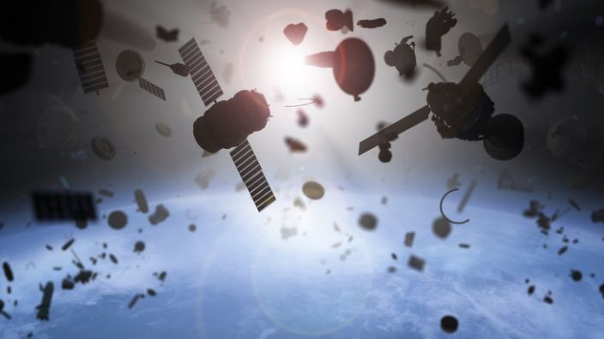
Space: The Next Frontier Garbage Dump

Slide 11
Space Junk Facts
There are more than 150 million pieces of cataloged space junk
Space junk is comprised of manmade items including rocket boosters, etc. etc
Space junk presents little to no danger to life on Earth, but it does present a hazard to the International Space Station and commercial and government satellites orbiting the Earth

Slide 12
Questions
Is there a correlation between higher GDP and the amount of junk those nations dump into space?
Since the end of “The Space Age,” has the amount of space junk increased or decreased?

Slide 13
Biggest Space Litterbugs
PLACEHOLDER: OUTPUT CHART OF NATIONS THAT HAVE RELEASED THE MOST SPACE JUNK

Slide 14
Correlation Between GDP and Space Junk
PLACE HOLDER FACTS SUPPORTING CORRELATION BETWEEN GDP AND SPACE JUNK

Slide 15
Space Age = More Junk
PLACEHOLDER OUTPUT LINE GRAPH OF SPACE JUNK OVER THE LAST SIX DECADES SHOWING THE CORRELATION OF SPACE JUNK TO THE DAWN AND END OF THE SPACE AGE

Slide 16
Conclusions
PLACE HOLDER CONCLUSIONS ABOUT SPACE JUNK

Slide 17
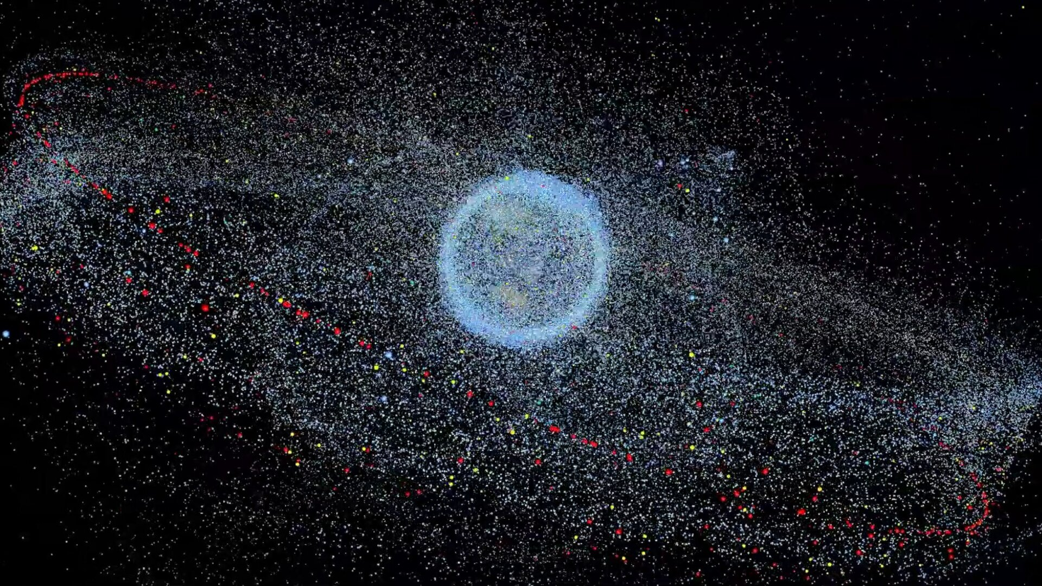
Earth’s Rings
*Source: Author Mike Wall
*Source: European Space Agency,
https://www.esa.int/ESA_Multimedia/Videos/2019/02/Distribution_of_space_debris_in_orbit_around_Earth

