Slide 1
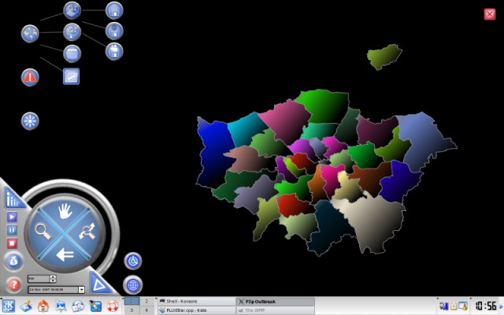


Iesim: Simulating and Understanding Real World Events in a Game-like Environment
Joana Simões*, Chris Skelly, João Simões
* Speaker

Slide 2

Outline
Introduction
Case Study: outbreakP2P
Implementation Notes
Final Remarks

Slide 3
Introduction
Modelling Environment, that implements models through a set of plugins.
Targets: programmers and users.
Intuitive and easy to use, as a computer game!
Cope with lack of data, creating fictitious scenarios (as in games!)

Slide 4
Case Study: outbreakP2P
Package built using Iesim ADL.
Simulates the spreading of a non-vector infectious disease.
Split into three sub-models: community, hazard and intervention.
Each sub-model is implemented in a separate plugin: ICom, IHaz and IInt.

Slide 5
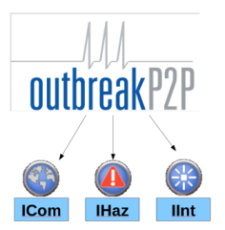
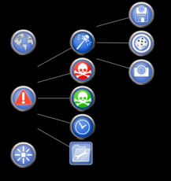
Each plugin is loaded at run-time and appears as an icon, which gives access to a set of sub-menus to configure the different model parameters.
So how do we use the model?

Slide 6
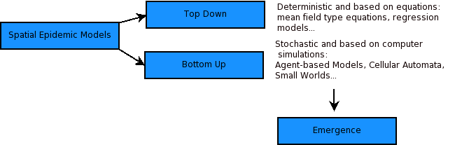
Model Background:
Approaches in Epidemic Modelling: “Top down” and “Bottom-up”.
Mixed Agent-based/Network approach.

Slide 7
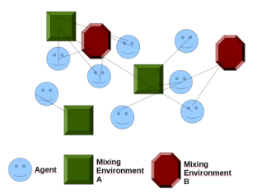
Community
Agents and “Exposure” or “Mixing”environments (ME).
Agents: households.
ME: functional networks that link the households together.

Slide 8
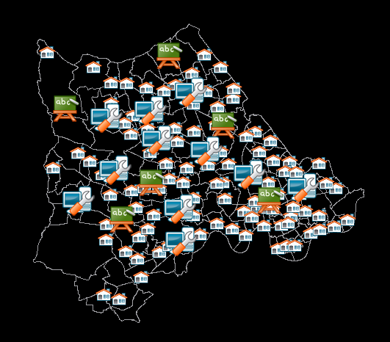
ME considered in this model: workplaces, schools (others...).
During the configuration, the user loads/generates this information and aggregates the households around the ME.

Slide 9
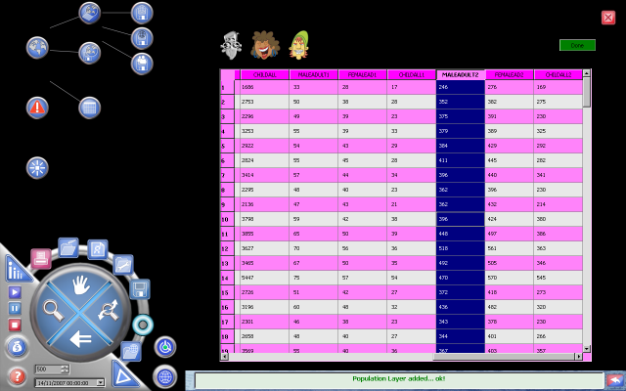
1
Load Population Data from a Shapefile.

Slide 10
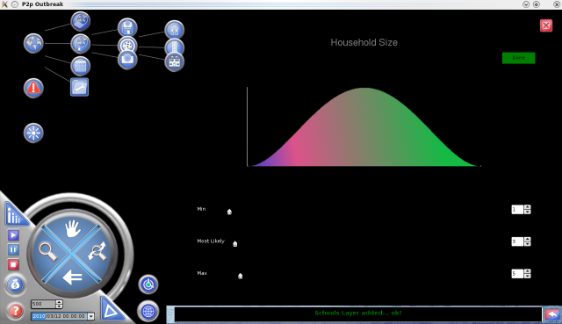
2
Use aggregated data to generate households with a certain structure: Pert Distribution.

Slide 11
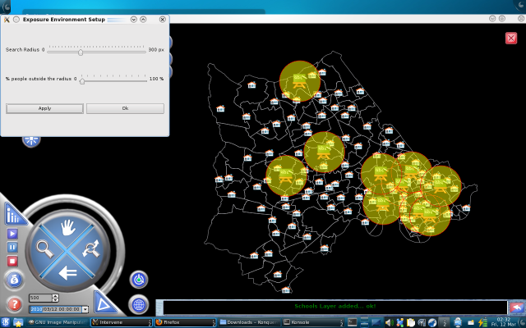
3
Create ME: load them, generate them randomly or input them in the map.
A buffer is used, to aggregate the households around the ME.

Slide 12

What about time?

Slide 13
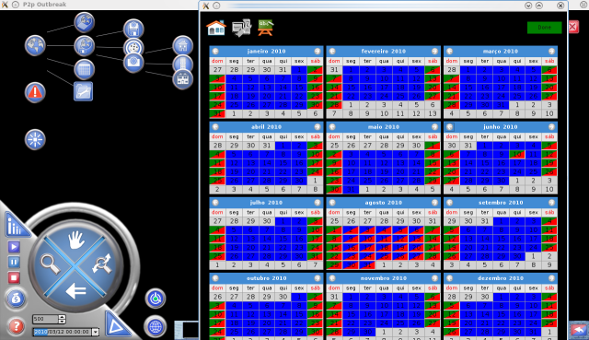
4
Setting the time dynamics of the ME.
Calendar control: a user friendly UI for a complex task.

Slide 14
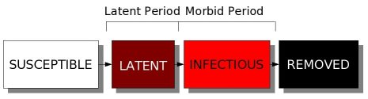
Hazard
Hazard: infectious disease.
SEIR model: susceptible, latent, infectious and Removed.
Latent Period: symptomatic and asymptomatic periods.

Slide 15
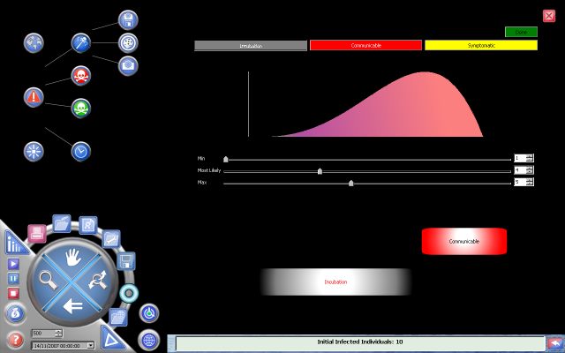
Control for configuring the time dynamics.

Slide 16
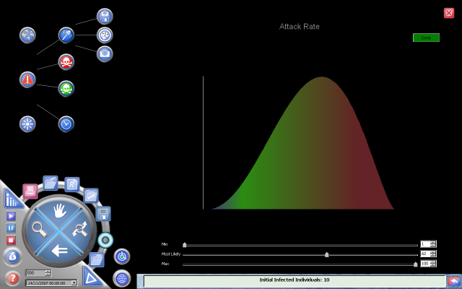
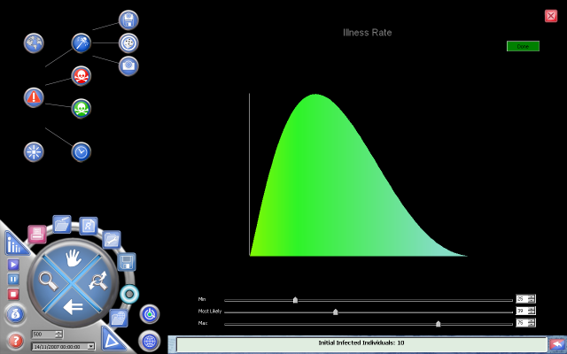
Attack rate (β) and Illness/Impact rate: Pert Distribution.

Slide 17
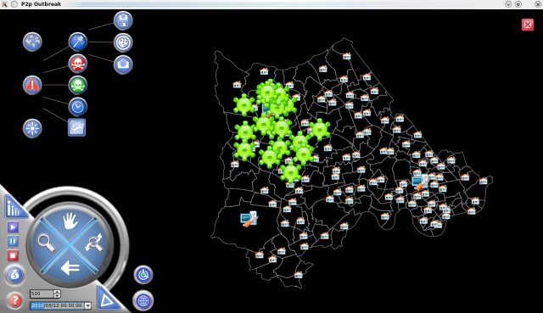
Locate the source of the hazard: known locations of infected individuals.
Load, generate or input.

Slide 18
Intervention
Test strategies for the optimal control of an infection in a spatial complex landscape..
Heterogeneous populations: in space and in structure.
Vaccination Strategies: proactive and reactive.
Only Reactive vaccination was implemented!

Slide 19
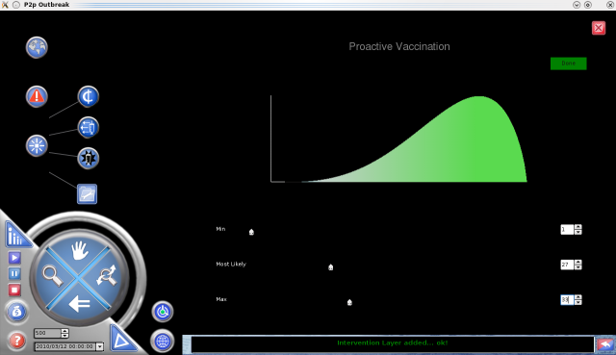
1
Choose immunisation rate.

Slide 20
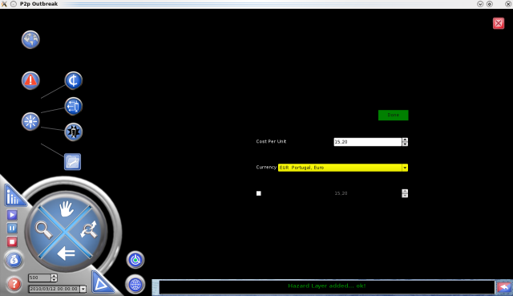
2
Define costs (currency, budget).

Slide 21
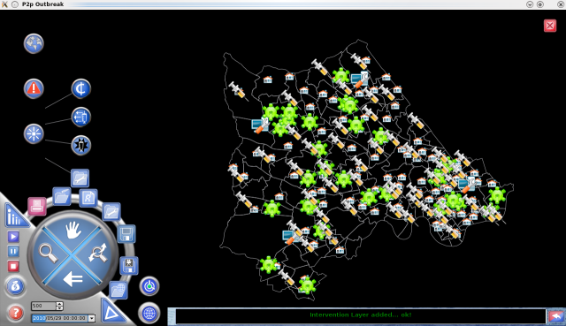
3
Randomly vaccinate population.

Slide 22
Play: Simulate
The simulation integrates information from the three sub-models.
Play, stop and pause.
The output of each time step is presented in real time.

Slide 23
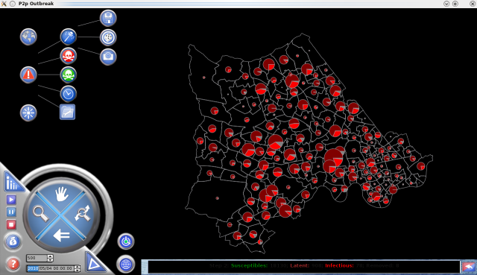
Map with distributed pie charts, containing the proportion of population states.

Slide 24
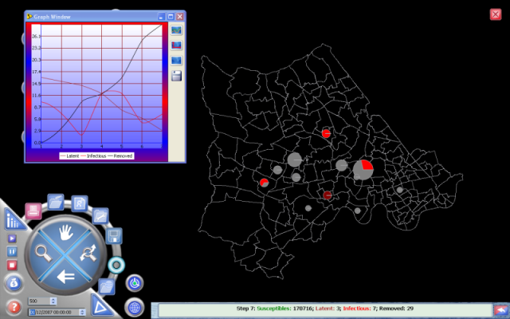
Three different ways of displaying information: map, chart and text (log).

Slide 25
Implementation Notes
C++ using Qt framework.
Native but easily portable (Linux and Windows).
GIS importance: justified the development of an in-house library.
Target: Load and manipulate geographic data in an efficient way!

Slide 26
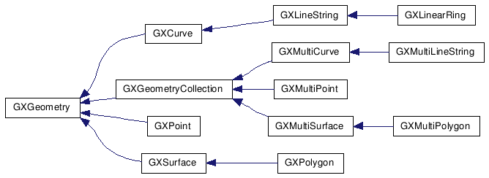
Inheritance Diagram of the Geometry class (GIS Library)

Slide 27
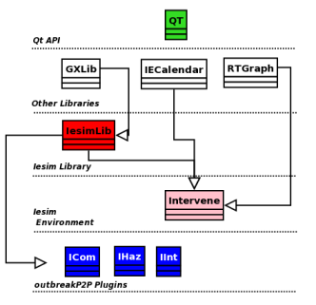

Slide 28
Final Remarks
“Game” approach in scientific modelling.
Tools to be used by non experts.
The product is still under development.
Collaboration, both with programmers and users could “push” the development of the product (and extend it to new areas)

Slide 29



Some Links:
http://www.iesim.co.uk
http://www.iesim.co.uk/api/index.html
http://e-geo.fcsh.unl.pt/uk/index.asp
http://casa.ucl.ac.uk/JoanaMargarida/
Thank You for Listening!

