Slide 1


SurveillanceSim
“Improving disaster preparedness and response through improved training and decision making”
7th April 2008
Dr Chris Skelly
Kevin Braithwaite

Slide 2
Outline
An introduction to ieSIM
Markets
Next Steps
Challenges

Slide 3
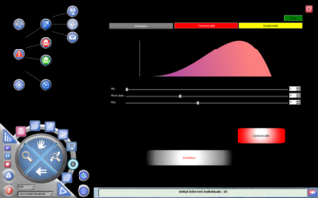
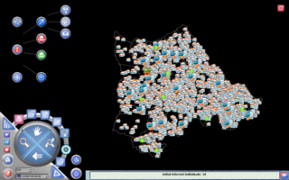
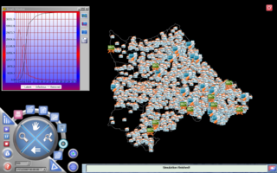
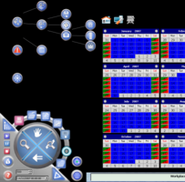
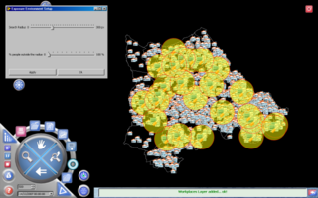
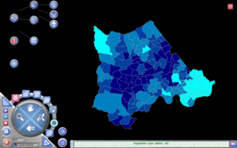
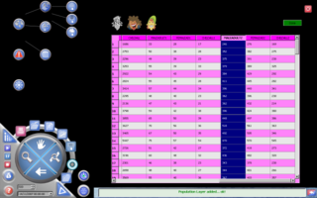
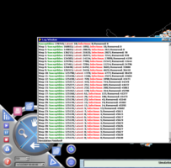
1. An introduction to ieSim

Slide 4
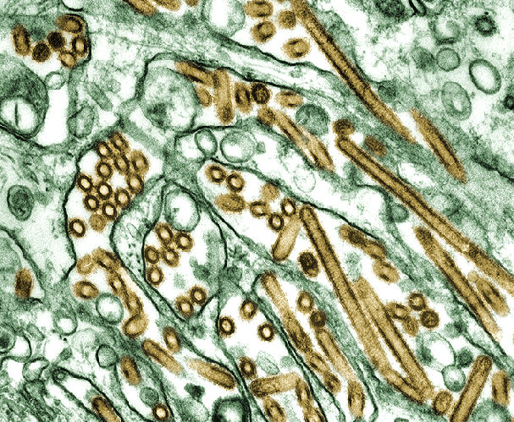

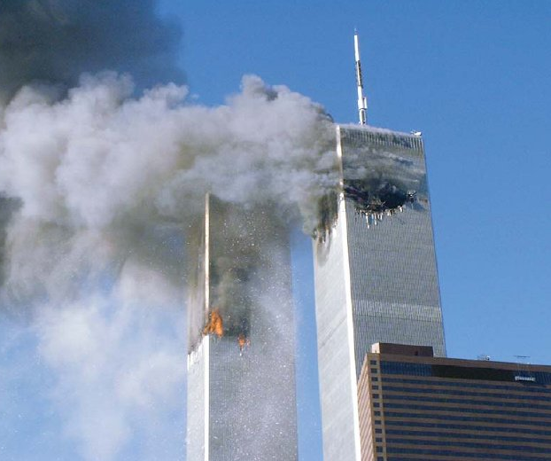
The Need
Pandemics
Such as Avian Flu
(Influenza A Virus H5N1)
Losses from 2003 SARS epidemic exceeded $30bn
Natural Disasters & Climate Change
Insured losses from Hurricane Katrina exceeded $66bn
Terrorism
Insured losses from the 9-11 attacks exceeded $30bn

Slide 5
The Need
Increased need for preparedness:
  Pandemics, Flooding, Terrorism etc.
Disaster simulations highly specialized & expensive
- Multinational corporations / national governments
Concerns over accuracy of risk models
Disaster simulation needs to be more accessible
  To allow the impact of a wide range of interventions to be tested
  To enable data and tools to be more widespread
  To meet the needs of national corporations, local government and healthcare providers
  To become a real time decision support tool rather than just a “back room” activity

Slide 6
Computer Simulation
We have built a
A tool
to allow the user to combine a knowledge of processes with data
Simulation Applications
This tool is called ieSim and it’s an iceberg-like creation!
Application
Development
Library (ADL)

Slide 7
Simulation Technology
We have produced a simulation technology that we believe to be unique.
The user builds a computer model of the community of interest
From census data the simulator creates households and populates them
In addition to households, other ‘exposure’ environments, eg. schools, workplaces, transportation links, etc can be created
Networks of exposure environments are then ‘built’ by the simulator using prescribed rules, eg usual opening ours of workplaces
Hazards can then be imposed upon this community
Interventions can be employed to mitigate impacts and test planning

Slide 8
This is Unique Because…
We simulate geographic location of facilities and temporal population movements
Hazards can be visualised in ‘real-time’ spreading over a map of the simulated community
Interventions can be imposed on the simulation and multiple scenarios can be tested and evaluated – to generate reports on options.

Slide 9
Value Proposition
A
Multi-hazard
Simulation Platform
Modelling hazards,
communities &
interventions over time and space
Easy to use visual applications
Increasing Customer Value

Slide 10
Product Range (& Potential products)
ADE 1.0 currently available, ADE 2.0 available in 2008
New product?
Online service providing networked simulation, model market and data sharing
Outbreak P2P in Beta in 2008
Other simulations could be developed for a variety of applications
ADL
App Development
Sim XChange
Cost
Outbreak P2P
Simulation Models
Community
Hazard
Intervention
Environment
Outbreak A2A
Outbreak A2P
Enviro Health
RunTime
Browser Plug-In
Flood and Storm
Mobile Access
Toxic Release
Major Incident
Fire & Explosions
RunTime 1.0 available, version 2.0 available in 2008

Slide 11

Demonstration

Slide 12



ICom
IHaz
IInt

Slide 13
2. Market

Slide 14
Market Trends
Multiple risks need to be considered
Climate change concerns
Unpredictability of events, e.g. terrorism
Disaster prevention and intervention must include a wide range of stake holders
Simulation is an increasingly accepted business tool as the “Nintendo” and “PlayStation” generation progress in the workforce.

Slide 15
Markets & accessibility
Revenue potential
I
II
III
IV
REINSURANCE
Market entry & initial development
Initial sales and team development
INSURANCE
FACILITIES MANAGEMENT
HOMELAND SECURITY
RETAIL
Exit
(Assumed to be acquired by trade purchaser)
EMERGENCY SERVICES
High growth
Entry into to high value markets, large contracts
HEALTH TRAINING
HUMANITARIAN RELIEF
EDUCATION
Expansion
Entry into new markets, team expanded
Time
Market accessibility/ease of market entry: High Low Very Low

Slide 16
Potential ieSim ‘Ecosystem’
Reinsurance Market
Insurance Companies
Intervention plans
Multi-site simulations
Brokers
Analytics
Consultants
New products
& discounts
Improved models
Benchmark data
Risk information
Customer research
Emergency Services
Facilities Management
Healthcare
Retail
Utilities
Chem, Oil & Gas
Homeland Security
Best practice
Specialist models
New models
Translations
Trained developers
Universities, Colleges & Research Institutes

Slide 17
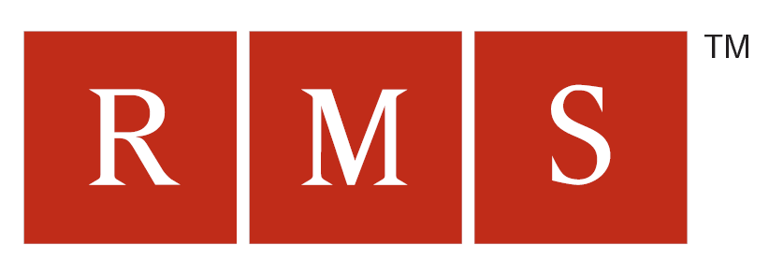




Competition
Broad focus
Multi-sector risk management solutions
IBM Pandemic Business Impact Modeller & Global Pandemic Initiative
ETC Simulation’s Advanced Disaster Management Simulator
CIVA’s EpiCast developed from EpiSim
Emergency Services Interactive Simulator – focused on fire risk / fire control
Narrow focus

Slide 18
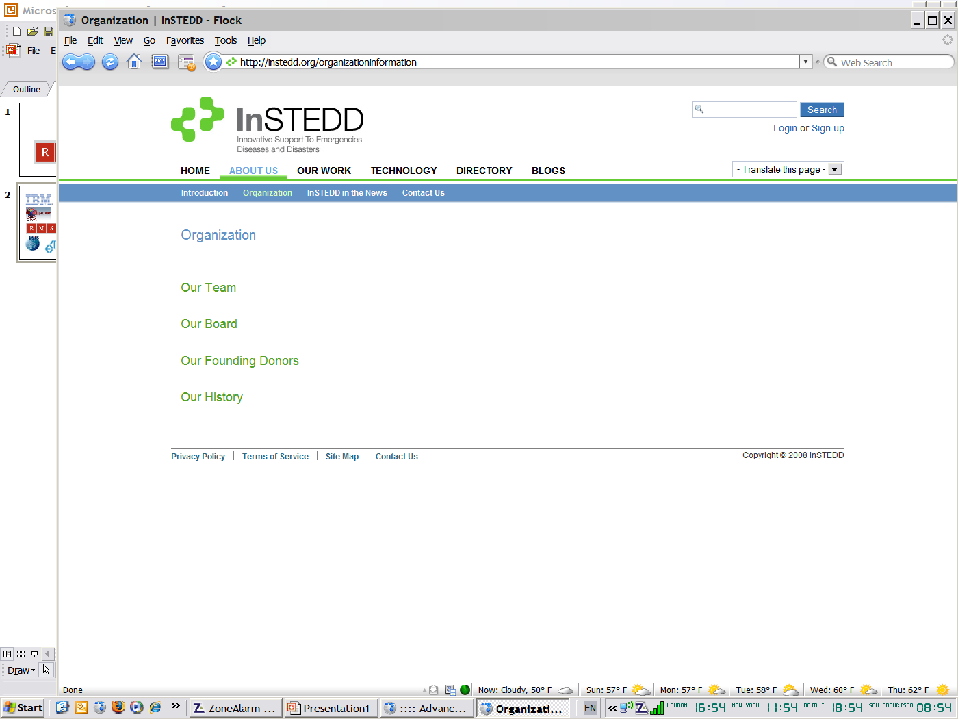

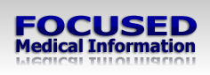




Potential Partners
Insurance & Insurance
Diseases & Disasters
Public Health Training
Environ-mental

Slide 19
3. Next Steps

Slide 20
Initial focus on Public Health
Rationale for initial pandemic focus:
  Product is available now
  Current leads / opportunities
  Market trends
  Credibility
  Catalyst for other markets
  Market positioning and awareness
  Potential to bring value to partners

Slide 21
OutBreakP2P Market Entry
+ Web interface
Public health training
Universities & Hospitals
Major employers
Pandemic planning (Preparedness & Response)
Hospitals
+ Integration with Third Party applications
Local authorities
Emergency services
Major employers
Transportation hubs
+ Health economics
Economic & operational impact
Major retailers
Major corporations
Insurance / reinsurance

Slide 22
Team
Executive Board
Advisory Board
(Market experts)
Founder / Acting CEO
Dr. Chris Skelly
Development support
Pre-sales support
CTO / Developer
Technical pre-sales support
Business Development Director
Freelance interface developers
Freelance market research facilitator
Freelance C++ developer
External IP / legal advisors
Freelance web developer
Specific market advisors

Slide 23
Key deliverables
Detailed market research
Business plan / presentation
Financial projections / pricing models
Marketing materials
Product enhancement
Team (advisory board, dev. team etc.)

Slide 24
4. Challenges

Slide 25
Key Sales Challenges
Universities / training – Limited budgets
Hospitals / local government – Slow sales cycle
Emergency services – Limited budgets
Corporations – Reactionary / creditability gap
Insurance – N.I.H. syndrome / secretive
Who is highlighting the risk to UK Plc from pandemics?

Slide 26





Initial Targets
Crisis management & healthcare consultancies
Risk assessment consultancies
Pandemic simulation consortium
Drivers: New tools, pandemic/GIS expertise
Drivers: community, collaboration, simulation
Drivers: New revenue streams

Slide 27
Key Challenges
Limited human resources, funds & time
Consultancy Vs product development
Creditability gap until have case studies
Need for detailed customer research & testing
Freelance developers need to be secured
Gaining more revenue from the most accessible sectors:
  Education, Public Health Training, Emergency Services & Relief
Gaining reference sites that are relevant to the most lucrative sectors:
  Insurance, Reinsurance & Homeland Security.

Slide 28
Questions
Is there a way to gain reference sites sooner?
Should the product be rolled up with other tech?
Is this a standalone product or an add on service to existing products?
Is the real value in not just testing a pandemic plan but preparing it?
Is there value in being a real time decision support tool?
Is the NHS or NIH worth pursuing?
What funding options exist? (equity/grant)
What is the real value of an ieSIM “ecosystem”?
How much should we make available through Open Source – if at all?

Slide 29
Q & A / Brainstorm

