Slide 1


SurveillanceSim Project
“Improving disaster preparedness and response through improved training and decision making”
Dr Chris Skelly
Institute for the Environment
Brunel University
chris.skelly@brunel.ac.uk

Slide 2
Currently seeking…
simulation partnerships with 2-3 organisations that
  Want to explore the development of a specific type of simulation
  Software, support and collaboration provided at cost – demonstration projects
  Start time next 6 months
  Probably organisations that are pushing the boundaries in the use of existing tools

Slide 3
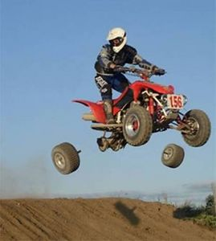
Just imagine if…
a pilot shut down an engine in-flight to see if they would restart!
an engineer built a bridge with fewer welds to see if it would stand!
an environmental regulator allowed a discharge to see its effect!
Before the wheels come off!
These professionals simulate

Slide 4
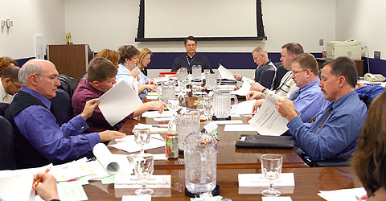
Decision-Making
How do public health and other decision-makers prepare for the unthinkable?
Hold meetings
Gather experts around a table
Have a consultant prepare a report

Slide 5
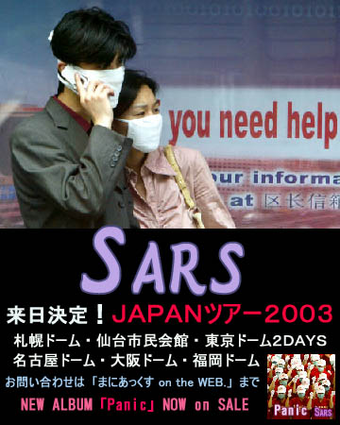
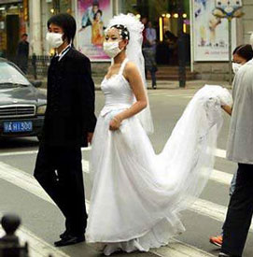
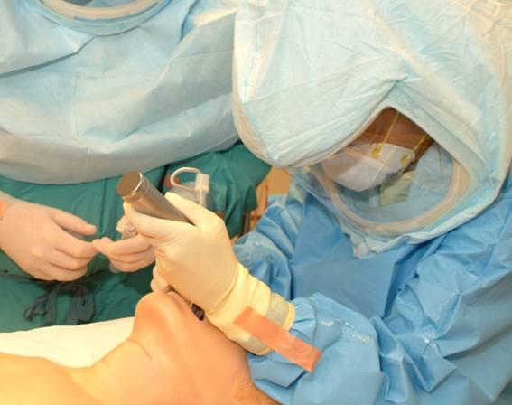
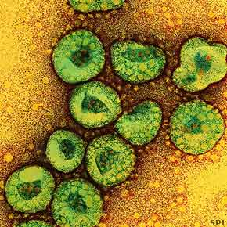
Simulation
Change behaviour?
    a new business process
    Invest in a decision support system

Slide 6
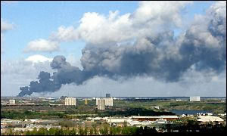
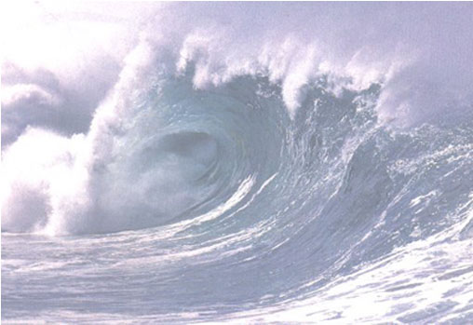

ieSim tools can aid preparedness planning
Allow decision makers to:
  visualize the dynamics of disaster
  simulate readiness and response
  evaluate response times
  quantify the costs
  contrast good and poor interventions
Learn the easy way – before disaster strikes!

Slide 7
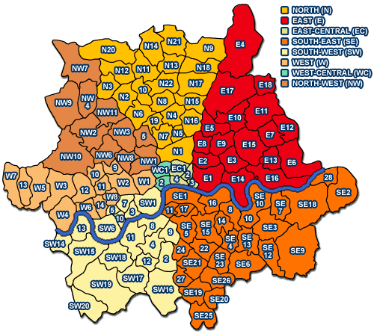
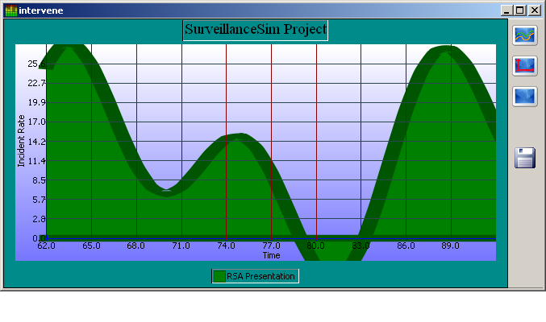
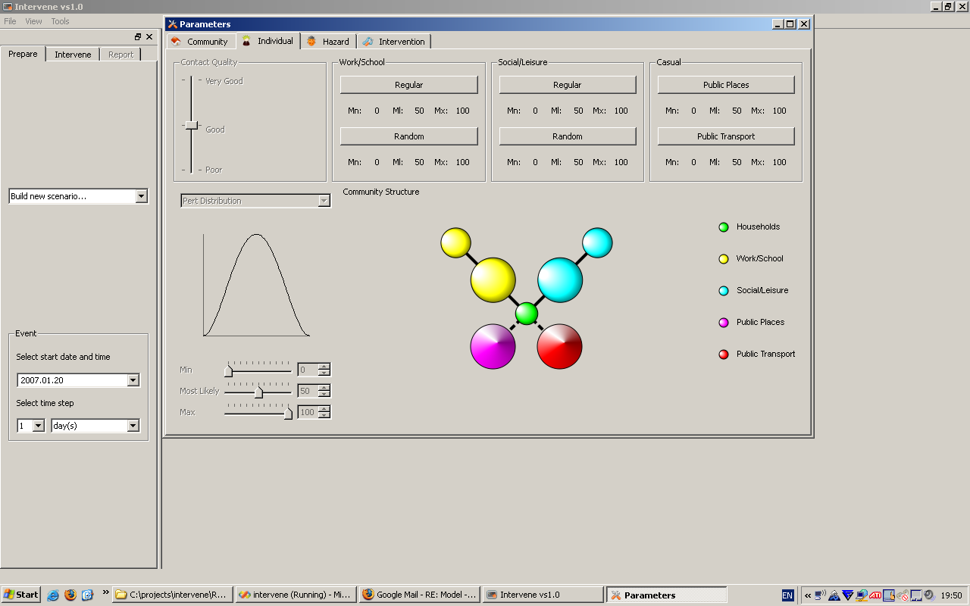
Benefits and USPs
ieSim tools are ‘simple’
Upload community data
Parameterize
  individuals & households
  communities
  hazards
  interventions
Run simulations
4. Learn – Evaluate - Improve

Slide 8
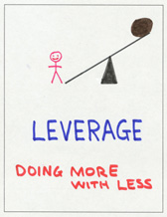
ieSim leverages existing investments
corporate data
resident knowledge experts
training exercises

Slide 9
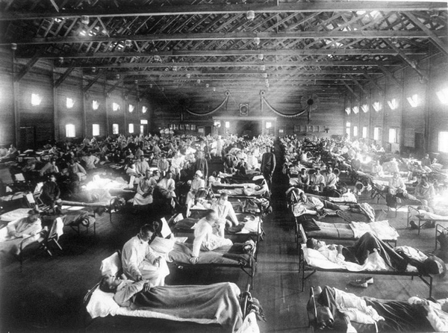

Slide 10
The Deliverables
Application Development Library
provides the tools to allow others to build simulation applications
ieSim ADL
ieSim AE
outbreakP2P
Sept
Application Environment
allows others to run applications
Feb
Application
allows others to simulate a person-person disease outbreak

Slide 11
Product Placement
Simulation Systems, e.g. Simula, Simul8
Programming From Scratch
Application Model
BESPOKE
Can only change parameters
ieSim ADL
+ spatial
+ focussed on communities
+ hazard events & interventions
+ multi-platform

Slide 12
Using Applications
outbreakP2P
  Community Model
  Hazard Model
  Intervention Model
  Environment Model

Slide 13
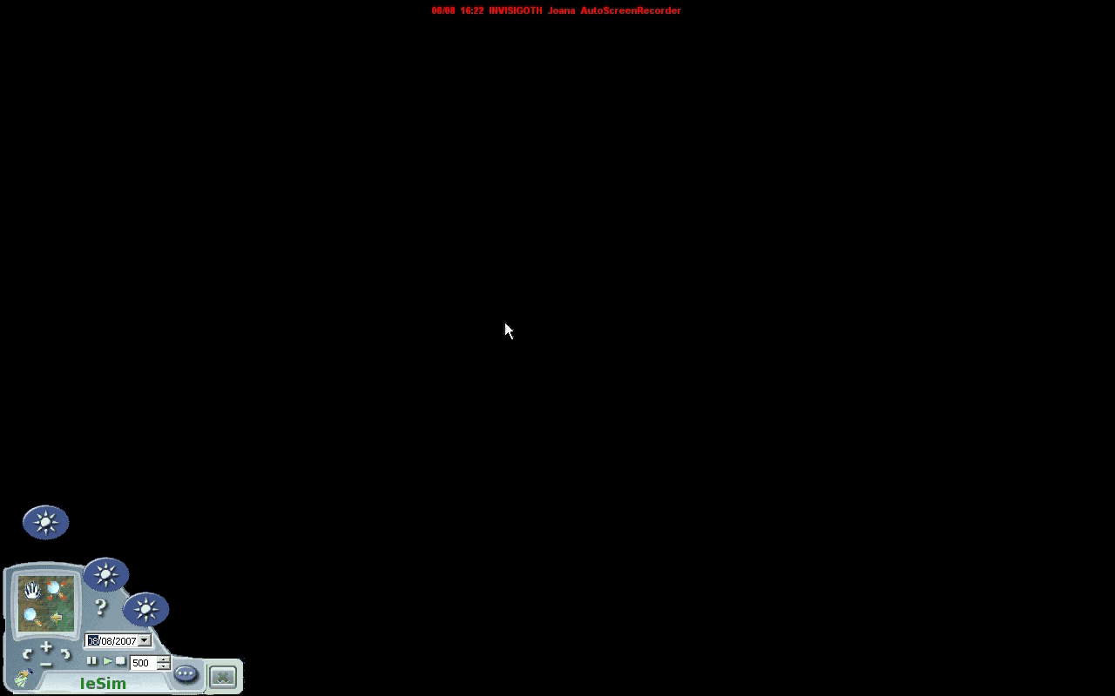
Community

Slide 14

Hazard

Slide 15
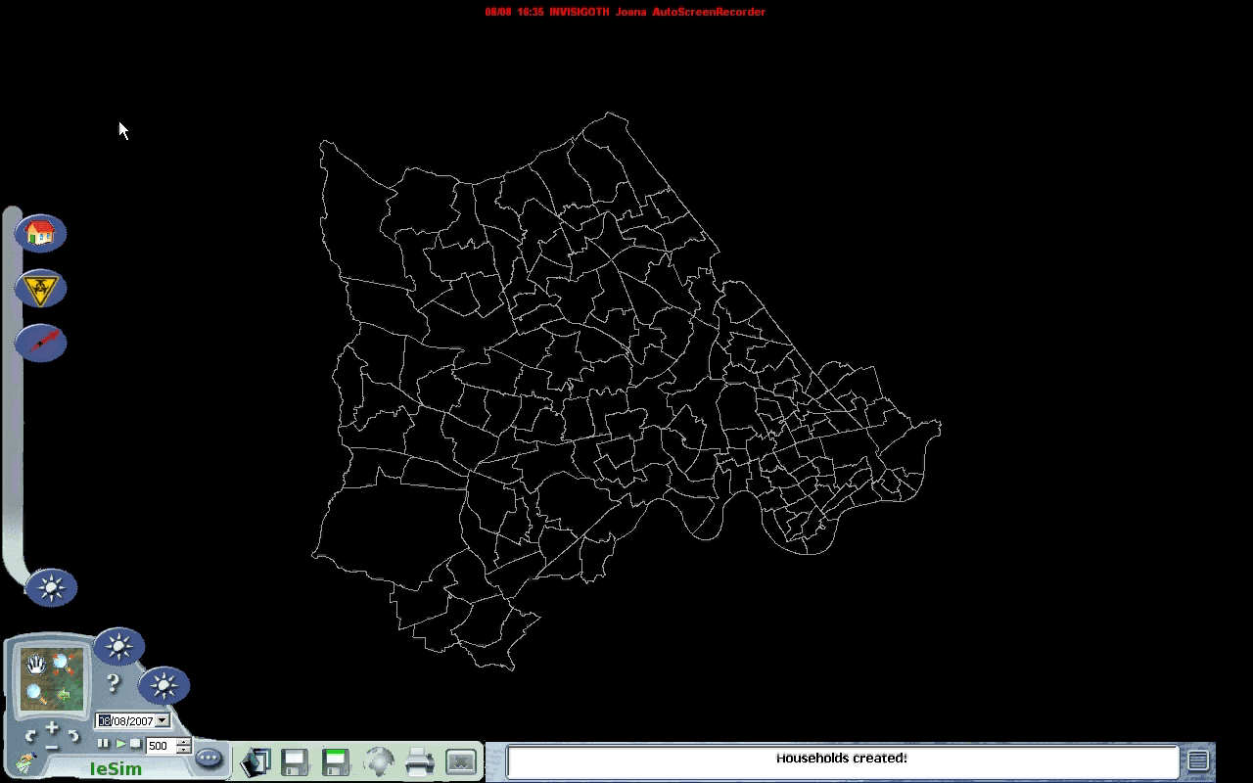
Intervention

Slide 16
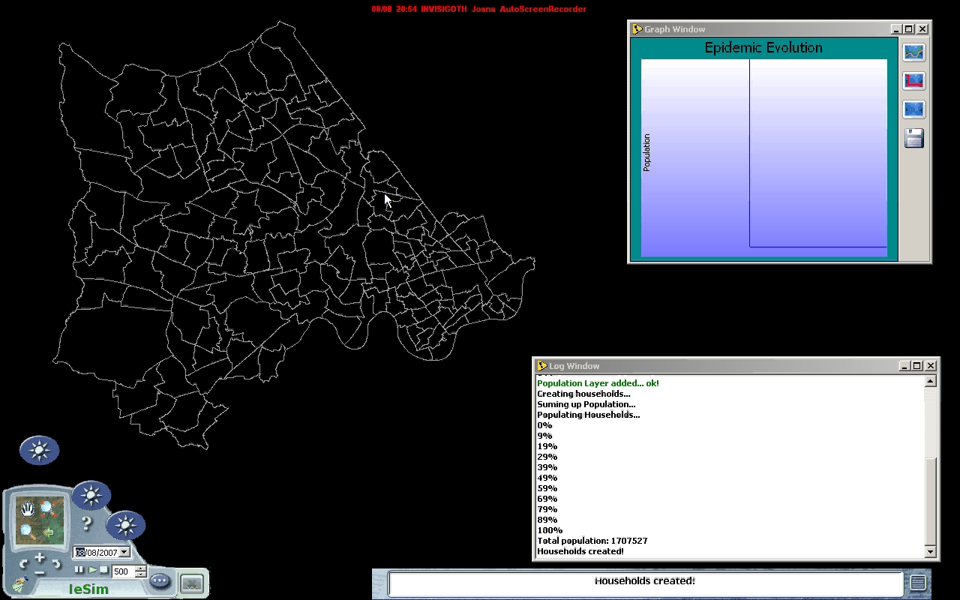
Run Simulation

Slide 17
“Improving disaster preparedness and response through improved training and decision making”
Thank you!

