Slide 1
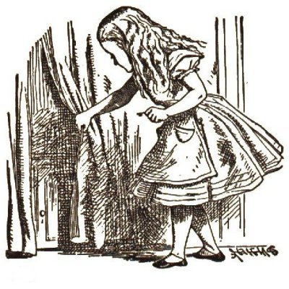
Alice in Mozartland
Leif Kornstaedt
14 October 1999

Slide 2
Down the Rabbit-Hole
Statically typed language w/ transients
Dynamically typed VM
Values of different types need not be dynamically distinguishable
Abstraction boundaries are not enforced dynamically
Want easy interoperability
(esp. calling Hell from Heaven)

Slide 3
A Word About Modules
Module language completely eliminated by the front-end:
Structures | Translated to records
Functors | Translated to procedures
Signatures | Not represented
Signature coercions | Not represented (but could be)

Slide 4
Values of Basic Types
Int, LargeInt, IntInf, Char | Infinite-precision integers
Wordn | Provided by native functor
Real, LargeReal | Floats
String | Byte strings
WideString, Intn, … | Not supported (optional)

Slide 5
Tuples and Records
Records are not translated to tuples
  Would make interoperability cumbersome
Mozart records always carry a label
Unit value (): {} | Empty tuple ’#’ (could also use unit)
Records (and tuples) | Records with label ’#’

Slide 6
Procedures: Facts
Mozart procedures:
  Carry their arity as a feature list
  Relational: no explicit return values
Alice procedures:
  Always unary on the language level
  Multiple arguments expressed through …
    Currying: primarily used for functionals
    Records: the common idiom – optimize!

Slide 7
Procedures: Representation
Standard translation:
  Produce procedures with arity {1, 2}
Cartesian procedures:
  Use arity from record argument,
  extended by a feature for the return value
  (highest unused integer feature)
  Resulting arity may not be {1, 2}
  (to distinguish f x and f {1 = x})

Slide 8
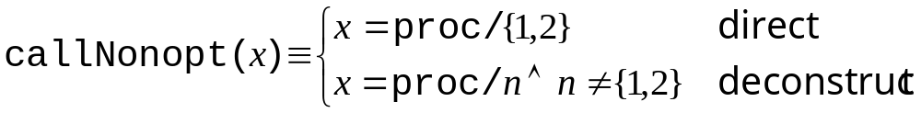
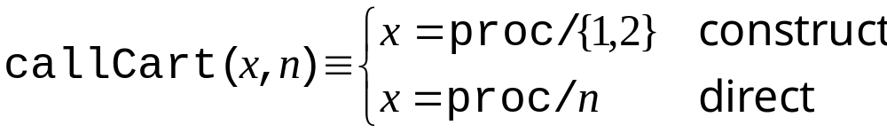
Procedures: VM Extensions
Procedure arities already represented
as feature lists (because of methods)
Need new call instructions aware of cartesian procedures

Slide 9
Procedures: Interoperability
Oz has … | Alice sees …
n-ary procedure | (n-1)-ary tupled proc.
Alice has … | Oz sees …
Standard procedure | Binary procedure
n-ary tupled proc. | (n+1)-ary procedure
n-ary record proc. | Non-callable procedure

Slide 10
Reference Cells
Language definition ensures:
all occurrences of ref statically known
  First-class use
    ref: ’a -> ’a ref → NewCell
  Reference creation
    ref exp → {NewCell exp}
  Reference matching
    ref pat → {Access …}

Slide 11
Constructors (Excepting ref)
… of closed data types | Atoms of same name
… of open data types | Names
Standard constructors of closed data types | Unique names or atoms
Bool.bool | true, false
List.list | Atoms | and nil
Top-level constructors of open data types | Named names (debugging)

Slide 12
Constructed Values
A constructed value is a value tagged with a constructor
On the language level, all constructors
are unary (in contrast to OCaml)
Naïve representation:
unary tuple with constructor as label

Slide 13
Constructed Values (cont’d)
Goal: make n-ary constructors explicit
by merging the constructor node with the record node
Problem: need unique representations, but constructor arity may not be statically known
No solution ready yet

Slide 14
Constructed Values (cont’d)
It is not even possible to decide syntactically which arity to use for a constructor, e.g.:
  struct
  type u = int * int
  datatype t = C of int * int
  end :>
  sig
  type u
  datatype t = C of u
  end
Possibility: make above coercion illegal

Slide 15
Transients
Immediately map to Mozart transients
  Non-blocking promises available via an emulator property
Problem: what data representation optimizations are still possible?
  datatype ’a t = C of ’a
  case C x of C _ => …
  case future p of C _ => …

Slide 16
Exceptions
Any value can be raised as an exception in the Mozart VM
Raised exceptions can include debug information
Alice exceptions easily caught in Oz
Oz exceptions only catchable in Alice
via catch-all clause

Slide 17
Other Data Types
Array.array | Arrays
Vector.vector | Tuples
TextIO.instream, TextIO.outstream | Instances of Open.file

Slide 18
Components
Functors and module managers provide for most of the infrastructure
Strong type-checking at link time has yet to be implemented

Slide 19
Evaluation
Differences to native representation:
  Every record carries a label
  Records and structures not translated to tuples
  Procedure return values passed by binding a logic variable
    Allocated on heap by caller
    Bound by callee

Slide 20
Technical Details

Slide 21
Cartesian Procedures
Current call instructions:
callX(XRegisterIndex Arity)
callY(YRegisterIndex Arity)
callG(GRegisterIndex Arity)
tailCallX(XRegisterIndex Arity)
tailCallG(GRegisterIndex Arity)
callGlobal(GRegisterIndex ArityAndIsTail)
callConstant(Constant ArityAndIsTail)
callProcedureRef(ProcedureRef ArityAndIsTail)

Slide 22
Cartesian Procedures (cont’d)
Possibilities:
  Introduce Nonopt and Cart versions
    All cartesian procedures can be optimized
    Large instruction set
    Interoperability limitations
  Make call instructions cartesian-aware
    Record cartesian procedures not optimized
    Nonopt versions not needed
    Full interoperability for procedures

