Slide 1
GTK Binding for Alice
Eine GTK-Schnittstelle für Alice
Robert Grabowski

Slide 2
Overview
Concepts
Implementation
Demo
Outlook

Slide 3
Overview
Concepts
  GTK+
  Mapping C Libraries to Alice
  Event Handling
  Garbage Collection
Implementation
Demo
Outlook

Slide 4
GTK+
Collection of libraries:
GnomeCanvas
- a special widget
GTK
- widget collection
GDK
- platform graphics abstraction
OS API

Slide 5
GTK+ - Main Ideas
widgets
attributes
connect callback functions for handling events
event-driven main loop
automatic memory management

Slide 6
Mapping C Libraries to Alice
C Libary contains:
Alice Mapping:
functions → wrapper (marshalling)
structures → field accessor functions
constants → datatype constructors

Slide 7
Event Handling in C
delegate control to main loop...
...which invokes registered callback functions
program
callback
C
event
idle
check events
handle events

Slide 8
Naive Approach
main loop never returns
→ breaks concurrency model
cannot register Alice functions
Alice
program
callback
?
event
idle
C
check events
handle events

Slide 9
Solution
split main loop
asynchronous callback function call
idle
Alice
check events
callback
dispatcher
→id
event
id
C
handle events
marshaller_{id}

Slide 10
Garbage Collection
GTK: own memory management
reference counters
Problem: GTK may delete object too early
Alice
C
5
0
?

Slide 11
Solution
keep reference to object while visible in Alice
Alice
C
5
6
1

Slide 12
Solution
keep reference to object while visible in Alice
Alice finalization decreases counter
Alice
C
3
1

Slide 13
Solution
keep reference to object while visible in Alice
Alice finalization decreases counter
Alice
C
0

Slide 14
Overview
Concepts
Implementation
  Design
  Generator
  Type Mapping
  Examples
Demo
Outlook

Slide 15
Design
generated interface
  function wrappers, constants, field accessors
hand-written core
  main loop, event handling, garbage collection
Alice
generated interface
core
C
GTK+

Slide 16
Design
generated interface
  function wrappers, constants, field accessors
hand-written core
  main loop, event handling, garbage collection
Alice
generated interface
core
FFI
C
GTK+

Slide 17
Generator
GTK+ header files
C preprocessor, clean-up programs
all declarations
CKIT
Abstract Syntax Tree
Mapper
high-level
generated
components:
own representation
native

Slide 18
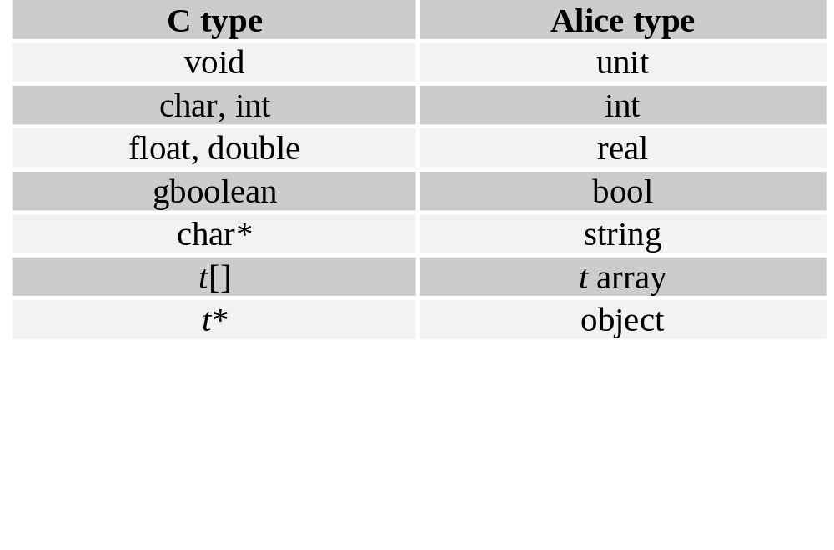
Type Mapping

Slide 19
Constants
C-Deklaration:
typedef enum {
GTK_WINDOW_TOPLEVEL,
GTK_WINDOW_POPUP
} GtkWindowType;
Alice-Deklaration:
datatype GtkWindowType =
WINDOW_TOPLEVEL
| WINDOW_POPUP

Slide 20
Examples
Simple example
void gtk_scale_set_draw_value(GtkScale*, gboolean)
val scaleSetDrawValue : object * bool → unit
Input/Output argument example
void gtk_entry_get_layout_offsets (GtkEntry*, int*, int*)
val entryGetLayoutOffsets : object → int * int
val entryGetLayoutOffsets’ : object * int * int → int * int

Slide 21
Overview
Concepts
Implementation
Demo
Outlook

Slide 22
Overview
Concepts
Implementation
Demo
Outlook

Slide 23
Outlook
GTK
  high-level functional UI design
  GtkBuilder
  use advanced Alice features
Generic Generator Tool
  work in progress by Sven Woop

