Slide 1
A Semantics for Components
Andreas Rossberg

Slide 2
Motivation
Components are not understood well
Current design is adhoc
We want 1st-class components

Slide 3
Ingredients of Components
Modules
Dynamic typing
Dynamic binding
Laziness
Pickling/cloning
Partial evaluation?

Slide 4
A First Calculus
e := x
{e₁,e₂}
λx:t.e
e.i
e₁ e₂
import x:t from y in e
export e₁:t as y in e₂
t := α
{t₁,t₂}
t₁→t₂

Slide 5
Intuition
Components are expressions headed by imports
Export corresponds to setting up the Composer
Both can be used in more flexible ways (corresponding to a Composer runtime interface)

Slide 6
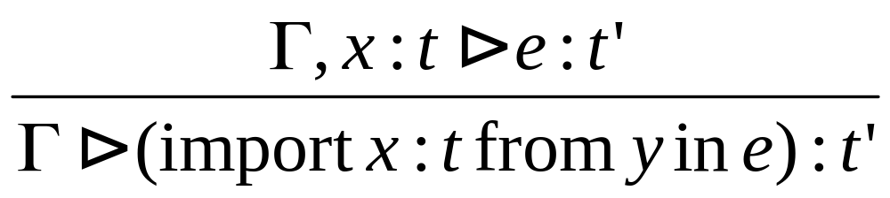
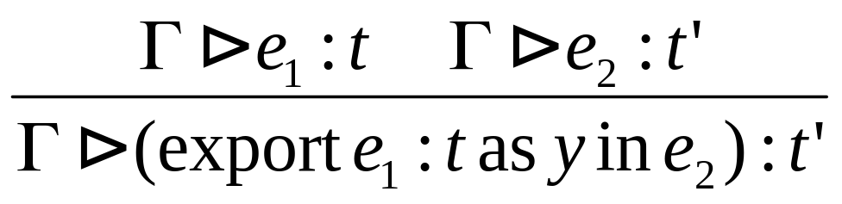
Typing

Slide 7
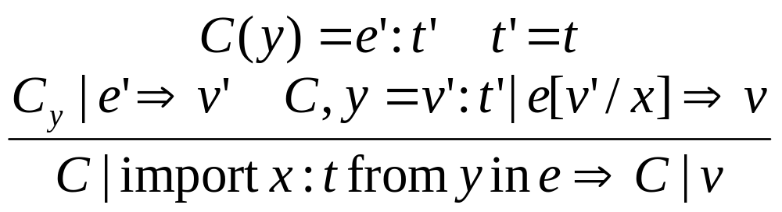
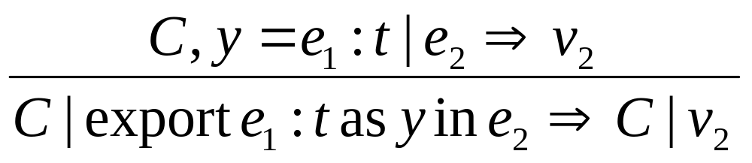
Operational Semantics

Slide 8
Decomposition
import x:t from y in e
= let x = lazy (unpack ?y : t) in e
export e₁:t as y in e₂
= e₂ with y = lazy (pack e₁ : t)

Slide 9
First-class Components and Pickling
First-class component (unevaluated) modeled via abstraction: λ():unit.e
Externalization of a component modeled by cloning its first-class representation: clone(λ():unit.e)
So persistence is completely orthogonal

Slide 10
The ‘Natural’ Component Model
Simply uses the previous decomposition
Advantages:
  Clear model: no mixture of static/dynamic types in module manager (linktime tc = runtime tc)
  Import type checking is most general
Disadvantages:
  Requires explicit import/export type annotations
  Components must be evaluated prior to typecheck
  Dynamic references not explicit (⇒ have to use simple archive model for static linking)
  Import types not accessible (⇒ no tc in static linker)

Slide 11
Tackling the Disadvantages
Explicit type annotations by compiler magic (requires substitution translation scheme for RTTs)
Delay evaluation by making typechecking as lazy as possible
Or use static types and perform substitution in Composer
Use code reflection to achieve true linking if really wanted (model does not cover it)

Slide 12
Making it more lazy
Use static type as approximation as long as the ‘exact’ (dynamic) type is not available
Match static signatures under substitution
Extend substitution with dynamic types of evaluated components to get ‘correct’ types once they are available
Use promises to extend substitution at start of evaluation (to avoid pathological match errors)
In general different components may use different placeholders for a single dynamic type, how do we know??

Slide 13
An Alternative Calculus
e := x
{e₁,e₂}
λx:t.e
e.i
e₁ e₂
comp x:t from y in e
exec e
create e₁:t as y in e₂
t := α
{t₁,t₂}
t₁→t₂
comp t

Slide 14
Redundancy
λx:t.e
= comp x:t from arg in e
e₁ e₂
= create e₂:t as arg in exec e₁

Slide 15
Typechecking of Components is different from Packages
Not intended for programmatic use
(cannot retry on failure)
Types are not explicit
Typechecking after extraction
(implicit lazy indirection)

