Slide 1
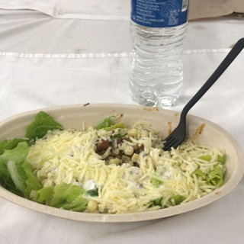
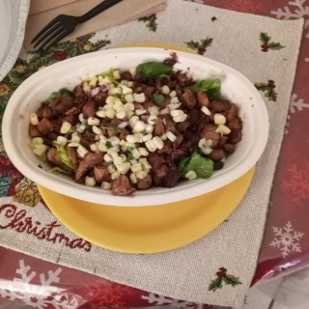
01
DATA
02
INPUTS
03
MODELS
04
PREDICTION
CGMacros
Meal photo
Image encoder
Nutrition estimator
MODEL A
Glucose response
official
CGMacros
MobileCLIP-S2 · frozen
nearest meals + GBM
Gradient-boosted trees
45 adults · 1,397 meals · ~10 days
LightGBM · glucose at 15–120 min, peak, iAUC
next 2 hours · 80% band
mg/dL
+
+
…
250
512-d
Meal photos
CGM
Heart rate
carbs · protein · fat · fiber · kcal
200
Activity
Food log
Age · sex · BMI
Nutrients from photo
Trained on
CGMacros · days 1–7
BIG IDEAs
days 1–7 · train
8+ · test
Glucose before the meal
150
Meal time · previous meal
MODEL B
Σ
CGM
MetaboNet
official
First-week glucose profile
In-context transformer
100
1,085 people with type 1 diabetes · 671k meals
Similar meals, own and others'
reads the person's past meals, outputs the whole curve
blend
−60
0
60
120 min
CGM
Carbs
Insulin
meal tokens
Age · sex · BMI
Past meals with their glucose curves
new
Heart rate
Peak glucose
Peak rise
191
mg/dL
+97
mg/dL
Activity (METs, active kcal)
real 187
real +92
BIG IDEAs
Age · sex · BMI
Time to peak
iAUC, mg/dL·min
16 adults · 397 meals
Logged kcal (optional)
quantile head
10 / 50 / 90%
90
min
6.2k
CGM
Food log
Sex
Insulin dose and timing
up to 30
Transformer layers × 3
real 106
real 6.3k
Glucose after the meal (target)
1
Pretrain · MetaboNet, 671k meals
Example: a real lunch on an unseen
A
B
2
Fine-tune · CGMacros, days 1–7
test day; "real" is the recorded CGM.
PROFILE MODELS
Colas 2019
CGM metrics (up to 7 days)
HbA1c estimate
Estimated HbA1c
208 adults · 2.7-year follow-up
Age · BMI · fasting glucose · HbA1c
Ridge regression · 261 people
CGM, 1–2 days
Clinical labs
Lab HbA1c (target)
Type 2 diabetes risk
Risk tier
T2D outcome
Developed type 2 diabetes (target)
Logistic regression · 208 people

