Slide 1
Introduction to Security Reduction II: Public Key Encryption
SHUANGJUN ZHANG

Slide 2
Content
Number Theory and Cryptographic Hardness Assumptions
Indistinguishable Encryption in Public-Key Model
ElGamal Encryption
Hashed ElGamal

Slide 3
Content
Number Theory and Cryptographic Hardness Assumptions
Indistinguishable Encryption in Public-Key Model
ElGamal Encryption
Hashed ElGamal

Slide 4
1. Number Theory and Cryptographic Hardness Assumptions
Modern cryptosystems are invariably based on an assumption that some problem is hard.
For example, in our first slide we construct some indistinguishable encryptions by PRG and PRF. However, the assumption that pseudorandom permutations exist seems quite strong and unnatural. It can be proved that PRG/PRF exist based on the much milder assumption that one-way functions exist.
One goal of this chapter is to introduce various problems believed to be “hard”, and to present conjectured one-way functions based on those problems.

Slide 5
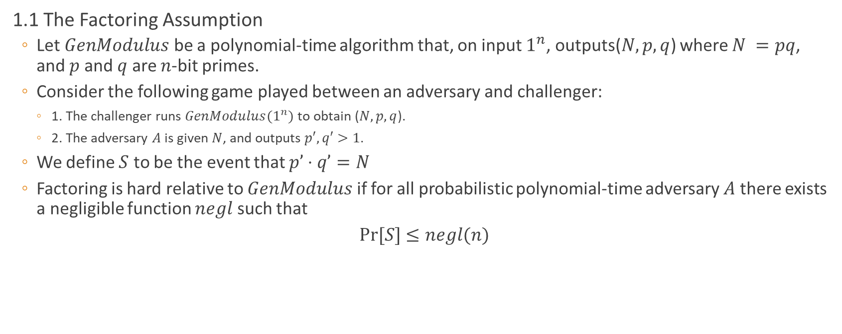
1. Number Theory and Cryptographic Hardness Assumptions
1.1 The Factoring Assumption
Let $GenModulus$ be a polynomial-time algorithm that, on input $1^{n}$, outputs($N, p, q$) where $N =pq$, and $p$ and $q$ are $n$-bit primes.
Consider the following game played between an adversary and challenger:
1. The challenger runs $GenModulus(1^{n})$to obtain ($N, p, q$).
2. The adversary $A$ is given $N$, and outputs $p′, q′>1$.
We define $S$ to be the event that $p’⋅q’=N$
Factoring is hard relative to $GenModulus$ if for all probabilistic polynomial-time adversary $A$ there exists a negligible function $negl$ such that
$Pr⁡[S]$ $≤negl(n)$

Slide 6
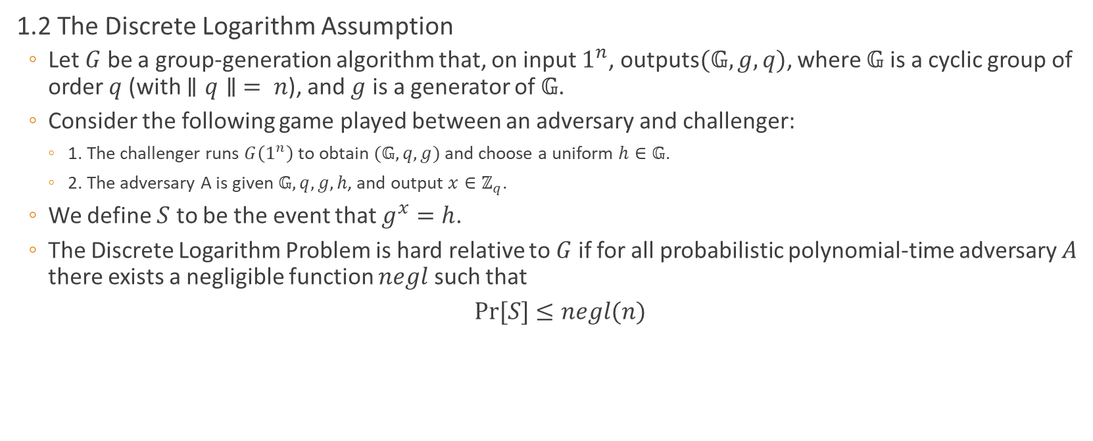
1. Number Theory and Cryptographic Hardness Assumptions
1.2 The Discrete Logarithm Assumption
Let $G$ be a group-generation algorithm that, on input $1^{n}$, outputs$(𝔾, g, q)$, where $𝔾$ is a cyclic group of order $q$ (with $∥q∥ = n$), and $g$ is a generator of $𝔾$.
Consider the following game played between an adversary and challenger:
1. The challenger runs $G\left(1^{n}\right)$to obtain $(𝔾, q, g)$ and choose a uniform $h∈𝔾$.
2. The adversary A is given$𝔾, q, g, h$, and output $x∈ℤ_{q}$.
We define $S$ to be the event that $g^{x}=h$.
The Discrete Logarithm Problem is hard relative to $G$ if for all probabilistic polynomial-time adversary $A$ there exists a negligible function $negl$ such that
$Pr⁡[S]$ $≤negl(n)$

Slide 7
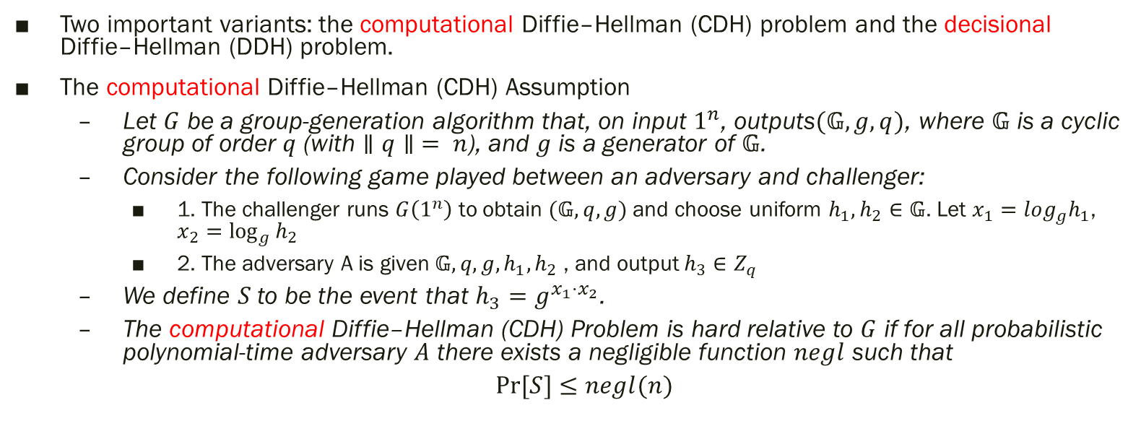
1. Number Theory and Cryptographic Hardness Assumptions
Two important variants: the computational Diffie–Hellman (CDH) problem and the decisional Diffie–Hellman (DDH) problem.
The computational Diffie–Hellman (CDH) Assumption
Let $G$ be a group-generation algorithm that, on input $1^{n}$, outputs$(𝔾, g, q)$, where $𝔾$ is a cyclic group of order $q$ (with $∥q∥ = n$), and $g$ is a generator of $𝔾$.
Consider the following game played between an adversary and challenger:
1. The challenger runs $G\left(1^{n}\right)$to obtain $(𝔾, q, g)$ and choose uniform $h_{1},h_{2}∈𝔾$. Let $x_{1}=log_{g}h_{1}$, $x_{2}=\log_{g}{h_{2}}$
2. The adversary A is given$𝔾, q, g, h_{1},h_{2}$ , and output $h_{3}∈Z_{q}$
We define $S$ to be the event that $h_{3}=g^{x_{1}⋅x_{2}}$.
The computational Diffie–Hellman (CDH) Problem is hard relative to $G$ if for all probabilistic polynomial-time adversary $A$ there exists a negligible function $negl$ such that
$Pr⁡[S]$ $≤negl(n)$

Slide 8
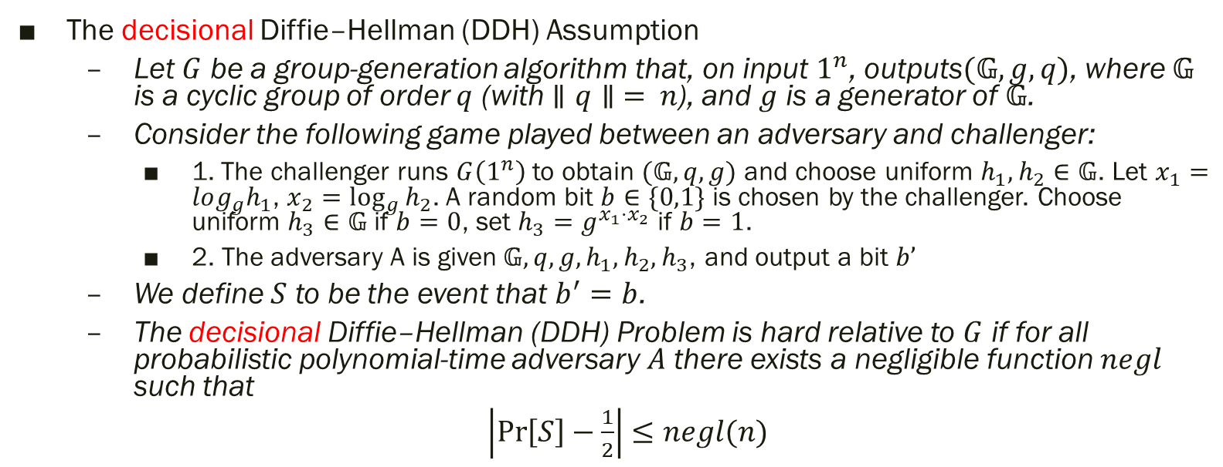
1. Number Theory and Cryptographic Hardness Assumptions
The decisional Diffie–Hellman (DDH) Assumption
Let $G$ be a group-generation algorithm that, on input $1^{n}$, outputs$(𝔾, g, q)$, where $𝔾$ is a cyclic group of order $q$ (with $∥q∥ = n$), and $g$ is a generator of $𝔾$.
Consider the following game played between an adversary and challenger:
1. The challenger runs $G\left(1^{n}\right)$to obtain $(𝔾, q, g)$ and choose uniform $h_{1},h_{2}∈𝔾$. Let $x_{1}=log_{g}h_{1}$, $x_{2}=\log_{g}{h_{2}}$. A random bit $b∈\{0,1\}$ is chosen by the challenger. Choose uniform $h_{3}∈𝔾$ if $b=0$, set $h_{3}=g^{x_{1}{⋅x}_{2}}$ if $b=1$.
2. The adversary A is given$𝔾, q, g, h_{1},h_{2}, h_{3}$, and output a bit $b’$
We define $S$ to be the event that $b^{′}=b$.
The decisional Diffie–Hellman (DDH) Problem is hard relative to $G$ if for all probabilistic polynomial-time adversary $A$ there exists a negligible function $negl$ such that
$\left|\operatorname{Pr}\left[S\right]−\frac{1}{2}\right|$ $≤negl(n)$

Slide 9
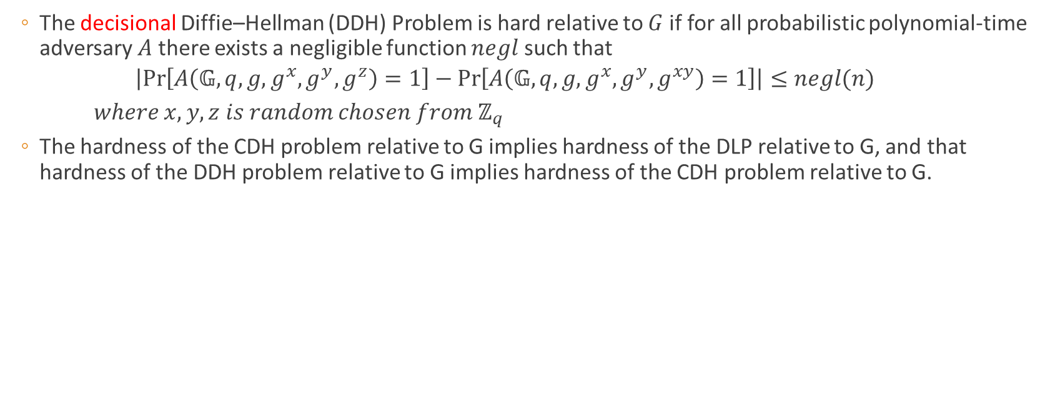
1. Number Theory and Cryptographic Hardness Assumptions
The decisional Diffie–Hellman (DDH) Problem is hard relative to $G$ if for all probabilistic polynomial-time adversary $A$ there exists a negligible function $negl$ such that
$$\left|\operatorname{Pr}\left[A\left(𝔾,q,g,g^{x},g^{y},g^{z}\right)=1\right]−\operatorname{Pr}\left[A\left(𝔾,q,g,g^{x},g^{y},g^{xy}\right)=1\right]\right|≤negl(n)$$
$where x, y, z is random chosen from ℤ_{q}$
The hardness of the CDH problem relative to G implies hardness of the DLP relative to G, and that hardness of the DDH problem relative to G implies hardness of the CDH problem relative to G.

Slide 10
Content
Number Theory and Cryptographic Hardness Assumptions
Indistinguishable Encryption in Public-Key Model
ElGamal Encryption
Hashed ElGamal

Slide 11
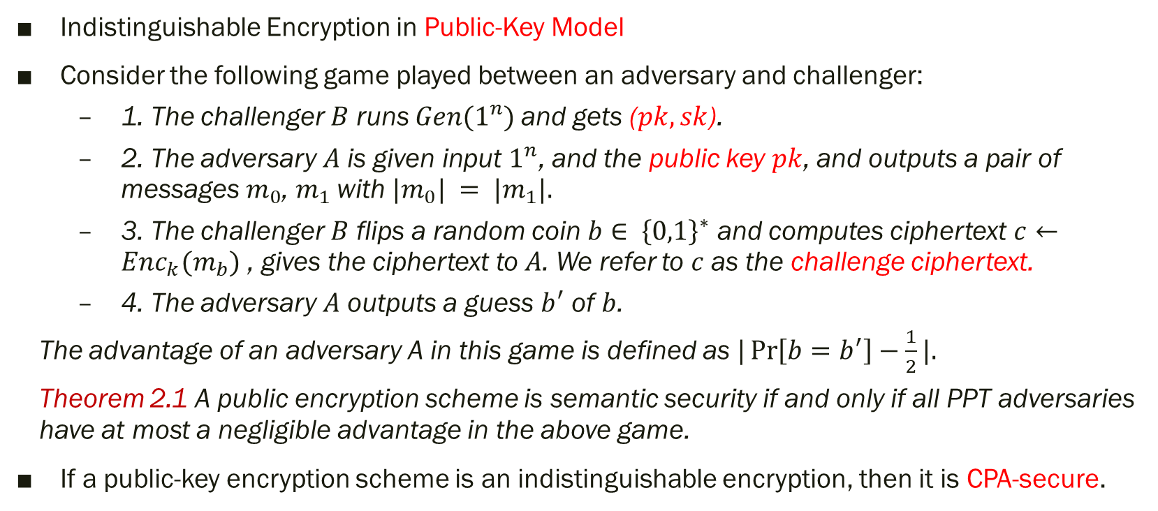
2. Indistinguishable Encryption in Public-Key Model
Indistinguishable Encryption in Public-Key Model
Consider the following game played between an adversary and challenger:
1. The challenger $B$ runs $Gen(1^{n})$and gets ($pk, sk$).
2. The adversary $A$ is given input $1^{n}$, and the public key $pk$, and outputs a pair of messages $m_{0}$, $m_{1}$with $|m_{0}| = |m_{1}|.$
3. The challenger $B$ flips a random coin $b∈ {\left\{0,1\right\}}^{∗}$ and computes ciphertext $c←Enc_{k}(m_{b})$ , gives the ciphertext to $A$. We refer to $c$ as the challenge ciphertext.
4. The adversary $A$ outputs a guess $b^{′}$ of $b$.
The advantage of an adversary A in this game is defined as $|\operatorname{Pr}\left[b=b^{′}\right]−\frac{1}{2}|.$
Theorem 2.1 A public encryption scheme is semantic security if and only if all PPT adversaries have at most a negligible advantage in the above game.
If a public-key encryption scheme is an indistinguishable encryption, then it is CPA-secure.

Slide 12
Content
Number Theory and Cryptographic Hardness Assumptions
Indistinguishable Encryption in Public-Key Model
ElGamal Encryption
Hashed ElGamal

Slide 13
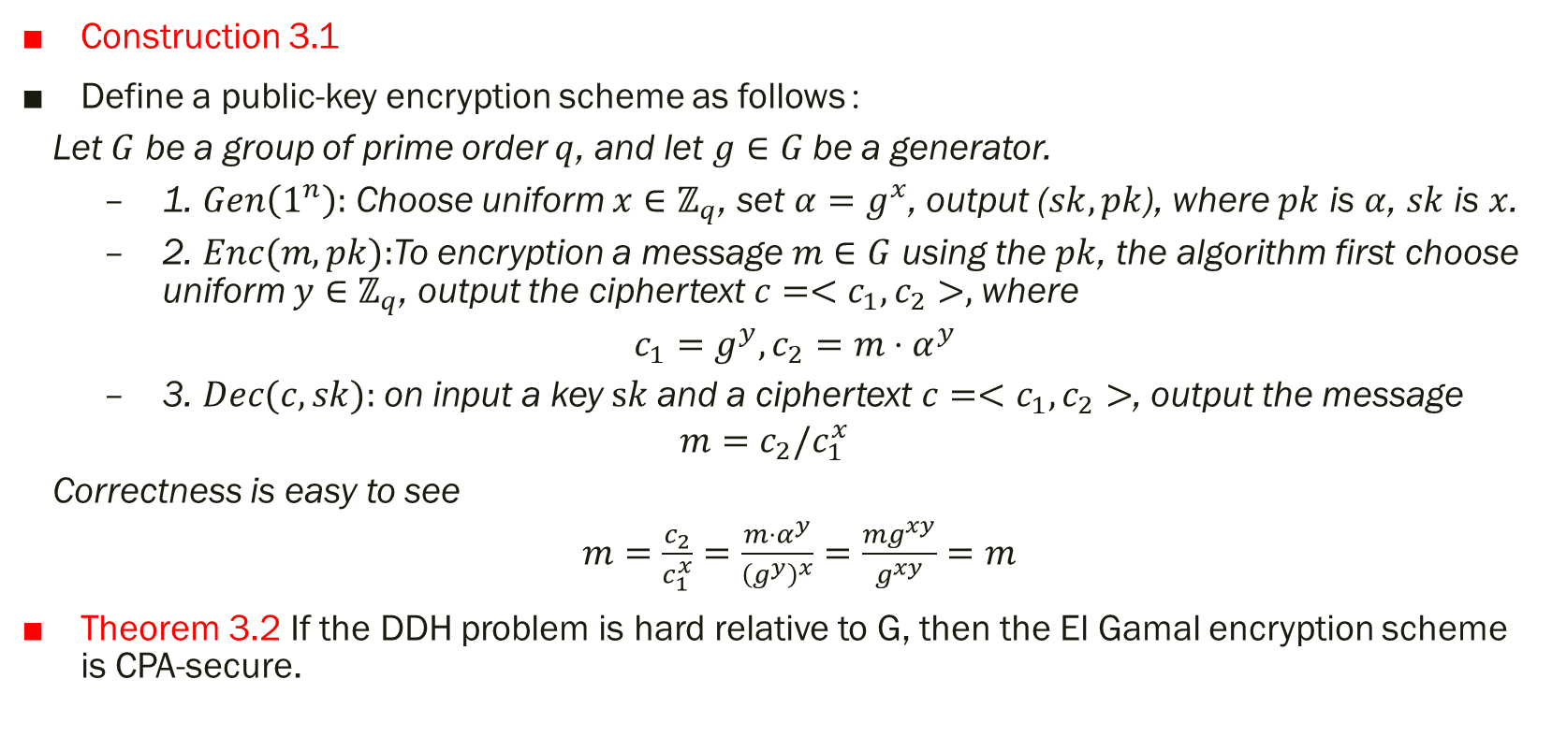
3.Elgamal Encryption
Construction 3.1
Define a public-key encryption scheme as follows：
Let $G$ be a group of prime order $q$, and let $g∈G$ be a generator.
1. $Gen\left(1^{n}\right):$ Choose uniform $x∈ℤ_{q}$, set $α=g^{x}$, output ($sk, pk$), where $pk$ is $α$, $sk$ is $x$.
2. $Enc(m, pk):$To encryption a message $m∈G$ using the $pk$, the algorithm first choose uniform $y∈ℤ_{q}$, output the ciphertext $c=<c_{1}, c_{2}>,$where
$c_{1}=g^{y}, c_{2}=m⋅α^{y}$
3. $Dec(c, sk):$on input a key $sk$and a ciphertext $c=<c_{1}, c_{2}>$, output the message
$$m=c_{2}/c_{1}^{x}$$
Correctness is easy to see
$m=\frac{c_{2}}{c_{1}^{x}}=\frac{m⋅α^{y}}{{\left(g^{y}\right)}^{x}}=\frac{mg^{xy}}{g^{xy}}=m$
Theorem 3.2 If the DDH problem is hard relative to G, then the El Gamal encryption scheme is CPA-secure.

Slide 14
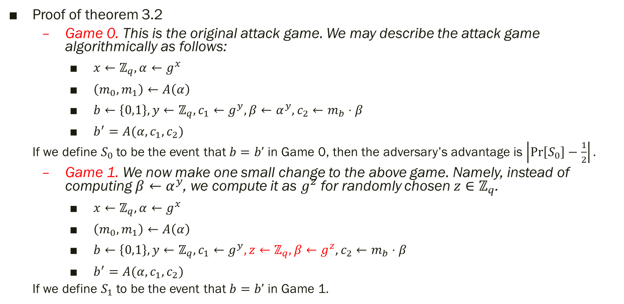
3.Elgamal Encryption
Proof of theorem 3.2
Game 0. This is the original attack game. We may describe the attack game algorithmically as follows:
$x←ℤ_{q}, α←g^{x}$
$\left(m_{0},m_{1}\right)←A\left(α\right)$
$b←\left\{0,1\right\}, y←ℤ_{q}, c_{1}←g^{y}, β←α^{y}, c_{2}←m_{b}⋅β$
$b^{′}=A(α,c_{1},c_{2})$
If we define $S_{0}$to be the event that $b=b’$ in Game 0, then the adversary’s advantage is $\left|\operatorname{Pr}\left[S_{0}\right]−\frac{1}{2}\right|.$
Game 1. We now make one small change to the above game. Namely, instead of computing $β←α^{y}$, we compute it as $g^{z}$ for randomly chosen $z∈ℤ_{q}$.
$x←ℤ_{q}, α←g^{x}$
$\left(m_{0},m_{1}\right)←A\left(α\right)$
$b←\left\{0,1\right\}, y←ℤ_{q}, c_{1}←g^{y}, z←ℤ_{q}, β←g^{z}, c_{2}←m_{b}⋅β$
$b^{′}=A(α,c_{1},c_{2})$
If we define $S_{1}$to be the event that $b=b’$ in Game 1$.$

Slide 15
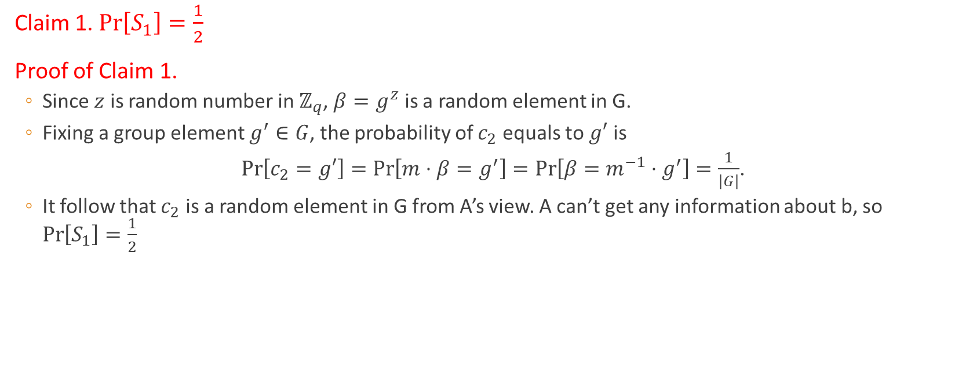
3.Elgamal Encryption
Claim 1. $\operatorname{Pr}\left[S_{1}\right]=\frac{1}{2}$
Proof of Claim 1.
Since $z$ is random number in $ℤ_{q}$, $β=g^{z}$ is a random element in G.
Fixing a group element $g^{′}∈G$, the probability of $c_{2}$ equals to $g′$ is
$\operatorname{Pr}\left[c_{2}=g′\right]=\operatorname{Pr}\left[m⋅β=g^{′}\right]=\operatorname{Pr}\left[β=m^{−1}⋅g^{′}\right]=\frac{1}{\left|G\right|}$.
It follow that $c_{2}$ is a random element in G from A’s view. A can’t get any information about b, so $\operatorname{Pr}\left[S_{1}\right]=\frac{1}{2}$

Slide 16
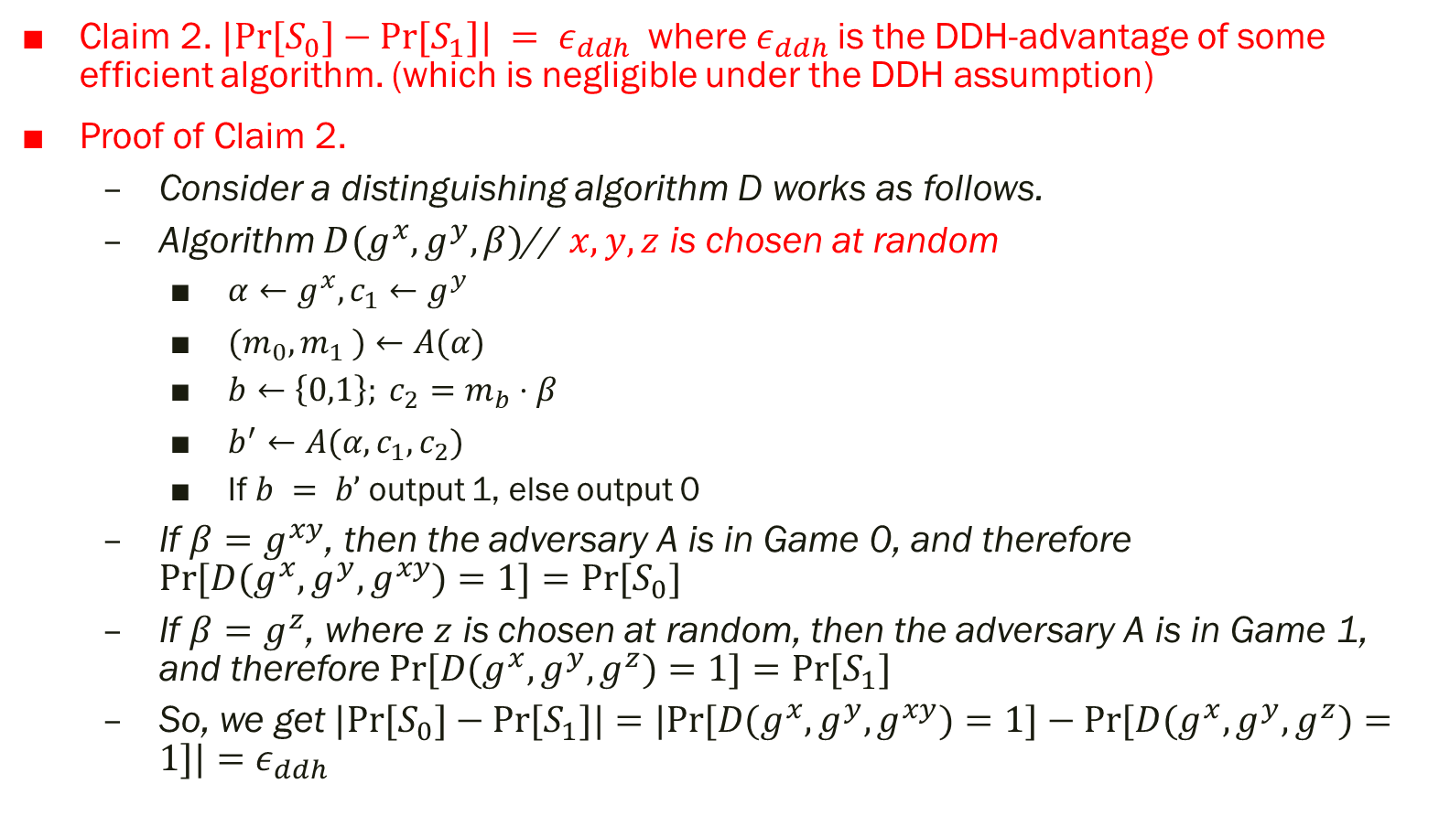
3.Elgamal Encryption
Claim 2. $|Pr⁡[S_{0}]−Pr⁡[S_{1}]| = ε_{ddh}$where $ε_{ddh}$is the DDH-advantage of some efficient algorithm. (which is negligible under the DDH assumption)
Proof of Claim 2.
Consider a distinguishing algorithm D works as follows.
Algorithm $D(g^{x}, g^{y}, β)$// $x,y,z$ is chosen at random
$α←g^{x},c_{1}←g^{y}$
$(m_{0},m_{1} )←A(α)$
$b←\left\{0,1\right\}; c_{2}=m_{b}⋅β$
$b^{′}←A(α,c_{1},c_{2})$
If $b = b’$output 1, else output 0
If $β=g^{xy}$, then the adversary A is in Game 0, and therefore $Pr⁡[D(g^{x},g^{y},g^{xy})=1]=Pr⁡[S_{0}]$
If $β=g^{z}$, where $z$ is chosen at random, then the adversary A is in Game 1, and therefore $Pr⁡[D(g^{x},g^{y},g^{z})=1]=Pr⁡[S_{1}]$
So, we get $|Pr⁡[S_{0}]−Pr⁡[S_{1}]|=|Pr⁡[D(g^{x},g^{y},g^{xy})=1]−Pr⁡[D(g^{x},g^{y},g^{z})=1]|=ε_{ddh}$

Slide 17
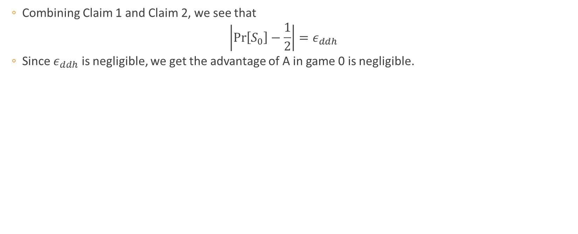
3.Elgamal Encryption
Combining Claim 1 and Claim 2, we see that
$$\left|\operatorname{Pr}\left[S_{0}\right]−\frac{1}{2}\right|=ε_{ddh}$$
Since $ε_{ddh}$ is negligible, we get the advantage of A in game 0 is negligible.

Slide 18
Content
Number Theory and Cryptographic Hardness Assumptions
Indistinguishable Encryption in Public-Key Model
ElGamal Encryption
Hashed ElGamal

Slide 19

4. Hashed ELGamal
For a number of reasons, it is convenient to work with messages that are bit strings, say, of length $l$, rather than group elements. Because of this, one may choose to use a “hashed” version of the ElGamal encryption scheme.
This scheme makes use of a family of keyed “hash” functions $H := {\left\{H_{k}\right\}}_{k∈K}$, where each $H_{k}$is a function mapping $G$ to ${\left\{0, 1\right\}}^{l}$

Slide 20
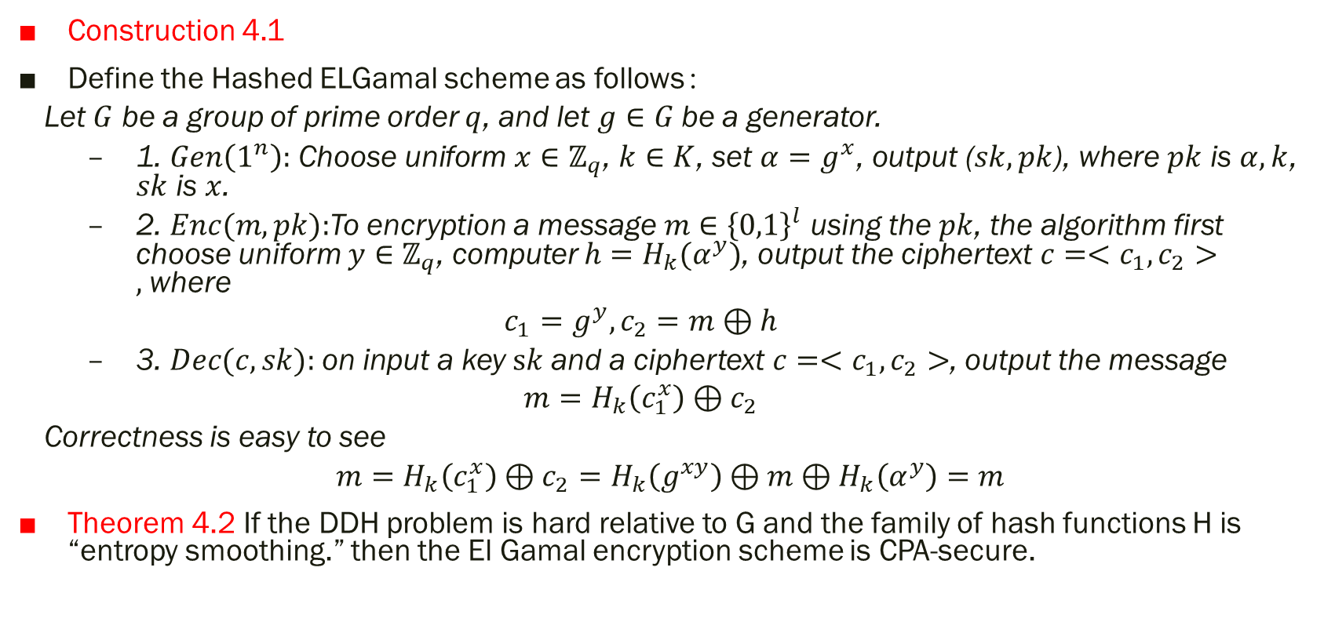
4. Hashed ELGamal
Construction 4.1
Define the Hashed ELGamal scheme as follows：
Let $G$ be a group of prime order $q$, and let $g∈G$ be a generator.
1. $Gen\left(1^{n}\right):$ Choose uniform $x∈ℤ_{q}$, $k∈K$, set $α=g^{x}$, output ($sk, pk$), where $pk$ is $α,k$, $sk$ is $x$.
2. $Enc(m, pk):$To encryption a message $m∈{\left\{0,1\right\}}^{l}$ using the $pk$, the algorithm first choose uniform $y∈ℤ_{q}$, computer $h=H_{k}(α^{y})$, output the ciphertext $c=<c_{1}, c_{2}>,$where
$$c_{1}=g^{y}, c_{2}=m⊕h$$
3. $Dec(c, sk):$on input a key $sk$and a ciphertext $c=<c_{1}, c_{2}>$, output the message
$$m=H_{k}\left(c_{1}^{x}\right)⊕c_{2}$$
Correctness is easy to see
$m=H_{k}\left(c_{1}^{x}\right)⊕c_{2}=H_{k}\left(g^{xy}\right)⊕m⊕H_{k}\left(α^{y}\right)=m$
Theorem 4.2 If the DDH problem is hard relative to G and the family of hash functions H is “entropy smoothing.” then the El Gamal encryption scheme is CPA-secure.

Slide 21
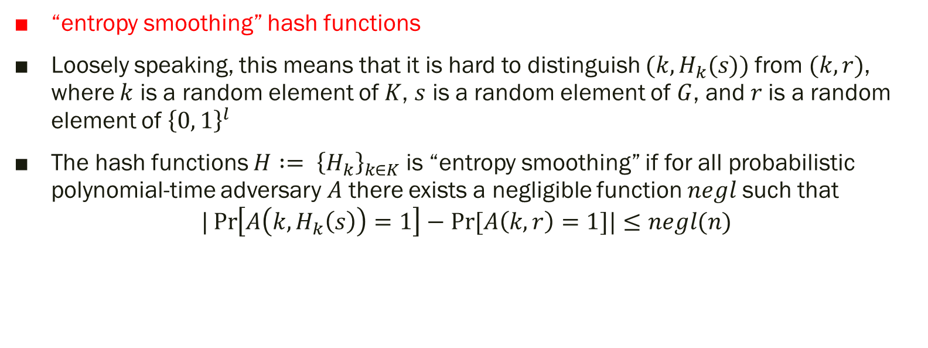
4. Hashed ELGamal
“entropy smoothing” hash functions
Loosely speaking, this means that it is hard to distinguish $(k,H_{k}(s))$from $(k, r)$, where $k$ is a random element of $K$, $s$ is a random element of $G$, and $r$is a random element of ${\left\{0, 1\right\}}^{l}$
The hash functions $H := {\left\{H_{k}\right\}}_{k∈K}$is “entropy smoothing” if for all probabilistic polynomial-time adversary 𝐴 there exists a negligible function 𝑛𝑒𝑔𝑙 such that
$$|\operatorname{Pr}\left[A\left(k,H_{k}\left(s\right)\right)=1\right]−Pr⁡[A\left(k,r\right)=1]|≤negl(n)$$

Slide 22
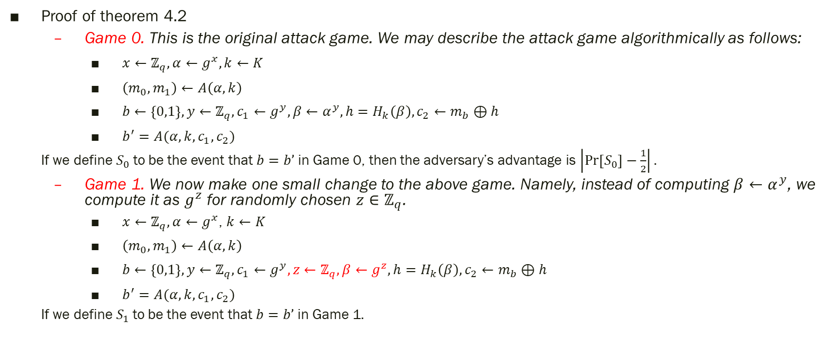
4. Hashed ELGamal
Proof of theorem 4.2
Game 0. This is the original attack game. We may describe the attack game algorithmically as follows:
$x←ℤ_{q}, α←g^{x},k←K$
$\left(m_{0},m_{1}\right)←A\left(α,k\right)$
$b←\left\{0,1\right\}, y←ℤ_{q}, c_{1}←g^{y}, β←α^{y}, h=H_{k}\left(β\right),c_{2}←m_{b}⊕h$
$b^{′}=A(α,k,c_{1},c_{2})$
If we define $S_{0}$to be the event that $b=b’$ in Game 0, then the adversary’s advantage is $\left|\operatorname{Pr}\left[S_{0}\right]−\frac{1}{2}\right|.$
Game 1. We now make one small change to the above game. Namely, instead of computing $β←α^{y}$, we compute it as $g^{z}$ for randomly chosen $z∈ℤ_{q}$.
$x←ℤ_{q}, α←g^{x}$, $k←K$
$\left(m_{0},m_{1}\right)←A\left(α,k\right)$
$b←\left\{0,1\right\}, y←ℤ_{q}, c_{1}←g^{y}, z←ℤ_{q}, β←g^{z},h=H_{k}\left(β\right),c_{2}←m_{b}⊕h$
$b^{′}=A(α,k,c_{1},c_{2})$
If we define $S_{1}$to be the event that $b=b’$ in Game 1$.$

Slide 23
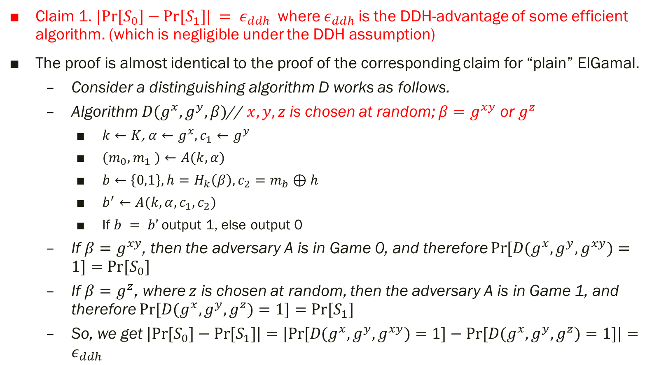
4. Hashed ELGamal
Claim 1. $|Pr⁡[S_{0}]−Pr⁡[S_{1}]| = ε_{ddh}$where $ε_{ddh}$is the DDH-advantage of some efficient algorithm. (which is negligible under the DDH assumption)
The proof is almost identical to the proof of the corresponding claim for “plain” ElGamal.
Consider a distinguishing algorithm D works as follows.
Algorithm $D(g^{x}, g^{y}, β)$// $x,y,z$ is chosen at random; $β=g^{xy}$ or $g^{z}$
$k←K$, $α←g^{x},c_{1}←g^{y}$
$(m_{0},m_{1} )←A(k,α)$
$b←\left\{0,1\right\},h=H_{k}\left(β\right),c_{2}=m_{b}⊕h$
$b^{′}←A(k,α,c_{1},c_{2})$
If $b = b’$output 1, else output 0
If $β=g^{xy}$, then the adversary A is in Game 0, and therefore $Pr⁡[D(g^{x},g^{y},g^{xy})=1]=Pr⁡[S_{0}]$
If $β=g^{z}$, where $z$ is chosen at random, then the adversary A is in Game 1, and therefore $Pr⁡[D(g^{x},g^{y},g^{z})=1]=Pr⁡[S_{1}]$
So, we get $|Pr⁡[S_{0}]−Pr⁡[S_{1}]|=|Pr⁡[D(g^{x},g^{y},g^{xy})=1]−Pr⁡[D(g^{x},g^{y},g^{z})=1]|=ε_{ddh}$

Slide 24
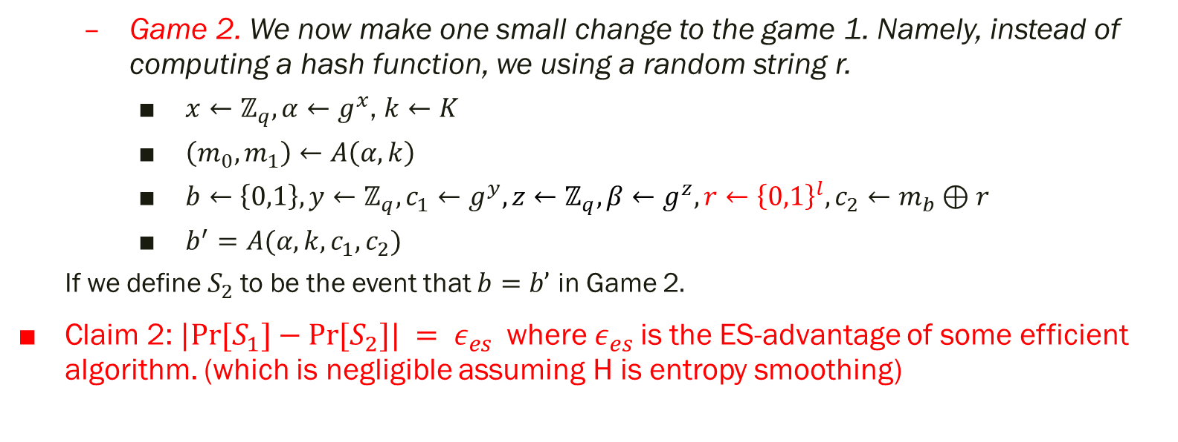
4. Hashed ELGamal
Game 2. We now make one small change to the game 1. Namely, instead of computing a hash function, we using a random string r.
$x←ℤ_{q}, α←g^{x}$, $k←K$
$\left(m_{0},m_{1}\right)←A\left(α,k\right)$
$b←\left\{0,1\right\}, y←ℤ_{q}, c_{1}←g^{y}, z←ℤ_{q}, β←g^{z},r←{\left\{0,1\right\}}^{l},c_{2}←m_{b}⊕r$
$b^{′}=A(α,k,c_{1},c_{2})$
If we define $S_{2}$to be the event that $b=b’$ in Game 2$.$
Claim 2: $|Pr⁡[S_{1}]−Pr⁡[S_{2}]| = ε_{es}$where $ε_{es}$is the ES-advantage of some efficient algorithm. (which is negligible assuming H is entropy smoothing)

Slide 25
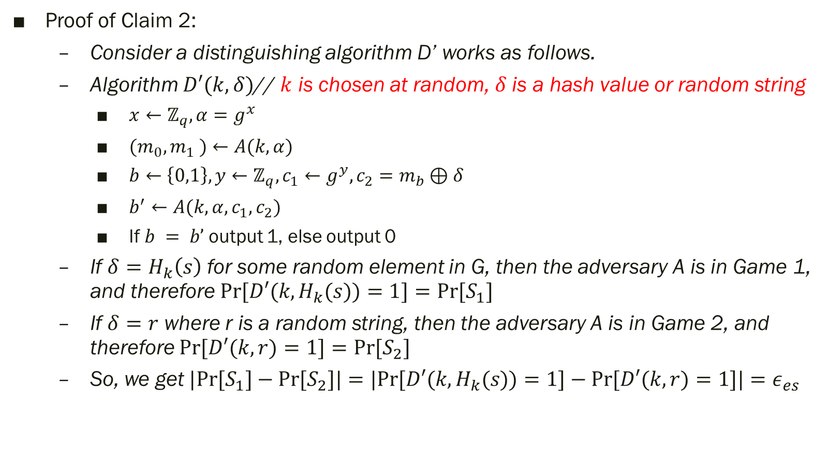
4. Hashed ELGamal
Proof of Claim 2:
Consider a distinguishing algorithm D’ works as follows.
Algorithm $D′(k,δ)$// $k$ is chosen at random, $δ$is a hash value or random string
$x←ℤ_{q},α=g^{x}$
$(m_{0},m_{1} )←A(k,α)$
$b←\left\{0,1\right\},y←ℤ_{q}, c_{1}←g^{y},c_{2}=m_{b}⊕δ$
$b^{′}←A(k,α,c_{1},c_{2})$
If $b = b’$output 1, else output 0
If $δ=H_{k}\left(s\right)$ for some random element in G, then the adversary A is in Game 1, and therefore $Pr⁡[D′(k,H_{k}(s))=1]=Pr⁡[S_{1}]$
If $δ=r$ where r is a random string, then the adversary A is in Game 2, and therefore $Pr⁡[D′(k,r)=1]=Pr⁡[S_{2}]$
So, we get $|Pr⁡[S_{1}]−Pr⁡[S_{2}]|=|Pr⁡[D′(k,H_{k}(s))=1]−Pr⁡[D′(k,r)=1]|=ε_{es}$

Slide 26
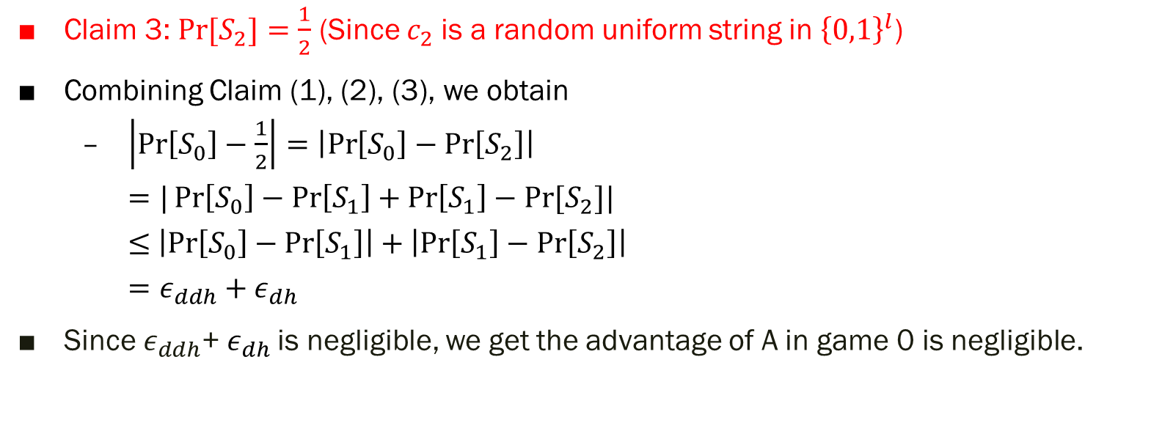
4. Hashed ELGamal
Claim 3: $Pr⁡[S_{2}]=\frac{1}{2}$ (Since $c_{2}$is a random uniform string in ${\left\{0,1\right\}}^{l}$)
Combining Claim (1), (2), (3), we obtain
$\left|\operatorname{Pr}\left[S_{0}\right]−\frac{1}{2}\right|=\left|\operatorname{Pr}\left[S_{0}\right]−\operatorname{Pr}\left[S_{2}\right]\right|$
$=|\operatorname{Pr}\left[S_{0}\right]−\operatorname{Pr}\left[S_{1}\right]+\operatorname{Pr}\left[S_{1}\right]−Pr⁡[S_{2}]|$
$≤$ $\left|\operatorname{Pr}\left[S_{0}\right]−\operatorname{Pr}\left[S_{1}\right]\right|+\left|\operatorname{Pr}\left[S_{1}\right]−\operatorname{Pr}\left[S_{2}\right]\right|$
$=ε_{ddh}+ε_{dh}$
Since $ε_{ddh}$+ $ε_{dh}$is negligible, we get the advantage of A in game 0 is negligible.

Slide 27
5.

