Slide 1
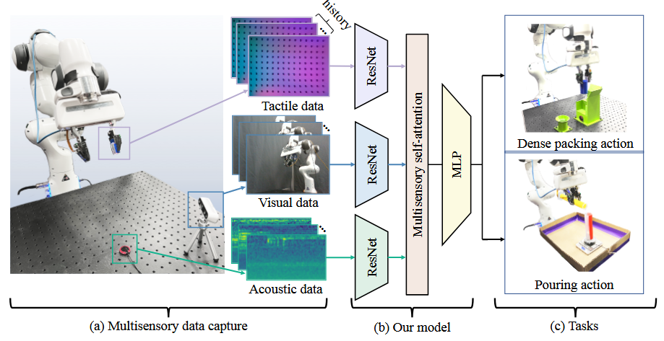
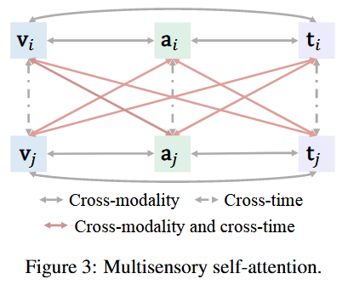
See, Hear, and Feel: Smart Sensory Fusion for Robotic Manipulation CoRL 2022.

Slide 2
