Slide 1
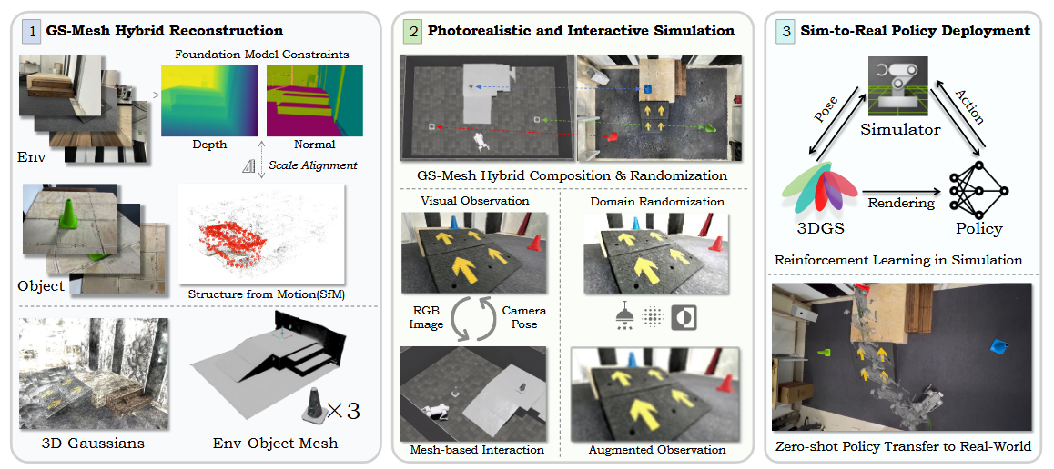
VR-Robo: A Real-to-Sim-to-Real Framework for Visual Robot Navigation and Locomotion

Slide 2
