Slide 1
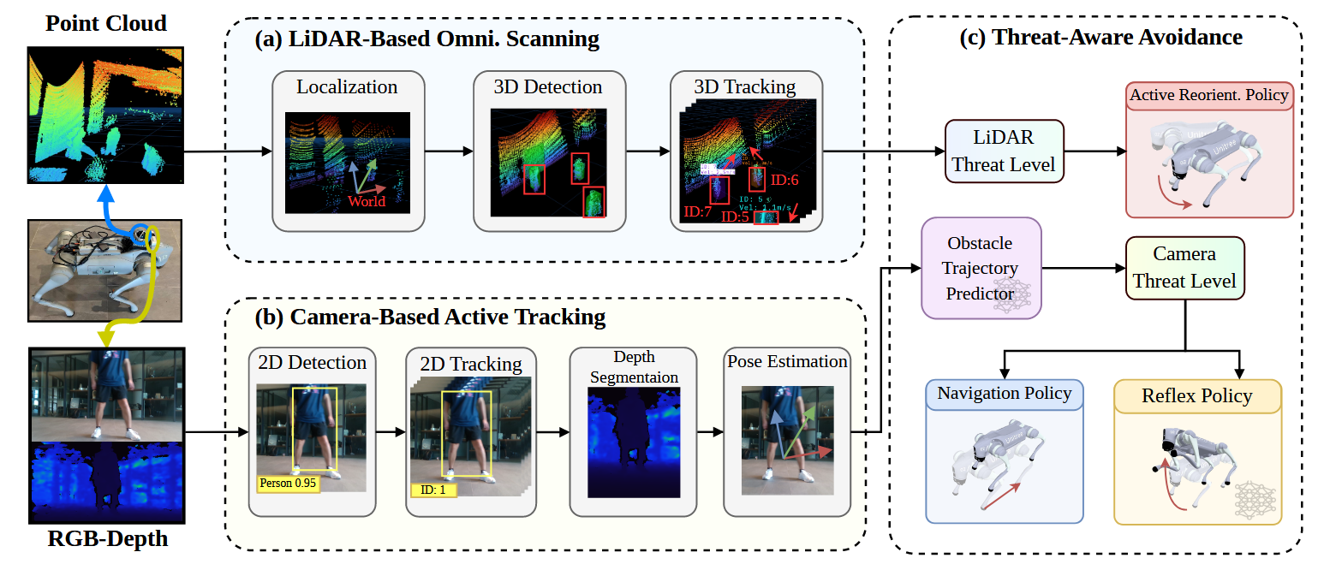
APREBot: Active Perception System for Reflexive Evasion Robot

Slide 2
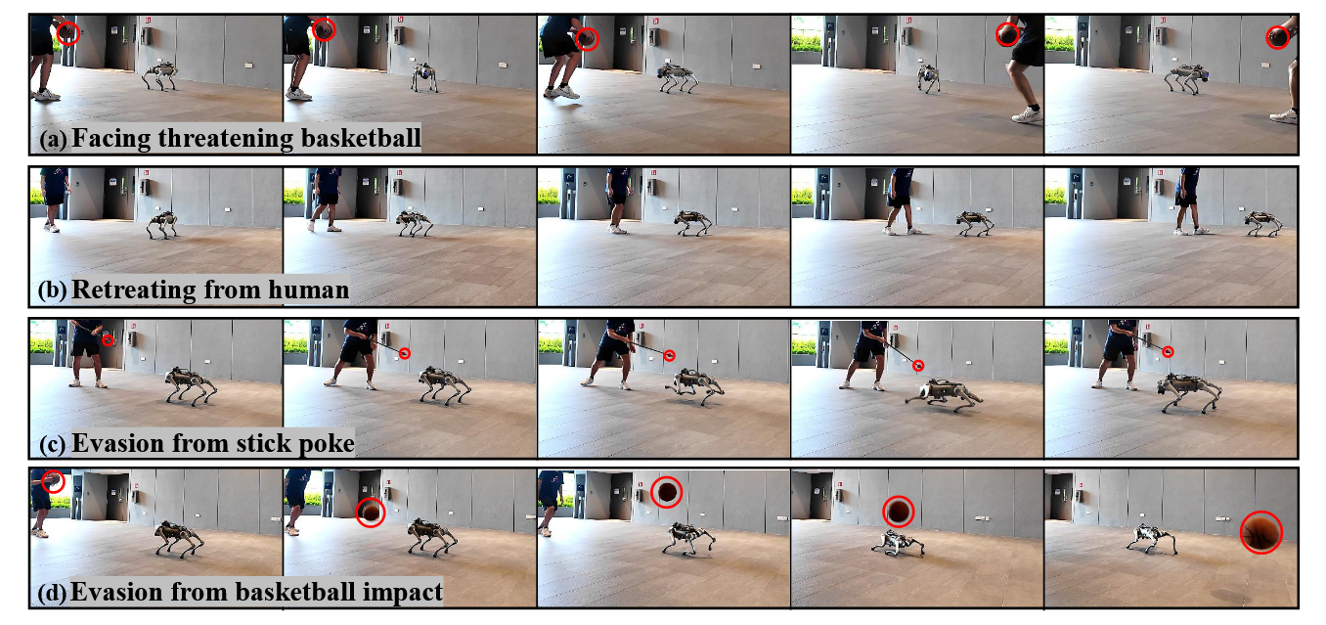
Fig. 4: Real-robot experiments demonstrating threat-aware decision making of the robot.
(a) The robot identifies the basketball in the human’s hand as a threat and continuously reorients to face it.
(b) The robot retreats slowly as the human approaches.
(c) When poked rapidly with a stick, the robot performs reflexive evasion.
(d) When hit with a basketball, the robot executes reflexive evasion.

