Slide 1
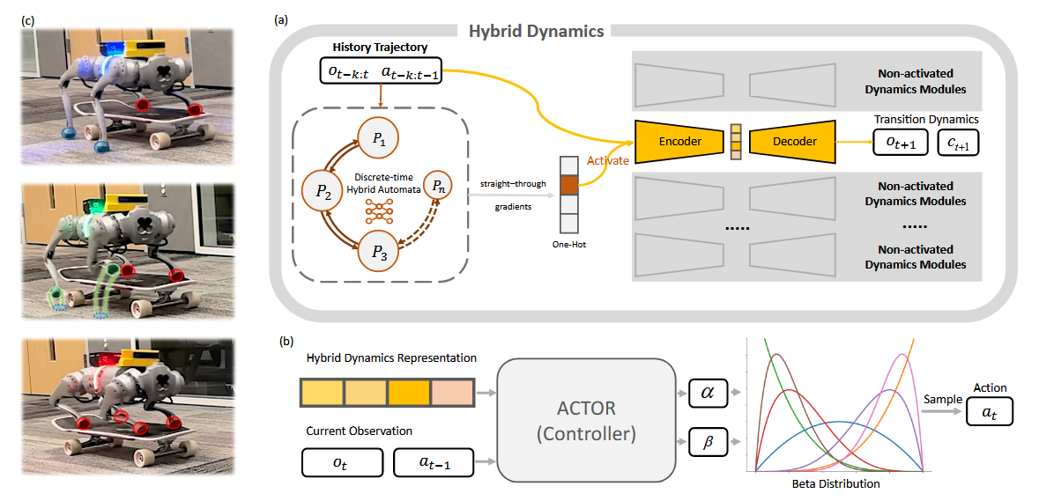
Discrete-Time Hybrid Automata Learning: Legged Locomotion Meets Skateboarding

Slide 2
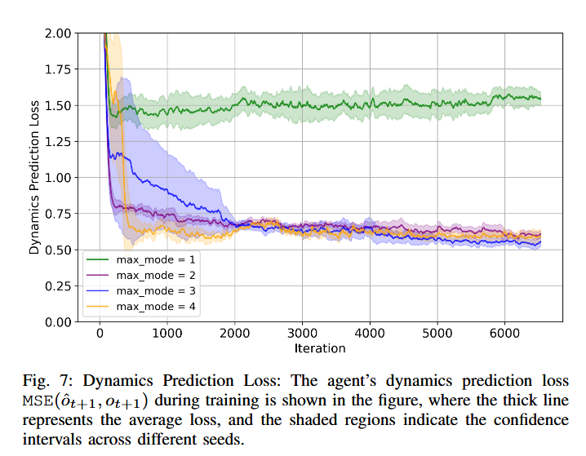
混合动力学模式的有效性

Slide 3
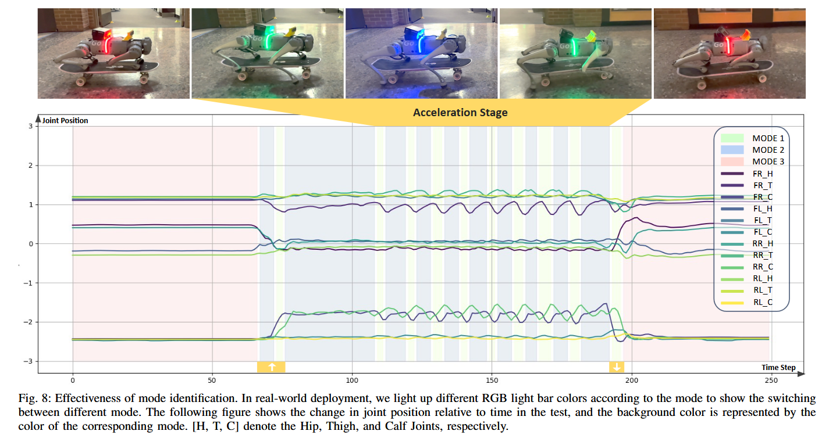
能否识别滑板模式?

