Slide 1
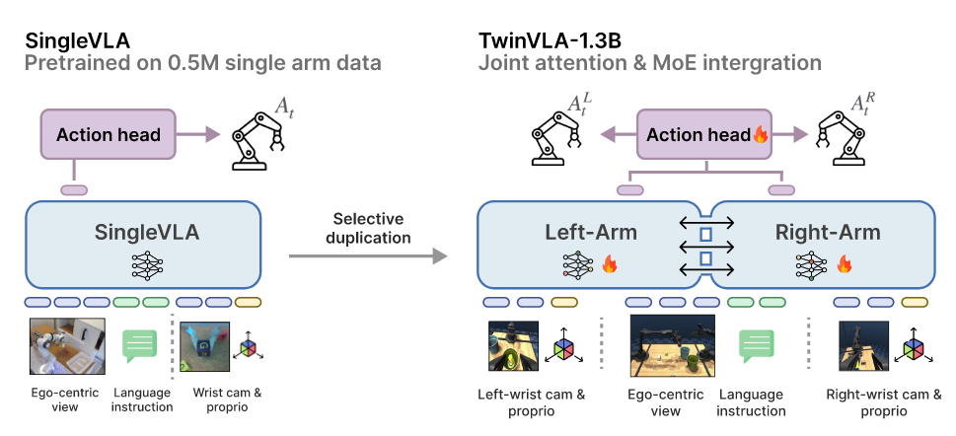
TwinVLA: Data-Efficient Bimanual Manipulation with Twin Single-Arm Vision-Language-Action Models

Slide 2
