Slide 1
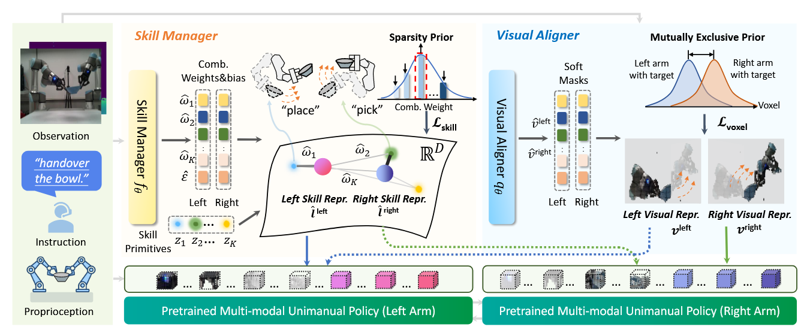
AnyBimanual: Transferring Unimanual Policy for General Bimanual Manipulation

