Slide 1
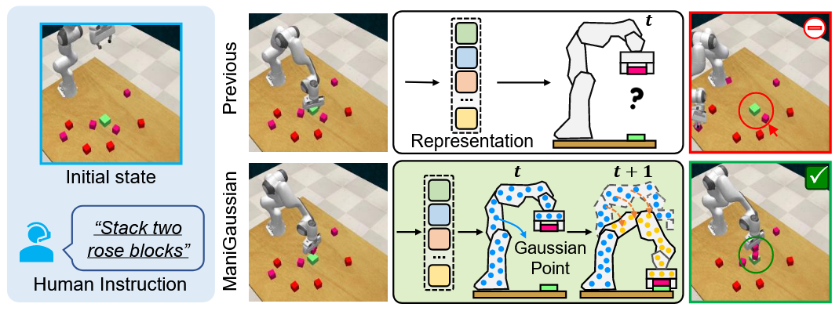
ManiGaussian: Dynamic Gaussian Splatting for Multi-task Robotic Manipulation

Slide 2
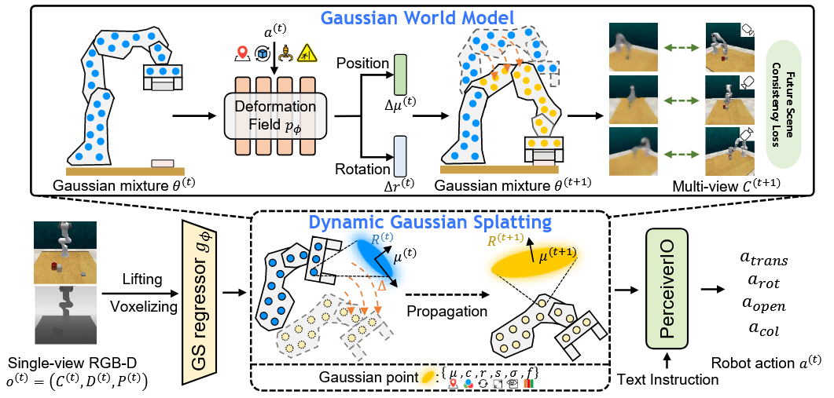

Slide 3
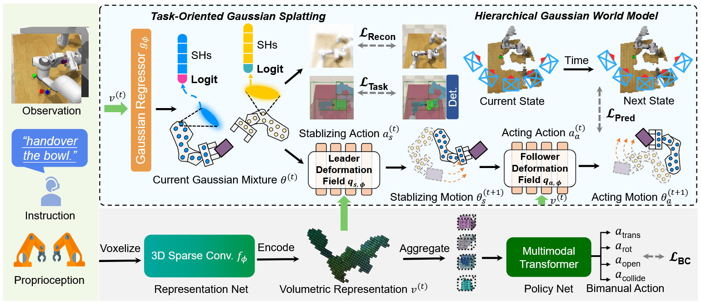
ManiGaussian++: General Robotic Bimanual Manipulation with Hierarchical Gaussian World Model

