Slide 1
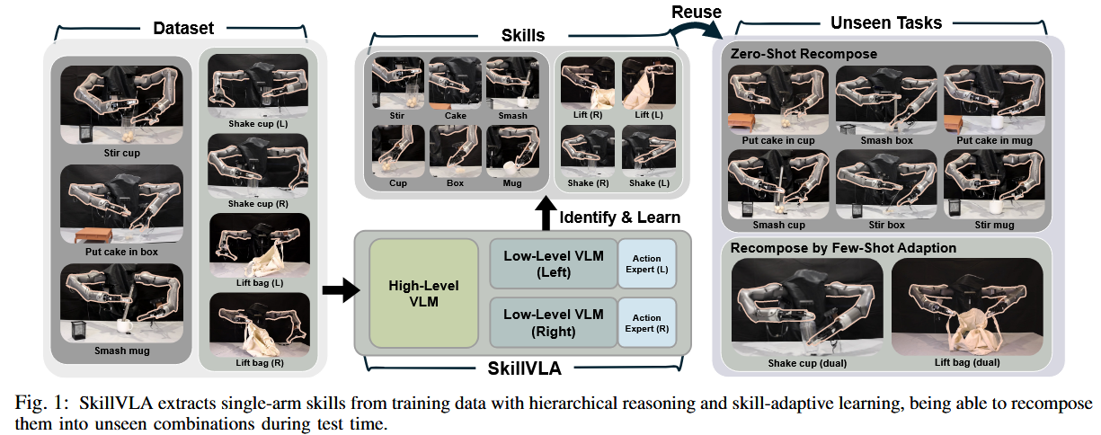
SkillVLA: Tackling Combinatorial Diversity in Dual-Arm Manipulation via Skill Reuse

Slide 2
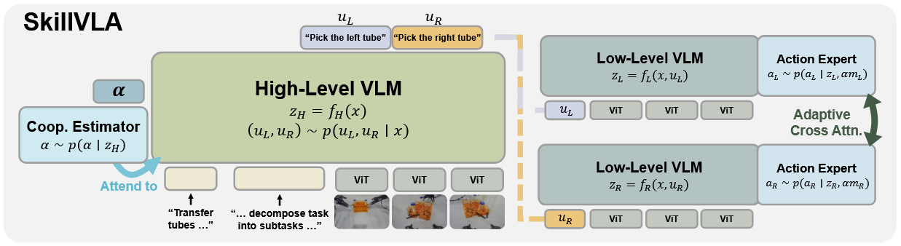
SkillVLA framework

