Slide 1
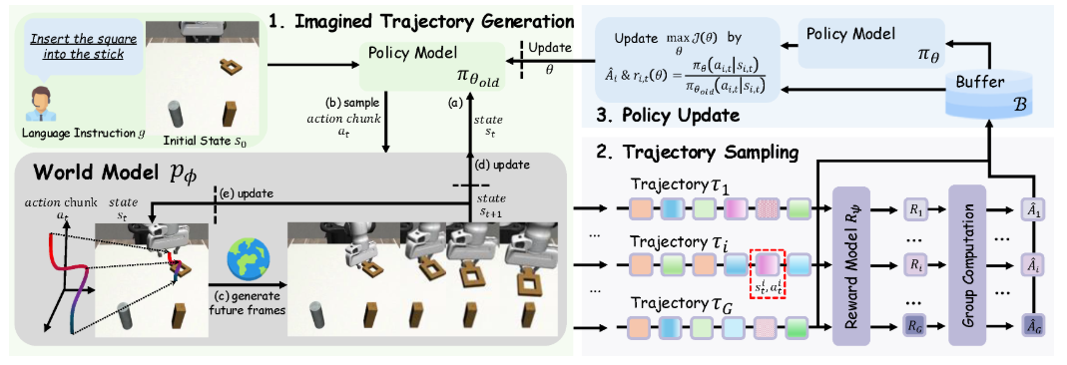
WMPO: World Model-based Policy Optimization for Vision-Language-Action Models

