Slide 1
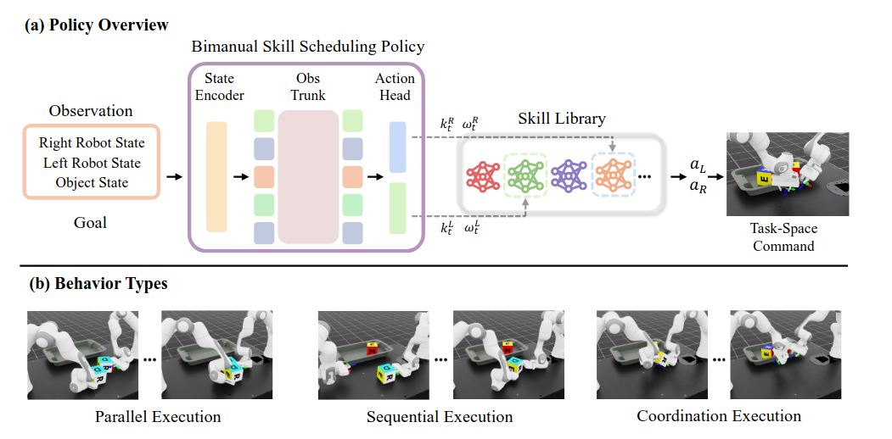
Learning to Plan & Schedule with Reinforcement-Learned Bimanual Robot Skills

Slide 2
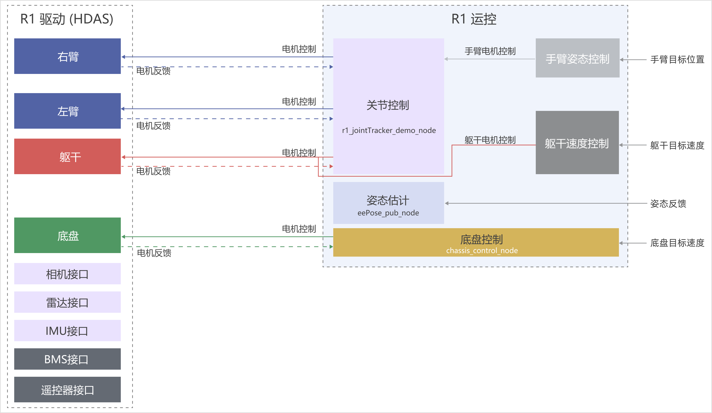
星海图R1机器人ROS2软件框架

