Slide 1
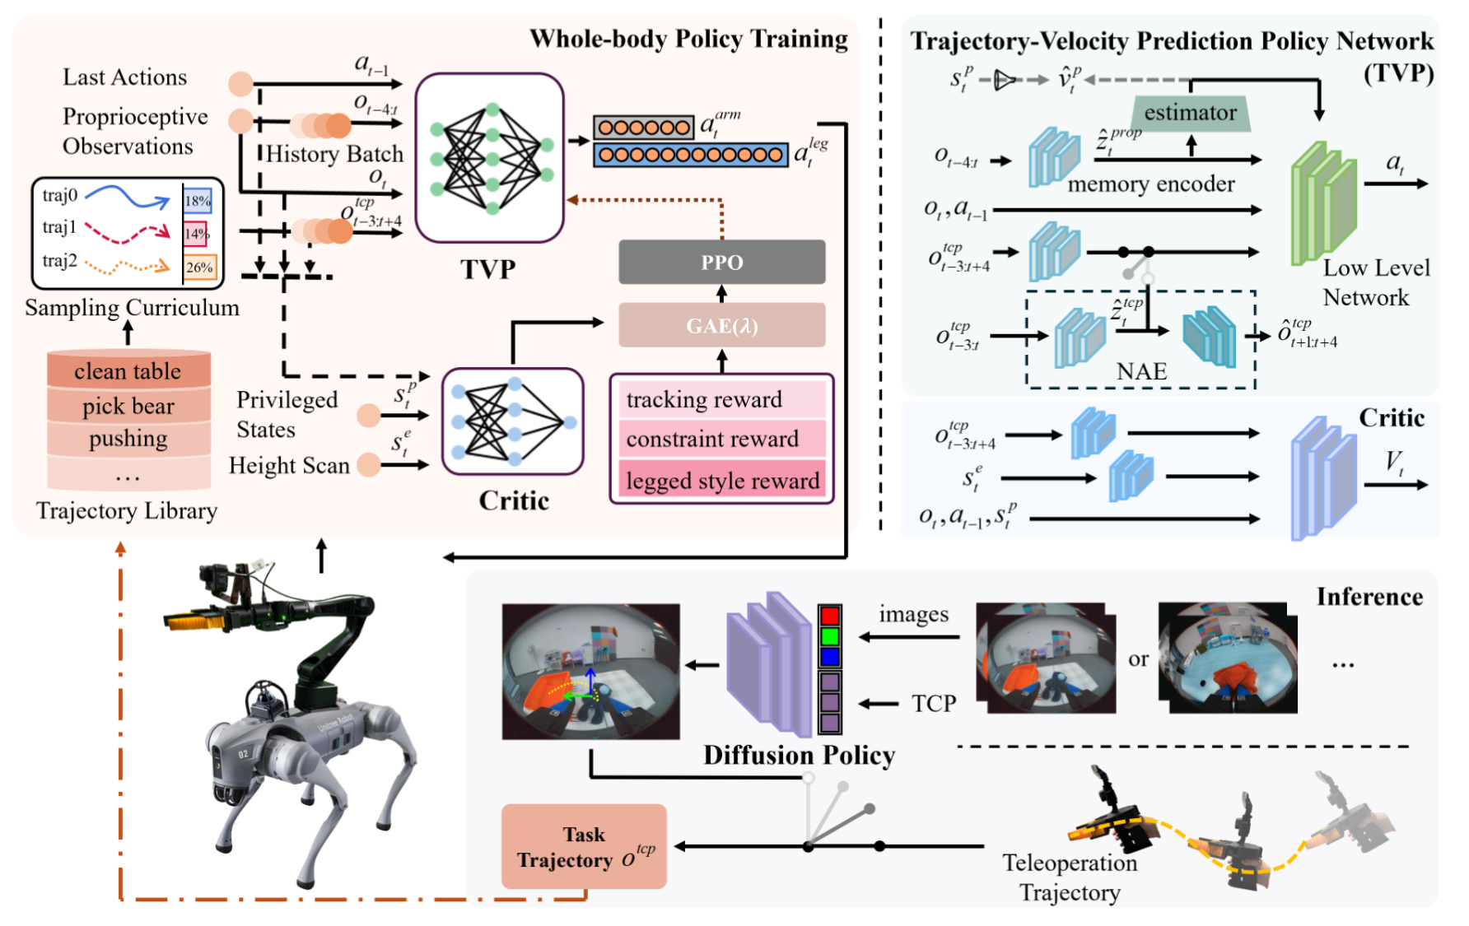
MLM: Learning Multi-task Loco-Manipulation Whole-Body Control for Quadruped Robot with Arm

Slide 2
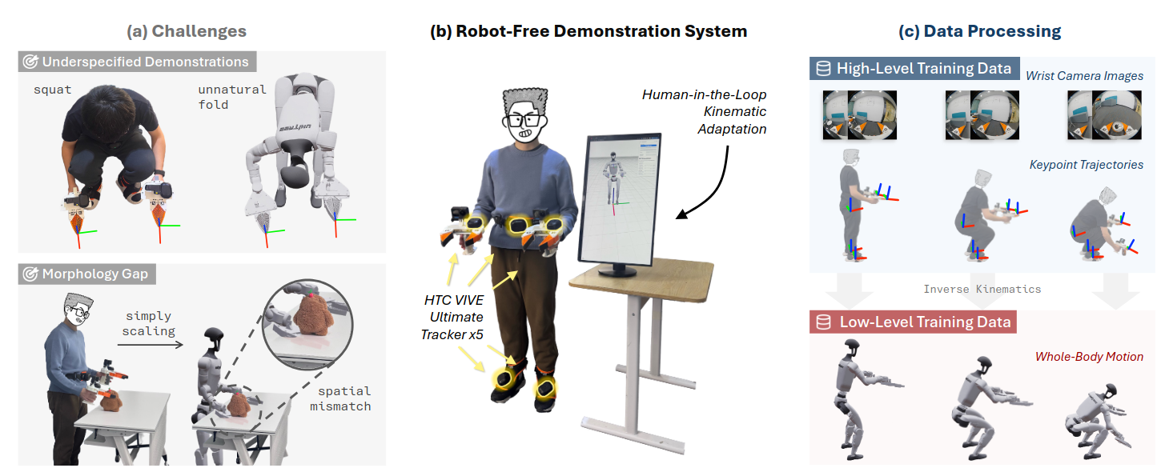
Humanoid Manipulation Interface: Humanoid Whole-Body Manipulation from Robot-Free Demonstrations

Slide 3
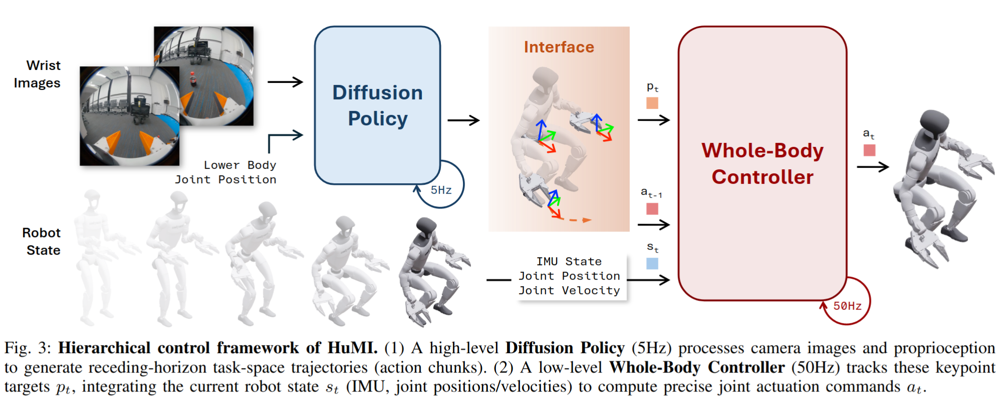

Slide 4
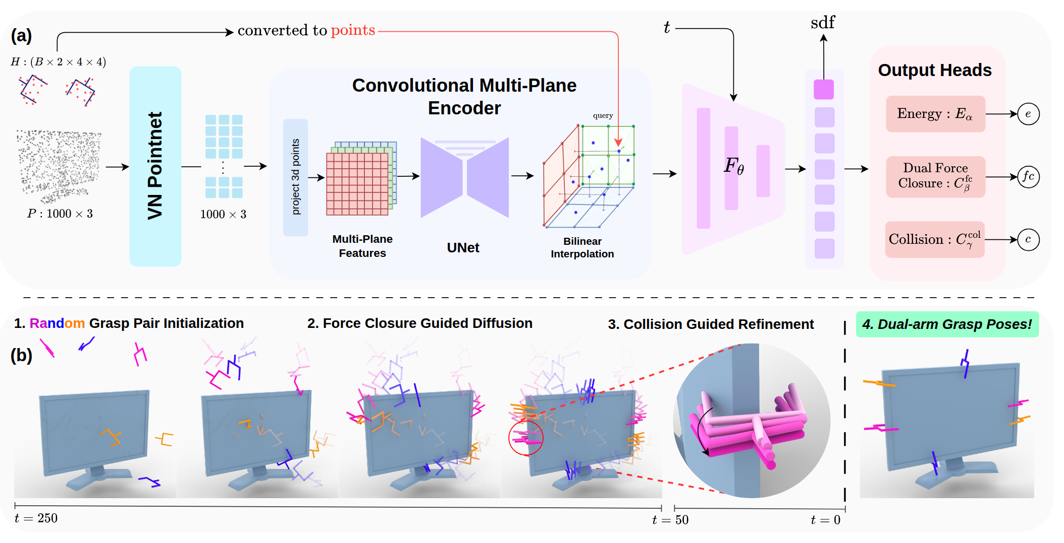
DAGDiff: Guiding Dual-Arm Grasp Diffusion to Stable and Collision-Free Grasps

Slide 5
