Slide 1
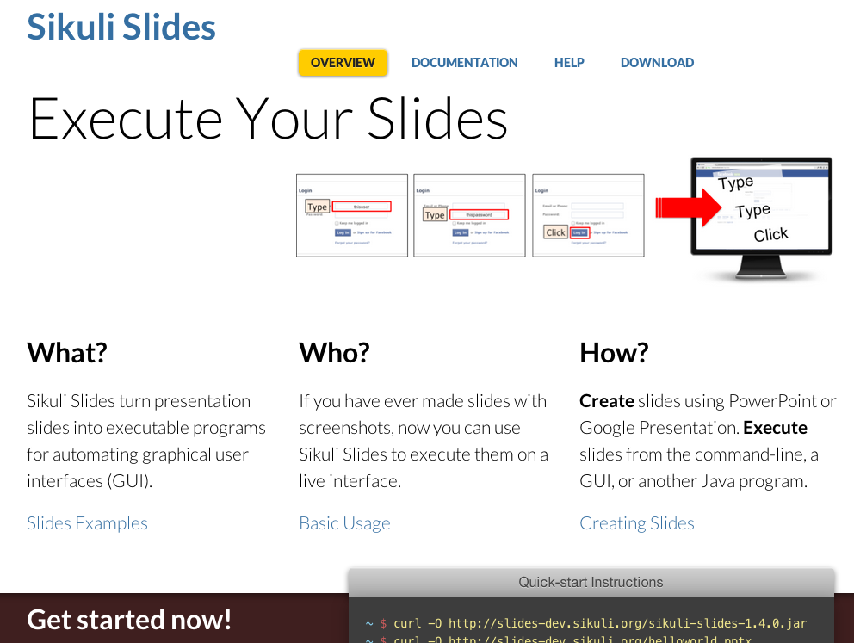
Browser http://slides.sikuli.org/

Slide 2
Welcome to Sikuli Slides

Slide 3
Let’s find a target to click
CLICK

Slide 4
CLICK
Read this to learn more

Slide 5
The End

