Slide 1
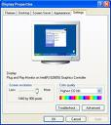


Web
Aggregate
Index
Rank
Contribute
Experts
Query
Preview
Read
User
User
User

Slide 2
Web
Image Search
Contribute
Reverse Image Search
Video Search
Experts
Bootstrap
Crawl
Filter
Index
Search
Candidates
Screenshot
Instructions
User

Slide 3
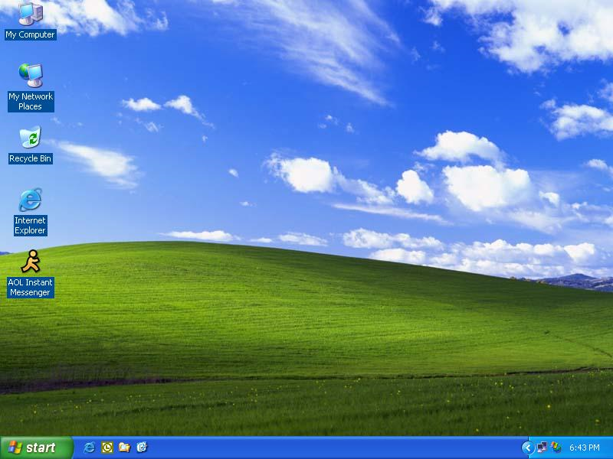

Slide 4
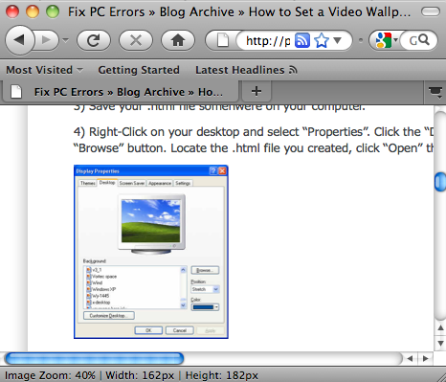
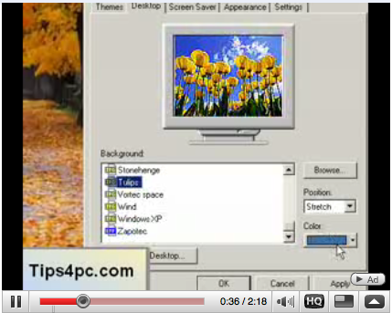

Slide 5

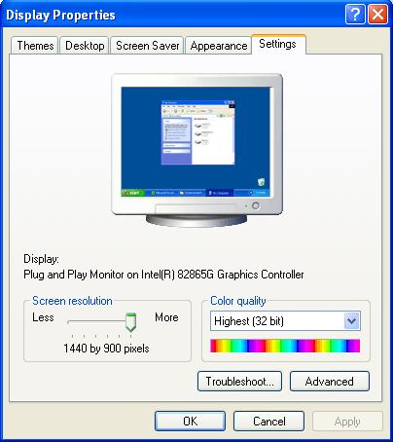
1’23”
Find the relevant segment in a
Find the relevant screenshot in a web page

Slide 6
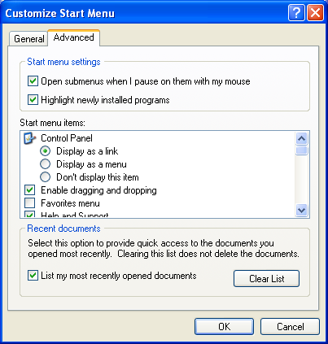
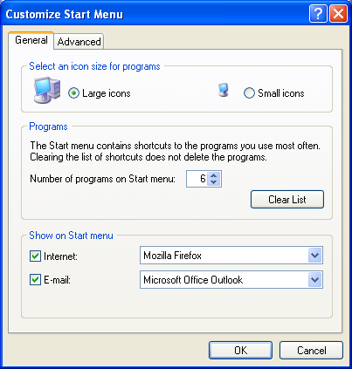
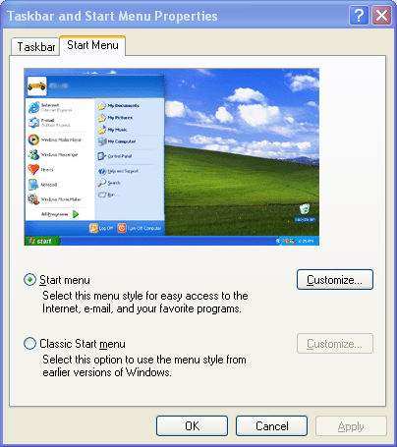
Webpage
Video
1’15”

Slide 7
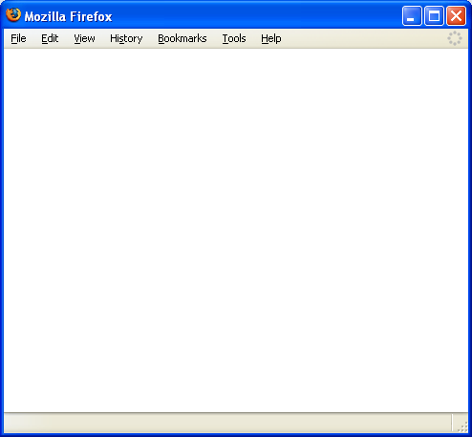

Slide 9
resolution
Search
Webpage
Video
Transcript:
let us move the slider to change the resolution
You can adjust the resolution by moving the slider ...

Slide 10
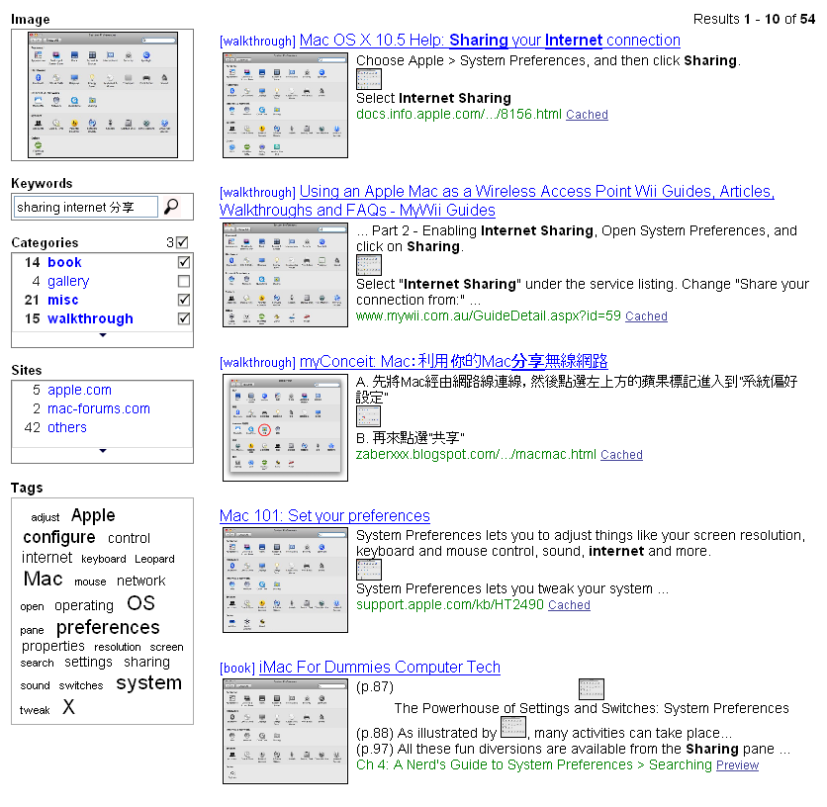

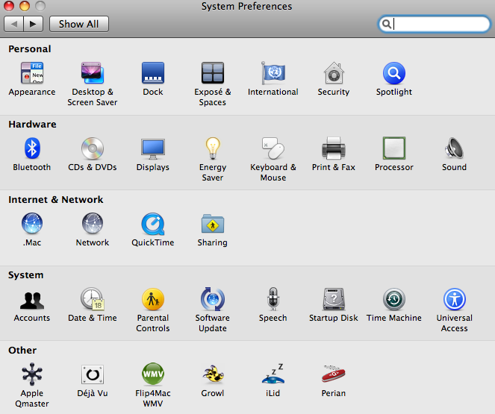
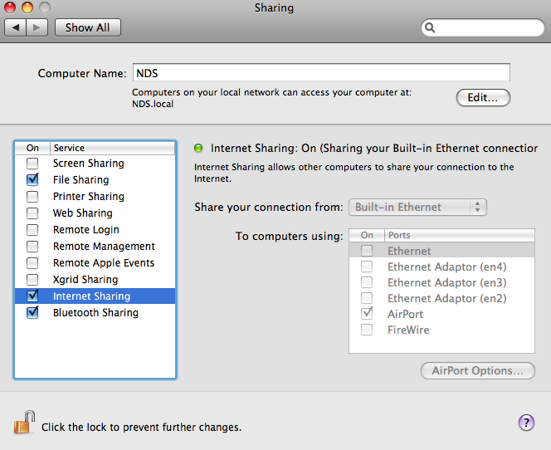
Matched Keywords
Title
Inline Thumbnail
Matched Screenshot
Source
Title
[video] How to share Internet connection
Matched Segment
teach how to share the internet. let us begin
select Internet Sharing
ehow.com
Previous Segment
1’19’’ / 4’34’’
Next Segment
Timeline
Matched Transcript Words

