Slide 1
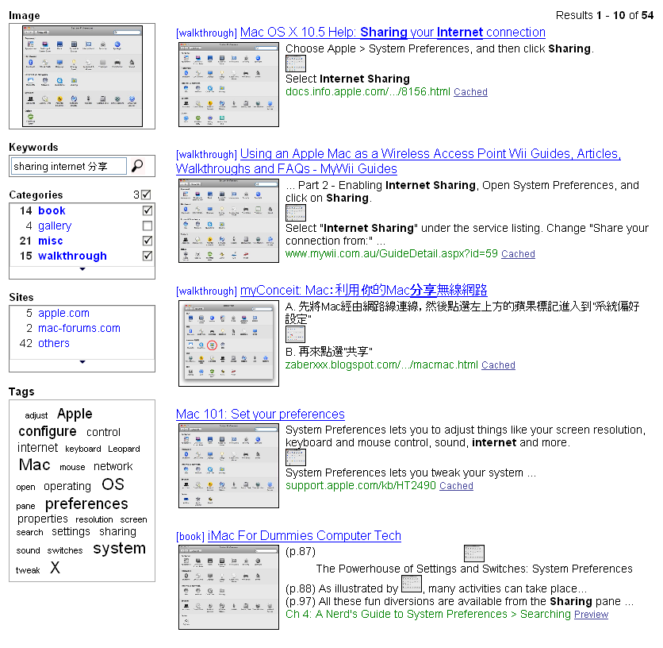
A program’s screenshot can be used to search for visually relevant pages.
Relationships between screenshots and nearby text are visualized by embedded thumbnails.
Keywords can be entered to re-rank the results by textual relevancy.
Matched keywords are emphasized in bold face.
Non-English pages with similar screenshots can be searched.
Results can be filtered by categories and sites.
Words extracted from the pages are shown as a tag cloud.
Figure captions are displayed under screenshot thumbnails.
Figure references are shown as thumbnails embedded in the text.

Slide 2
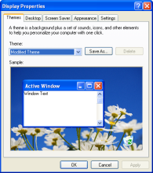
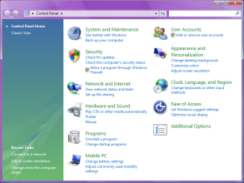
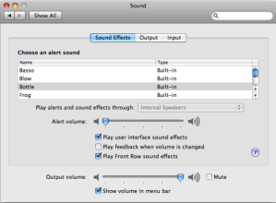
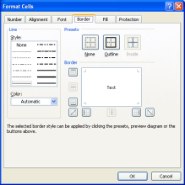
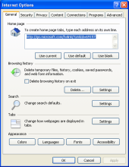
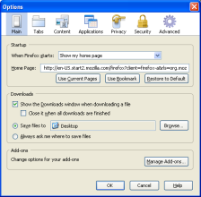
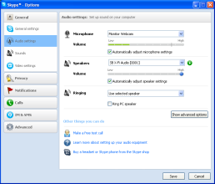
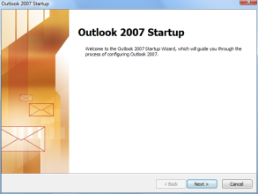
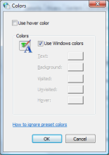
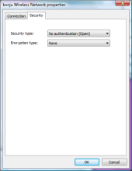
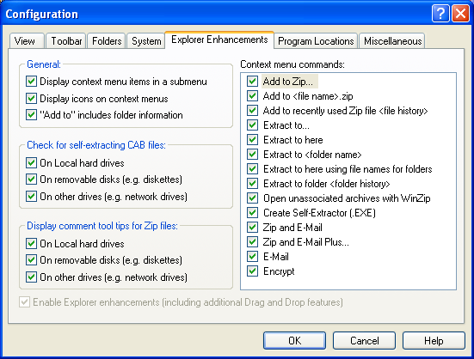
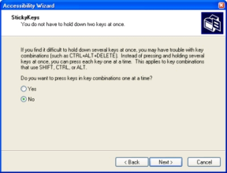
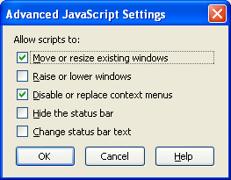
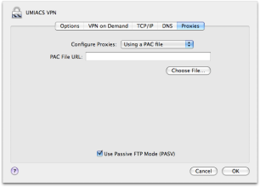
XP
Vista
OS X
Office
IE
Firefox
Skype

Slide 3
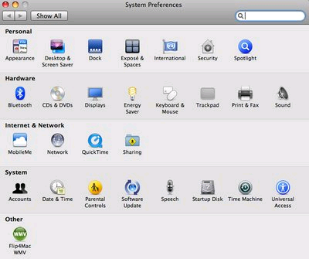
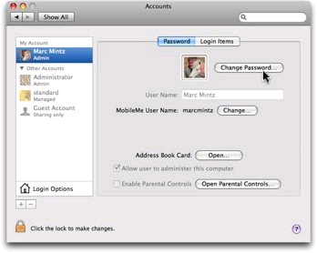
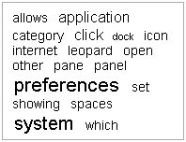
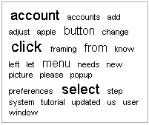

Slide 4
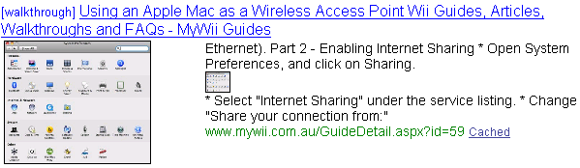

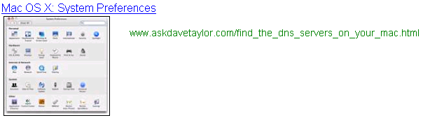
Our approach
Bing Web
Bing Images

Slide 6
Title
Excerpt
Source
Title
Excerpt
Source
Tiny Thumbnail

Slide 7
Title
Excerpt
Source
Category
Matched Screenshot
Page
Chapter / Section Headings
Inline Thumbnail

