Slide 1
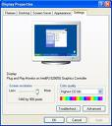


Web
Aggregate
Index
Rank
Contribute
Experts
Query
Preview
Read
User
User
User

Slide 2
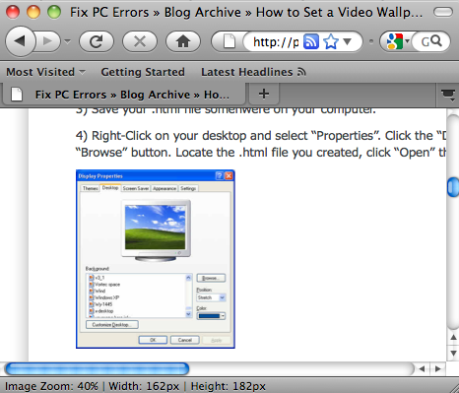
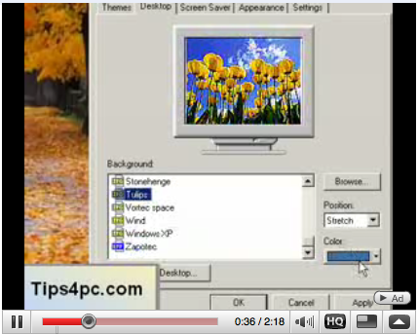

Slide 3
1’23”
Auto-forward to the relevant video segment
Auto-scroll to the relevant screenshot

Slide 4
resolution
Search
You can adjust the resolution by moving the slider ...

