Slide 1
Browse
http://youtu.be/_OBlgSz8sSM?t=15s

Slide 2
config
MIN SCORE
0.6

Slide 3
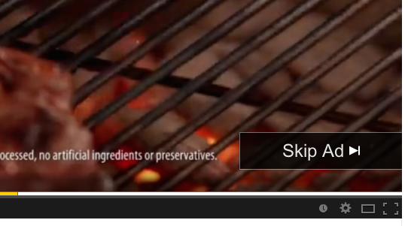
optional
click

Slide 4
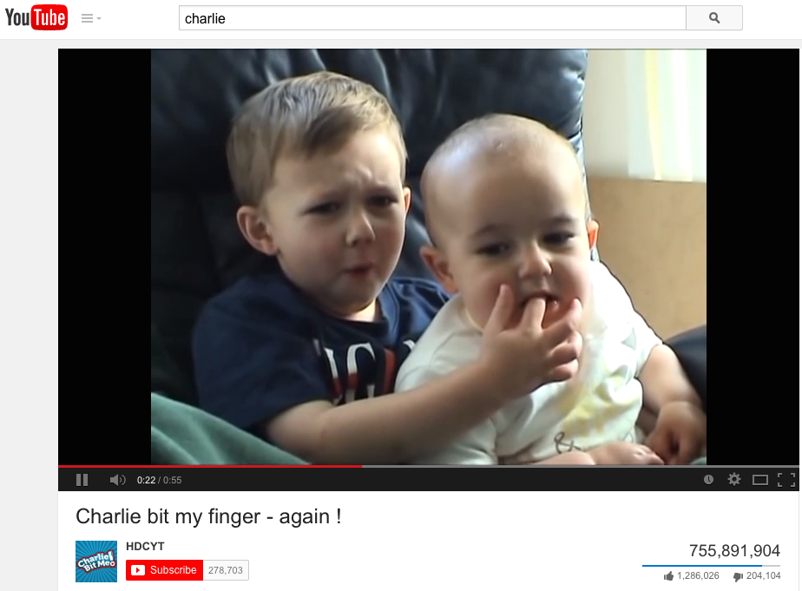
wait

Slide 5
Ouch!

Slide 6

click

