Slide 1
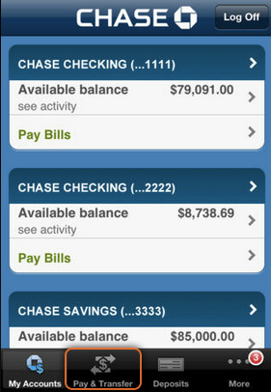
my
pay
deposit
more

