Slide 1
config
PARAMETERS
amount1
24913
amount2
91232

Slide 2
Browse
http://www.xe.com/currencyconverter/#converter

Slide 3
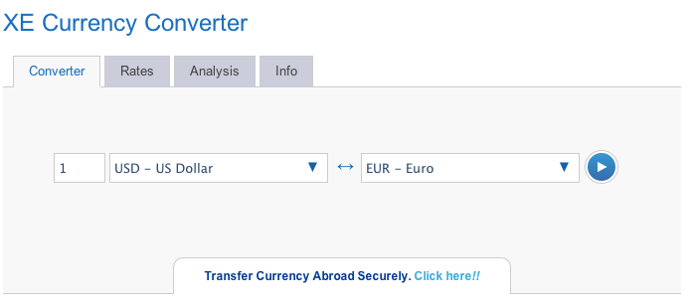
wait

Slide 4
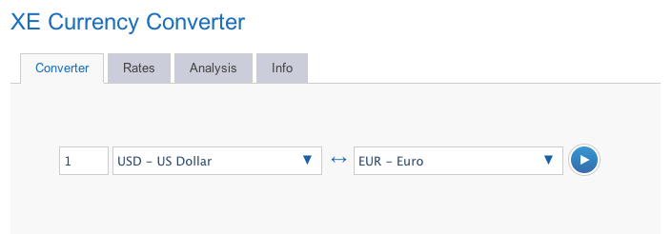
type <amount1>

Slide 5
click

Slide 6
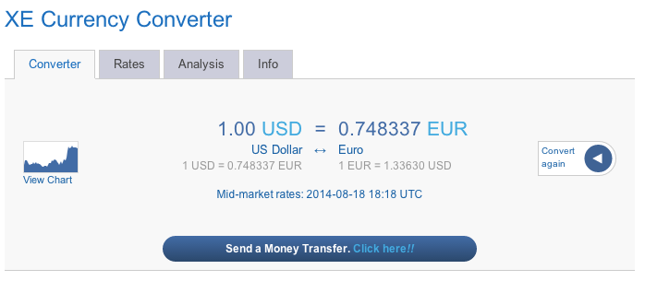
click

Slide 7
type <amount2>

Slide 8
click

