Slide 1
Browse
https://twitter.com/TheEllenShow/status/440322224407314432/photo/1

Slide 2
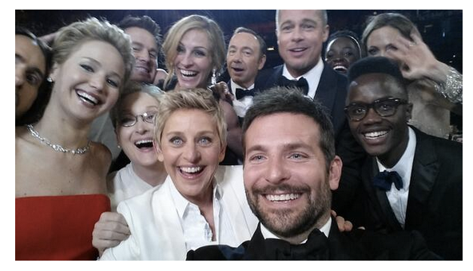
Jennifer
Kevin
Ellen

Slide 3
Brad
Julia
Bradley

Slide 4
Angelina
Jared
Meryl

