Slide 1
Browse https://www.healthcare.gov/

Slide 2

First step
click

Slide 3

click
Second step

Slide 4
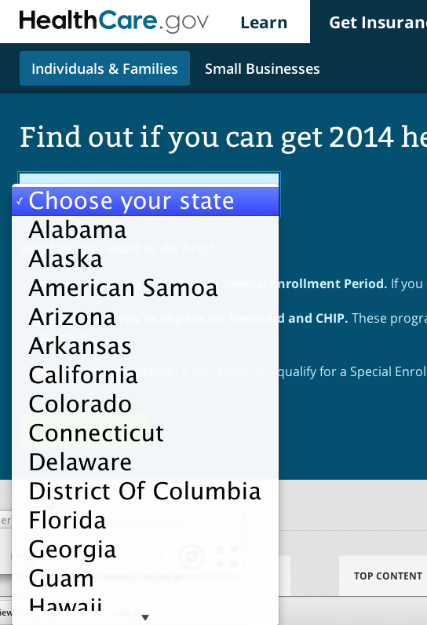
click

Slide 5
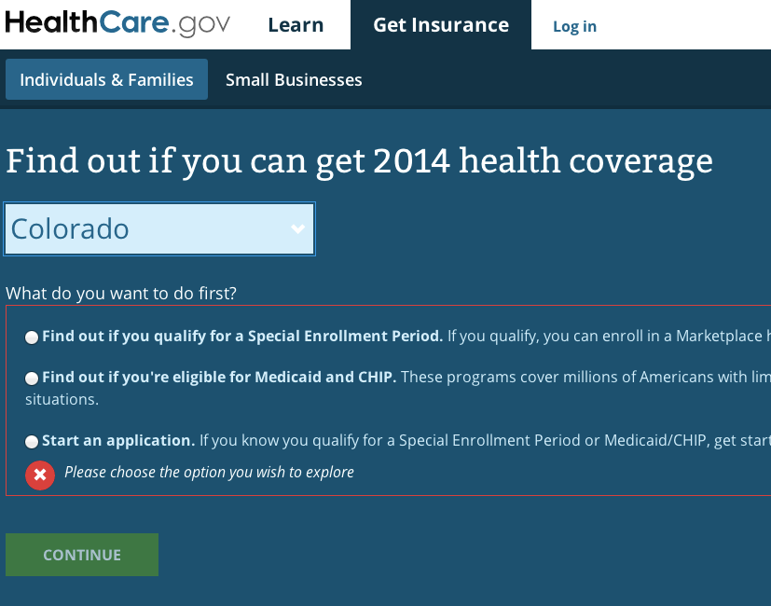
Third step
click

Slide 6

click
Final step

