Slide 1
Browse
http://www.kongregate.com/games/Ironhidegames/kingdom-rush

Slide 2
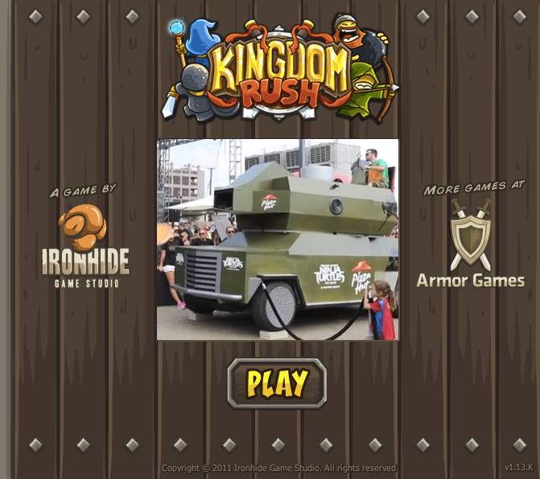
wait

Slide 3
click

Slide 4

wait

Slide 5
click

