Slide 1
Browse
https://twitter.com/search-home

Slide 2
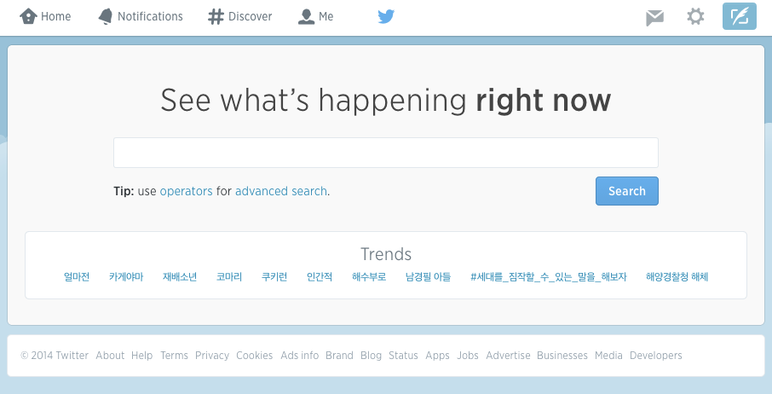
type sikuli[ENTER]

