Slide 1
Open http://www.un.org/en

Slide 2
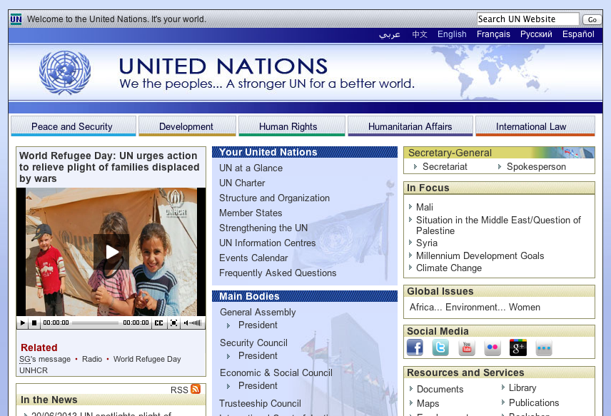
Click
Hello United Nations!

