Slide 1
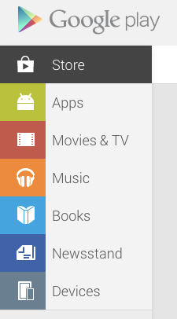
logo
apps
movies
music
books

