Slide 1
Active localization
Plans for a few demos

Slide 2
Many-door example*
Objective
  Testing accuracy of algorithms
  Bayes filtering results as ground truth
*inspired by the three-door problem in Probabilistic Robotics

Slide 3
Many-door example
Map1
  Doors distributed on a finite section of real line
D-
0
D1
D+
D+ = 1000 cm
D- = -1000 cm
D1 = 500 cm

Slide 4
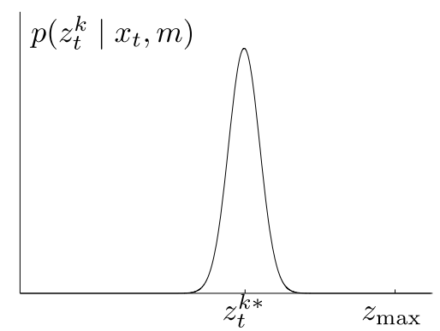
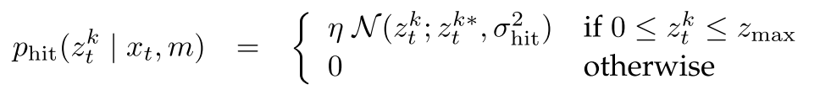
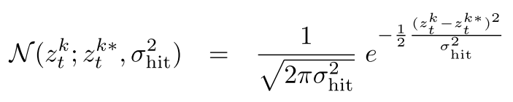
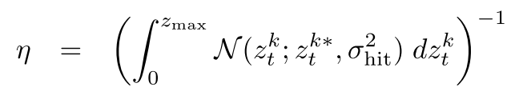
Many-door example
Measurement model
  A range finder detecting its distance to the closest door.
z
D
x
Z = abs(x-D)
*temporarily we assume zmax is infinite

Slide 5
Many-door example
Process model
  The robot can move with a constant speed
    100 cm/s
*temporarily we assume zmax is infinite

Slide 6
Many-door example
Approaches
  Bayes filter
  Greedy technique
  Candidates are within [-2000, -1900,…,1900, 2000] initially
2δ

