Slide 1
Toxic Comment Classification
Brane Warren

Slide 2
Introduction
This model will focus on using NLP (Natural Language Processing) to determine whether a comment contains toxicity or is clean and to categorize into different labels

Slide 3
Data
The data is taken from Wikipedia’s talk page edits (https://www.kaggle.com/c/jigsaw-toxic-comment-classification-challenge/)
Disclaimer: the dataset contains text that may be considered profane, vulgar, or offensive.

Slide 4
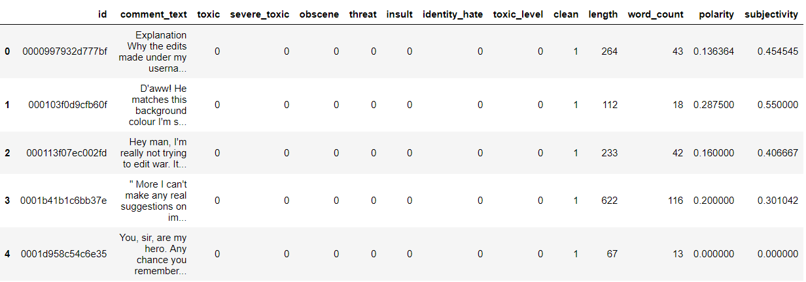
Data

Slide 5
Terms
Cancer
Data that contains either one of the label (toxic, severe toxic, obscene, threat, insult, or identity hate)
Clean
Data that didn’t have any label

Slide 6

Business Problem

Slide 7
There are a lot of conversations, comments, or text in the digital world
Internet can be easily accessed by all people with different age, ethics, nationality, etc.
There are a lot of communities in the internet that is toxic
High toxic communities will tend to make people avoid interacting with it
Reducing the time-on-apps
Impacting the revenue and popularity in bad manners

Slide 8
Target
Game’s communities chats (or any other platforms that usually have toxic audience)
Why?
Most game have toxic communities
Dead game because of toxic (+noob) players or even communities
Underaged kids join and play

Slide 9
Objective
Screening the chat contents in game (and other platform) while prioritizing the clean ones

Slide 10

Let’s move to the notebook

Slide 11

Conclusion
Model can predict clean text accurately
Moderately able to guess perfectly all the label

Slide 12
Future Improvements
Add more data (different platform, different kind of toxicity and key words)
Specify the level of punishment
Try more combination
Differentiate sarcasm
Increase recall of cancer label

Slide 13
Thank You

