Slide 1
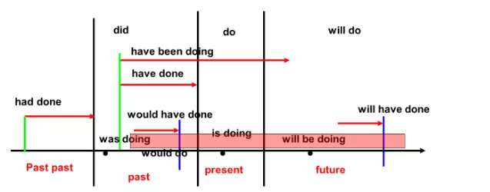
Tense

Slide 2
时 态 种 类 | 构成形式
 | 现在 | 过去 | 将来 | 过去将来
一般时态 | do/does | did | shall/will+do | should/would+do
进行时态 | am/is/are+doing | was/were+doing | shall/will+be+doing | should/would+be+doing
完成时态 | have/has+done | had+done | shall/will+have+done | should/would+have+done
完成进行时态 | have/has+been +doing | had+been+doing | shall/will+have+been+doing | should/would+have+been +doing

Slide 3
常用的有11种：一般现在时、一般过去时、一般将来时、一般过去将来时、现在进行时、过去进行时、将来进行时、现在完成时、现在完成进行时、过去完成时和将来完成时。
一、一般现在时的用法：
1. 构成：do/does
2. 常用词：常与always, often, sometimes, usually, never, seldom, every morning, in the morning, once a month, now and then等连用。
3. 用法：
①表示经常性或习惯性发生的动作，常与常用词连用。
I usually get up at six o’clock. 我通常六点钟起床。
He goes to school every day. 他每天去上学。
They go to the cinema twice a month. 他们一个月去看两次电影。
②表示客观事实、真理和自然现象。
The earth moves around the sun. 地球绕着太阳转。
Knowledge is power. 知识就是力量。
It is hot in summer and cold in winter. 夏天热冬天冷。
③表示现在的特征或状态。
I live in Lianyungang. 我居住在连云港。
They are students. 他们是学生。
④表示正在进行的动作，用于倒装句中。
Look! Here comes the bus. 看！公共汽车来了。
Listen! There goes the bell. 听！铃响了。
⑤在when, before, until, as soon as, the moment等引导的时间状语从句和if, unless, even if等引导的条件状语从句中，用一般现在时表示将来。
I will go with you as soon as I finish my work. 我一完成工作就和你一起去。
If it rains tomorrow, we won’t go there. 如果明天下雨，我们就不去那儿了。
⑥一些动词用一般现在时表示按规定、计划（主要指按时刻表、日程表）或安排将要发生的动作。常见的动词有：come, go, leave, depart, start, begin, stay, return, run, arrive, open, close, take, take off等。
The plane takes off at 8 a.m. tomorrow. 飞机明天上午8点钟起飞。
The meeting begins at 2:00 and ends at 5:00 in the afternoon. 会议下午两点钟开始，五点钟结束。
He comes here tonight. 他今晚来这儿。
⑦书报的标题，小说等情节介绍常用一般现在时。
Beckham Takes Football Movie Role 贝克汉姆出演足球电影。（新闻标题）

Slide 4
二、一般过去时的用法：
1. 构成：did
2. 常用词：常与yesterday, last week, two days ago, just now, the other day, in the past, in 2000, at that time等连用。
3. 用法：
①表示在过去某一时间里发生的动作或存在的状态，常与常用词连用。
I saw her in the street yesterday. 昨天在大街上我看见她了。
He went home just now. 刚才他回家了。
②表示过去经常性、习惯性的动作或状态，常与always, often, sometimes, usually, never, seldom, every day等连用。
Their children often went hungry in the old days. 在旧社会，他们的孩子经常挨饿。
He played football nearly every day last year. 去年他几乎天天踢足球。
She was always late last term. 上学期她总是迟到。
③用“used to+动词原形”或“would+动词原形”也可表示过去经常或反复发生的动作。
He used to go fishing. 他过去常常去钓鱼。
He would sit under the tree and read English every morning.每天早上他总是坐在树下读英语。
④在时间、条件状语从句中表示过去将要发生的动作。
She would ring me up as soon as she arrived. 她一到达就给我打电话。
They would come if we promised to wait for them. 如果我们答应等他们，他们会来的。
⑤一般过去时可与today, this week, this month等时间状语连用。
I met him today. 今天我遇见他了。
He came here late twice this week. 本周他迟到两次。

Slide 5
现在进行时的用法：
1. 构成：am/is/are+doing
2. 常用词：常与now, right now, at present, at the moment, for the present等连用。
3. 用法：
①表示现在正在进行的动作，常与常用词连用。
I am talking and you are listening. 我正在讲话，你们正在听。
We are having an English class now. 现在我们正在上英语课。
She is doing her homework at present. 现在她正在做家庭作业。
②表示现阶段正在进行的动作，但说话时不一定正在进行。
The workers are building a new factory. 工人们正在新建一个工厂。
He is writing a novel. 他正在写一部小说。
③有些动词如come, go, leave, arrive, start, open, return, stay, die, lose, take off等用现在进行时表示将来。
I am coming in a minute. 一会儿我就来。
They are going there tomorrow. 明天他们要去那儿。
She is leaving for Beijing. 她要动身去北京。
④现在进行时常与always, often, usually, forever, constantly, continually, frequently, all the time等副词连用，表示反复发生的或习惯性的动作，常表示不满、厌恶、抱怨或赞赏等感情色彩。
Don’t believe him. He is always telling lies. 别相信他，他老是撒谎。
He is always thinking of others. 他总是想着别人。
The children are constantly disturbing us. 孩子们老是打扰我们。
Tom is usually leaving things about. 汤姆总是丢三落四。
⑤表示一个动作刚刚开始。
The tulip is opening. 郁金香刚刚开放。
I’m forgetting my English. 我的英语开始忘了。
⑥一些表示感觉、感情、存在、占有与从属、思考与理解等的动词通常不可以用于进行时态。
see, hear, smell, taste, feel, notice, look, appear; （感觉）
hate, love, like, fear, want, wish, prefer, refuse, forgive; （感情）
be, exist, remain, stay; （存在）
have, possess, own, contain, belong to, consist of, form; (占有与从属)
understand, know, believe, think, doubt, forget, remember（思考与理解）

Slide 6
过去进行时的用法：
1. 构成：was/were+doing
2. 常用词：常与at this time yesterday, at that time, at that moment, at 8 o’clock yesterday等连用。
3. 用法：
①过去进行时表示过去某一时刻或某一阶段正在进行的动作，常与常用词连用。
We were having a class at this time yesterday. 昨天这个时候我们正在上课。
He was watching TV at that time. 那时他正在看电视。
What were you doing at ten o’clock last night? 昨天晚上十点钟你在干什么？
②表示在过去一段时间内持续进行的动作（有时可以间歇）。
It was raining last night. 昨晚一直在下雨。
We were discussing the plan the whole morning yesterday.昨天整个上午我们一直在讨论这个计划。
③常用于介绍故事的背景。
Once an Arab was traveling in the desert. 有一次一个阿拉伯人在沙漠里旅行。
A mother crocodile was looking for food near the bank. 一条母鳄鱼在岸边觅食。
④过去进行时常与always, often, usually, forever, constantly, continually, frequently, all the time等副词连用，表示反复发生的或习惯性的动作，常表示不满、厌恶、抱怨或赞赏等感情色彩。
She was always finding fault with him. 她以前总是挑他的毛病。
He was continually asking her questions. 他总是问她问题。
⑤when引导的从句表示一个短暂的时间点, 谓语动词用一般过去时，主句用过去进行时；while引导的从句表示一段持续的时间，谓语动词用过去进行时，主句用一般过去时。
I was writing a letter when he came. 当他来时，我正在写信。
We were walking in the street when I met my old friend.当我遇见我的老朋友时，我们正在大街上散步。
While we were having supper, the light went out. 我们正在吃晚饭时，灯熄灭了。
The telephone rang while she was reading. 当她看书时，电话响了。

Slide 7
将来进行时的用法：
1. 构成：shall/will +be+doing（shall用于第一人称, will 可用于各种人称。）
2. 常用词：常与at this time tomorrow, at 8 o’clock next Sunday等连用。
3. 用法：
①表示在将来某一时间内正在进行的动作, 常与常用词连用。
I shall be seeing a friend off at this time tomorrow. 明天这个时候我将送一位朋友。
What will you be doing at 8 o’clock this evening? 今天晚上八点钟你将干什么？
②表示稍晚一点儿的安排。
In a few minutes the meeting will be going on. 几分钟后会议将继续举行。
We are studying Unit 1 this week, and next week we will be studying Unit 2.
这周我们学习第一单元，下周我们将学第二单元。
③表示对将要发生的动作的预测。
The weather report says that it will be raining when we arrive in London.
天气预报说当我们到达伦敦时天将下雨。
The train will be arriving soon. 火车很快就要到了。
④用在问句中，表示委婉、礼貌。
Will you be visiting your uncle in London? 在伦敦你将看望你叔叔吗？
When will you be coming again? 你什么时候再来？

Slide 8
现在完成时的用法：
1. 构成：have/has+done
2. 常用词：常与already, yet, just, ever, now, before, by this time, so far, recently, lately, today, this morning, up to now, all one’s life, since, “for+一段时间”,“in the past/last+一段时间”等连用。
3. 用法：
①表示过去发生的动作对现在造成的影响或结果，常与常用词连用。
I have seen the film. 我已看过那部电影了。
China has already made great progress in science and technology.
中国在科技方面已经取得了巨大的进步。
②表示开始于过去、持续到现在并可能持续下去的动作或状态。只能用于某些带有延续意义的动词。常与these days, now, up to now, today, this week, so far, since,“for+一段时间”等时间状语连用。
They have studied English for six years. 他们学英语已有六年了。
He has lived here since 1949. 自从1949以来，他一直住在这儿。
He has grown such a lot since we last saw him. 自从上次看见他以来，他已长高了许多。
Now I have finished the work. 现在我已完成工作了。
③表示过去发生过一次或多次的动作，已成为某种经验。
I have read the book many times. 我已看过那本书许多遍。
We have all played with snow and ice. 我们都玩过雪和冰。
He has been to the USA. 他到过美国。
④现在完成时还可用在时间和条件状语从句中，表示将来某时完成的动作。
I’ll go to your home as soon as I have finished my homework. 我一完成家庭作业就去你家。
If it has stopped snowing in the morning, we’ll go to the park.
如果早上停止下雪，我们就去公园。
Don’t get off the bus until it has stopped. 等车完全停下来后再下车。
Once you have promised, you must keep it. 一旦许下诺言，你务必遵守。
⑤主句是“It/This/That is the first (second…) time that…”，从句中的谓语动词用现在完成时。
It is the third time that I have visited Beijing. 这是我第三次参观北京。
⑥It/This/That is +形容词最高级+n.+that…结构，that从句中的谓语动词用现在完成时。
This is the best film that I have ever seen. 这是我看过的最好的电影。
⑦It has been/is+一段时间+since从句+did。主句常用现在完成时或一般现在时，从句用一般过去时。
It has been/is six years since I came here. 我来这儿已经六年了。

Slide 9
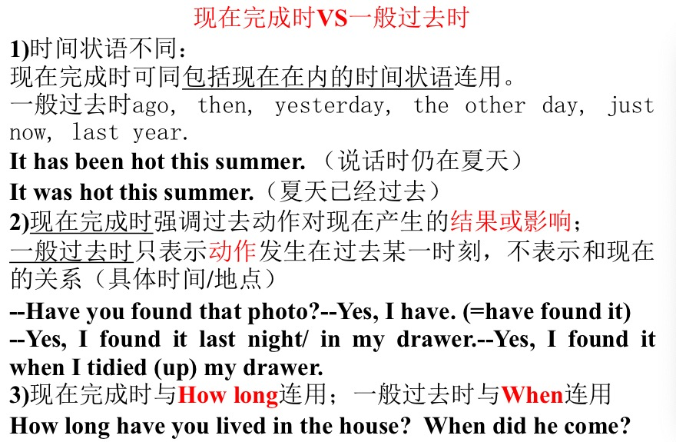

Slide 10
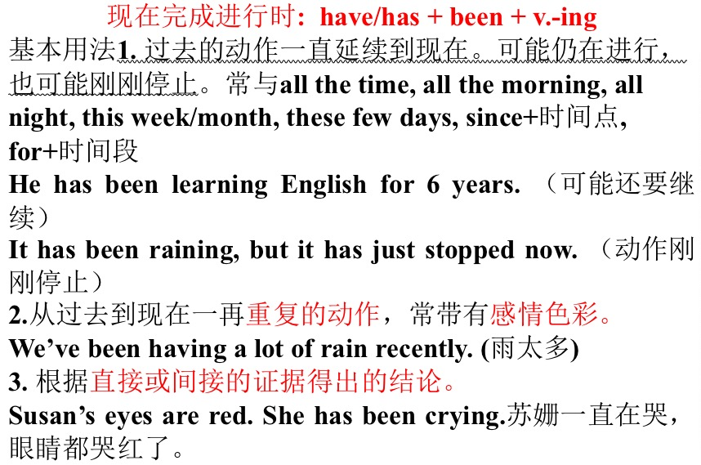

Slide 11
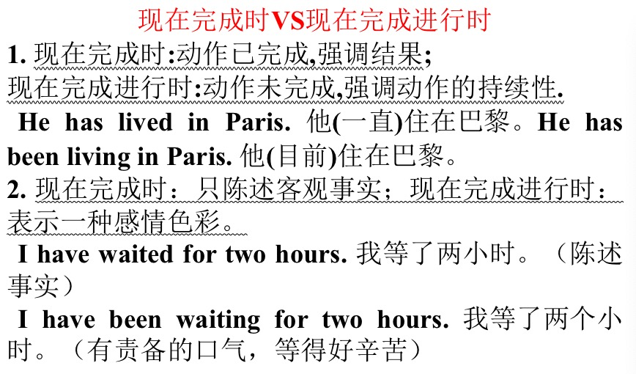

Slide 12
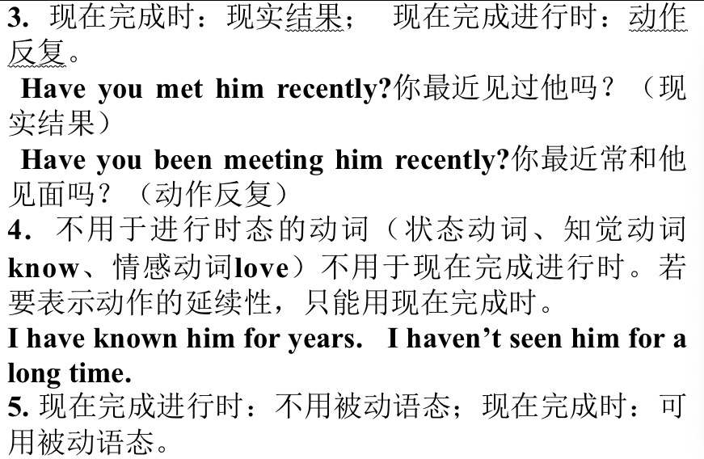

Slide 13
过去完成时的用法：
1. 构成：had+done
2. 常用词：常与“by (the end of ) +过去时间”, “by the time+一般过去时态的句子”及before,when, since等引出的短语或从句连用。
3. 用法：
①表示在过去某一时刻或动作之前就已发生的动作或存在的状态，即“过去的过去”。常与“by (the end of ) +过去时间”，“by the time+一般过去时态的句子”或以“before/until/when/than+一般过去时态的句子”连用。
We had learned 5000 English words by the end of last term.
到上学期末为止，我们已经学了5000个英语单词。
By the time we arrived there, the famous film star had left.到我们到达时，那位著名的影星已经走了。
When we got to the station, the train had left. 当我们到达火车站时，火车已经走了。
I had known about the case before I read the paper. 我在读报前就已经知道这个案子了。
It rained yesterday after it had been dried for many months.干旱了好几个月之后，昨天下雨了。
②表示从过去某一时刻开始，一直持续到过去另一时刻的动作或状态，常与for, since等引导的时间状语连用。
He told us that he had done the scientific research for five years.他告诉我们他做科研工作已经五年了。
She said she had made much progress since she came here.她说自从她到这儿后已取得了很大的进步。
③过去完成时用于“no sooner…than…; hardly/scarcely/barely…when…(一……就……)”句型中。当no sooner, hardly/scarcely/barely, 位于句首时, 需倒装。
He had no sooner gone to bed than the phone rang. 他刚一上床电话就响了。
Hardly had they got home when it began to rain. 他们刚一到家天就开始下雨了。

Slide 14
④主句是“It/This/That was the first (second…) time that…”，从句中的谓语动词用过去完成时。
It was the third time that I had visited Beijing. 这是我第三次参观北京。
⑤在句型“It was/had been+一段时间+since+从句”中，从句中的谓语动词用过去完成时。
It was/had been ten years since we had left Beijing. 我们离开北京有十年了。
⑥mean, plan, intend; hope; want; think, suppose, expect等词的过去完成时可用来表示过去未曾实现的打算、希望、意图等。意为“本打算/本希望/本想要/本以为……”，但实际上并未干。
We had meant to help them, but we were busy then.我们本打算帮助他们的，但当时我们很忙。
They had wanted to take part but couldn’t get there in time.他们原想参加的，但没能及时赶到那里。
⑦表示一种未实现的愿望或想法，常用于if引导的与过去事实相反的条件句以及wish, if only, as if, would rather等引导的与过去事实相反的从句中。
If you had worked hard, you would have passed the exam.如果你努力学习的话，你就可以通过考试了。
I wish I had come here yesterday. 要是我昨天来这儿就好了。
If only you had seen the film. 要是你看过那部电影就好了。
It looked as if time had not had any effect on him. 光阴好像一点都没有改变他。
⑧如果before引导的时间状语从句用一般过去时，主句可用一般过去时代替过去完成时；如果after引导时间状语从句，主句用一般过去时，从句可用一般过去时代替过去完成时。
John (had) left before I came home. 在我回家之前约翰就走了。
He began to write a review after he (had) watched the film twice. 看了那部电影两次后，他开始写评论。

Slide 15
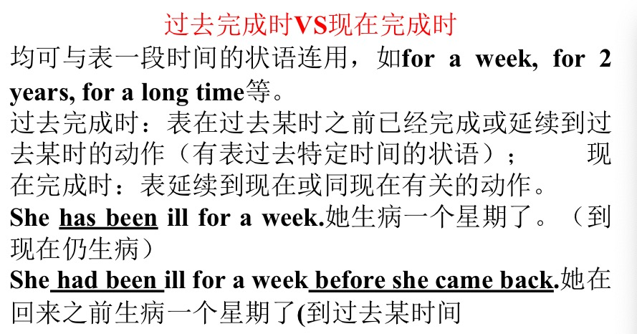

Slide 16
一般将来时的用法：
1. 构成： shall/will+do （shall用于第一人称,will 可用于各种人称。）
2. 常用词：常与tomorrow, tomorrow morning, next week, this afternoon, the day after tomorrow, in 2060等连用。
3. 用法：
①表示将要发生的动作或存在的状态，常与常用词连用。
We will visit the Great Wall tomorrow. 明天我们要去参观长城。
I will be back in a week. 一周后我将回来。
②表示将来的看法、假定或推测。常用于由think, believe, suppose, expect, know, hope, doubt, wonder, be afraid等引导的宾语从句中。
I think he will visit his teacher. 我认为他会去看望他的老师的。
We hope they will pass the exam. 我们希望他们将通过考试。
③常和时间状语、条件状语从句连用。
When it gets warmer, the snow will start to melt. 天气变暖，雪就开始融化。
If you go there, you will see him. 如果你去那儿，你将看见他。
④用于“祈使句/名词短语+and/or+陈述句”中。
Use your head, and you will find a way. 动动脑筋，你就会想出办法的。
Hurry up, or you will be late. 快点，否则你会迟到的。
One more step further, and I will beat you flat. 再往前走一步，我将把你揍扁。

Slide 17
一般将来时除了①“shall/will +动词原形”外，还有以下几种形式：
②“be (am/is/are) going to+动词原形” 表示打算、准备干某事或有迹象要发生的事。
I’m going to play football tomorrow. 我打算明天踢足球。
The play is going to be put on next week. 这部戏下周将上演。
Look at the dark clouds. It is going to rain. 看天上的乌云，要下雨了。
③ “be (am/is/are) to+动词原形” 表示计划、安排将要发生的动作。
We are to meet our professor at the station this afternoon. 今天下午我们要去火车站接教授。
Am I to wait here till their arrival? 我要在这儿一直等到他们抵达吗？
④ “be (am/is/are) about to+动词原形；be on the point of +doing”可以表示将来，表示正要干某事或即将干某事。不能与具体的时间连用，但可以和when引导的时间状语连用。即：am/is/are about to do sth. when… ; am/is/are on the point of doing sth. when…意为“正要干……这时……”。
We are about to leave. 我们即将动身。
I am about to go out when the phone rings. 我正要出去，这时电话响了。
She is on the point of leaving when I arrive. 她正要出去，这时我到了。
⑤“be (am/is/are) +doing” 这些动词有：come, go, leave, arrive, start, open, return, stay等。
I am coming in a minute. 一会儿我就来。
They are going there tomorrow. 明天他们要去那儿。
She is leaving for Beijing. 她要动身去北京。
⑥有些动词可以用一般现在时表示将来。这些动词有：be, come, go, leave, arrive, take off等。
Tomorrow is Sunday. 明天是星期天。
The meeting starts at five o’clock. 会议将于五点钟开始。
The plane takes off at five p.m..飞机下午五点钟起飞。

Slide 18
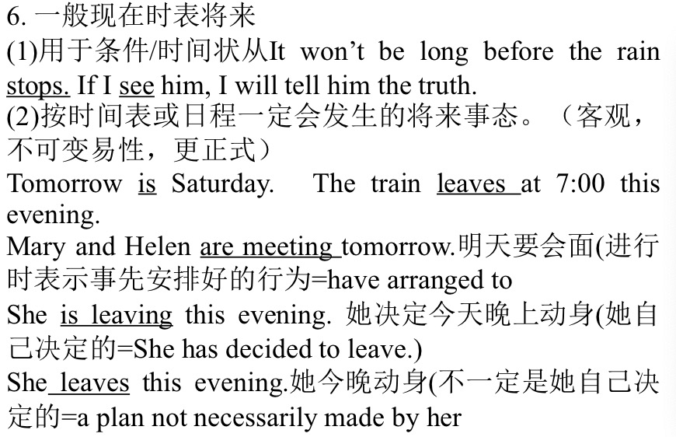

Slide 19
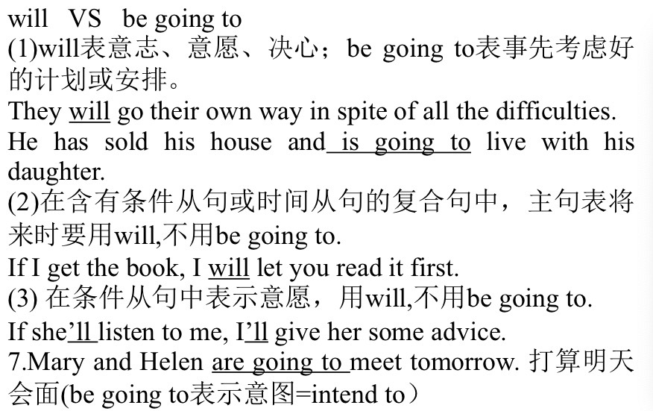

Slide 20
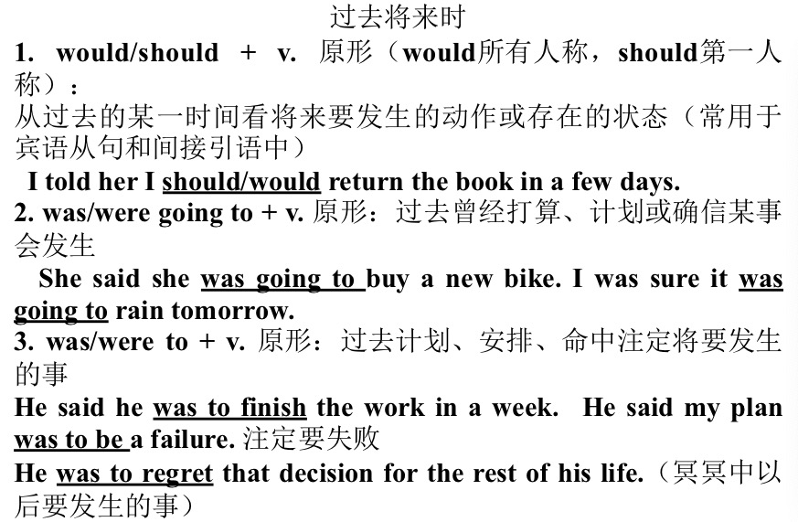

Slide 21
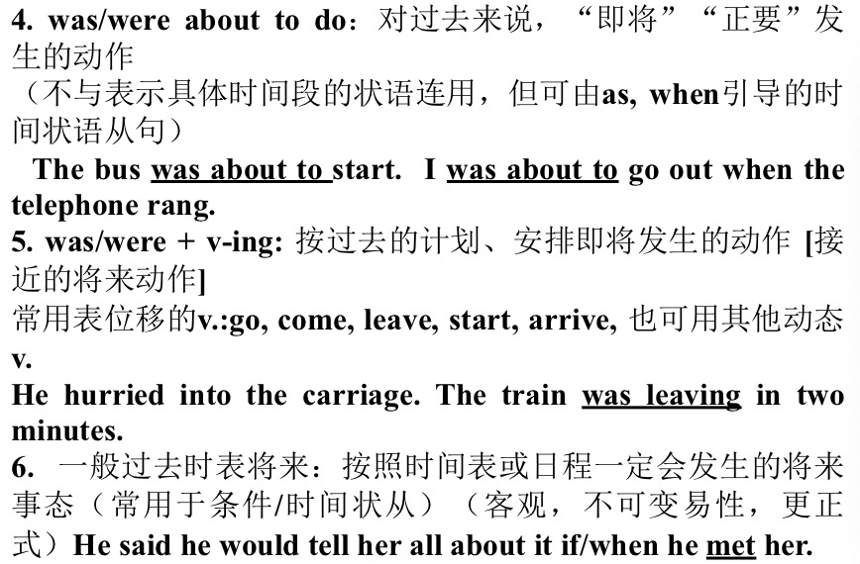

Slide 22
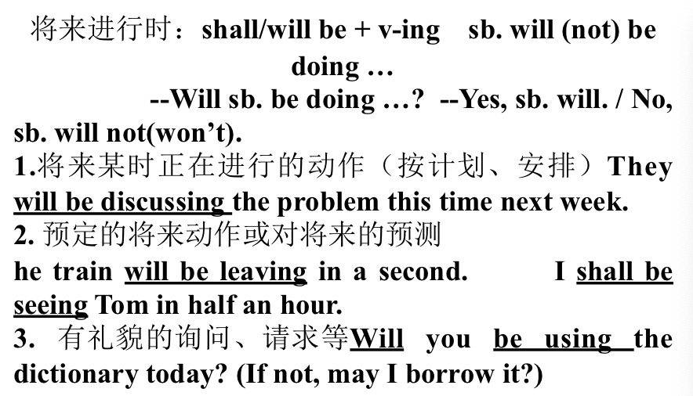

Slide 23
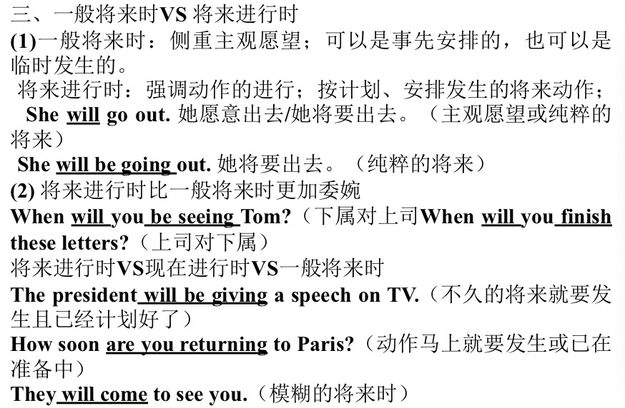

Slide 24
将来完成时的用法：
1. 构成：shall/will +have +done （shall用于第一人称, will 可用于各种人称。)
2. 常用词：常与“by (the end of) +将来时间”, ever, never, soon, before long ,when, if等连用。
3. 用法：
①将来完成时表示在将来某一时间之前完成的动作，并往往对将来某一时间产生影响，常与常用词连用。
I shall have finished reading the book by the end of this week. 我将在本周末前读完这本书。
Before long, he will have forgotten all about the matter.
不久以后，他很快就会把这件事全忘了。
②将来完成时往往可和时间或条件状语从句连用。
When I have done that, I shall have done all I was supposed to do.
我做完这件事，就做了我全部应做的事。
If you come at six o’clock, I shall not yet have finished dinner.
如果你六点钟来，我还没有吃完晚饭。
③will可用作情态动词，有“大概，料想是”等含义，有时并非表达“将要”的含义。
You will have heard the news, so I need not repeat it.
你们一定已经听到消息了，所以我就没有必要重复了。
They will have received our letter now. 他们这时一定收到我们的信了。

Slide 25
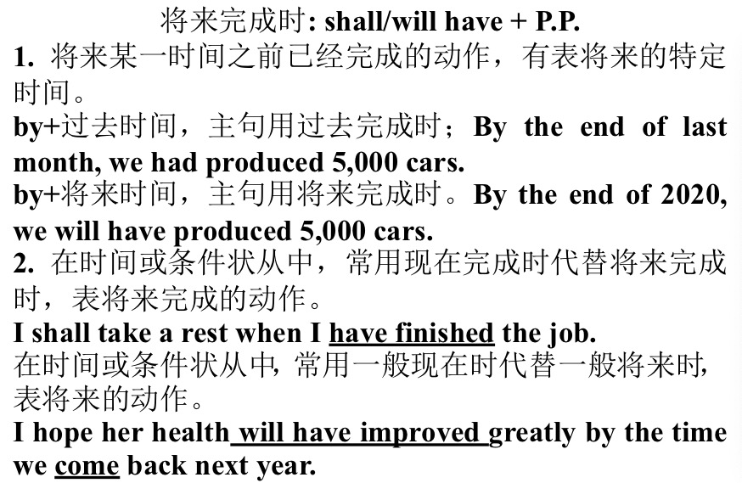

Slide 26
常见各种时态及含有情态动词的被动语态的构成：
①一般现在时：am/is/are + done You are required to do this.
②一般过去时：was/were + done The story was told by her.
③一般将来时：will/shall + be + done The problem will be discussed tomorrow.
④现在进行时：am/is/are + being + done The road is being widened.
⑤过去进行时：was/were + being + done The new tool was being made.
⑥现在完成时：have/has + been + done The novel has been read.
⑦过去完成时：had + been + done He said that the work had been finished.
⑧将来完成时：will/shall + have + been + done The work will have been finished by tomorrow.
⑨过去将来时：would/should + be + done He said that the trees would be planted.
⑩情态动词的被动语态：can/must…+ be + done TV can be watched by us every night.

