Slide 1
CS18000: Problem Solving and Object-Oriented Programming
Prof. H.E. Dunsmore
Notes:
Welcome slide for display pre-bell.
REFLECTION NOTES
Didn’t cover sections 1.3.8 (bitwise operators) and 1.3.9 (rational numbers).
The abstraction and architecture sections were somewhat difficult to present. Need improvement.

Slide 2
Announcements
Important websites:
courses.cs.purdue.edu/cs18000 Main course site: location of all relevant information
mycourses.purdue.edu Main Blackboard site for grades (find CS18000)
my.cs.purdue.edu CS Department site for signing agreements
www.piazza.com Question site: monitored by instructor and TAs
Kindle Fire checkout: LWSN 2121
Notes:
This slide is not for presentation: Use a browser to visit each of the sites and point out relevant items.
Important Piazza note: Anonymous posts are anonymous to classmates only; you are still known to instructor and TAs.
Get out your iClickers, we’ll be using them in a few minutes.

Slide 3
Problem Solving
Examples
Assemble a bookcase: directions
Bake a cake: recipe
Algorithm:
Step-by-step series of instructions to solve a problem
Abstraction:
The creation of a concept from specific examples
Notes:
Baking a cake and assembling a book case are problems. A recipe and directions are algorithms to solve those problems.
What is to the left of the : is a problem; to the right is a way to solve that problem. These “ways to solve problems” are called “algorithms”.
From these examples we define the term algorithm.
This process--considering examples, then generalizing--is the foundation of abstraction (and a key component of computer science, as I said).

Slide 4
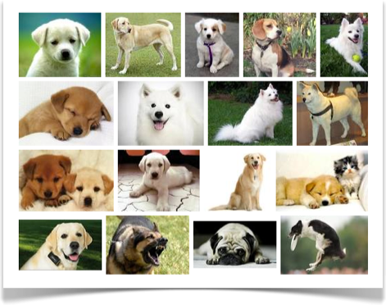
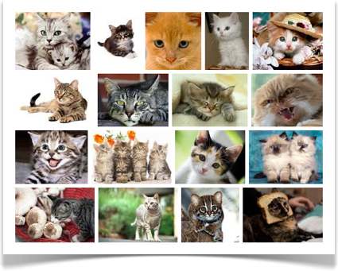
Dog
Cat
Notes:
Abstraction is a way that humans deal with complexity.
Abstraction is applied throughout programming and is one of its most creative aspects.
Next, we’ll consider another problem…

Slide 5
Problem: Buying a Computer
Computers have many different components
Use abstraction to understand essential properties
Notes:
The textbook uses an overarching problem to motivate the concepts of each chapter. This chapter is about some of the fundamental computing concepts—computer architecture, binary arithmetic, problem solving using abstraction—we’ll examine these concepts in the context of buying a new computer.
First abstracting from the overwhelming details of computers in the marketplace…

Slide 6
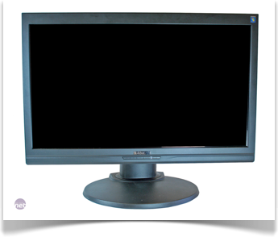
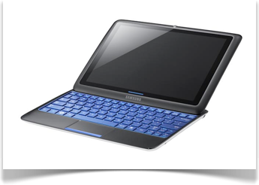
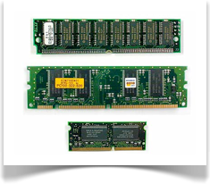
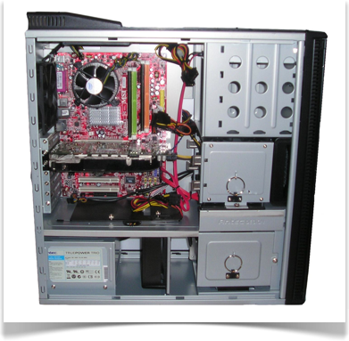
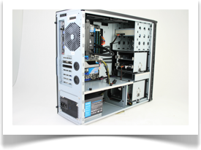

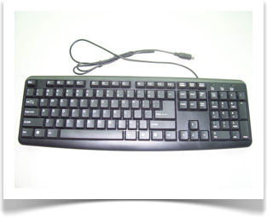
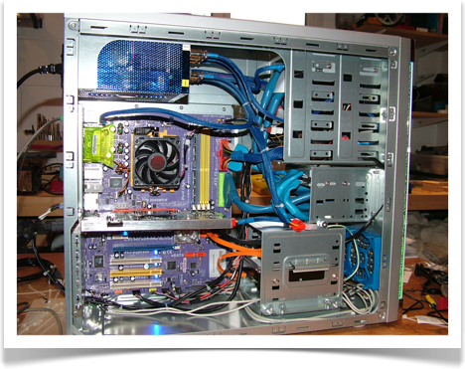
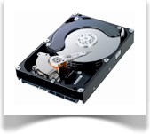
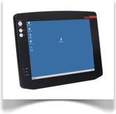
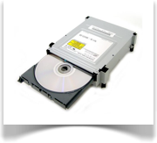
Notes:
Computer vendors have created a large number of product variations. Our first task is to create a framework that identifies the commonalities and gives us a basis for comparison.
We use abstraction…

Slide 7
Abstraction
Notes:
The three main components: I/O, CPU, Memory. Relate each to the pictures and to one another.
Input devices pictured: keyboard, mouse
Output devices pictured: computer monitor, tablet display
CPUs pictured: chips on motherboards
Memory pictured: memory chips in upper right, storage disks in lower right

Slide 8
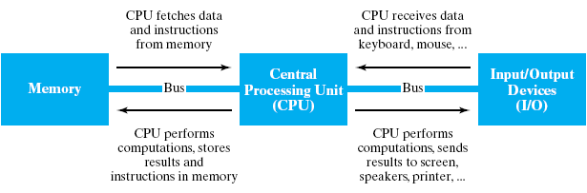
Von Neumann Architecture
Although specific components may vary, virtually all modern computers have the same underlying structure
known as the von Neumann architecture
named after computer pioneer, John von Neumann
The von Neumann architecture identifies 3 essential components
Input/Output Devices (I/O) allow the user to interact with the computer
Memory stores information to be processed as well as programs (instructions specifying the steps necessary to complete specific tasks)
Central Processing Unit (CPU) carries out the instructions to process information
Notes:
A key concept of present-day computers is the “von Neumann architecture”, in which both data and program instructions are stored in memory accessible to the CPU. This architecture originated in the late 40s. Before that time, computers were controlled by an external program that required an operator to manually set up or configure, e.g., plug board or paper tape.
Allowing a computer to “create its own program” brought a kind of full-circle completeness or generality to computing. It allowed programs that wrote programs and is the basis of (among many other things) the way high level languages like Java work.
The CPU is made up of one or more “cores”, which do the actual computation of the CPU. These are where numbers are add and subtracted, and decisions are made. Each core is able to execute an independent stream of instructions. One core might be updating the images on your screen while another core is processing data that is arriving over the network.
Multicore processors are the basis of concurrent computing. Each core can only do one thing at a time, but by breaking your problem down into independent pieces, you can have multiple cores working on different pieces of your problem simultaneously. When you buy a computer, generally the more cores it has the faster it will be able to complete independent computing tasks.
The CPU cores access memory for both data and instructions. The size and speed of memory are important considerations in buying a computer. While manufacturers have been successful in making memories larger and larger, larger size memory typically runs slower. So, hardware designers use memory caching to temporarily store data and program instructions that are “currently” being used.
The size of the memory cache is important although often overlooked in consumer-grade computers.
In the diagram, you see primary memory made up of cache and RAM. RAM is “random access memory”, so named because the CPU can access any memory location just as fast as any other memory location. It is, perhaps, a funny way to make this point. We’re not going to actually access the memory at random, but there is no penalty associated with fetching data from one location one instant and a far away location a different instant. This situation is in contrast to sequential access memory, typical of secondary storage like disk drives. Reading data from a disk requires moving a read head over a particular piece of the disk. If the head has to move a long distance, it takes more time than if the head moves only a short distance. So, sequential access memories are most efficiently accessed sequentially rather than randomly.
Another characteristic of the CPU is the frequency at which it runs. The details are complicated, but essentially the frequency of a CPU is proportional to the number of instructions it can execute per second. CPU speeds have topped out in recent years due to fundamental limitations of physics, so vendors now compete on other features, like number of cores and cache size.
Peripherals are typically plugged in to a “bus”, a hardware device that allows the CPU to communicate with several attached peripherals through a single mechanism. Note in example: USB for connecting mouse, keyboard, and printer; PCI (peripheral component interconnect) express for connecting graphics and sound cards.

Slide 9
Comparing Computers
What is the CPU like (cores, cache)?
How fast is it (frequency)?
Memory and storage (b, B, KB, MB, GB, TB)?
What peripherals? Keyboard, mouse, display, graphics card
Notes:
Summary of the previous discussion…
Cores: how many does it have? Generally, more is better.
How big are the caches? Sometimes you have to dig for this information. Expensive servers generally have larger, faster, and more expensive caches. Cheap caches are the hallmark of cheap computers.
What is the clock frequency? These numbers don’t compare across architectures (or vendors) since the number of cycles required to do a instruction is likely different. Still, it can be used to compare otherwise identical CPUs.
How much memory and storage does it have? Note that memory is typically “volatile”, meaning that it is erased when power is turned off. When the computer is off, only data on the disk is preserved. We generally use the terms “memory” and “storage” to refer to RAM and disk, respectively.
Memory and storage capacity are measured in multiples of bytes, which are themselves multiples of 8 bits. More on this in a minute. The abbreviations KB, MB, GB, and TB, refer to kilobyte, megabyte, gigabyte, and terabyte, which are a thousand, million, billion, and trillion bytes respectively. To add to the confusion, memory capacities are actually rounded up to the nearest power of 2, while storage capacities are expressed in the usual base 10 notation.
What peripherals? What do you need?

Slide 10
Memory and Storage Sizes
Unit | Size | Bytes | Practical Measure
byte | 8 bits | 2⁰ = 1 = 10⁰ | A single character
kilobyte (KB) | 1,024 bytes | 2¹⁰ = 1,024 ≈ 10³ | A paragraph of text
megabyte (MB) | 1,024 kilobytes | 2²⁰ = 1,048,576 ≈ 10⁶ | A minute of MP3 music
gigabyte (GB) | 1,024 megabytes | 2³⁰ = 1,073,741,824 ≈ 10⁹ | A half hour of video
terabyte (TB) | 1,024 gigabytes | 2⁴⁰ = 1,099,511,627,776 ≈ 10¹² | 80% of a human’s memory capacity
Notes:
This slide is to give you a sense for different memory and storage capacities, and how the numbers are computed.
The human memory capacity estimate is from Ray Kurzweil, futurist and promoter of the “singularity” concept—the point at which computers become more intelligent than humans. (The singularity is analogous to a black hole singularity—we cannot predict what it will be like since we have no basis for judgment.)
Good things to know: 2^10 is about a thousand and 2^20 is about a million.
Note that 2^32 is about 4 GB, which is the (directly-addressable) address space limitation for 32-bit computers.

Slide 11
Data Representation
Number systems
Decimal
Binary
Hexadecimal
Conversions
Integer vs. Floating Point
Notes:
[This topic is covered in detail and from a slightly different angle next week. It is included here to reinforce the buying a computer discussion and to provide background for future topics.]
We’re going to take a diversion for a few minutes to talk about number systems. This material will be review for some of you and new to some of you. I’ll go through it fairly quickly with some examples. The text includes more detail and we’ll take up the topic more as needed.
Use chalkboard to show.

Slide 12
Number Systems
Positional numbering
Value of a digit is related to the distance of its position from the decimal point
The system has a base, e.g., 2, 8, 10, or 16
Each position multiplies or divides value by the base

Slide 13
Examples
In decimal:
352 = 3 x 10^2 + 5 x 10^1 + 2 x 10^0
352 = 3 x 100 + 5 x 10 + 2
In binary:
1110 = 1 x 2^3 + 1 x 2^2 + 1 x 2^1 + 0 x 2^0
1110 = 1 x 8 + 1 x 4 + 1 x 2 = 14
In hexadecimal:
3F = 3 x 16^1 + Fx16^0
3F = 3 x 16 + 15 x 1 = 48 + 15 = 63
Notes:
These examples also illustrate conversion from binary and hex to decimal—just by expanding the notation.
To convert from decimal to other bases, see next slide…
[OCTAL WOULD MAKE AN EXCELLENT TEST QUESTION]

Slide 14
Conversions
Algorithm:
Divide number by base
Prepend remainder to the result string
Replace number by quotient
Repeat until quotient is zero

Slide 15
Example
42 to base 2:
42 / 2 = 21 + 0 remainder
21 / 2 = 10 + 1 remainder
10 / 2 = 5 + 0 remainder
5 / 2 = 2 + 1 remainder
2 / 2 = 1 + 0 remainder
1 / 2 = 0 + 1 remainder
Answer: 101010
Notes:
Read the remainders from bottom to top to get the digits from left to right.

Slide 16
Finite Precision
Computers store numbers using bits (base 2)
Bits organized into bytes (8 bits)
Bytes organized into words, typically
4 bytes or
8 bytes
4 bytes = 32 bits
8 bytes = 64 bits
So, can only represent integers that “fit” into that many bits
And, what to do about negative numbers?
Notes:
How many ways are there to set 32 bits? 2 x 2 x 2 x … x 2 (32 times) = 2^32 = about 4 GB or 9 decimal digits

Slide 17
Interpreting Bits
3-bit Word | Unsigned Interpretation | Unsigned N-bit Generalization | Signed Interpretation | Signed N-bit Generalization
000 | 0 | 0 | 0 | 0
001 | 1 |  | 1
010 | 2 |  | 2
011 | 3 |  | 3 | 2^{N-1} - 1
100 | 4 |  | -4 | -2^{N-1}
101 | 5 |  | -3
110 | 6 |  | -2
111 | 7 | 2^{N} - 1 | -1 | -1
Notes:
Create this table on the chalkboard a column at a time.
For the signed interpretation, begin by blocking the upper and lower halves of the table based on leading sign bit into positives and negatives.
Q: Signed positive interpretation is easy, but why do the negative values go “backwards”?
A: It simplifies hardware arithmetic. Covered in a later course.
Note that the column “Unsigned Interpretation” can be interpreted as octal numbers. Sometimes a sequence of bits are shown using octal numbers by grouping them in threes and replacing with 0-7.

Slide 18
4-bit Word | Unsigned Interpretation | Unsigned N-bit Generalization | Signed Interpretation | Signed N-bit Generalization
0000 | 0 | 0 | 0 | 0
0001 | 1 |  | 1
0010 | 2 |  | 2
0011 | 3 |  | 3
0100 | 4 |  | 4
0101 | 5 |  | 5
0110 | 6 |  | 6
0111 | 7 |  | 7 | 2^{N-1} - 1
1000 | 8 |  | -8 | -2^{N-1}
1001 | 9 |  | -7
1010 | 10 |  | -6
1011 | 11 |  | -5
1100 | 12 |  | -4
1101 | 13 |  | -3
1110 | 14 |  | -2
1111 | 15 | 2^{N} - 1 | -1 | -1
Notes:
Possibility: Add a column after “unsigned interpretation” for hexadecimal, explaining that 10-15 are represented as A-F.

Slide 19
Sign Bit
The left most bit of a word is the “sign bit”
0 -> positive
1 -> negative
Representation is called “two’s complement”
Positive numbers get leading 0s to word size
Negative numbers:
Convert positive value to binary
Flip all bits (0 <-> 1)
Add one
Notes:
Maybe should say the the leftmost bit can be interpreted as the sign bit. Some operations are signed, others are unsigned.

Slide 20
Example
Convert -42 to binary using an 8-bit “word”
42 = 101010
Fill to 8 bits = 00101010
Flip bits (one’s complement) = 11010101
Add one (two’s complement) = 11010110
Useful site: http://planetcalc.com/747/

Slide 21
Useful Consequences (Summary)
Largest (signed) positive number that can be stored in N bits is N-1 1s
= 2^{N-1} - 1
Example for 8 bits: 01111111 = 127
Largest negative number that can be stored in N bits is a 1 followed by N-1 0s
= -2^{N-1}
Example for 8 bits: 10000000 = -128
Notes:
[OTHER OUTSTANDING TEST QUESTIONS CAN COME FROM THIS SLIDE]

Slide 22
What Could Go Wrong?
Overflow
Sum of two positive numbers is “too positive”
Example: 127 + 1 in eight bits
Underflow
Difference of two numbers is “too negative”
Example: -128 – 1 in eight bits
Warning: Java ignores (quietly) overflow and underflow

Slide 23
Why is This Relevant?
Underlying hardware characteristics…
Bits, bytes, word length
Memory addresses (32-bit or 64-bit numbers)
…determine characteristics visible to computer buyers and programmers…
Available memory sizes
Properties of numerical operations
UNIX file protection properties as octal numbers
WWW colors as hexadecimal numbers
Notes:
Recall 2^32 is about 4GB. This limitation impacted Microsoft Windows and other operating systems, spurring the move to 64-bit hardware and 64-bit operating systems, to take advantage of larger memory sizes.

Slide 24
Dealing with Eight Bits
Number | View
00101010 | Binary (ugh)
42 | …Decimal (nice, but clumsy for bits)
0010 1010 | Use two groups of four to create…
2A | …Hexadecimal
00 101 010 | Or, groups of three to create…
052 | …Octal

Slide 25
Abstraction
Classes
Objects
Methods
Variables
Constants
Notes:
One of the main activities of computer scientists is creating abstractions: representations or models of the real world that distill the complexity of a “real” problem into something simple and elegant that captures the essence of the problem.
A primary approach to this abstraction process is using tools of object-oriented programming, the subject of this course.

Slide 26
Compute the circumference of a wheel with a 15” radius
2 * 3.14159 * 15
2 * PI x 15
f(x) = 2 * PI * x
Notes:
Motivating problem: Compute the circumference of a wheel with a 15” radius.
This example is done interactively using DrJava, first in calculator (interactions) mode, then by writing a Wheel class. Final result is on the next slide.

Slide 27
Wheel Class
public class Wheel {
double radius;
Wheel(double radius) {
this.radius = radius;
}
double getCircumference() {
return 2 * Math.PI * radius;
}
double getArea() {
return Math.PI * radius * radius;
}
double getRadius() {
return radius;
}
}

Slide 28
Software Development Lifecycle
Understand the problem
Design a solution
Implement the solution
Test the solution
Maintenance
Notes:
The creation of Abstractions generally spans steps 1-3 of the lifecycle, with language-specific abstractions used in step 3.

Slide 29
How is Software Written?
Programming language
high level language (complex statements)
assembly language (very simple instructions)
machine language (1s and 0s)
Compilers and interpreters
Integrated Development Environments (IDEs)
Allow editing of program files
Allow compiling, executing, and debugging programs
Notes:
Humans communicate in natural languages. However, natural languages are subtle, nuanced, and ambiguous—they are not appropriate for precise specification of an algorithm.
Compilers and interpreters allow programming to be done in high level languages rather than assembly or machine language.
IDEs allow these functions all in a single app.

Slide 30
Program Translation
Notes:
HIDE THIS SLIDE FOR LECTURE—UNHIDE TO PRINT NOTES

Slide 31
Tools for Abstraction
Object-Oriented Programming (OOP) is one way
Class
Gives a name to the abstraction and creates a template for objects, which are instances of the abstraction
Examples: Wheel, Robot, Car, Chair
Includes variables and methods that define the details of the abstraction
Variable
Names and stores a quantity
Examples: radius, name, speed, color
Method
Names and defines an operation on a class or object
Examples: getArea, speak, accelerate, eject
Notes:
Hold on to your socks—this slide introduces a lot of vocabulary—it will take several passes, examples, and problems for you to absorb them fully.

Slide 32
Simple Programs
Programs
Assignments
Simple Input and Output

Slide 33
Class vs. Program
Last time…
We saw a class (Wheel) only
This time…
Add “main” method
Program execution starts (and often ends) here
Using the command line
Edit, compile, run (IntelliJ, javac, java)
See the byte code (javap –c)
Examples: Robot.java and Calculator.java

Slide 34
Wheel Class (reminder)
public class Wheel {
double radius;
Wheel(double radius) {
this.radius = radius;
}
double getCircumference() {
return 2 * Math.PI * radius;
}
double getArea() {
return Math.PI * radius * radius;
}
double getRadius() {
return radius;
}
}
Notes:
Robot.java is coming up next. Start with empty class, add speak method, then add main method to call speak.

Slide 35
Robot.java
public class Robot {
void speak(String message) {
System.out.println(message);
}
public static void main(String[] args) {
Robot r = new Robot();
r.speak("hello world");
}
}
Notes:
Optional: Add field “name” for the name of the robot. Add constructor and modify the speak method to include the name of the robot.

Slide 36
Calculator.java
public class Calculator {
int add(int x, int y) {
return x + y;
}
int subtract(int x, int y) {
return x - y;
}
public static void main(String[] args) {
Calculator c = new Calculator();
System.out.println(c.add(3, 5));
System.out.println(c.subtract(3, 5));
}
}
Notes:
Redirect the output from this program to a file to show later with od.

Slide 37
Java Basics
Program structure
Top-level class
Name of class is name of file (with .java extension)
Example: class Robot in Robot.java
One or more methods
Program execution begins at main
Command line input and output
Scanner class [not seen yet]
System.out.println(…)
Notes:
They’ve learned most of this—need to introduce input and Scanner.

Slide 38
Syntax Details
// or /* */ for comments
White space ignored (delimits tokens)
Semicolon (;) to end or separate statements
Curly braces ({}) to group statements
Some words are “reserved” and cannot be used for variable, method, or class names
import statement gives access to other classes

Slide 39
Talk Like a Computer Scientist
Symbol(s) | Phrase
{ } | “open/close curly [brace]”
< > | “open/close angle bracket” or “input from/output to” (UNIX)
[ ] | “open/close [square] bracket”
#! | “pound bang” or “sh’bang” (UNIX) (Twitter popularized “hash tag” for #)
/ | “slash” (never “forward slash”)
\ | “backslash” (never “slash”)
* | “asterisk” or “star” (UNIX)
( ) | “open/close paren”
| | “vertical bar” or “pipe” (UNIX)
- | “dash”
` | “back quote”, “accent grave”, or “tic”
Reference: http://ascii-table.com/pronunciation-guide.php

Slide 40
Input and Output
Files (including command line interaction)…
Stream of “bytes” (characters)
Reading requires “parsing”: converting the bytes to internal representations (e.g., a string of digits to binary)
Writing requires “formatting”: converting from internal representations (e.g., binary to a string of digits)
Complete I/O system is complicated in Java—deferred to later in the course
Notes:
Draw picture on board: Show characters, then parse by finding a space that marks the end of a number, for example.
In UNIX, use od -a Wheel.java to show the character-by-character contents of a file. Also, create and show a simple file with a few numbers in it. Use output file from redirecting Calculator run to a file.
REFLECTION: I didn’t get to use od yet; would have been helpful, but ran out of time.

Slide 41
System Class
Has field members (variables) that reference the “standard input” and “standard output” files of the running Java program
In command-line systems (e.g., UNIX shell), these “files” can be the keyboard and display, or redirected from disk files or other programs
System.in: input stream
System.out: output stream

Slide 42
Parsing Input
class Scanner
To read from standard input, create a Scanner object and use its methods:
Scanner s = new Scanner(System.in);
int i = s.nextInt();
double d = s.nextDouble();
String s = s.nextLine();

Slide 43
Calculator.java
import java.util.Scanner;
public class Calculator {
int add(int x, int y) {
return x + y;
}
int subtract(int x, int y) {
return x - y;
}
public static void main(String[] args) {
Calculator c = new Calculator();
Scanner scanner = new Scanner(System.in);
int x = scanner.nextInt();
int y = scanner.nextInt();
System.out.println(c.add(x, y));
}
}
Notes:
Redirect the output from this program to a file to show later with od.

Slide 44
Java Formatting Notes
Naming conventions
Variables: lowerCamelCase
Classes: UpperCamelCase
Symbolic constants: UPPER_CASE
Open curly at end of line
Use consistent indentation (e.g., 4 blanks)
Complete documentation on course website

Slide 45
GUI Input and Output
If your Java program is running in a windowed environment, you can use the GUI (“graphical user interface”) for input and output
class JOptionPane methods
showInputDialog: prompt user for string (input)
showMessageDialog: display string to user (output)
Notes:
REFLECTION: Didn’t get to these next slides (ran out of time), but included them in the notes. Need a sample example here. Must import javax.swing.JOptionPane.

Slide 46
Method showInputDialog
String question = "What is your favorite color?";
String inputTitle = "Enter Input";
String answer = JOptionPane.showInputDialog(null,
question,
inputTitle, JOptionPane.QUESTION_MESSAGE);

Slide 47
Method showMessageDialog
String answer = "The answer is 42.";
String title = "Output Window";
JOptionPane.showMessageDialog(null,
answer,
title, JOptionPane.INFORMATION_MESSAGE);

Slide 48
How to Read an Assignment (1)
When the assignment says, “Create a class Henway…”
Create a file Henway.java that starts with this template...
public class Henway {
}
Note capitalization. Case matters!
Compile—you should get no errors. If you run it, you will get an error (why?)
Notes:
REFLECTION: Didn’t get to these slides either, but the students need them to help with reading the homework problems.

Slide 49
How to Read an Assignment (2)
When the assignment says, “Write a Java program named Henway…”
Create a file Henway.java that starts with this template...
public class Henway {
public static void main(String[] args) {
// Program execution begins here
}
}
Note capitalization. Case matters!
Compile and run—you should get no errors (and no output!)

Slide 50
How to Read an Assignment (3)
When the assignment says, “Read from standard input…”
At the beginning of the file (before “public class …”), insert…
import java.util.Scanner;
At the beginning of the main method (for example), insert…
Scanner scanner = new Scanner(System.in);
To read an integer and store it in variable x, use…
int x = scanner.nextInt();

