Slide 1
Writing an AngularJS plugin for Horizon
Douglas Fish, Advisory Software Engineer, IRC: doug-fish
Neela Shah, Senior Software Engineer, IRC: neela_shah

Slide 2
Agenda
AngularJS Plugin Overview
Workshop Overview
AngularJS Plugin Basics
AngularJS Basic Plugin Structure
Lab 1: Hands On - AngularJS panel (empty) plugin
Helpful Development Tools and Tips
Lab 2: Hands On – Modify table content of a panel
AngularJS and service interactions
Lab 3: Hands On – Add a row action to a table
Devstack Plugin
Horizon plugin registry
LBaaS v2 dashboard plugin
References

Slide 3
AngularJS Plugin Overview
Plugins extend and add functionality that already exists.
Allows control of content and progress independent of Horizon.
Deployers can selectively install features.
Horizon dashboard moving to AngularJS – Work in progress
Launch instance wizard, images, swift
Recommend new plugins to be written in AngularJS
AngularJS plugins can be bleeding edge
Potential impacts from horizon changes in Angular
Stay connected with the horizon community, IRC channel #openstack-horizon

Slide 4
AngularJS Plugin Basics
Create an appropriate repository
Meaningful name examples
xxx-dashboard, xxx-ui, xxx-horizon.
The infra team considers repos with these suffixes as Django projects.
A collection of JavaScript files or static resources.
Need to place all of our static resources inside the “static” folder.
This ensures that the Django static collector picks it up and distributes it to the browser correctly.

Slide 5
Workshop Overview
Assumes you did pre-lab setup per-
https://github.com/doug-fish/sample-horizon-angular-plugin/blob/master/README.rst
Setup will take a few mins!
Code Perspective
Unique to Angular plugin in Horizon
Not included in workshop
Unit testing
How to integrate plugin into the infra project
Translation Process
Packaging

Slide 6
AngularJS Basic Plugin Tree
^{├──sample_dashboard}
^{│ ├──dashboards}
^{│ │ ├──__init__.py}
^{│ │ └──project}
^{│ │ ├──__init__.py}
^{│ │ └──sample}
^{│ │ ├──__init__.py}
^{│ │ ├──panel.py}
^{│ │ ├──templates}
^{│ │ │ └──sample}
│ │ │ └──index.html
^{│ │ ├──urls.py}
^{│ │ ├──views.py}
^{│ ├──enabled}
│ │ ├──_1485_project_network_sample_enabled.py
^{│ │ └──__init__.py}
^{│ ├──__init__.py}
^{│ └──static}
^{│ └──dashboard}
^{│ └──project}
^{│ └──sample}
^{│ ├──network}
│ │ └──table.html
│ ├──sample.module.js
│ └──sample.module.spec.js

Slide 7
AngularJS Basic Plugin Structure
Note: To follow along locally - git checkout lab-1
Enabled file (﻿_1485_project_network_sample_enabled.py)
Enabled folder contains the configuration file(s) that registers your plugin with Horizon.
File is prefixed with an alpha-numeric string that determines the load order of your plugin.
The higher the alpha-numeric string the later it gets loaded (might override previous plugins).
The left navigation list is built in the order the plugins are loaded – the higher the number, the lower its position.
This is python code!
References panel.py and angular module – tells horizon where to find your code.
Describes the dashboard and panel group that the panel is added in the left navigation.

Slide 8
AngularJS Basic Plugin Structure
panel.py
Panel where the plugin content will reside.
Specifies the Panel name in the navigation.
slug - panel’s unique identifier, often use as part of the URL. Must match what you have in your enabled file.:
from django.utils.translation import ugettext_lazy as _ import horizon
from openstack_dashboard.api import neutron class Sample(horizon.Panel): name = _(”Sample") slug = ”sample”
permissions = ('openstack.services.network',)

Slide 9
AngularJS Basic Plugin Structure
urls.py
URL that users can use to visit our new panel!
URLs under the plugin’s base URL are routed using angular
URL will typically point to a view.:
from django.conf.urls import patterns
from django.conf.urls import url from sample_dashboard.dashboards.project.sample import views
urlpatterns = patterns( 'sample_dashboard.dashboards.project.sample.views',
url('', views.IndexView.as_view(), name='index'), )

Slide 10
AngularJS Basic Plugin Structure
views.py
Rendering of the index page is done server-side - view references an HTML page.
Once returned to browser, angular takes over.
from django.views import generic class IndexView(generic.TemplateView): template_name = 'project/sample/index.html’

Slide 11
AngularJS Basic Plugin Structure
index.html
Needed for rendering and serves as an entry point for Angular.
In this example, we use a Django template as the glue to our Angular template.
Why Django template - base.html contains the navigation piece for panels.
{% extends 'base.html' %}
{% load i18n %}
{% block title %}{% trans "Sample Plugin Title" %}{% endblock %}
{% block page_header %}{% endblock %}
{% block ng_route_base %}
<base href="{{ WEBROOT }}">
{% endblock %}
{% block main %}
<div ng-view></div>
{% endblock %}
Note - Angular’s directives are prefixed with ng. Similarly, Horizon’s directives are prefixed with hz. You can think of them as namespaces.

Slide 12
AngularJS Basic Plugin Structure
table.html
This is our view.
In this example, we are displaying “Hello Sample” text on the panel.
<hz-page-header header="{$ 'Sample Page' | translate $}"></hz-page-header> <div>Hello Lab 1!</div>
sample.module.js
Top level angular file
Contains routing information – tells angular where to find the plugin code.
Good place to put a plugin-scoped information eg. global constants

Slide 13
Lab 1: Hands On - Angular panel (empty) plugin
Goals
Change panel in left navigation to “<Your First Name>”
Change the panel text to “Hello <Your First Name>”
Instructions
Assumes you did pre-lab setup per-
https://github.com/doug-fish/sample-horizon-angular-plugin/blob/master/README.rst
git checkout lab-1
If running in Apache-
﻿Run /opt/stack/sample-dashboard/misc_goodies/﻿update_static.sh

Slide 14
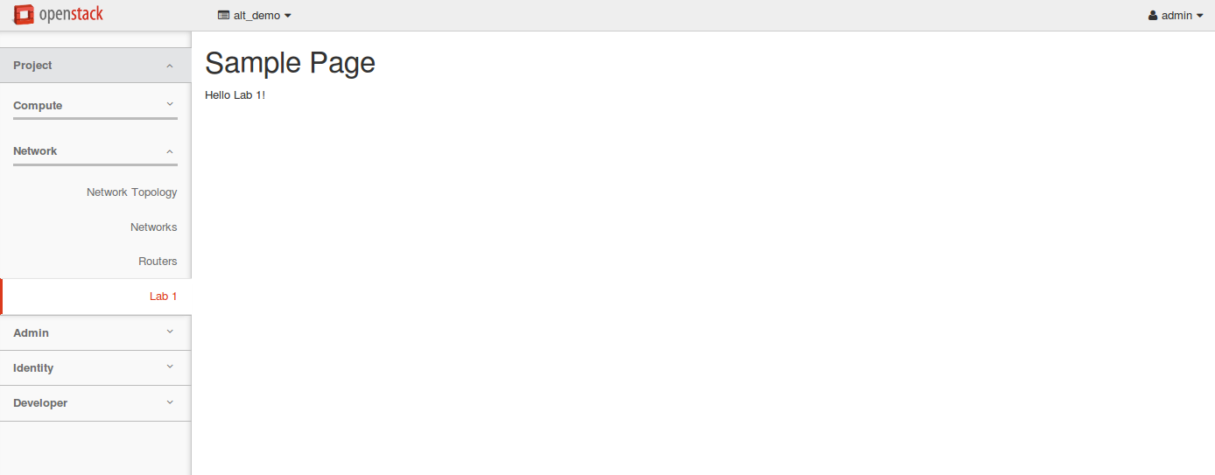
Lab 1: End Result
Hello “First Name”
^{“First Name”}

Slide 15
Lab 1 Solution
sample_dashboard/dashboards/project/sample/panel.py
class Sample(horizon.Panel):
name = _("Doug")
slug = 'sample’
sample_dashboard/static/dashboard/project/sample/network/table.html
<hz-page-header header="{$ 'Sample Page' | translate $}"></hz-page-header>
<div>Hello Doug!</div>

Slide 16
Helpful Development Tools and Tips
Debugging
Chrome for javascript debugging
Horizon Settings
COMPRESS_ENABLED=False
WEBROOT=“/“ so the Django development server can be used (rather than apache)
javascript console.log();

Slide 17
Helpful Development Tools and Tips
Horizon dev server
Use the Django dev server from Horizon
./run_tests.sh -N —runserver 0.0.0.0:8081
Script for facilitating updates when using apache
cd /opt/stack/horizon
cp ../sample-dashboard/sample_dashboard/enabled/_1485* openstack_dashboard/local/enabled/
python manage.py collectstatic --noinput
python manage.py compress --force
sudo service apache2 restart
Scripted in /opt/stack/sample-dashboard/misc_goodies/﻿update_static.sh

Slide 18
AngularJS and service interactions
﻿
Note: To follow along locally - git checkout lab-2
sample_network.py
This file serves to define new REST interfaces for the plugin’s client - side to communicate with Horizon.
Typically, the REST interfaces here make calls into myservice.py.
Must be explicitly imported from a non-top level module (eg. from the __init__.py of the module that defines the panel) as its not directly referenced anywhere, so that the urls will be registered.
from django.views import generic
from openstack_dashboard.api import neutron
from openstack_dashboard.api.rest import urls
from openstack_dashboard.api.rest import utils as rest_utils
@urls.register
class SampleNetwork(generic.View):
""" sample interface for networks
"""
url_regex = r'sample-network/networks/$'
@rest_utils.ajax()
def get(self, request):
"""List networks for current project.
The listing result is an object with property "items".
"""
networks = neutron.network_list(request)
return {'items': networks}

Slide 19
AngularJS and service interactions
myservice.py
When using a service not already interacting with horizon you should create this file, otherwise use an existing service.
In our example, we are using existing neutron service by importing-
from openstack_dashboard.api import neutron
Intended to act as a convenient location for interacting with the new service this plugin is supporting.
Allows for isolating the logic, an established pattern in Horizon.
Alternative - Interactions with the service can be handled directly from the view class (eg. sample_network.py)

Slide 20
AngularJS and service interactions
networks.controller.js
Controller is the glue between the model and the view.
Angular dependency injection
$inject – lists names of angular dependencies
Those dependencies get passed in as function parameters
(function() {
'use strict';
angular
.module('horizon.dashboard.project.sample.networks')
.controller('SampleNetworkTableController’, SampleNetworkTableController);
SampleNetworkTableController.$inject = [
'horizon.app.core.openstack-service-api.sample-network',
'horizon.dashboard.project.sample.networks.actions.batchActions',
'horizon.dashboard.project.sample.networks.actions.rowActions' ];
function SampleNetworkTableController(api, batchActions, rowActions) {
…..
init();
////////////////////////////////
function init() {
api.getNetworks().success(success);
}

Slide 21
AngularJS and service interactions
table.html
Code snippets of interest-
Define a table and connect the table to the controller, tell smart table about the entire collection of items
<table ng-controller="SampleNetworkTableController as table”
st-table="table.items”
st-safe-src="table.src"
Table Head – defines the column headers
<thead>
Loop for the items in the table. Note use of ng-repeat-start and ng-repeat-end
<tr ng-repeat-start="item in table.items track by item.id”
Table row details
<tr ng-repeat-end class="detail-row">

Slide 22
AngularJS and service interactions
sample-network.service.js
Wrapper to encapsulate javascript code to interact with the Horizon REST API

Slide 23
Lab 2: Hands-on – Modify table content on the panel
Goals:
Change the filter on Admin State to show Up and Down instead of Yes and No
Add a Shared column to the view
Instructions
Assumes you did pre-lab setup per-
https://github.com/doug-fish/sample-horizon-angular-plugin/blob/master/README.rst
git checkout lab-2
If running in Apache-
﻿Run /opt/stack/sample-dashboard/misc_goodies/﻿update_static.sh
Hints
There is a decode filter that accepts a javascript dictionary
See Example – in neutron-lbaas-dashboard project , neutron_lbaas_dashboard/static/dashboard/project/lbaasv2/pools/detail.html#L21
Controller is a great place to define the dictionary
Items returned already have a shared value. The view just needs to be updated to display it. (and possibly use a filter on it)

Slide 24
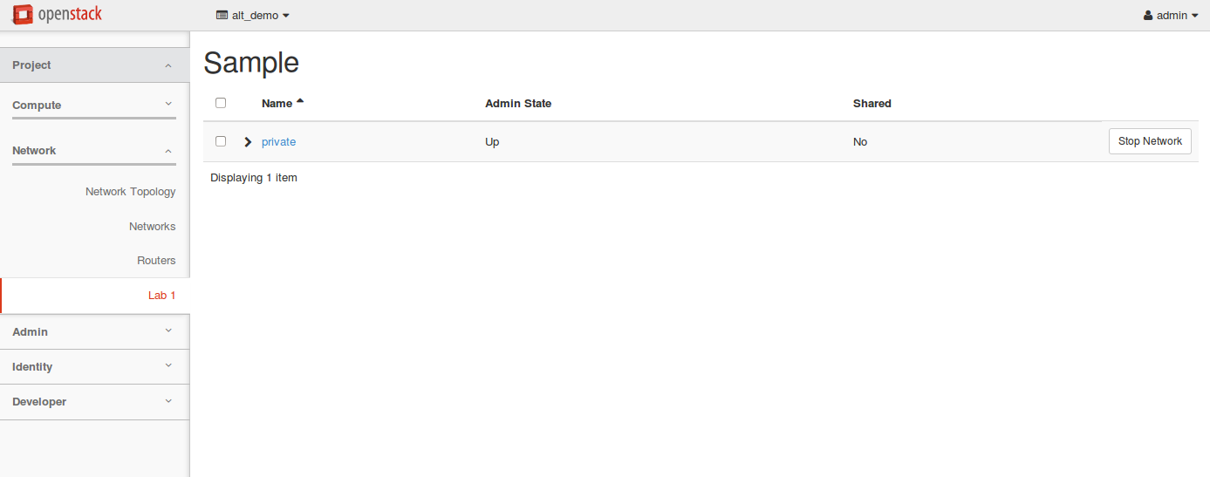
Lab 2: End Result

Slide 25
Lab 2: Solution
sample_dashboard/static/dashboard/project/sample/network/networks.controller.js
ctrl.batchActions = batchActions;
ctrl.rowActions = rowActions;
ctrl.admin_state = {
'true': gettext('Up'),
'false': gettext('Down')
};

Slide 26
Lab 2: Solution
sample_dashboard/static/dashboard/project/sample/network/table.html
<th class="rsp-p1" st-sort="name" st-sort-default="name" translate>Name</th>
<th class="rsp-p1" st-sort="admin_state_up" translate>Admin State</th>
<th class="rsp-p1" st-sort="shared" translate>Shared</th>
</tr>
</thead>
…
</span>
</td>
<td class="rsp-p1"><a ng-href="project/sample/{$ ::item.id $}">{$ ::(item.name || item.id) $}</a></td>
<td class="rsp-p1">{$ ::item.admin_state_up | decode:table.admin_state $}</td>
<td class="rsp-p1">{$ ::item.shared | yesno $}</td>
<td class="actions_column">

Slide 27
Adding table row actions
row-actions.service.js
Array of actions available on each row
Service to invoke the action
Label for the action
function actions() {
return [{
service: stopNetworkService, template: { text: gettext('Stop Network') }

Slide 28
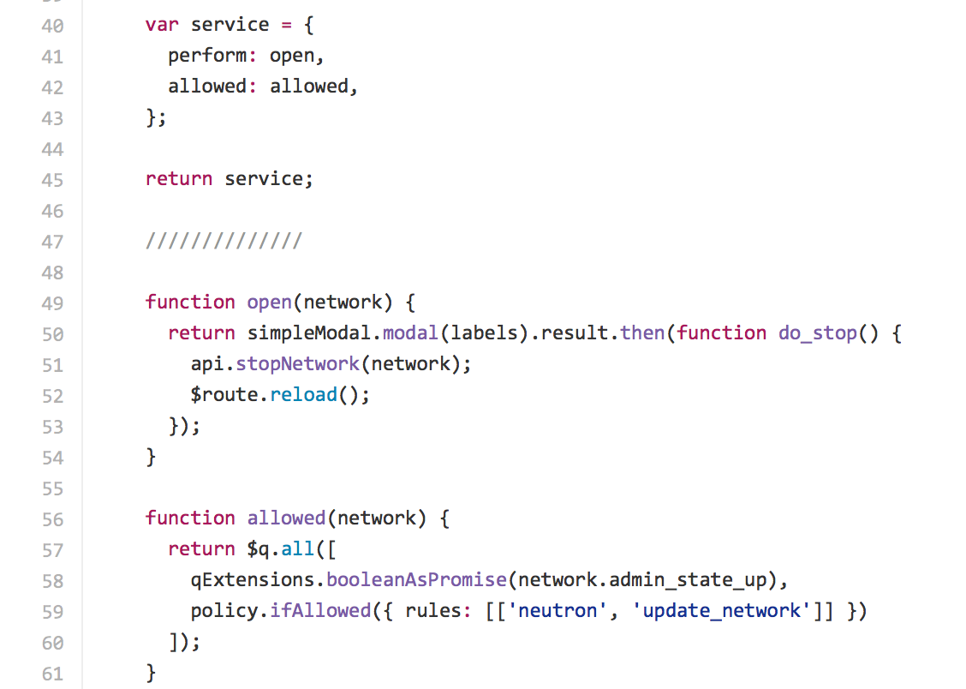
Adding table row actions
modal.service.js
Action service needs – perform and allowed objects
Allowed describes if action should be available to the user
Perform describes what the action does

Slide 29
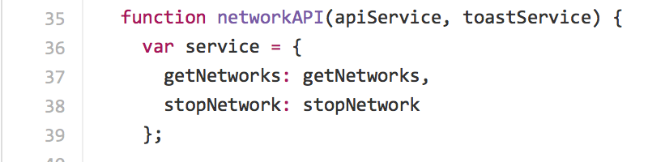
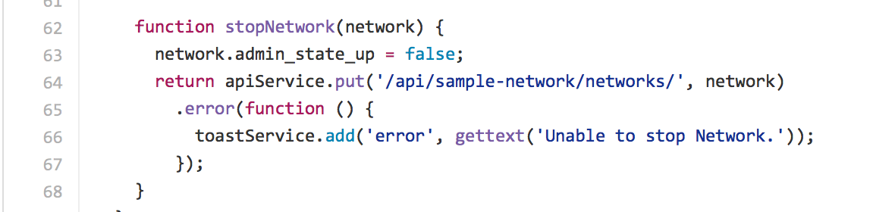
Adding table row actions
sample-network.service.js lab-3 version has an update for the stop-network api call.

Slide 30
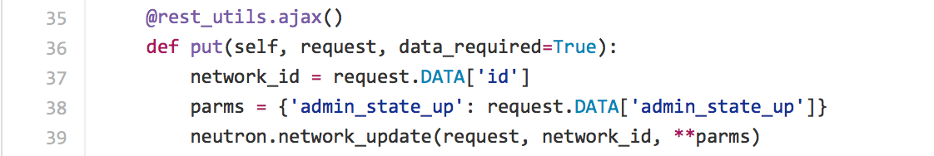
Adding table row actions
sample_network.py
lab-3 version
Added a put implementation for the action

Slide 31
Lab 3: Add a row action to a table
Goal
Add an action “Start network” (a “Stop network” action has been provided).
Instructions
Assumes you did pre-lab setup per-
https://github.com/doug-fish/sample-horizon-angular-plugin/blob/master/README.rst
git checkout lab-3
If running in Apache-
﻿Run /opt/stack/sample-dashboard/misc_goodies/﻿update_static.sh

Slide 32

Lab 3: End Result

Slide 33
Lab 3: Solution
/sample_dashboard/static/app/core/openstack-service-api/sample-network.service.js
function networkAPI(apiService, toastService) {
var service = {
getNetworks: getNetworks,
stopNetwork: stopNetwork,
startNetwork: startNetwork
};
…
function startNetwork(network) {
network.admin_state_up = true;
return apiService.put('/api/sample-network/networks/', network)
.error(function () {
toastService.add('error', gettext('Unable to start network.'));
});
}

Slide 34
Lab 3: Solution
sample_dashboard/static/dashboard/project/sample/network/actions/row-actions.service.js
tableRowActions.$inject = [
…
'horizon.dashboard.project.sample.networks.actions.start-network',
’…
];
…
function tableRowActions($location, basePath, stopNetworkService,
startNetworkService, gettext) {
var service = {
actions: actions
…
, {
service: startNetworkService,
template: {
text: gettext('Start Network')
}
}];
} }

Slide 35
Lab 3: Solution
sample_dashboard/static/dashboard/project/sample/network/actions/start_network/modal.service.js (new file) Part 1
(function() {
'use strict';
angular
.module('horizon.dashboard.project.sample.networks')
.factory('horizon.dashboard.project.sample.networks.actions.start-network', startNetworkService);
startNetworkService.$inject = [
'$q',
'$route',
'horizon.app.core.openstack-service-api.policy',
'horizon.app.core.openstack-service-api.sample-network',
'horizon.framework.widgets.modal.simple-modal.service',
'horizon.framework.util.i18n.gettext',
'horizon.framework.util.q.extensions’
];

Slide 36
Lab 3: Solution
sample_dashboard/static/dashboard/project/sample/network/actions/start_network/modal.service.js (new file) Part 2
function startNetworkService($q, $route, policy, api, simpleModal, gettext, qExtensions) {
var labels = {
title: gettext('Start Network'),
body: gettext('Are you sure you want to start this network?'),
submit: gettext('Yes'),
cancel: gettext('No')
}
var service = {
perform: open,
allowed: allowed,
};
return service;

Slide 37
Lab 3: Solution
sample_dashboard/static/dashboard/project/sample/network/actions/start_network/modal.service.js (new file) Part 3
function open(network) {
return simpleModal.modal(labels).result.then(function do_start() {
api.startNetwork(network);
$route.reload();
});
}
function allowed(network) {
return $q.all([
qExtensions.booleanAsPromise(network.admin_state_up === false),
policy.ifAllowed({ rules: [['neutron', 'update_network']] })
]);
}

Slide 38
Devstack plugin
Resides in project repository for your plugin
Devstack plugin for our lab sample plugin –
https://github.com/doug-fish/sample-horizon-angular-plugin/tree/master/devstack
Copies the plugin enabled file into the horizon enabled folder

Slide 39
Horizon plugin registry
File containing list of horizon plugins
Should update with any new plugins
https://github.com/openstack/horizon/blob/b0f3ec3ace531c110f328d208cded302d2617f88/doc/source/plugin_registry.rst

Slide 40
LBaaS v2 AngularJS Plugin
A released AngularJS Horizon plugin for Load Balancer As A Service (LBaaS) V2 available in Mitaka
https://github.com/openstack/neutron-lbaas-dashboard
In a separate repository
Devstack plugin available
It’s AWESOME! ☺

Slide 41

References
Lab repository - https://github.com/doug-fish/sample-horizon-angular-plugin
Horizon plugin tutorial - http://docs.openstack.org/developer/horizon/tutorials/plugin.html
LBaaS v2 Angular plugin - https://github.com/openstack/neutron-lbaas-dashboard

Slide 42
Thank You

Slide 43
Extra Credit: Implement a create network action
Goal
Implement a create network action.
Hint
Consider the example at https://github.com/openstack/neutron-lbaas-dashboard/tree/master/neutron_lbaas_dashboard/static/dashboard/project/lbaasv2/loadbalancers/actions/associate-ip

