Slide 1
THROUGH LINE · LIVE WALKTHROUGH
From mission to evidence to story, end to end
A full test of the working prototype with a fictional nonprofit, Keystone Family Housing Partners, using live AI agents (gpt-6-luna via Portkey) and synthetic participant data.
Prepared for Doug · AI Foundations final project · 2026-10-20

Slide 2
THE JOURNEY
What you'll see: one organization, start to finish
1
2
3
4
5
6
7
Sign up
Share
Five questions
Logic model
Metrics
Collect
Dashboard
Staff account first; everything saves to the org
Upload what you have (read, never saved)
AI team interviews the director
Drafted, peer-reviewed, refined
Research-backed questions & scales
Survey tools, portal, staff entry
Charts, downloads, report
How this test was run
The Logic Model Studio was driven through the real browser UI so you can see the live team at work. Survey tools, the Survey Review Bot, 24 participants and program numbers were then loaded by scripts/run_test_profile.py from the saved test profile.
What was real vs. synthetic
Real: every agent decision, question, draft, citation and review (live gpt-6-luna, live web search). Synthetic: the organization, the director's answers (from the profile's answer bank), and all participant data.
Live test · Keystone Family Housing Partners (fictional) · gpt-6-luna via Portkey · 2026-10-20

Slide 3
TEST PROFILE
The saved test profile: reusable fake data
• Organization: Keystone Family Housing Partners, family rapid rehousing (fictional, West Haven, CT)
• Uploaded document: its 2-page PDF profile from data/test_organizations/
• Staff account: keystone.test · Maria Okafor (test ED)
• Interview answer bank: 7 answers, matched to whatever the AI asks
• Scripted feedback for one logic model round and one metrics round
• 24 synthetic participants with fixed demographics and a seeded response pattern (75% improve; ~8% skip the post survey)
• 6 months of program numbers, matched to the plan's indicators by keyword, plus 3 custom numbers
Where it lives
data/test_profiles/keystone_family_housing/
profile.json: the fake firm and its data
demo_screens/: screenshots for this deck
runs/<date>/: outputs of each run
Run it again
.venv/Scripts/python scripts/run_test_profile.py data/test_profiles/keystone_family_housing
Add --from tools (or collect, numbers, export) to resume part-way. Same seed gives the same participant data.
Live test · Keystone Family Housing Partners (fictional) · gpt-6-luna via Portkey · 2026-10-20

Slide 4
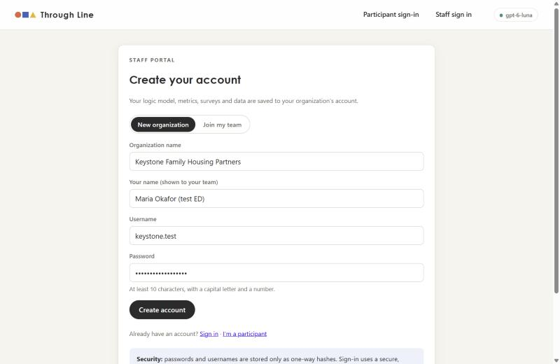
STEP 1 · SIGN UP
Step 1
Accounts come first, and they're built to be safe
• Signing up creates the organization; the logic model, metrics, surveys and data are all saved to it
• Passwords and PINs: Argon2id hashes only
• Usernames are never stored, only a keyed hash used to find the account
• Sign-in token in an HttpOnly, SameSite=Strict cookie; staff and participants use separate cookies
• 5 wrong attempts lock the account for 15 minutes
• Every query is scoped to the signed-in organization
Live test · Keystone Family Housing Partners (fictional) · gpt-6-luna via Portkey · 2026-10-20

Slide 5
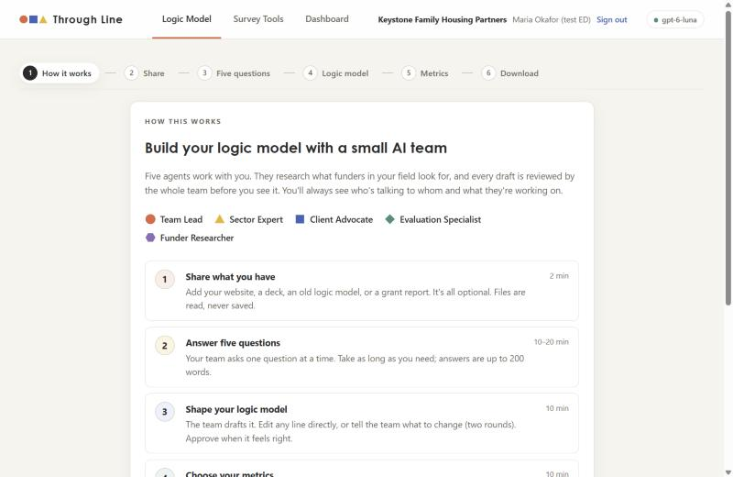
STEP 1 · HOW IT WORKS
Step 1
A short tutorial, then a team of five agents
Team Lead ● talks with the client and writes every draft
Sector Expert ▲ practice standards in the client's field
Client Advocate ■ the org's voice, capacity and participants
Evaluation Specialist ◆ logic, measurement, scales
Funder Researcher ⬢ live web research on what funders want
• A stepper across the top shows exactly where you are
Live test · Keystone Family Housing Partners (fictional) · gpt-6-luna via Portkey · 2026-10-20

Slide 6
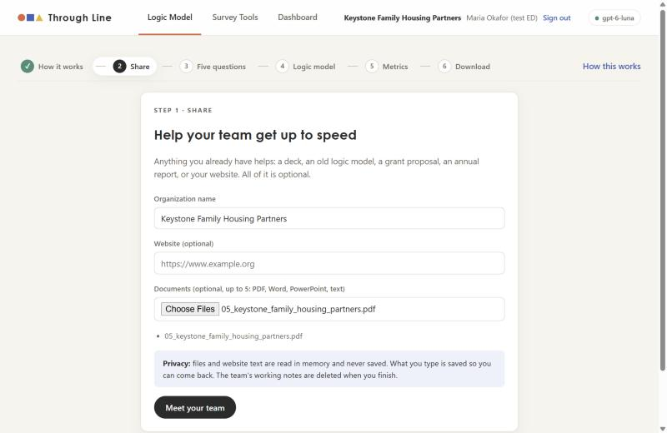
STEP 2 · SHARE
Step 2
Share what you already have
• Keystone's 2-page PDF profile was uploaded here
• Files and website text are read in memory and dropped after intake: never written to disk, never in the audit log
• Org name defaults to the signed-in organization
Intake took about 15 seconds
The Team Lead read the PDF while four specialists worked in parallel: a practice brief, live funder research (16 sources, all verified), and proposed interview questions.
Live test · Keystone Family Housing Partners (fictional) · gpt-6-luna via Portkey · 2026-10-20

Slide 7
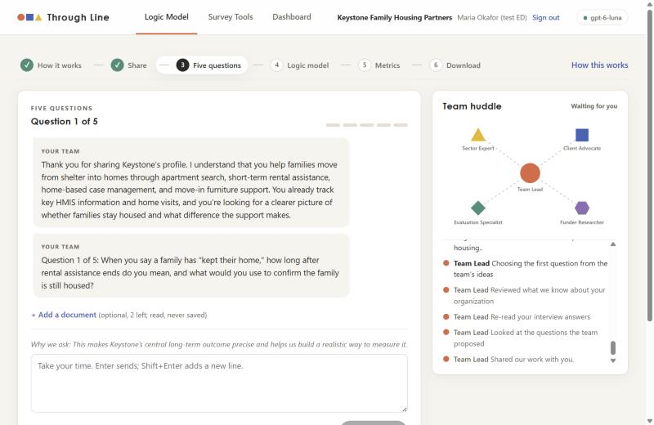
STEP 3 · FIVE QUESTIONS
Step 3
The interview starts with the team's best question
• The welcome shows the team actually read the PDF (HMIS, home visits, furniture)
• Question 1 came from the Evaluation Specialist's proposal: what does 'kept their home' mean, and how would you confirm it?
• The live huddle (right) shows each agent as a shape and logs every hand-off
• "Why we ask" explains each question in plain language
Live test · Keystone Family Housing Partners (fictional) · gpt-6-luna via Portkey · 2026-10-20

Slide 8
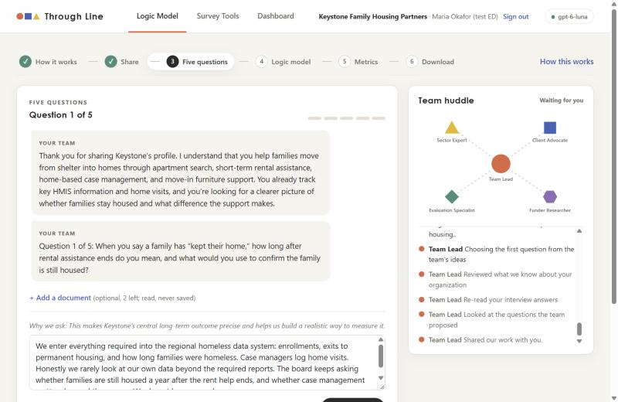
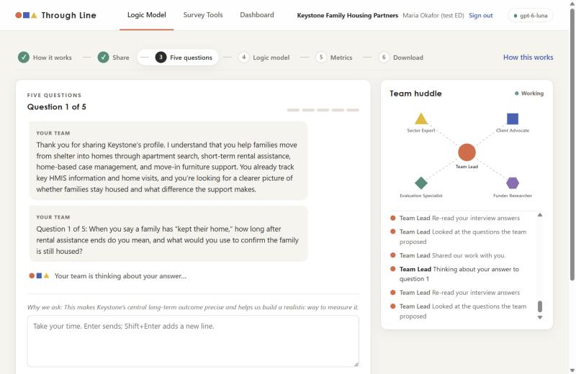
STEP 3 · FIVE QUESTIONS
Step 3
Answering: a word countdown, then the team thinks
Answers are capped at 200 words; the bar counts down as you type.
While the Team Lead works, the huddle switches to "Working" and narrates.
Live test · Keystone Family Housing Partners (fictional) · gpt-6-luna via Portkey · 2026-10-20

Slide 9
STEP 3 · FIVE QUESTIONS
Step 3
All five questions were written live by the AI
# | What the team asked | Answer given (profile topic)
1 | When you say a family has “kept their home,” how long after rental assistance ends do you mean, and what would you use to confirm the family is still housed? | how we know
2 | During case management, what changes do you hope families make that help them stay housed, and what could staff realistically notice or record during visits? | changes we see
3 | What does case management look like in practice—what support do families receive, how often do you meet or visit, and for how long? | who we serve
4 | What kinds of support do case managers typically provide to a family, and how often and for how long do they meet or visit? | what we do
5 | Which grants or contracts fund these services, and what outcomes or reports do those funders ask you to provide? | funders
The team adapted
Question 3 asked how case management works, but the test's answer matcher sent the 'who we serve' answer. The Team Lead noticed the gap and asked about case management again in question 4. (The matcher has since been fixed.)
Live test · Keystone Family Housing Partners (fictional) · gpt-6-luna via Portkey · 2026-10-20

Slide 10
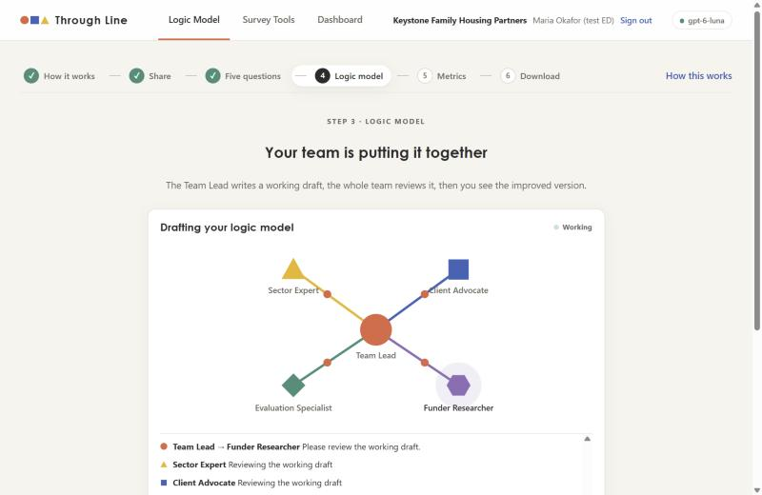
STEP 4 · LOGIC MODEL
Step 4
Every draft is peer-reviewed before you see it
• The Team Lead writes a working draft
• All four specialists review it at the same time: every link lights up
• The Team Lead folds their reviews into the version you see
• What the reviewers changed (from the live run):
• Sector Expert: made housing skills observable; removed 'steadier income'
• Client Advocate: case management described as voluntary and tailored
• Evaluation Specialist: separated move-in timing from family outcomes
• Funder Researcher: centred retention and returns to homelessness
Live test · Keystone Family Housing Partners (fictional) · gpt-6-luna via Portkey · 2026-10-20

Slide 11
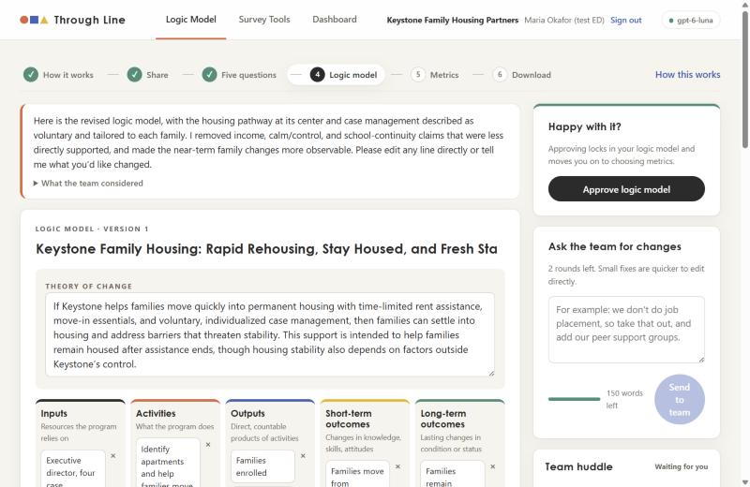
STEP 4 · LOGIC MODEL
Step 4
The first draft, ready to edit
Theory of change (as drafted)
If Keystone helps families move quickly into permanent housing with time-limited rent assistance, move-in essentials, and voluntary, individualized case management, then families can settle into housing and address barriers that threaten stability. This support is intended to help families remain housed after assistance ends, though housing stability also depends on factors outside Keystone’s control.
• Edit any line directly, or ask the team for changes (2 rounds)
• "Approve" is disabled while edits are unsaved
Live test · Keystone Family Housing Partners (fictional) · gpt-6-luna via Portkey · 2026-10-20

Slide 12
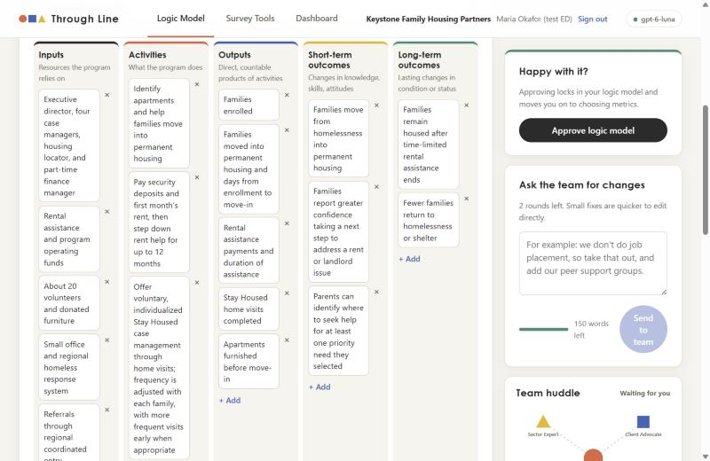
STEP 4 · LOGIC MODEL
Step 4
The logic model workspace
• Inputs: 5 · Activities: 5 · Outputs: 5
• Short-term outcomes: 4 · Long-term: 2
• Long-term outcomes use HUD's framing: staying housed after assistance ends; fewer returns to shelter
• Each item is an editable line with add/remove
Live test · Keystone Family Housing Partners (fictional) · gpt-6-luna via Portkey · 2026-10-20

Slide 13
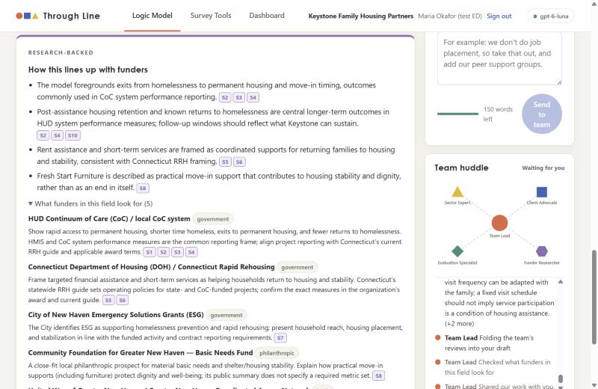
STEP 4 · LOGIC MODEL
Step 4
Research-backed: how it lines up with funders
• The Funder Researcher searched the web live through Portkey; it works
• Found real local and federal funders: HUD Continuum of Care, CT Dept. of Housing, City of New Haven ESG, Community Foundation for Greater New Haven, United Way
• Each alignment note carries citation chips (S2, S4, …)
• The prompt forbids adding outcomes the client doesn't actually pursue
Live test · Keystone Family Housing Partners (fictional) · gpt-6-luna via Portkey · 2026-10-20

Slide 14
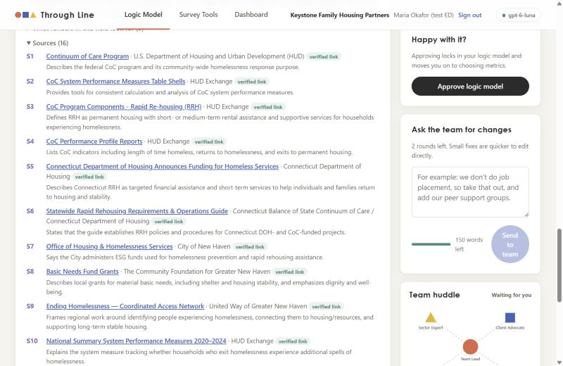
STEP 4 · LOGIC MODEL
Step 4
Every source is checked in code
• 16 sources at intake; all 16 'verified link'
• 'Verified' is set by code only if the URL appeared in that run's actual search results
• If web search ever fails, the researcher says so, removes links and marks everything 'unverified'
• Neither the AI nor the client can forge a source or its status
Live test · Keystone Family Housing Partners (fictional) · gpt-6-luna via Portkey · 2026-10-20

Slide 15
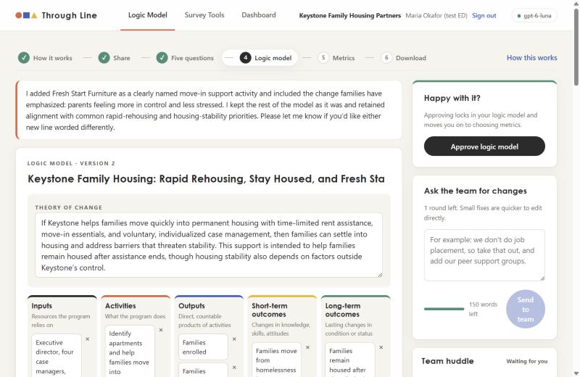
STEP 4 · LOGIC MODEL
Step 4
Feedback in plain words → a revised model
What the director asked
This is close. Please add our Fresh Start Furniture move-in support as its own activity, and make one short-term outcome about parents feeling more in control and less stressed, because families tell us that matters most.
What the team did (version 2)
I added Fresh Start Furniture as a clearly named move-in support activity and included the change families have emphasized: parents feeling more in control and less stressed. I kept the rest of the model as it was and retained alignment with common rapid-rehousing and housing-stability priorities. Please let me know if you’d like either new line worded differently.
Live test · Keystone Family Housing Partners (fictional) · gpt-6-luna via Portkey · 2026-10-20

Slide 16
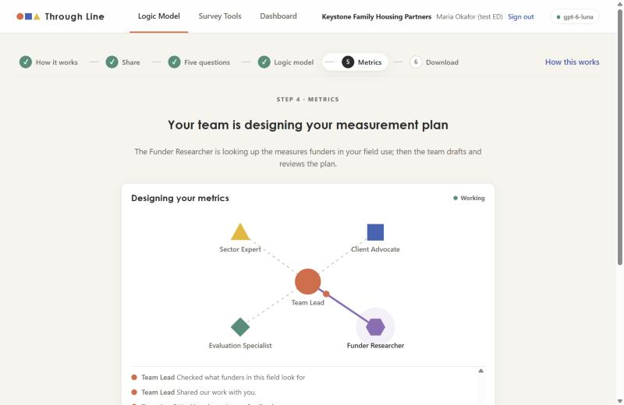
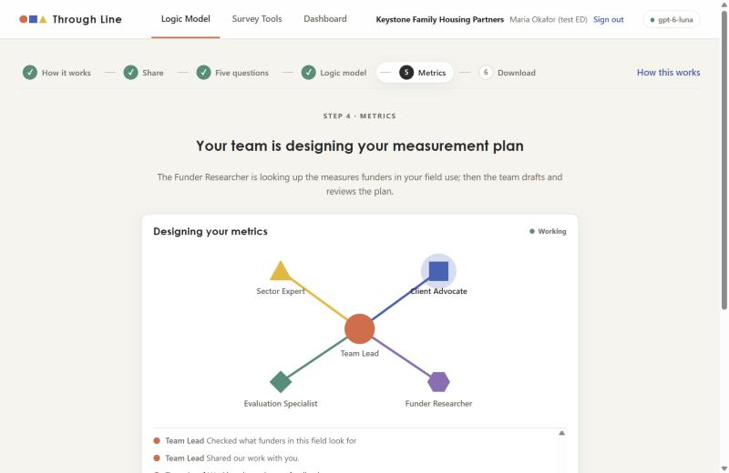
STEP 5 · METRICS
Step 5
Designing metrics: research first, then peer review
The Funder Researcher searches for measures and real question items funders use.
Then all four specialists review the working plan in parallel.
Live test · Keystone Family Housing Partners (fictional) · gpt-6-luna via Portkey · 2026-10-20

Slide 17
STEP 5 · METRICS
Step 5
The measurement plan: five metrics, two ways to collect
Metric | Method | Questions on | Outcome it tracks
Permanent-housing move-in and time to move-in | program records | 3 of 3 | Families move from homelessness into permanent housing
Confidence addressing a rent or landlord issue | participant survey | 1 of 3 | Families report greater confidence taking a next step to address a rent or landlord issue
Parent-reported stress | participant survey | 2 of 3 | Parents report feeling more in control and less stressed
Knowing where to seek help for a chosen need | participant survey | 1 of 3 | Parents can identify where to seek help for at least one priority need they selected
Housing status 12 months after move-in | program records | 5 of 5 | Families remain housed after time-limited rental assistance ends
Director's feedback
Please keep the participant survey short, no more than about 8 recommended questions, and make sure we measure whether families stay housed 12 months after move-in.
Version 2
I’ve kept the participant survey to four recommended questions, with the optional alternatives still switched off. I also changed the housing follow-up to be measured 12 months after each family’s move-in date and made unknown status visible rather than treating it as housed or unhoused. One distinction to note: this follow-up may happen while rental assistance is still active for some families, so it complements—but…
Live test · Keystone Family Housing Partners (fictional) · gpt-6-luna via Portkey · 2026-10-20

Slide 18
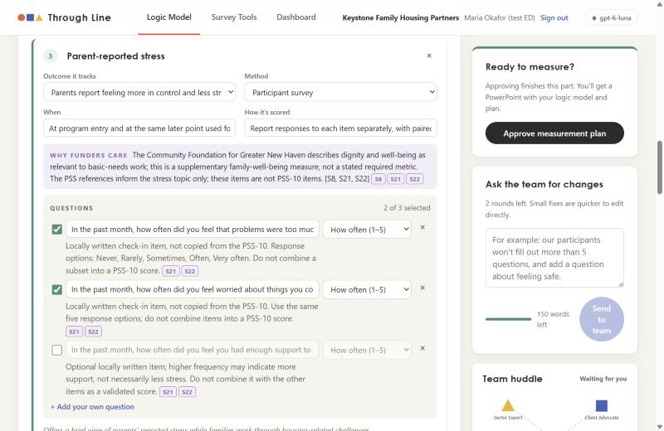
STEP 5 · METRICS
Step 5
Several cited questions per metric, and you choose
• Each metric offers 3–5 candidate questions; the team switches on the 2–3 it recommends
• "Why funders care" links each metric to specific funders, with citations
• Good catch from the team: the stress items are inspired by the PSS-10 but are not copies, so it warned not to score them as a PSS-10 and to check licensing
• 13 cited sources on the final plan, all verified
Live test · Keystone Family Housing Partners (fictional) · gpt-6-luna via Portkey · 2026-10-20

Slide 19
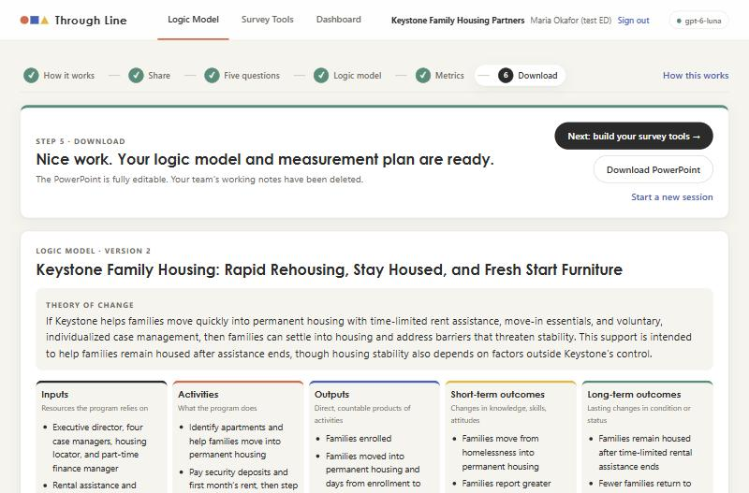
STEP 5 · DONE
Step 5
Approved, saved to the account, downloadable
• Approving copies the logic model and plan onto the organization
• The team's working notes (research, brief, question pool) are deleted
• The PowerPoint download includes the logic model, plan, tool question lists, a funder alignment slide and sources
• Next: build the survey tools
Live test · Keystone Family Housing Partners (fictional) · gpt-6-luna via Portkey · 2026-10-20

Slide 20
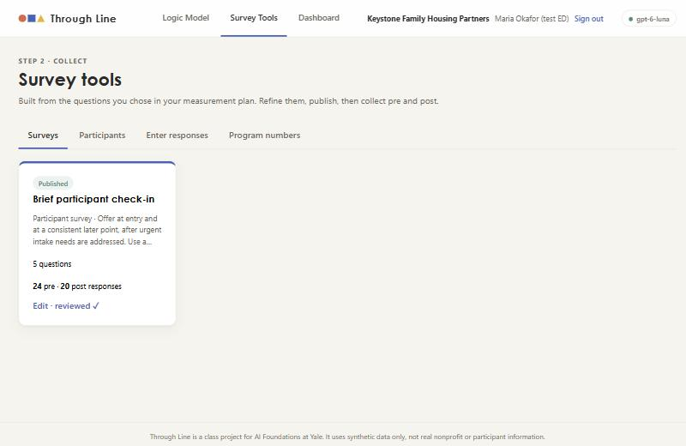
STEP 6 · COLLECT
Step 6
Survey tools are built straight from the metrics
• One click turned the approved plan into tools:
• 'Brief participant check-in': the 4 switched-on participant questions
• 8 program numbers from the two 'program records' metrics (move-in and 12-month housing status), entered by staff and never sent as a survey
• Staff can hide questions, change timing, add open questions, mark reverse-scoring and pick demographics
• Once answers exist, wording and scales lock so pre and post stay comparable
Live test · Keystone Family Housing Partners (fictional) · gpt-6-luna via Portkey · 2026-10-20

Slide 21
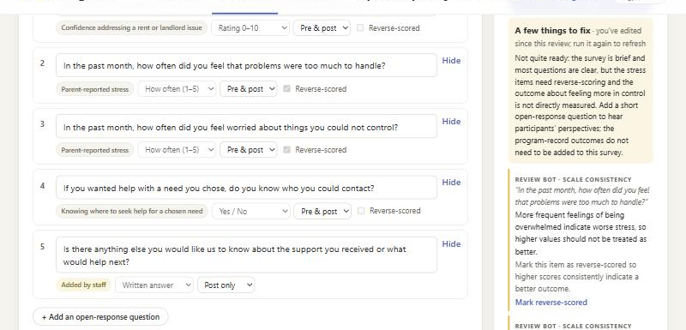
STEP 6 · COLLECT
Step 6
The Survey Review Bot caught a real problem
Its summary (live)
Not quite ready: the survey is brief and most questions are clear, but the stress items need reverse-scoring and the outcome about feeling more in control is not directly measured. Add a short open-response question to hear participants’ perspectives; the program-record outcomes do not need to be added to this survey.
• Applied: set reverse: More frequent feelings of being overwhelmed indicate worse stress, so higher values s…
• Applied: set reverse: More frequent worry indicates worse stress, so higher values should not be treated as…
• Applied: add open question: There is no open-response question, so participants cannot share their perspective in…
• Staff choose: fixes only change the draft until you Save
Live test · Keystone Family Housing Partners (fictional) · gpt-6-luna via Portkey · 2026-10-20

Slide 22
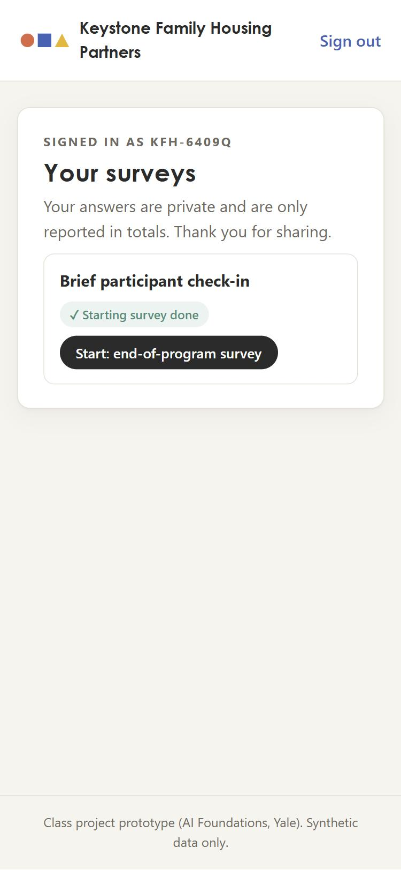
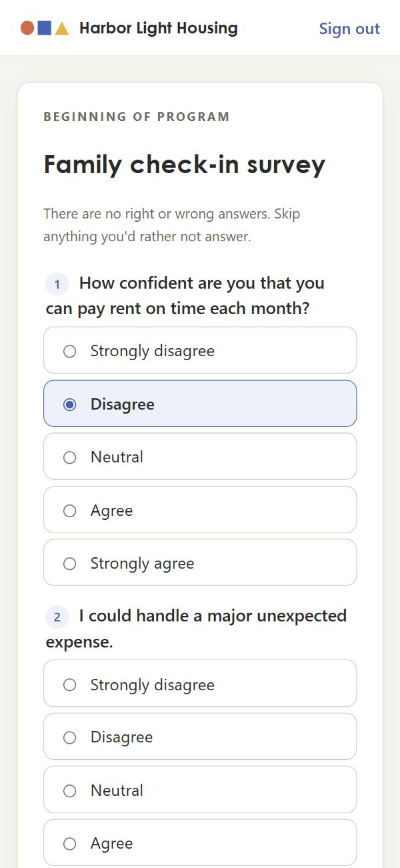
STEP 6 · COLLECT
Step 6
Participants get their own portal: a code and PIN, no names
• Staff create codes + 6-digit PINs, shown once (CSV/print); stored only as hashes
• Participants see only their own pending surveys and can submit pre and post once each
• Phone-first: big tap targets, optional demographics with 'Prefer not to say'
• This run: 24 pre and 20 post surveys from 24 participants
• (The form screenshot is from the earlier scripted test, same screen.)
Live test · Keystone Family Housing Partners (fictional) · gpt-6-luna via Portkey · 2026-10-20

Slide 23
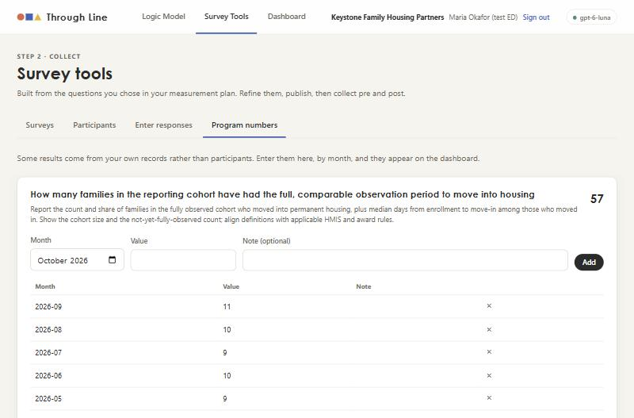
STEP 6 · COLLECT
Step 6
Numbers the organization already has: entered by staff
• No survey needed for things like move-ins, follow-ups, dollars spent or volunteers' work
• 8 numbers came from the plan; 3 custom ones were added (rental assistance $, apartments furnished, landlord partners)
• Entered by month; totals and history shown; each appears as a dashboard chart
Live test · Keystone Family Housing Partners (fictional) · gpt-6-luna via Portkey · 2026-10-20

Slide 24
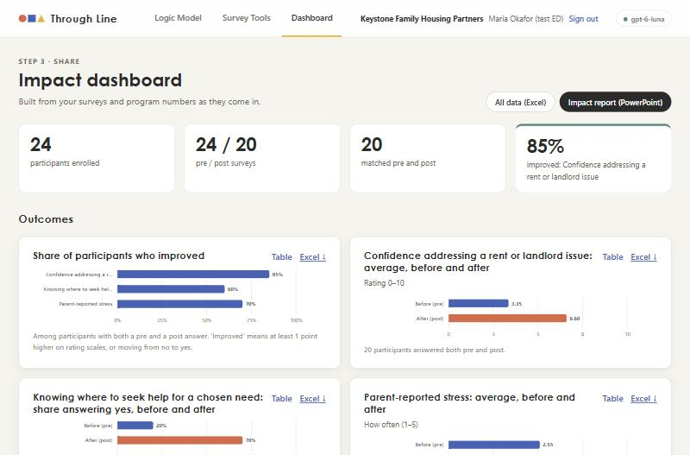
STEP 7 · DASHBOARD
Step 7
The dashboard fills itself as data comes in
• 24 participants · 24 pre / 20 post · 20 matched
• Top result: 85% improved on confidence addressing a rent or landlord issue
• Change is measured only for people who answered both pre and post
• Every chart has a table view and its own Excel download
Live test · Keystone Family Housing Partners (fictional) · gpt-6-luna via Portkey · 2026-10-20

Slide 25
STEP 7 · DASHBOARD
Step 7
Results from the synthetic data (native, editable charts)
Matched participants only. The stress items are reverse-scored, so a higher average means less stress.
Live test · Keystone Family Housing Partners (fictional) · gpt-6-luna via Portkey · 2026-10-20

Slide 26
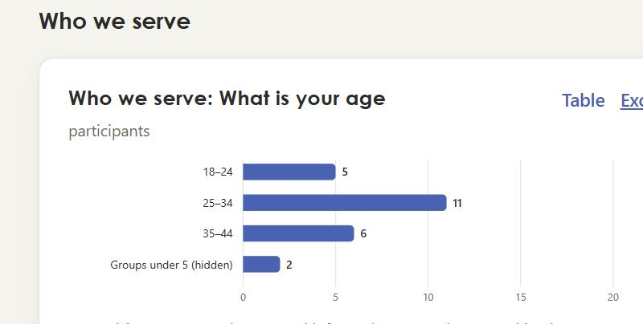
STEP 7 · DASHBOARD
Step 7
Who we serve, with privacy built in, and program activity
Groups under 5 people are combined, so no one can be identified.
Live test · Keystone Family Housing Partners (fictional) · gpt-6-luna via Portkey · 2026-10-20

Slide 27
STEP 7 · DOWNLOADS
Step 7
Everything downloads, in formats nonprofits already use
Each chart as Excel: its data plus a native Excel chart
All data as Excel: codebook, one sheet per tool (participant code × wave), program numbers
Impact report as PowerPoint: theory of change, headline numbers, every chart (editable), quotes, method
Studio PowerPoint: logic model, measurement plan, tool question lists, funder alignment, sources
• Text that starts with = + - @ is escaped so it can't run as a spreadsheet formula
From this run (in runs/2026-10-20_live_demo/)
impact_report.pptx · survey_data.xlsx · dashboard.json · studio.json (full transcript, logic model, plan, sources) · run_log_tools_collect.json · participant_codes.json
"In their words" (synthetic reflections)
“When the landlord tried to raise the rent, my case manager helped me talk to him.”
“I learned to put rent first and plan the rest around it.”
“My kids have their own beds now. They sleep through the night.”
Live test · Keystone Family Housing Partners (fictional) · gpt-6-luna via Portkey · 2026-10-20

Slide 28
BEHIND THE SCENES
Under the hood: cost, time and accountability
28
56
298K / 40K
agent runs
model requests
input / output tokens
~18 min
3
170
whole live test
extra consults refused by budget
audit entries, hash chain intact
• Most tokens went to the Team Lead (≈155K in) and the Funder Researcher's web research (≈81K in); the Survey Review Bot used ≈4K
• Every agent step, hand-off, approval, download and sign-in is in output/audit_log.json; no passwords, PINs or uploaded text
Live test · Keystone Family Housing Partners (fictional) · gpt-6-luna via Portkey · 2026-10-20

Slide 29
FINDINGS
What the test taught us, and what I fixed on the spot
Working well: live web research with verified local funders; real peer review; metrics that respect licensing and privacy
Working well: the Survey Review Bot caught reverse-scoring and a missing open question
Working well: pre/post matching, suppression of small groups, all downloads
To watch: intake is fast (~15 s); drafting and metrics take 1–4 minutes each
Fixed: test answer matching now uses whole words (it mis-sent one answer)
Fixed: program numbers matched to the AI's indicator names, with realistic values; re-runs replace, not duplicate
Fixed: charts now say 'higher = better' for reverse-scored metrics
Fixed: squished 'Send to team' button; long tool descriptions clamped
Next: Privacy Guard for quotes, password reset, PDF report
Live test · Keystone Family Housing Partners (fictional) · gpt-6-luna via Portkey · 2026-10-20

Slide 30
NEXT
Try it yourself
• Sign in as keystone.test (password in profile.json) to explore Keystone's real results
• Participant portal: /participant, using any code + PIN from participant_codes.json
• Re-run everything: .venv/Scripts/python scripts/run_test_profile.py data/test_profiles/keystone_family_housing
• Rebuild this deck: .venv/Scripts/python scripts/build_demo_deck.py data/test_profiles/keystone_family_housing 2026-10-20_live_demo
Live test · Keystone Family Housing Partners (fictional) · gpt-6-luna via Portkey · 2026-10-20

