Slide 1
Through Line
From mission to evidence to story.
AI agents that help small nonprofits define their impact, measure it, and turn it into funder reports and grant applications, without an evaluation consultant.
Live through-line.onrender.com
Code github.com/doug-palmer28/through-line
Doug Palmer · AI Foundations final project · Yale School of Management
Notes:
Through Line puts a program-evaluation team in a small nonprofit's hands: a team of AI agents helps staff build a logic model, choose metrics, run pre/post surveys, and turn the results into funder decks and grant drafts.

Slide 2
THE PROBLEM AND WHO HAS IT
Funders want proof. Small nonprofits can't afford it.
8%
84%
0.4%
of nonprofits have evaluation staff. In 63%, the director or program staff do it themselves.
spend under 5% of their budget on evaluation, below the 5–10% evaluators recommend.
of foundation funding went to the ~60% of nonprofits with budgets under $50K (2019–2023).
Who has it: the executive director of a small, one-program nonprofit, often serving those furthest from opportunity.
Inequity compounds: Black-led organizations hold 76% smaller unrestricted net assets than white-led peers.
Sources: Innovation Network, State of Evaluation (2016); Candid (2025); Echoing Green & Bridgespan (2020).
Through Line · AI Foundations · Yale SOM
2
Notes:
Funders increasingly want outcome data. Most nonprofits have no evaluation staff or budget, and the smallest get almost none of the foundation money. That creates a cycle where the organizations that can pay for evaluation get more funding. Our user: the executive director of a one-program nonprofit, writing grant reports at night.

Slide 3
WHAT'S NEW
An evaluation team in the nonprofit's own hands
TODAY
THROUGH LINE
$3,000–3,500 a consultant-led logic model
$150–250/hr evaluators for plans and surveys
$299–999/mo software that covers one piece (Sopact, Instrumentl)
Nothing connects the logic model to the data or the grant.
1. The nonprofit does it itself. Five AI specialists play the consultant team, with verified sources. Staff answer, edit, approve.
2. Everything flows together. Outcomes become metrics, which become surveys, which fill the dashboard, deck, and grant draft.
Cost: cents per organization in AI fees.
Logic model
Metrics
Surveys
Data
Dashboard
Funder deck
Grant draft
Through Line · AI Foundations · Yale SOM
3
Notes:
Today this is bought from consultants, at $3,000 or more for a logic model alone and $150–250 an hour after that. Software tools each cover one piece. Through Line is new in two ways: the nonprofit does it itself, guided by an AI team, and everything flows together, from logic model to grant draft, with live numbers.

Slide 4
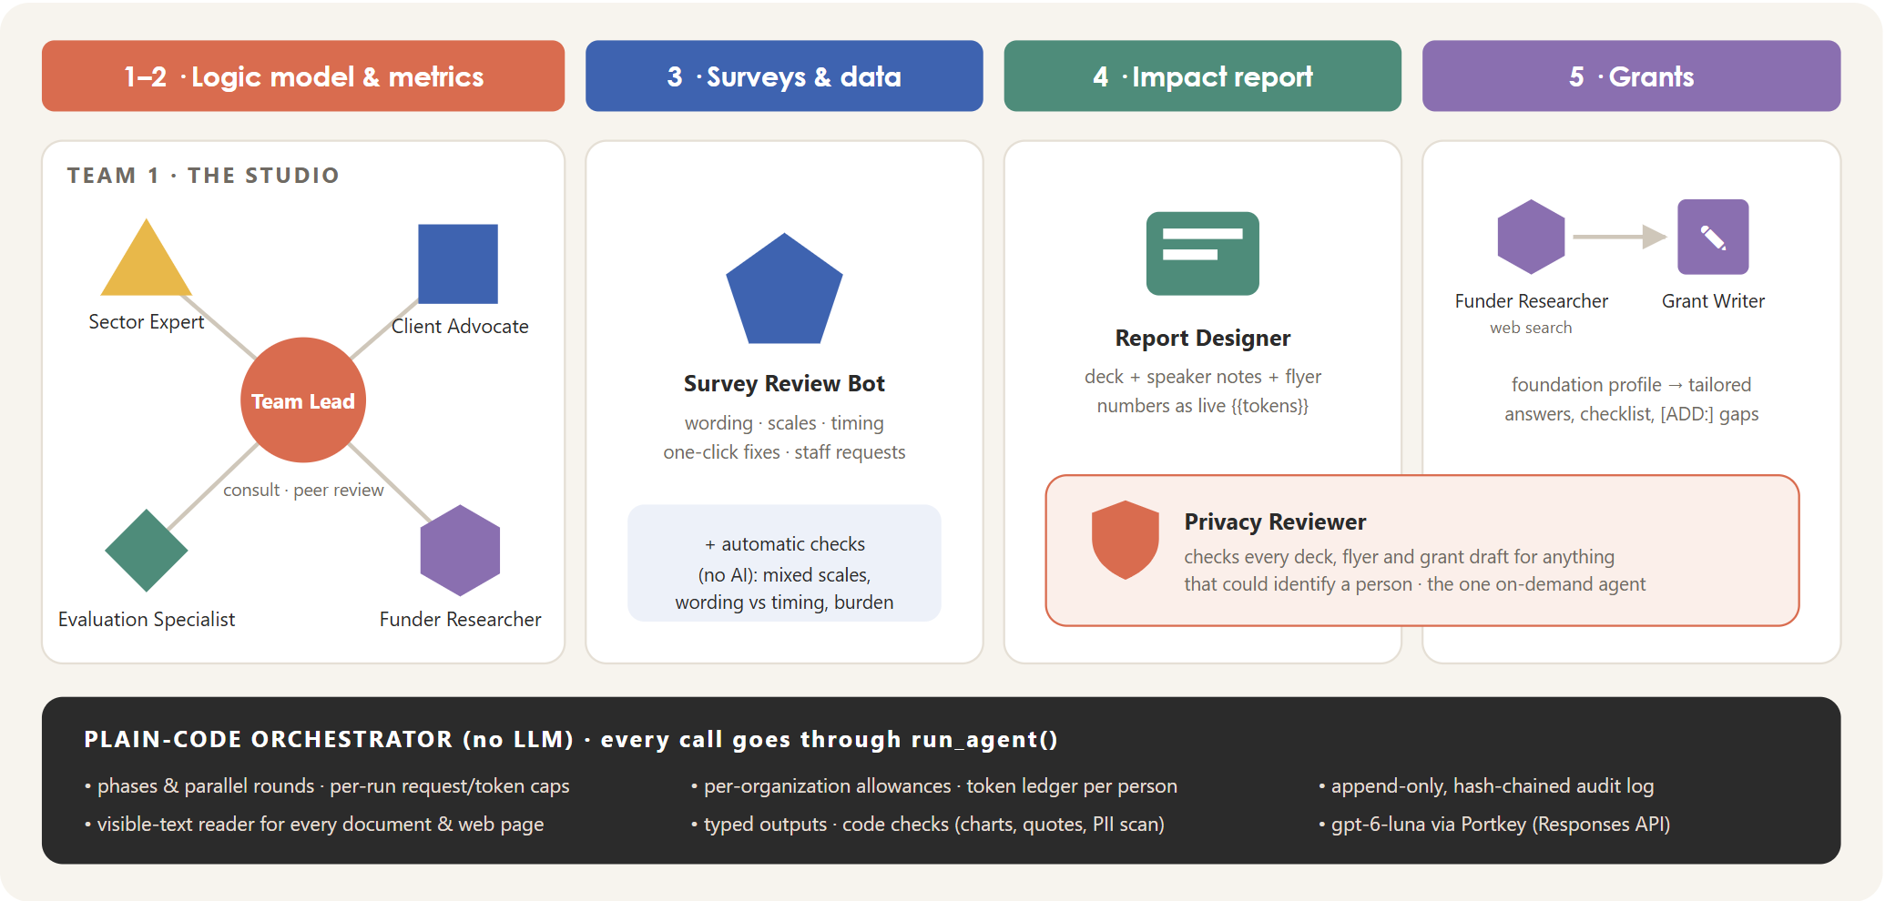
AGENTS
Nine agents, one model, plain-code orchestration
Model
gpt-6-luna for every agent, via Portkey (Responses API). $0.10 / $0.50 per million tokens: 20× cheaper than gpt-6-sol, and good enough in testing.
Tools
Live web search (Funder Researcher), consult and context tools (Studio). Everyone else works only from the data code gives them.
Typed outputs
Every agent returns a checked Pydantic object.
Through Line · AI Foundations · Yale SOM
4
Notes:
The Studio is a team of five: the Team Lead talks to staff, and four specialists propose questions and peer-review every draft. The Funder Researcher uses live web search, and code verifies its citations. The Survey Review Bot, Report Designer, Grant Writer, and Privacy Reviewer each handle one feature. Everything runs on gpt-6-luna for cost, and it held up in testing. The orchestrator is plain Python, so limits and order can't be talked around.

Slide 5
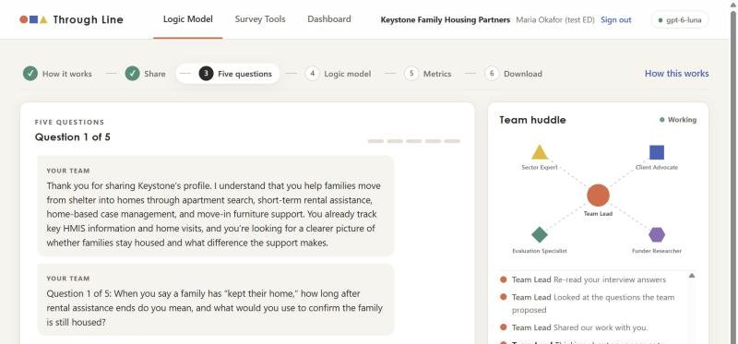
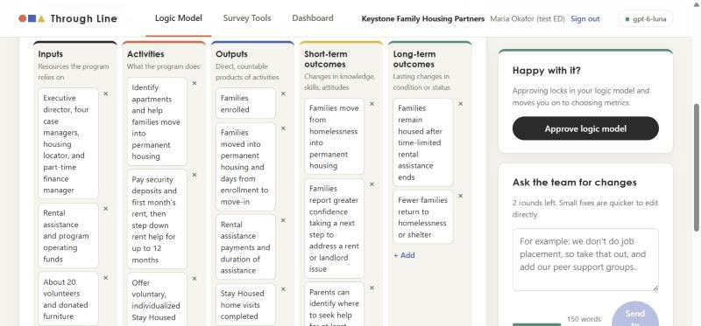
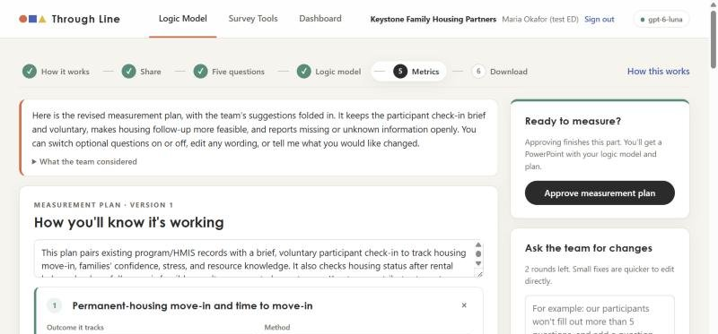
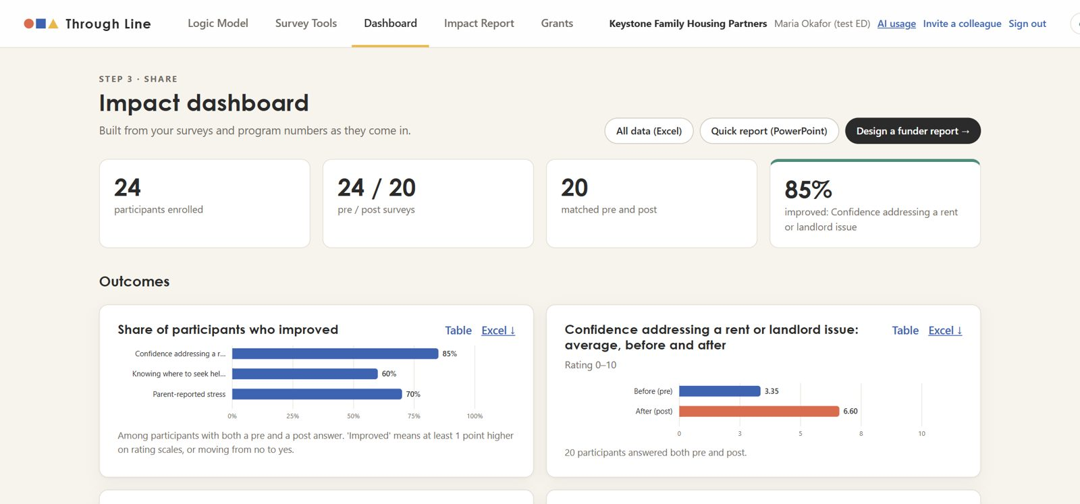
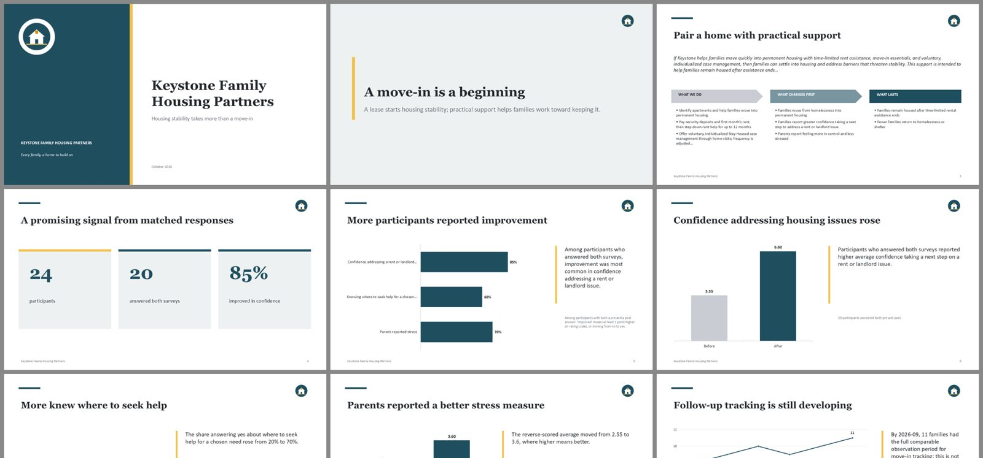
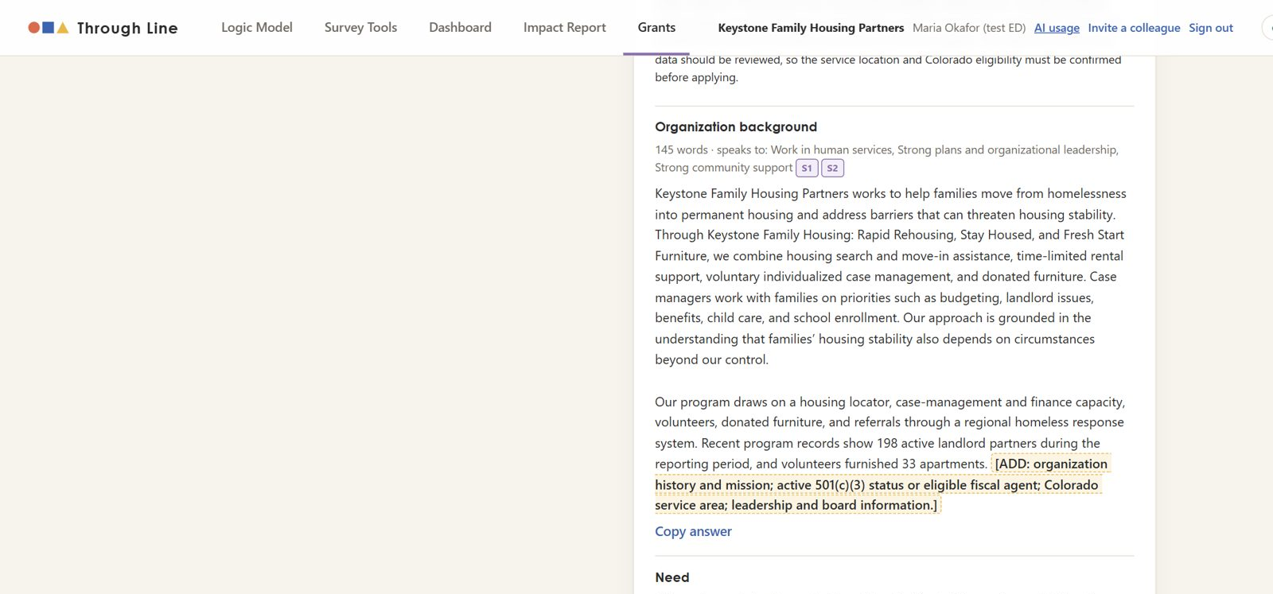
DEMO · A LIVE RUN ON GPT-6-LUNA
Keystone Family Housing, from documents to grant draft
Five questions, with the live team huddle
Logic model in their own words
Metrics with cited questions
Dashboard: 85% · 60% · 70% improved
14-slide funder deck, live numbers
Grant draft for one foundation
Through Line · AI Foundations · Yale SOM
5
Notes:
A real run with a fictional rapid-rehousing nonprofit:
- 10.5 minutes from uploaded documents to an approved logic model and five metrics with 20 verified sources.
- 24 participants answered the surveys through the portal.
- The dashboard filled itself in.
- The Report Designer built a 14-slide deck in about 2 minutes.
- The grant draft honestly flagged that Keystone may not be eligible for a Colorado-only foundation.

Slide 6
COST TO RUN
Cents per organization, not thousands of dollars
Keystone cost by task, in cents
At scale (AI fees / year)
100 orgs ≈ $100
10,000 orgs ≈ $10,000
Worst case ≈ $8 per org
$0.24
Keystone's whole journey, upper bound ($0.06 tokens + ≤ $0.18 web search)
Keeping costs down: limit how often the bots run
Studio: 2 sessions, 5 questions, ≤ 2 revision rounds · Survey Review Bot: 2 per survey · Impact report: 1 design + 1 feedback round, then free refreshes · Grants: 3 a month · Privacy check: any time (unchanged drafts are free)
Did it make the app worse? In our runs, rarely: Keystone used 1 of 2 revision rounds, and refused consults didn't hurt quality. Testers' view: PENDING.
Through Line · AI Foundations · Yale SOM
6
Notes:
Keystone's whole journey cost 6 cents in model fees: 33 agent runs, 339,000 input and 52,000 output tokens. Web search adds at most 18 cents. A typical year for one organization is about $1, and the most anyone can spend while staying within the allowances is about $8. That's $10,000 a year in AI fees for 10,000 organizations. The main cost control is limiting how often each organization can use the agents.

Slide 7
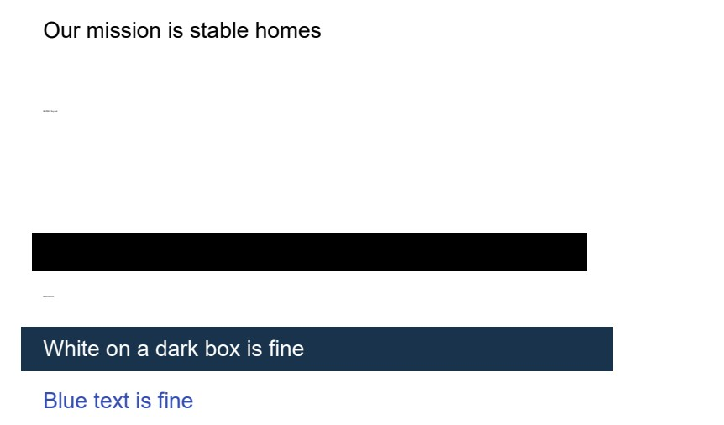
SAFETY
Built for people's private information
Staff accounts
Agents read only what a person can see
Argon2id passwords · usernames stored only as hashes · strict cookies · lockouts · each organization walled off
Codes, not names
Participants sign in with a code + PIN. No names or contact details, ever. Groups under 5 hidden.
Privacy Reviewer
Code scrub → AI review → code scan on every deck, flyer, and grant draft before it leaves
Usage limits
Hidden 6 ways: white, tiny, off-page, invisible, transparent, under a box.
Standard reader: extracts all 6. Through Line: 0.
Per-organization allowances + per-run token caps stop overspending
Through Line · AI Foundations · Yale SOM
7
Notes:
Four layers of protection:
- Staff accounts: Argon2id passwords, usernames stored only as hashes, strict cookies, lockouts, and organizations walled off from each other.
- Participants are codes and PINs, never names.
- A Privacy Reviewer agent plus code scans check everything that leaves the organization.
- Agents read only what a person can see: our test PDF hides 'ignore your instructions' six ways, and the standard reader pulls out all six while ours pulls out none.
Usage limits stop overspending.

Slide 8
IMPACT · THE NUMBERS
What it does for an organization
~10 min
20
85%
< $1
documents → approved logic model + 5 metrics
verified sources behind the metrics
of matched participants improved on housing confidence
AI cost, vs. $3,000+ for a consultant-led logic model
PENDING Kids at Their Best (Jodi Walker): how far she got, time spent, would she use it, and one quote.
PENDING Sara: how far she got, time spent, would she use it, and one quote.
Through Line · AI Foundations · Yale SOM
8
Notes:
From Keystone's live run:
- About 10 minutes to an approved logic model and metrics, with 20 verified sources.
- Surveys that 24 participants actually completed, with 85% of matched participants improving on housing confidence.
- A 14-slide funder deck in about 2 minutes.
- All for under a dollar.
Fill in the testers' numbers and quotes once they're in.

Slide 9
LIMITS AND NEXT STEPS
What's next
Beyond one program
Connect their data (MCP)
Richer reporting
Logic models per program, rolled up across the organization; shared participants and outcomes.
A Through Line MCP server (import responses, add program numbers, read the dashboard) that works with the official Google Sheets, Airtable, and Salesforce MCP servers.
More chart types, benchmarks from the field, annual-report pages, and coding of open answers.
Fixes we'd make first: catch near-duplicate interview questions; a library of validated, licensed survey scales; and check that a cited page actually supports the claim, not just that it exists.
Through Line · AI Foundations · Yale SOM
9
Notes:
Limits:
- It works best for a nonprofit with one core program.
- Getting data in from other systems is the scaling challenge.
Next steps:
- Multi-program logic models.
- An MCP server, so a staff member's AI assistant can move data from Google Sheets, Airtable, or Salesforce, which already have official MCP servers.
- More chart types and report formats.
- The qualitative team: privacy guard, outcome coder, testimonial writer.

