Slide 1



See the process. Reimagine the possibilities.
How we use AIxRay in a Jump Start workshop to understand how your work runs today and design how it could run with supervised AI.
Notes:
Thank you for making the time. Today I want to show you how we use a tool called AIxRay inside our Jump Start workshops. The idea is simple. Before we talk about where AI could help, we put one of your real processes on the screen, agree how it works today, and then design how it could work with supervised AI. By the end of this conversation I hope you will have a clear picture of what the workshop looks like and what you would take away from it.

Slide 2
One shared view of a process turns AI ideas into decisions
EXECUTIVE SUMMARY
Many AI conversations stall because nobody can point to where the work happens, who does it and what a change would be worth.
In a Jump Start, we put one of your processes under AIxRay and work through it with the people who run it. The same model carries the discussion from today's process to a future design and a first estimate of its value.
01
Understand. We build a model of today's process from your documents and the people in the room, then play real cases through it, exceptions included.
02
Reimagine. We design a future version, trying simpler fixes first and using supervised AI where it earns its place, with approvals and fallbacks written down.
03
Evaluate. We estimate cycle time, effort and cost from assumptions everyone can see and challenge, and agree what to validate next.
→
You leave with an agreed current-state model, a future-state design, a prioritized list of opportunities and a pilot brief with named owners.
Notes:
Let me start with the short version. Many AI conversations stall because nobody can point to where the work actually happens, who does it, and what a change would be worth. In a Jump Start, we take one of your processes and work through it with the people who run it, in three conversations. First we understand it, including the exceptions. Then we reimagine it, trying simpler fixes before AI, and writing down the approvals and fallbacks for every AI step. Then we evaluate it, with estimates built on assumptions everyone in the room can see and challenge. You leave with an agreed model of today, a future design, a ranked list of opportunities and a pilot brief with named owners.

Slide 3



AI ideas need a real process to land in
WHY START WITH THE PROCESS
Before deciding where AI fits, a leadership team needs the same picture of how work moves today. Three things usually get in the way.
Process knowledge sits with people
AI opportunities stay abstract
Business cases hide their assumptions
Without a shared view of the steps, it is hard to say where AI helps, where a simpler fix would do, and where people need to stay in control.
How work really moves, where it waits and how exceptions are handled often lives in people's heads and in documents that disagree with each other.
Benefit figures are hard to trust when nobody can see the volumes, effort and costs behind them, or which of those were measured and which were guessed.
Notes:
Why start with the process at all? In our experience three things get in the way. First, the knowledge of how work really moves sits with people, and the documents often disagree with each other. Second, without a shared view of the steps, AI opportunities stay abstract. It is hard to say where AI genuinely helps, where a simpler change would do, and where people need to stay in control. And third, business cases are hard to trust when nobody can see the volumes, effort and costs behind them, or which of those numbers were measured and which were guessed.

Slide 4
AIxRay: See the process. Reimagine the possibilities.
MAKE AI TANGIBLE THROUGH A SHARED VIEW OF TODAY'S WORK, TOMORROW'S DESIGN, AND THE ASSUMPTIONS BEHIND THE IMPACT.
UNDERSTAND
REIMAGINE
EVALUATE
Start with the
real process
AIxRay | Before-and-after process exploration
Explore
business impact
Routine
Minor exception
Major escalation
Order confirmed › Fulfillment complete › Customer need resolved
Before: human-led coordination
Rework across handoffs
Process evidence
Operations
Review
order
Documents, maps,
operating notes
Check
availability
Coordinate
delivery
Chase
status
Cycle
time
Human
effort
Fulfillment
Customer care
Rebuild case
context
Resolve and
approve
$
Business context
Approvals
Operating
cost
Redeployable
capacity
Roles, handoffs,
controls, exceptions
Manual handoffs
Repeated checks
Fragmented context
After: supervised AI and automation
Fewer status checks · Preserved context · Human control retained
COMPARE MODELED OUTCOMES
Validate
context
Central estimates
Workshop assumptions
Rules & systems
AI-assisted work
Propose
fulfillment plan
Planning ranges
Volumes, effort,
waits, costs
Human authorization
Authorize
action
Reconcile
events
Resolve with
context
Validation gaps
Physical fulfillment
Execute
physical work
Separate what is known from
what needs validation
Controls stay visible
Shared illustration. Scenario metrics vary. Highlighting shows time progression, not workflow execution.
Approvals · permissions · audit
evidence · escalation
Known evidence / validation needs
Inspect the model → Challenge assumptions → Prioritize validation
Directional estimates,
not guaranteed results
Which process should we put under the AIxRay?
Turn an AI conversation into a concrete process-transformation discussion.
Notes:
AIxRay makes AI tangible using a shared view of a real process. Start with process evidence, business context, and workshop assumptions. Separate what is known from what needs validation. In the routine illustration, human-led coordination relies on manual handoffs, repeated checks, and rebuilding case context. The supervised AI and automation model validates context, proposes a fulfillment plan, retains explicit human authorization, executes physical work, reconciles events, and resolves issues with the right context. Explore cycle time, human effort, operating cost, and redeployable capacity using central estimates, planning ranges, and validation gaps. Approvals, permissions, audit evidence, and escalation stay visible. All modeled outcomes are directional and require validation. Ask the audience which process they would like to put under the AIxRay.

Slide 5
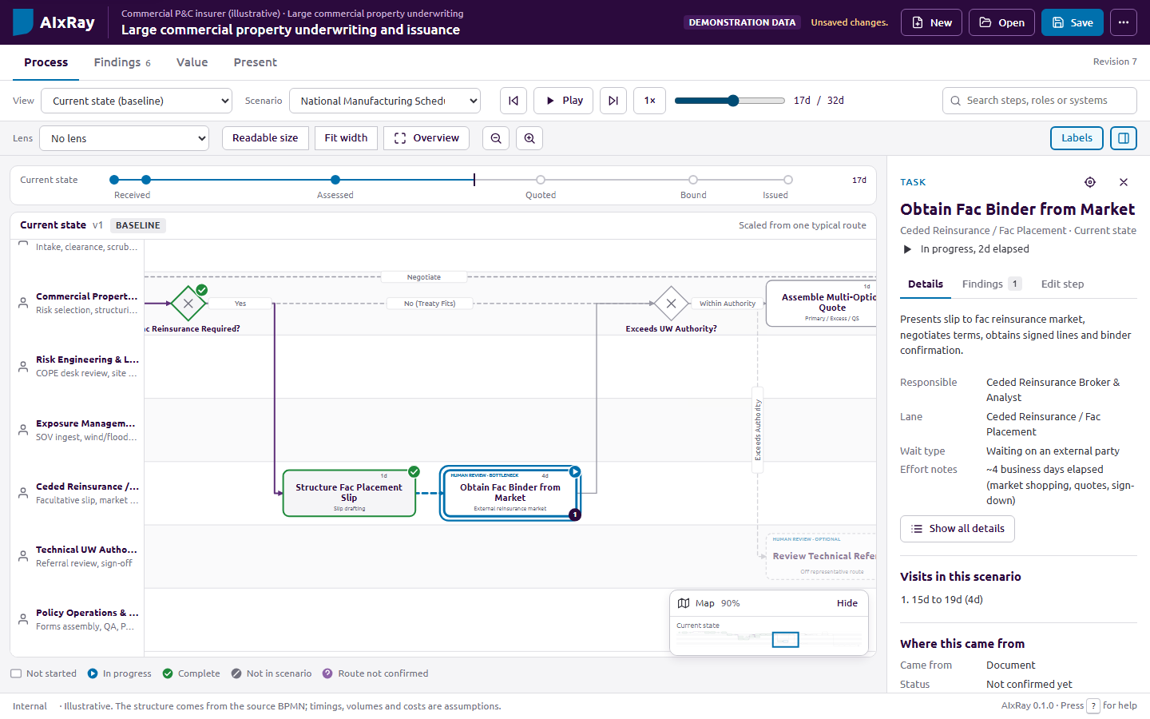
AIxRay is a workbench for process workshops
THE TOOL
01
Plays a case through the process step by step, on one screen the whole room can follow.
02
Records pain points, questions and ideas on the step where they come up.
03
Compares today's process with a future design on the same clock.
04
Shows every figure with its formula and inputs, labeled by how much we know about them.
05
Runs in the browser from local files, with no server, account or installation.
Illustrative example: commercial property underwriting, demonstration data.
Notes:
AIxRay is the workbench we use to deal with those three problems. It plays a case through your process step by step, on one screen that the whole room can follow. When someone raises a problem or an idea, we record it on the step where it came up. It lets us compare today's process with a future design on the same clock. Every figure it shows comes with its formula and inputs, and each input is labeled by how much we actually know about it. And it runs in the browser from local files, so there is no server, no account and nothing to install on your side. What you see here is a demonstration example from insurance underwriting.

Slide 6
One model carries the work from understanding to evaluation
HOW AIXRAY FITS IN A JUMP START
The workshop runs as three conversations, understand, reimagine and evaluate, with preparation before and a clear hand-over after.
BEFORE
01
02
03
AFTER
Prepare
Understand
Reimagine
Evaluate
Hand over
We gather your procedures, maps and notes, plus a system event log where one exists, and draft a first model.
We walk routine cases and exceptions with the people who do the work, correct the model live and capture findings.
We try removing, simplifying and connecting steps before adding automation and AI, and design the controls.
We model cycle time, effort and cost against today's baseline, test key assumptions and rank opportunities.
We agree a checkpoint, produce the pilot brief and report, and send a review form to wider stakeholders.
ON SCREEN IN AIXRAY
AI-drafted model, reviewed by our team
Walkthrough and findings at each step
Future alternatives and automation designs
Value, sensitivity, matrix and waves
Pilot brief, report, review form and exports
Notes:
Here is how it fits into the Jump Start. Before we meet, we gather the material you already have, and where it exists a system event log, and we draft a first model. The workshop itself is three conversations. In Understand, we walk routine cases and exceptions with the people who do the work and correct the model live. In Reimagine, we look at removing, simplifying and connecting steps before we add automation or AI, and we design the controls for each AI step. In Evaluate, we model cycle time, effort and cost against today's baseline and rank the opportunities. Afterwards, we agree a checkpoint, produce the pilot brief and report, and send a review form to anyone who could not attend.

Slide 7
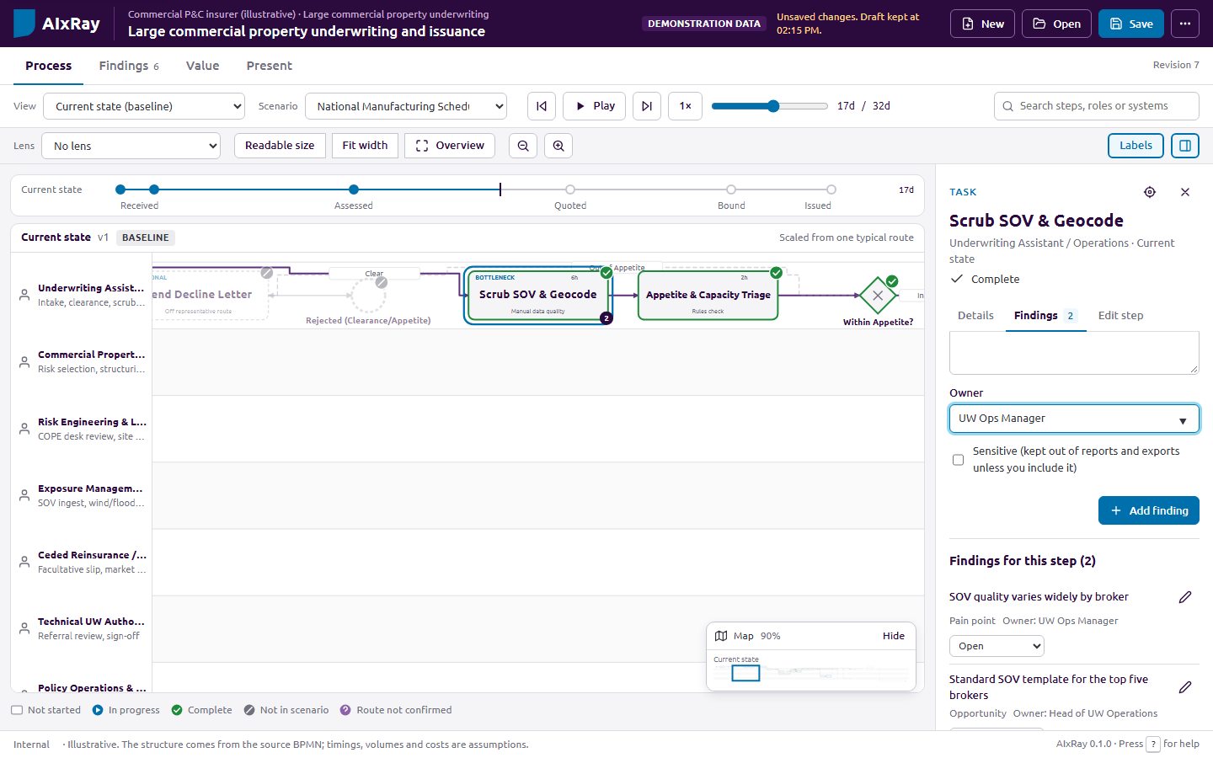
Agree how the work runs today
01 UNDERSTAND
A
Start from what you have. Procedures, maps, slides, notes or BPMN files. AI can draft the first model; our team reviews it before you see it.
B
Walk the routes. The routine case first, then the exceptions, choosing each branch with the participants.
C
Capture at the step. Pain points, open questions and decisions are recorded where they arise, each with an owner.
D
Keep evidence apart from belief. Each step shows where it came from and whether you have confirmed it.
Findings recorded on the step they belong to. Illustrative example, demonstration data.
Notes:
The first conversation is about agreeing how the work runs today. We start from the evidence you already have. AI can help us draft a first model from your documents, and our team reviews that draft before you ever see it. In the room, we walk the routine case first and then the exceptions, and the participants choose each branch. When a pain point, a question or a decision comes up, we record it on that exact step and give it an owner. And every step shows where it came from and whether you have confirmed it, so we keep what we know apart from what we still need to check.

Slide 8
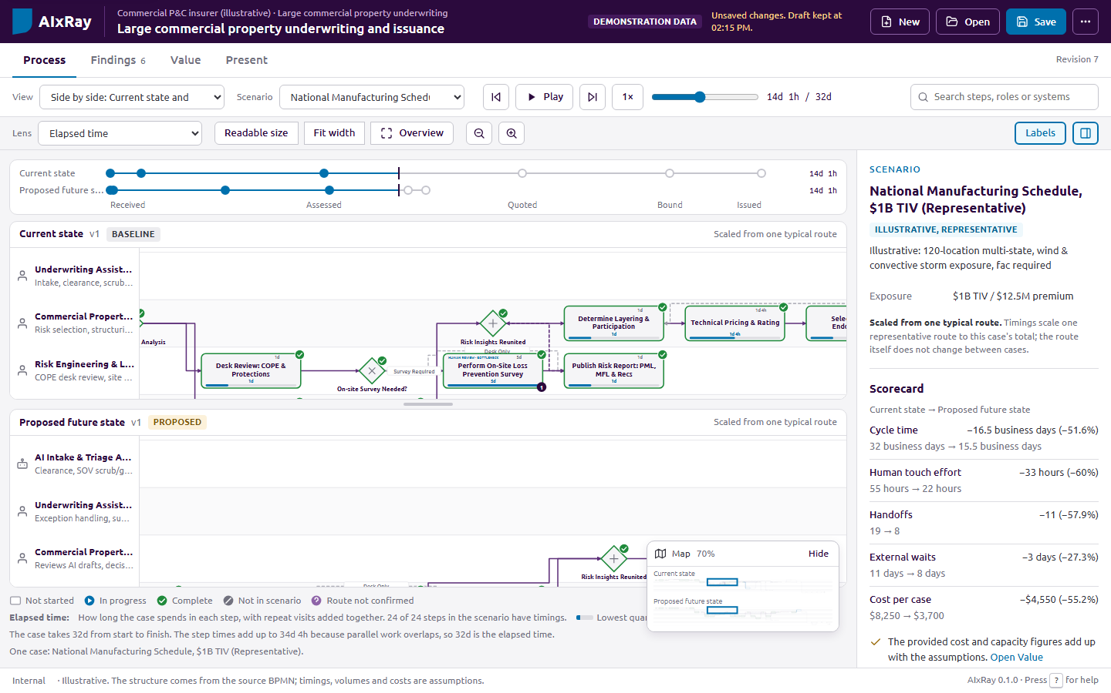
Design the future process against a locked baseline
02 REIMAGINE
A
Simpler changes first. Each opportunity asks whether removing, simplifying, standardizing or connecting systems would do the job before automation or AI.
B
A baseline that cannot drift. Today's process is locked. Every future alternative records which steps changed, were added or removed, and why.
C
Side by side, on one clock. Both versions play together, so the room sees where time, handoffs and waits fall away.
Current and proposed future state with the scorecard. Illustrative example, demonstration data.
Notes:
The second conversation is about the future. We deliberately ask whether a simpler change would do the job before reaching for automation or AI: removing a step, simplifying it, standardizing it or connecting two systems. Once we start designing, today's process is locked as a baseline, so it cannot quietly drift. Every future alternative records which steps changed, were added or were removed, and why. Then we play both versions side by side on the same clock, and the room can see where time, handoffs and waiting fall away.

Slide 9

Every AI step is designed with its controls
02 REIMAGINE
For each step where automation or AI does the work, we write down how it is supervised before it goes anywhere near a pilot.
Approvals, permissions, escalation and test criteria stay attached to the design and flow into the pilot brief and its acceptance criteria.
DESIGN ELEMENT | EXAMPLE: AI CHECKS APPLICATION COMPLETENESS
Trigger | Application received
Rules and limits | Check required fields only. Do not approve applications.
Approval | Case handler approves every external message.
Fallback and escalation | Return to manual intake when extraction fails. Escalate uncertain cases to the duty manager.
Test criteria | Flag every missing required document in the agreed test set.
Owner | Operations lead
People keep the decisions that need judgment.
Illustrative example from a synthetic workshop.
Notes:
Whenever automation or AI takes on a step, we design its controls at the same time. On the right is an example from a synthetic workshop: an AI step that checks whether an application is complete. We write down what triggers it, the rules and limits it works within, who approves its output, what happens when it fails or is unsure, how we will test it, and who owns it. Those controls stay attached to the design and carry through into the pilot brief and its acceptance criteria. The aim is that people keep the decisions that need judgment.

Slide 10
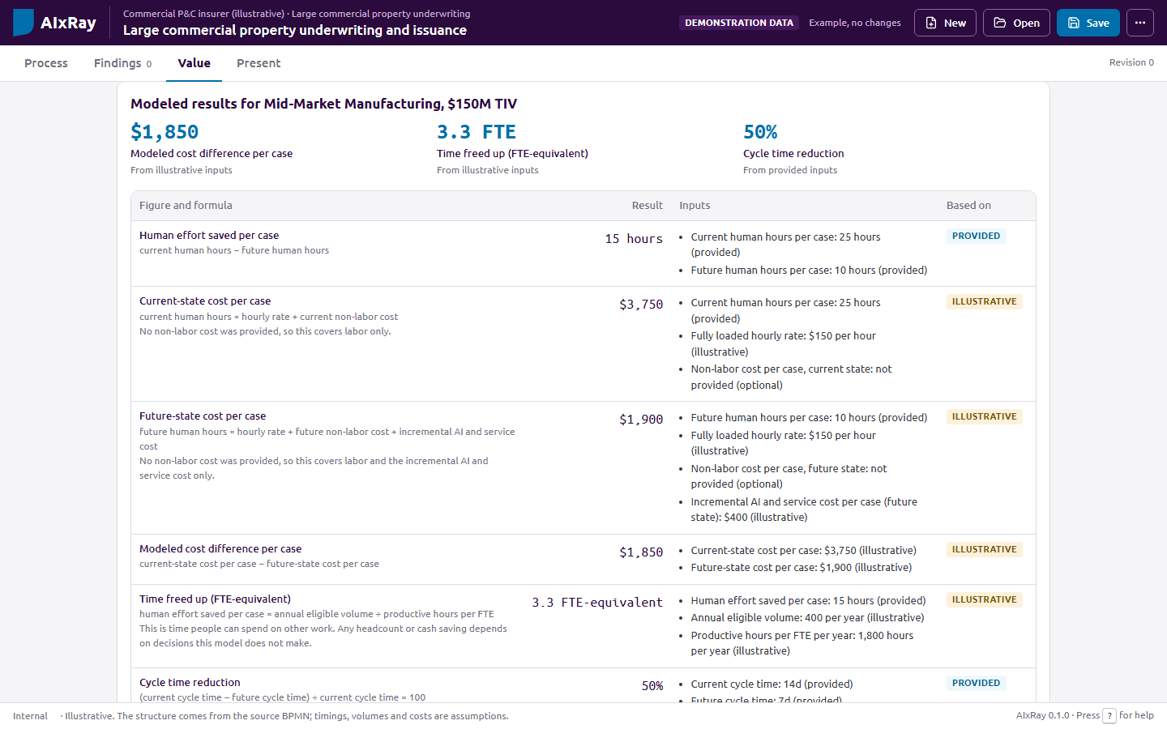
Directional estimates you can check line by line
03 EVALUATE
Cycle time
Human effort
Start to finish, waits included
Hands-on hours per case
Operating cost
Freed capacity
Labor plus AI and service cost
Time released, in FTE
→
Every figure shows its formula and inputs. Each input is labeled illustrative, provided, measured or confirmed.
→
A missing input leaves the result blank rather than assuming zero.
→
A sensitivity view shows which inputs move the result most, which tells us what to validate first.
Directional estimates for decision-making, not guaranteed results. Illustrative example, demonstration data.
Notes:
The third conversation is about value. We look at four measures: cycle time, human effort, operating cost and the capacity that is freed up. The important part is how those numbers are built. Every figure shows its formula and its inputs, and each input is labeled as illustrative, provided, measured or confirmed. If an input is missing, the result stays blank rather than quietly assuming zero. And a sensitivity view shows which assumptions move the result the most, which tells us what to validate first. These are directional estimates to support a decision, not guaranteed results.

Slide 11
From a list of findings to a plan in waves
03 EVALUATE
Each opportunity carries a small business case: effort saved, cases affected and cost to deliver. That lets us compare them on the same terms.
Value against effort
Delivery waves
Lower effort
Higher effort
Now
Quick wins and the first supervised AI pilot, with acceptance criteria and owners.
Quick wins
Major projects
Higher value
Start here
Plan and fund deliberately
Next
Changes that depend on the pilot's results or on connecting systems.
Fill-ins
Reconsider
Later
Larger redesigns, kept visible with their open questions.
Lower value
Do when capacity allows
Challenge before committing
Each wave shows a running total of its modeled value, built from the same formulas as the individual opportunities.
Notes:
From there we turn the findings into a plan. Each opportunity carries a small business case, which means we can compare them on the same terms. We place them by value against effort, which separates quick wins from major projects, fill-ins and ideas we should reconsider. Then we group them into delivery waves: what to do now, including the first supervised AI pilot, what comes next, and what comes later. Each wave carries a running total built from the same formulas.

Slide 12


Add measured data when you have it
BEYOND THE WORKSHOP
Workshop estimates are a starting point. If your workflow, ticketing or core system can export an event log, the same model can show how the process actually runs.
Only aggregates are kept
Counts and times per step. Individual events, case IDs and the names of people in the log are not stored.
Measure today's process
Check whether a change worked
How many cases reach each step, how long each step takes and which paths cases follow, shown next to what the workshop captured.
A log from before a change and one from after are compared step by step, with caveats such as seasonality and volume mix stated alongside.
Notes:
The workshop gives you estimates, but it does not have to stop there. If your workflow, ticketing or core system can export an event log, we can load it into the same model and see how the process actually runs: how many cases reach each step, how long each step takes and which paths cases follow. Later, a log from before a change and one from after can be compared step by step, with the caveats stated alongside. Only aggregates are kept, so no individual events, case IDs or names are stored.

Slide 13
What you take away from the Jump Start
OUTCOMES
01
02
03
Current-state model
Future-state design
Prioritized opportunities
Agreed with the people who run the process, with its sources and open questions.
One or more alternatives compared with the baseline, each change with its reason.
Ranked by value against effort and grouped into now, next and later.
04
05
06
Pilot brief
Report and review form
Exports for your tools
Automation designs with their controls, acceptance criteria and owned actions.
A printable summary, and a form that lets stakeholders confirm or dispute each step.
A PowerPoint deck, a BPMN 2.0 diagram, and a Jira, Azure DevOps or Excel backlog.
Notes:
So what do you take away? An agreed model of your current process with its sources and open questions. A future-state design compared against that baseline, with a reason for every change. A prioritized list of opportunities grouped into waves. A pilot brief with the automation designs, their controls, acceptance criteria and owners. A printable report, plus a review form your wider stakeholders can use to confirm or dispute each step. And exports into the tools your teams already use: PowerPoint, BPMN, and a Jira, Azure DevOps or Excel backlog.

Slide 14
Your material stays under your control
DATA HANDLING
Runs from local files
AI drafting is optional and labeled
Opened from disk, AIxRay makes no network requests. The saved project file is the record, stored like any other client document.
AI runs only on approved commercial plans with the project lead's approval. Every AI draft stays out of reports and exports until a person reviews it.
Sensitive findings stay out by default
Review forms carry only what you choose
Findings marked sensitive are left out of reports, review forms and exports unless someone deliberately includes them.
Steps and selected findings, with no figures, sources or notes. The form sends nothing anywhere; answers come back as a file.
Where material includes personal or otherwise regulated data, we agree the handling with your data protection officer before the workshop.
Notes:
A word on your data, because I know it matters. AIxRay runs from local files, and when it is opened from disk it makes no network requests at all. Using AI to draft material is optional. It only runs on approved commercial plans with the project lead's approval, and every AI draft stays out of reports and exports until a person has reviewed it. Findings marked sensitive are left out by default, and review forms carry only what we choose to include. Where your material includes personal or regulated data, we agree how to handle it with your data protection officer before the workshop starts.

Slide 15

What we ask of you before the workshop
GETTING READY
01
A candidate process with a clear start, a clear end and a business owner who wants it improved.
02
The right people in the room: those who run the work day to day, and a decision maker for the checkpoint.
03
The evidence you already have: procedures, process maps, slides, notes or BPMN files, and a system event log if one is available.
04
Rough figures: volumes, effort, waiting times and costs. Estimates are fine; we label them as assumptions and test which ones matter.
Notes:
To get ready, we need four things from you. A candidate process with a clear start and end, and a business owner who wants it improved. The people who run that work day to day, plus a decision maker who can sign off the checkpoint. Whatever evidence you already have, and an event log if one exists. And rough figures for volumes, effort, waiting time and cost. Estimates are perfectly fine; we label them as assumptions and test which ones actually matter.

Slide 16

Which process should we put under the AIxRay?
Choose a candidate process, confirm participants and dates, and share what you have so we can prepare a first model.
Notes:
Which brings me to the question I would like us to leave with: which process should we put under the AIxRay? If we can agree on a candidate together, confirm who should be in the room and when, and you can share the material you already have, we will prepare a first model before we meet. Thank you. I am happy to take questions, or to show you the tool live.

Slide 17
Notes:
Before we finish, a word about us. Sogeti is part of the Capgemini Group, and we focus on making technology simple and impactful, with AI-driven solutions across quality engineering and testing, data and cloud. AIxRay is one of the ways we help clients turn ideas into action quickly.

Slide 18
Notes:
Thank you for your time. I look forward to choosing the first process with you.

