Slide 1

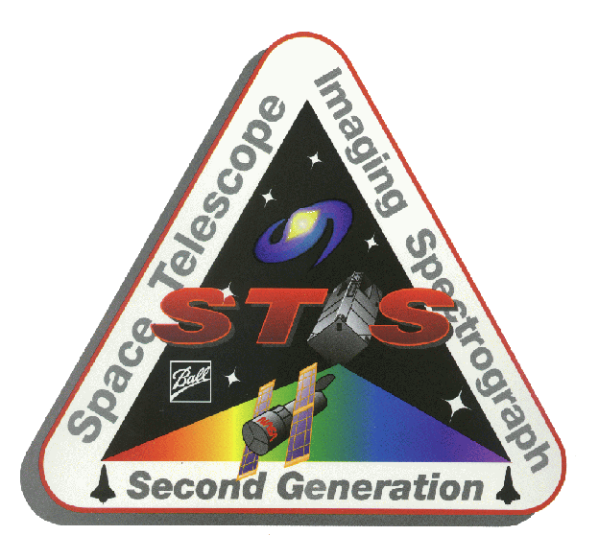
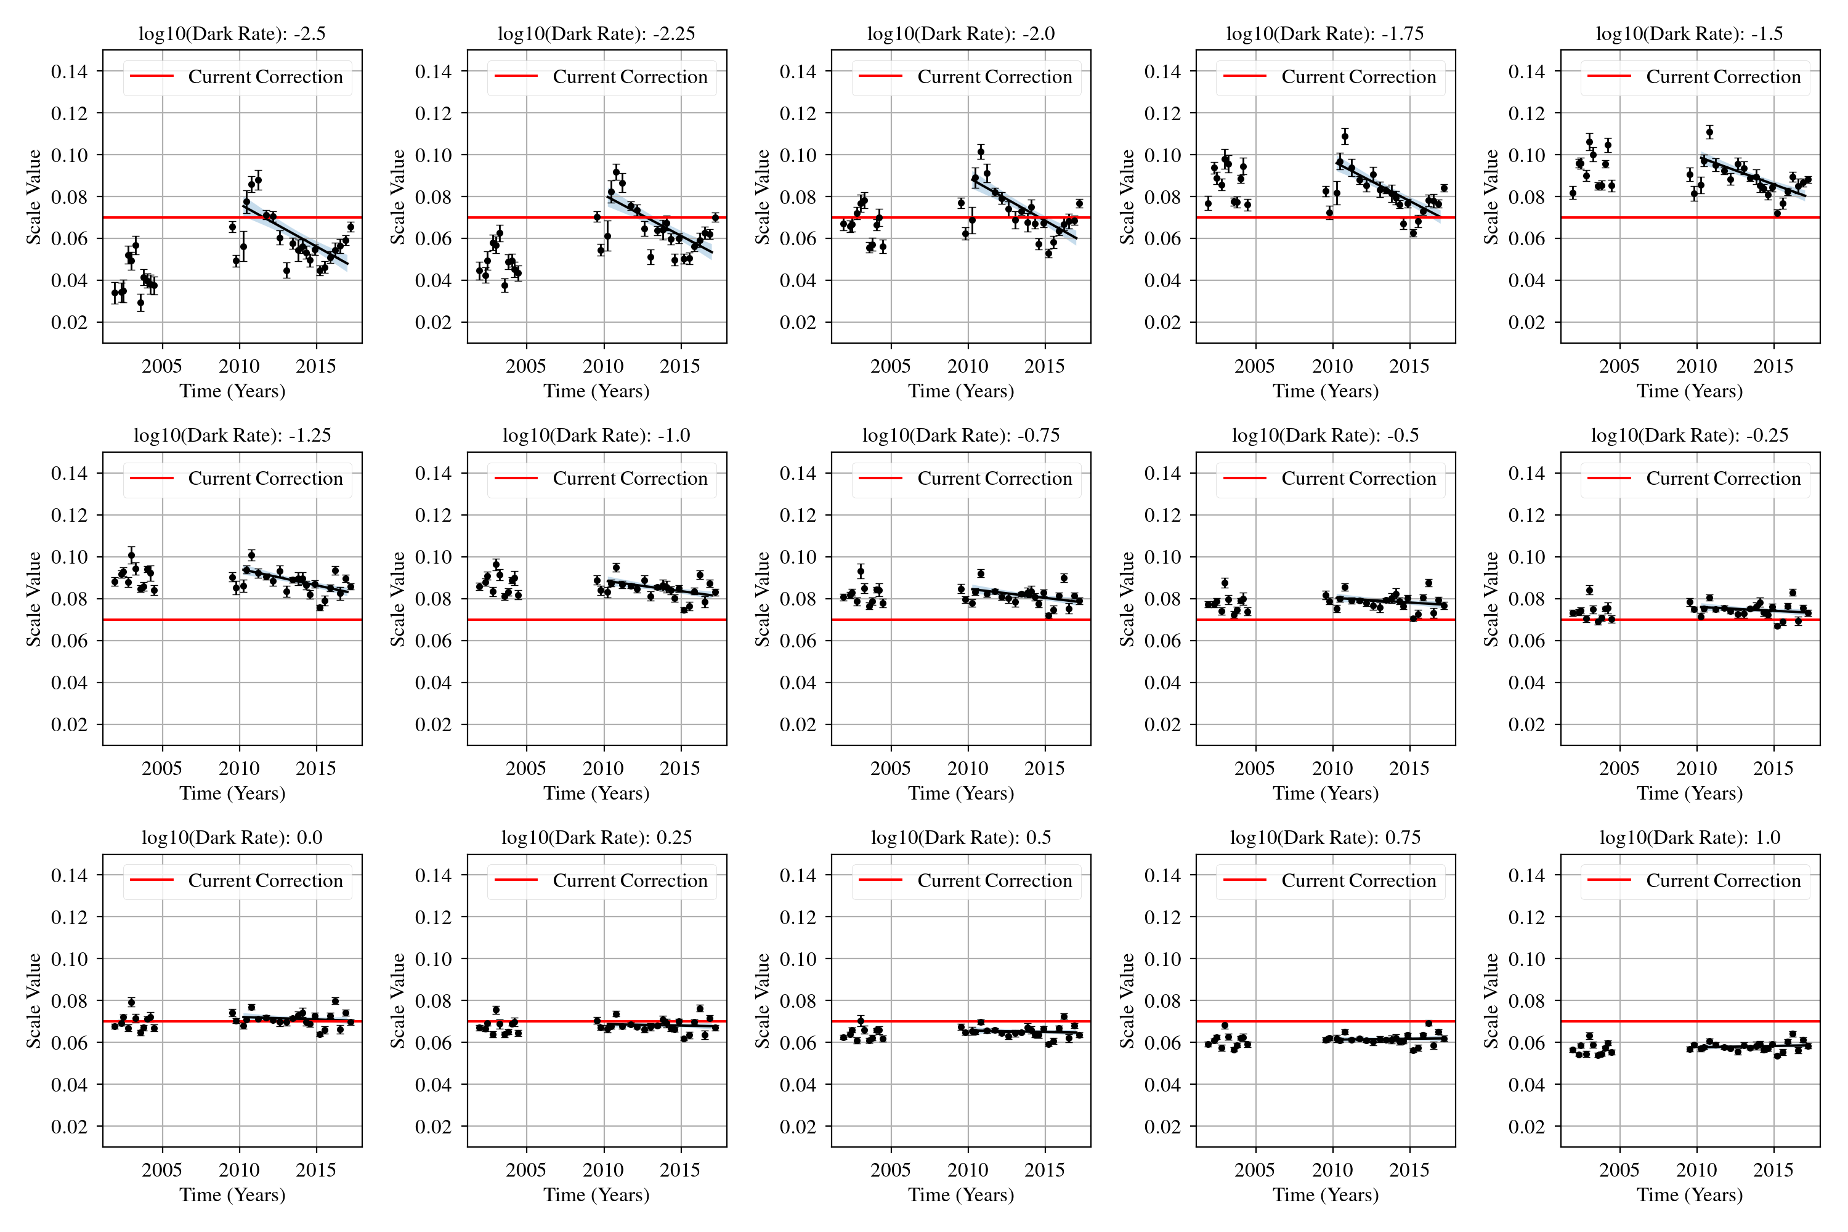
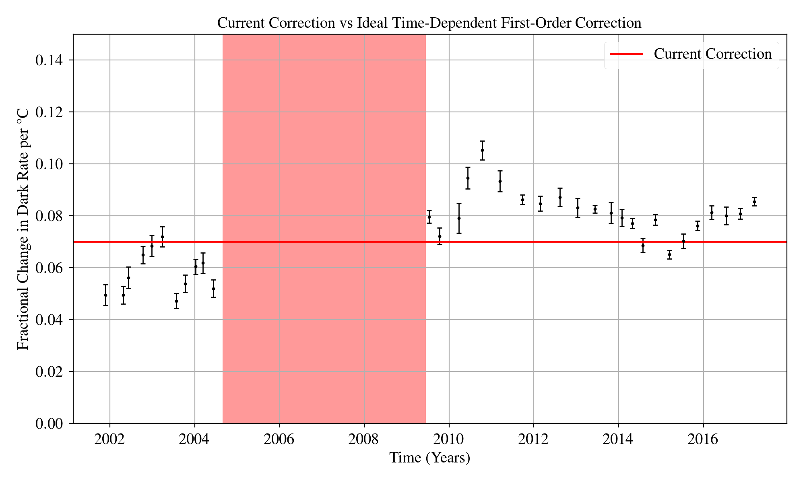
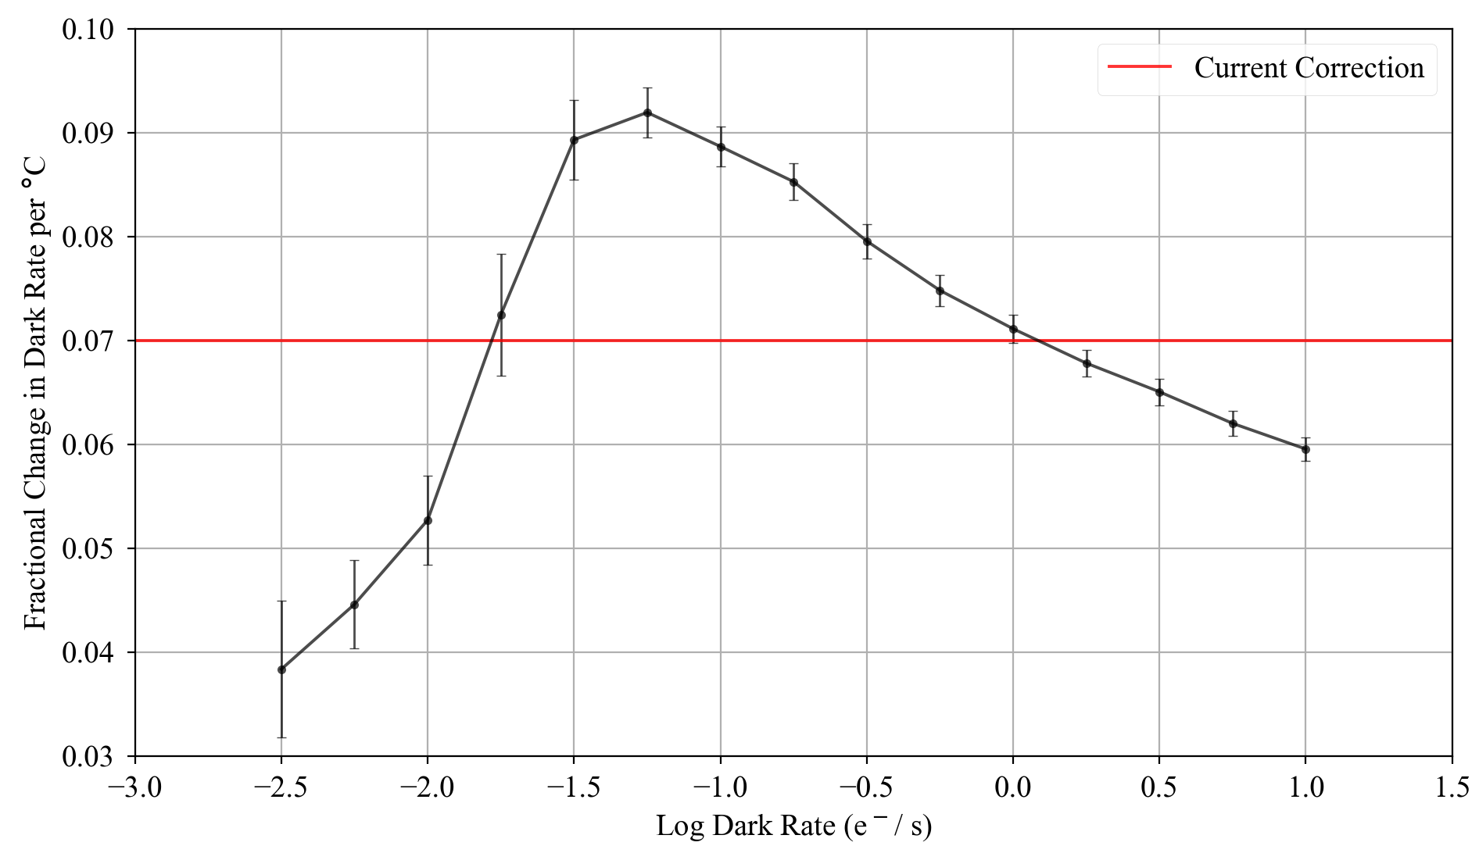
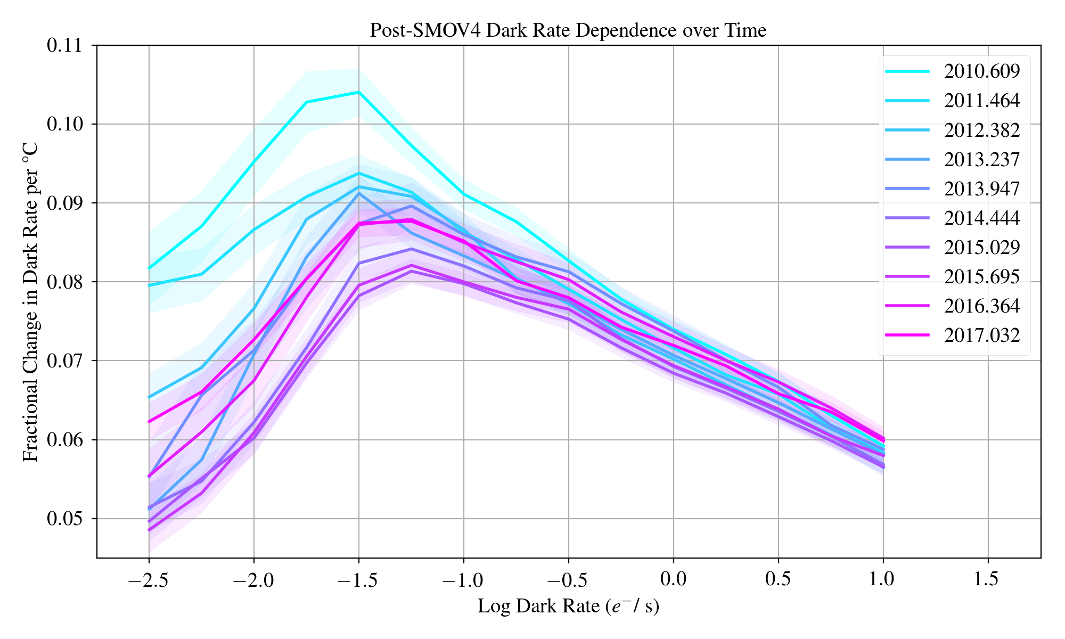
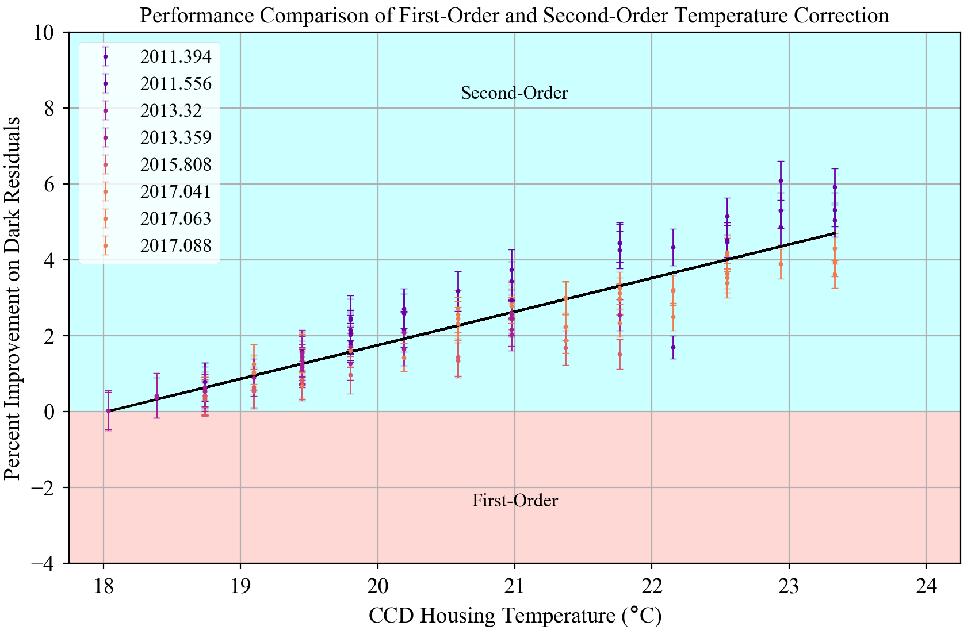
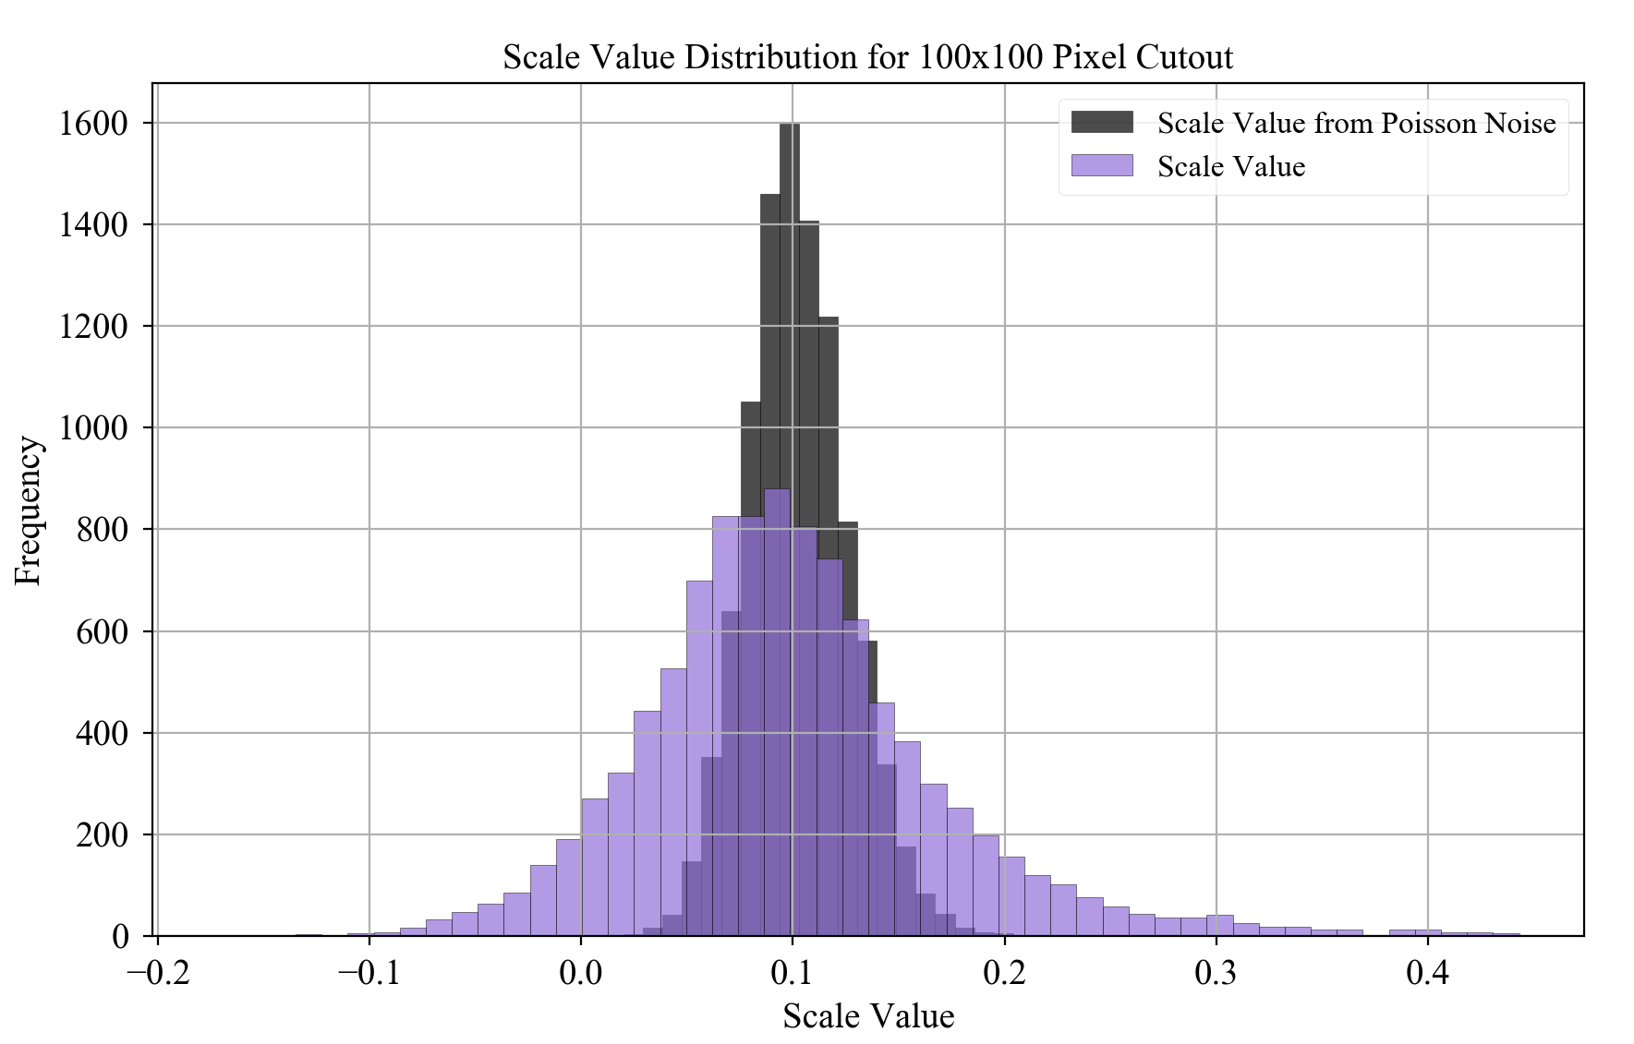
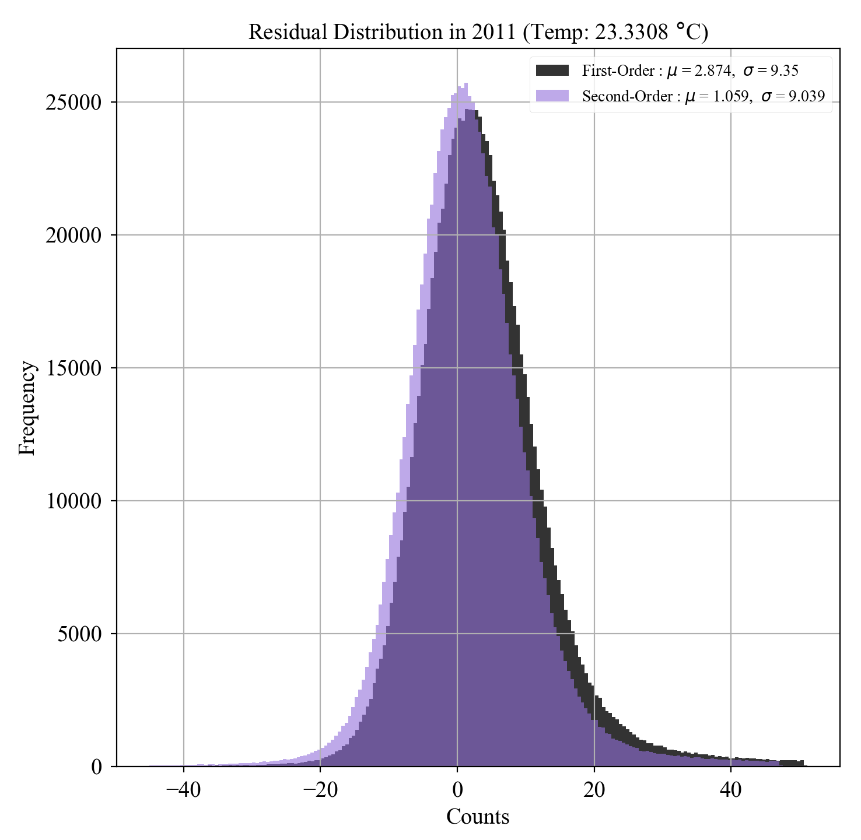
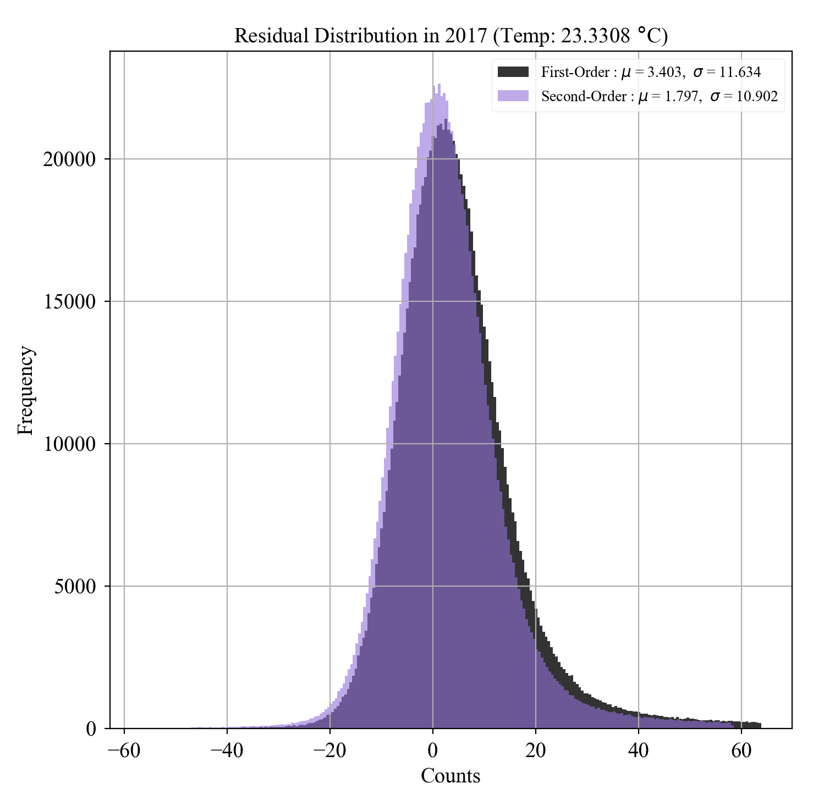
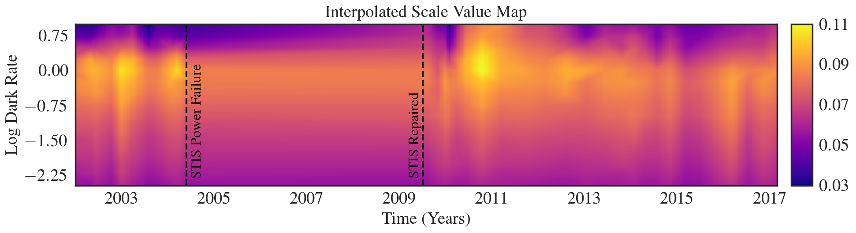
Performance of the STIS CCD Dark Rate Temperature Correction
Doug Branton
Abstract
Since July 2001, the Space Telescope Imaging Spectrograph (STIS) onboard the Hubble Space Telescope has operated on its Side-2 electronics due to a failure of the primary Side-1 electronics. While nearly identical, Side-2 lacks a functioning temperature sensor for the CCD, introducing a variability in the CCD operating temperature. Previous analysis utilized the CCD housing temperature telemetry to characterize the relationship between the housing temperature and the dark rate. It was found that a first-order 7%/°C uniform dark correction demonstrated a considerable improvement in the quality of dark subtraction on Side-2 era CCD data, and that value has been used on all Side-2 CCD darks since. In this report, we show how this temperature correction has performed historically. We compare the current 7%/°C value against the ideal first-order correction at a given time (which can vary between ~6%/°C and ~10%/°C) as well as against a more complex second-order correction that applies a unique slope to each pixel as a function of dark rate and time. Additionally, we present initial evidence suggesting that the variability in pixel temperature-sensitivity is significant enough to warrant a temperature correction that considers pixels individually rather than correcting them uniformly.
1. History of the CCD Dark Rate Temperature Sensitivity
At the Beginning of Side-2:
The sensitivity of the CCD dark rate to changes in temperature was, itself, dependent on the dark rate. The current temperature correction is a 7%/°C “first-order” correction from the reference temperature (18°C), applied uniformly to all pixels on the detector. It was chosen as it represents the middle point of the “scale value curve”.
Surveying the Scale Value across Dark Rate and Time:
A historical survey of the temperature sensitivity reveals several time-dependent characteristics of the detector.
Different dark rates evolve differently in time. Colder dark rates exhibit much more time-dependent variability than their warmer counterparts.
Temperature sensitivity spiked sometime in 2010. Colder dark rates experienced a ~2 %/°C spike in 2010 and have been linearly decaying ever since.
The Optimal First-Order Correction in Time:
The time evolution of the scale value curve combined with the linear growth of the median dark rate over time indicates that the optimal first-order correction has changed in time.
2. The Second-Order Method
3. Correction Method Comparison
4. Pixel Uniqueness
Dark Corrected Residuals:
Temperature correction methods can be compared by using each method to scale a super-dark to the temperature of a “science” dark. The magnitude of the residual is a measurement of the error in the temperature scaling method. Overall, the second-order method removes ~1%/°C more dark current than the first-order method.
A Case Against Generalizing Pixels:
For a given anneal period, the spread in individual pixel scale values is quite large. In the first-order case, every pixel is scaled uniformly using the 7%/°C scale value. Even in the second-order case, the applied scale value only ranges between 5%/°C and 10%/°C. For a large subset of the pixels (at all dark rates), these methods are suboptimal. In order to address this, a “pixel-by-pixel” method would apply a specific scale value to each pixel individually based on that pixels observed temperature sensitivity.
Accounting for Dark Rate and Time Dependence:
Instead of applying a flat scale value to all pixels uniformly, the second-order method applies a unique scale value to each pixel based on that pixels dark rate at the reference temperature and the time of the observation. This is done by linearly interpolating to the given dark rate and time from the historical survey data.
Science Impact:
At long exposure times and high temperatures, the performance benefit of the second-order method is maximized. Here at t=1100s, it removes ~1.5 additional dark counts per pixel. The benefit for a typical STIS observation (~20.5°C and t < 500s) is much smaller, with only a 2% difference between the two methods. This indicates that, over the history of STIS Side-2, the first-order correction has performed at a satisfactory level for the vast majority of STIS observations
Interested in the Project?
This Analysis will be detailed in an upcoming STIS Instrument Science Report.
References:
STIS ISR: “Temperature Dependence of the STIS CCD Dark Rate During Side-2 Operations”, Brown, 2001
STIS ISR: “Performance of the STIS CCD Dark Rate Temperature Correction”, Branton, 2018 (in review)
Source Code & Poster: https://github.com/dougbrn/STIS-TV
Questions? Want to be put on the STIS mailing lists?: Email dbranton@stsci.edu or help@stsci.edu

