Slide 1
Agentic Programming and RAG:
>>>50% of RAG deployments don’t work. How to make sure that doesnt happen to you.
Poor RAG Design
Throw everything into 1 massive vector db and DB and inverted index. Works in prototype, Always fails in production.
Document chunks don’t match vector search. Most policies are not based on vector similarity or keyword search. Dental insurance enrollment policy will never work with standard RAG. (DEMO)
Rerankers get overwhelmed. 10-20 max before being sent to the LLM. Adds latency and the relevant chunk never makes it to the LLM
Images; incorrect parsing from legacy OCR adds noise
Parsing errors typically near figures or tables pollute the index. TOC, Index pages, fragments of rows. Entries with no context. Most common solution is a hierarchical context. Tradeoff context length for bigger search result to get @top1
7% intrinsic failure rates for LLMs, will not see failures in production, Production failures cause MGMT to pull plug on funding project.
Poor Data Quality
Mix of images and text extracted pdfs. Missing data, PDFs look ok but internal database doesnt reflect status of documents. Images and tables cause cascading legacy OCR Failures.
Divide the corpus into clusters. Having one corpus with research, policies, SEC statements is guaranteed failure
Improper context attributed to figures, tables. Use LLM to add context, low cost if caching setup correctly
Improper filtering of noise. TOC and Indexes in search indexes pollute index.
LLM routers fail because of hallucinations. Not repeatable, can’t debug. Poor system reliability. Deterministic routers brittle.
Notes:
Opening thesis: more than half of RAG deployments fail, and they fail for predictable reasons. The two big buckets are poor design (one giant vector index, overloaded rerankers, standard RAG applied to rule-based policy questions) and poor data (bad OCR and parsing around tables and figures, TOC and index noise, missing context on figures). Grounded hallucination rates of a few percent stay invisible in a prototype and surface only at production scale, which is often when funding gets pulled. The rest of the talk shows each failure and the fix.

Slide 2
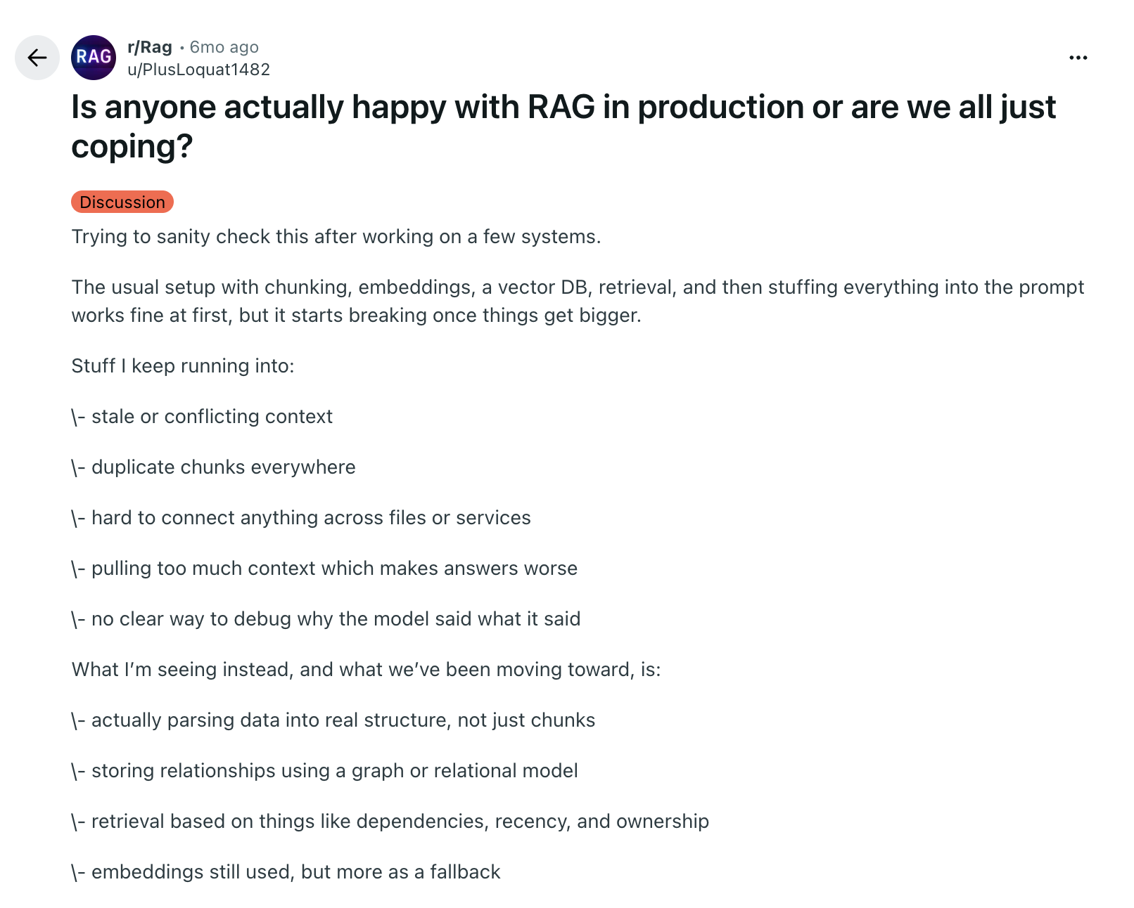
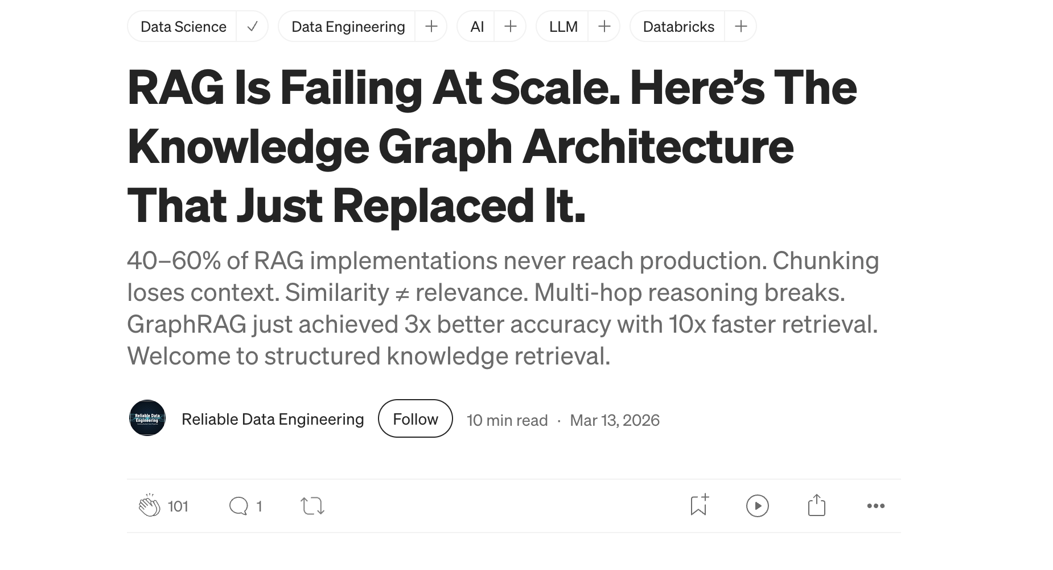
Notes:
This is not just our experience. Practitioners report the same pattern: a chunk-embed-retrieve pipeline works at first and then breaks at scale, with stale or conflicting context, duplicate chunks, too much context, and no way to debug why the model said what it said. The common direction is to parse documents into real structure and use embeddings as one tool rather than the whole system. The article on the right claims 40 to 60 percent of RAG implementations never reach production.

Slide 3
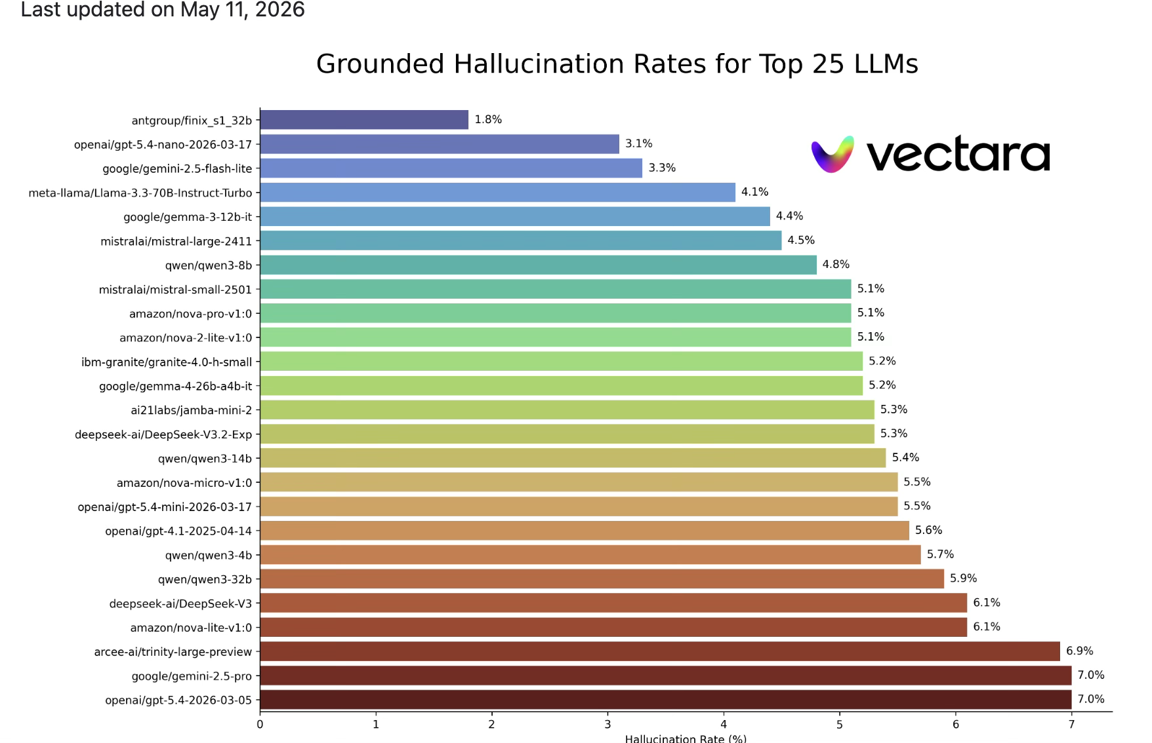
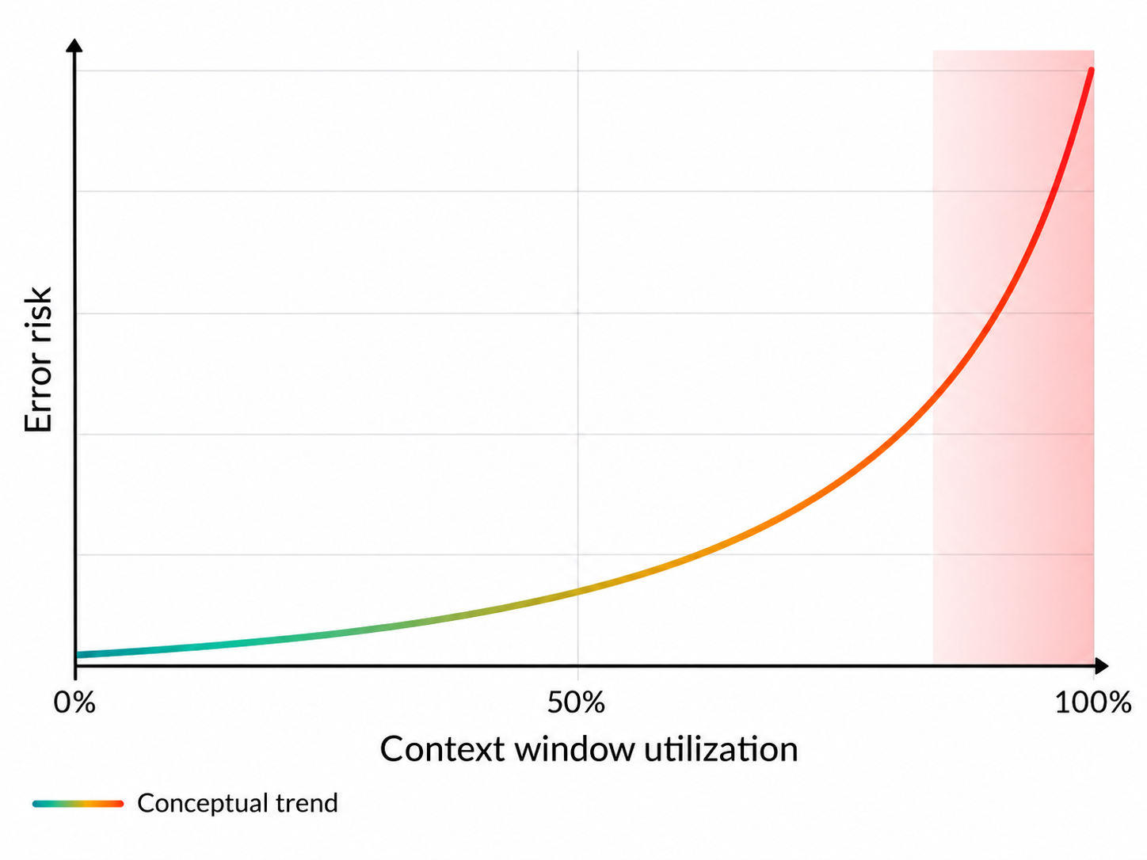
An error rate of 1.8–7% can remain invisible in prototypes and surface only at production scale.
These failures are difficult to simulate before launch.
Notes:
Vectara’s leaderboard measures grounded hallucination: how often a model adds or changes facts when summarizing a document it was given. Even the best models are around 1.8 percent and many sit between 5 and 7 percent. Those rates are too low to notice in a demo but large at production volume. The small curve is a conceptual reminder that error risk climbs as the context window fills.

Slide 4

Intrinsic and extrinsic hallucinations
Both are grounding failures, but they fail in different ways
Intrinsic hallucination
Extrinsic hallucination
Contradicts the retrieved evidence
Adds a claim absent from the evidence
The answer changes a fact that appears in the source.
The answer introduces a fact the source never establishes.
Evidence
Coverage requires prior authorization.
Evidence
The policy lists covered drug codes.
Answer
No prior authorization is required.
Answer
The policy guarantees same-day approval.
Evaluation question: Does the answer contradict the context, or does it go beyond the context?
Notes:
Two kinds of grounding failure. Intrinsic: the answer contradicts the retrieved evidence, for example the policy requires prior authorization and the answer says it does not. Extrinsic: the answer adds a claim the evidence never makes, such as promising same-day approval. The evaluation question is simple: does the answer contradict the context, or go beyond it? Both need checking separately.

Slide 5
Demo
Data Extraction and chunking, claude demo
Figure/table/extraction
how to measure retrieval errors, context assembly errors, answer complerteness errors
Initial hybrid retrieval: top 150 chunks
Reranker scores those 150 chunks with the query
Retain top 20 chunks
Pass those 20 chunks to the LLM
Notes:
Agenda for the demo portion: data extraction and chunking, figure and table extraction, and how to measure the three error types separately: retrieval errors, context-assembly errors and answer-completeness errors. The pipeline used throughout is hybrid retrieval of the top 150 chunks, a reranker that scores those 150 against the query, and the top 20 passed to the LLM.

Slide 6
RAG architectures, from naive to agentic
Notes:
This section walks the standard RAG architectures in order of complexity: the basic index-retrieve-generate loop, how embeddings and cosine similarity work, then hybrid search, reranking, query expansion, HyDE, parent-document retrieval, contextual retrieval, CRAG and agentic RAG. Each one exists to fix a specific failure, which the later sections test.

Slide 7
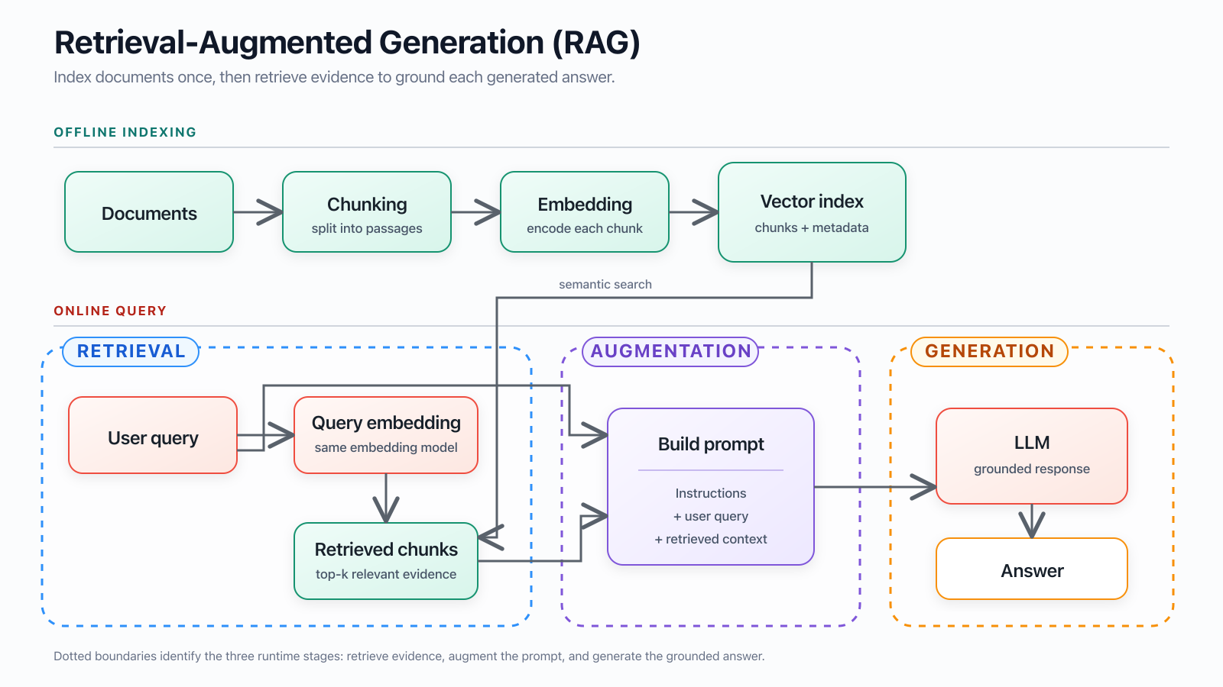
Notes:
The baseline everyone starts from. Offline, documents are chunked, tokenized, sent through embedding model and stored in a vector index. Online, the query is embedded with the same model, the nearest chunks are retrieved, a prompt is built from instructions, the question and the retrieved context, and the LLM generates a grounded answer. Retrieval, augmentation and generation are three separate stages, and each can fail on its own.

Slide 8
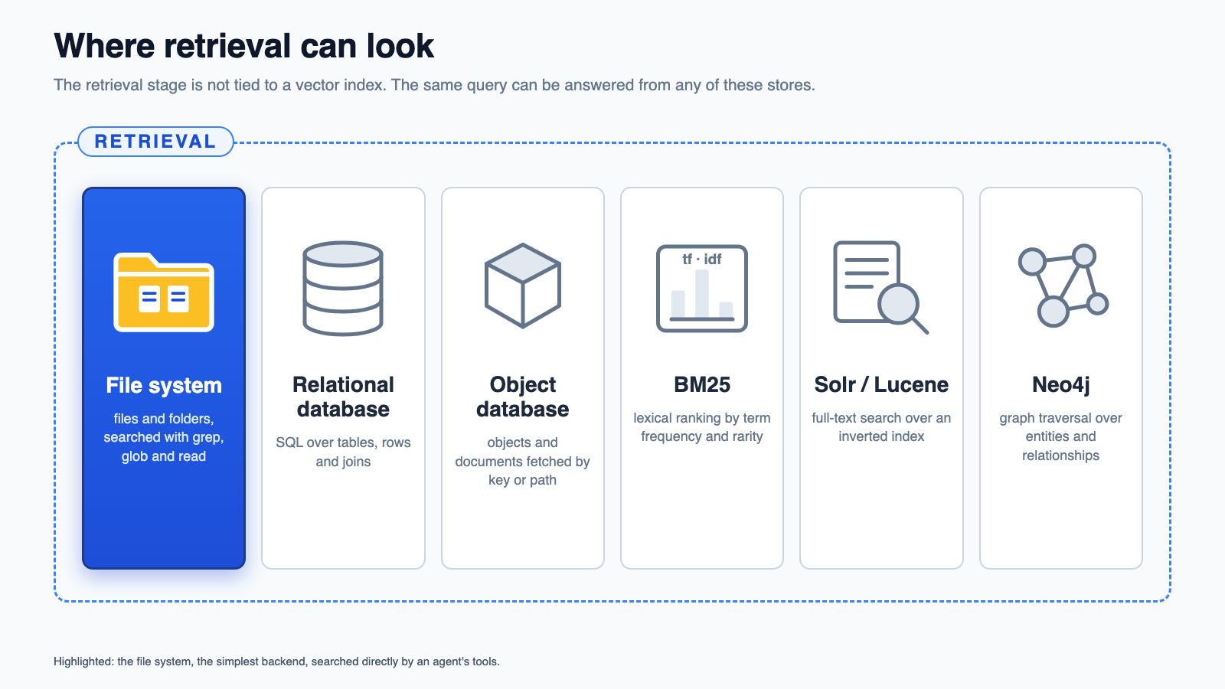
Notes:
Retrieval does not have to mean a vector index. The same retrieval stage from the previous slide can read from a file system, a relational database, an object database, a BM25 lexical index, a Solr or Lucene full-text index, or a Neo4j graph. The file system is highlighted because it is the simplest backend: an agent can search it directly with grep, glob and read, with no index to build or keep in sync. Each of the others trades setup cost for a different kind of match: SQL for structured fields, keys for stored objects, term statistics for exact wording, inverted indexes for full-text search at scale, and graph traversal for relationships between entities.

Slide 9
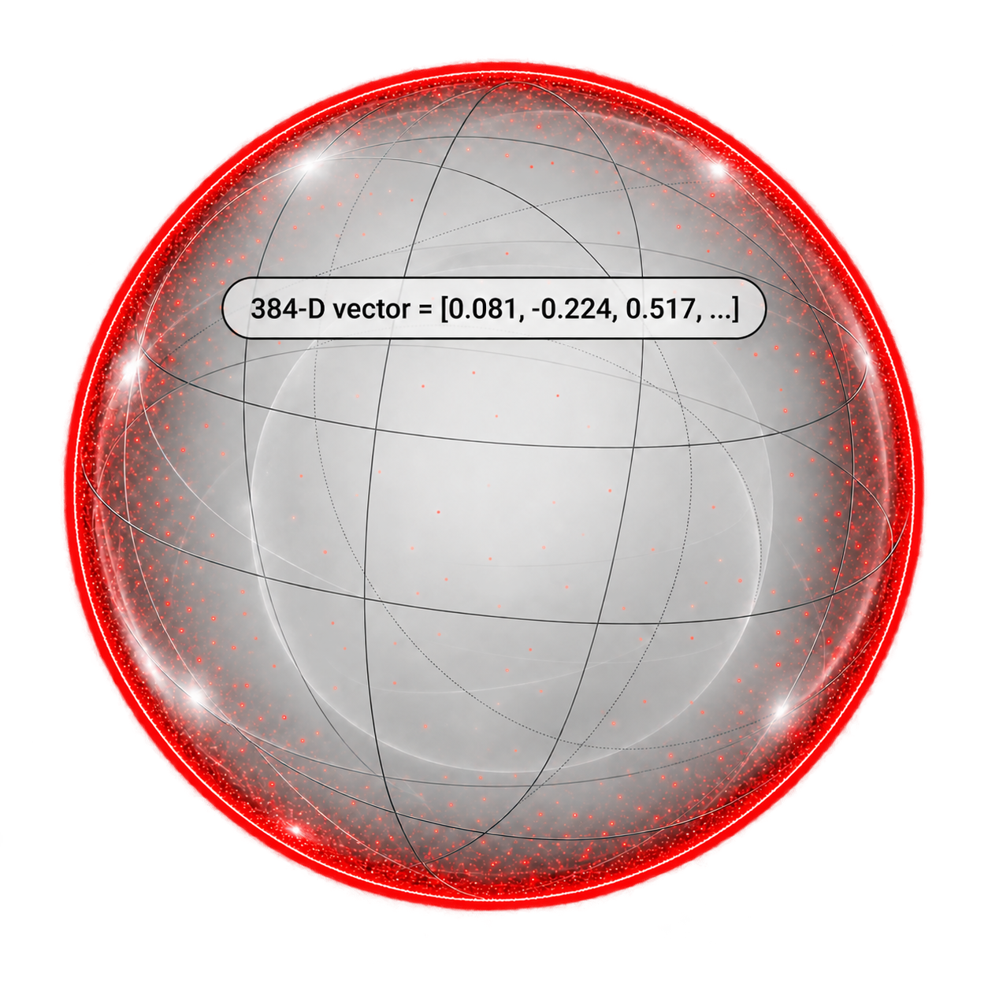
Cosine similarity in 384-dimensional space
The embedding model maps a query and every chunk to 384 floating-point coordinates
1 Query embedding
2 Embedding space
3 Compare direction
“Which policy covers thrombocytopenia?”
cos(q, c) = (q · c) / (‖q‖ × ‖c‖)
chunk B
dot product ÷ vector lengths
Vector length = 384
One coordinate per dimension
Illustrative normalized vectors
chunk A
query q
Chunk A Universal criteria
0.92
The image shows three values.
The ellipsis represents the remaining 381.
closest direction
Chunk B Billing codes
0.41
partial relation
chunk C
Chunk C Revision history
0.08
weak relation
Thin red shell: most probability mass
Highest cosine score
Pale center: very little probability mass
Chunk A becomes the top retrieval match
Cosine similarity ranges from -1 to 1. Higher values indicate more aligned vector directions.
Notes:
Illustrative explanation of the 384-dimensional embeddings used by BAAI/bge-small-en-v1.5 in the table RAG. The embedded image shows the abbreviated vector [0.081, -0.224, 0.517, ...]; the three coordinates and cosine scores are examples, not values from a production query. The monochrome ball is a three-dimensional metaphor for a 384-dimensional space. For a high-dimensional unit ball, most volume lies close to the boundary, represented by the thin red shell; the center contains comparatively little volume.

Slide 10
Retrieval-Augmented Generation (RAG)
OFFLINE INDEXING
Chunking
Embedding
Vector index
Documents
split into passages
encode each chunk
chunks + metadata

Slide 11
Retrieval-Augmented Generation (RAG)
OFFLINE INDEXING
Chunking
Tokenization
BM25 index
Documents
split into passages
extract lexical terms
terms + metadata
Good chunk
Bad chunk
One coherent topic with enough context to make sense by itself.
A fragment with missing context or unrelated material combined.

Slide 12
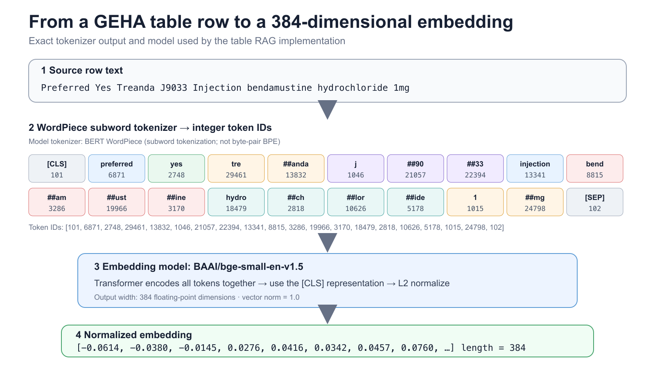
3 SentenceTransformer encoder
BGE-small processes all token IDs together and produces contextual token vectors.
4 Pooling and projection
Use the [CLS] vector. BGE-small has no separate projection layer; other checkpoints may include one.
5 Normalized embedding
Notes:
Short and misspelled queries are divided into WordPiece subwords. SentenceTransformers pads inputs only as needed for batching, and attention masking prevents padding from influencing the embedding. A misspelling changes the subword sequence and can reduce similarity to the correctly spelled indexed text, causing a retrieval miss. It does not directly cause hallucination. Query normalization, spelling correction, medical dictionaries, and hybrid retrieval can improve robustness. The reference architectures dont test for this because we have more fundamental issues to cover.

Slide 13
From a GEHA table row to a BM25 retrieval score
Exact lexical processing used by the table RAG implementation
1 Source row text
Preferred Yes Treanda J9033 Injection bendamustine hydrochloride 1mg
2 Lowercase alphanumeric tokenizer → lexical terms
Implementation: re.compile(r"[a-z0-9]+") applied after casefold()
preferred
yes
treanda
j9033
injection
bendamustine
hydrochloride
1mg
3 Index-time document statistics
4 Query-time BM25 scoring
Count term frequency in each row, document frequency across rows, and row length relative to the corpus average.
Tokenize “Which drug uses J9033?” Exact overlaps contribute. Rare terms weigh more; k₁ = 1.5 and b = 0.75.
5 Ranked lexical matches
Rows with the highest BM25 scores rank first. Zero shared terms produce score 0 and should display “No lexical match.”
Implementation source: context_assembly_benchmarks/table_rag.py · lexical_tokens() and bm25_scores()

Slide 14
Match the tokenizer to the embedding checkpoint
EmbeddingGemma · 768D
One model ID must govern subword segmentation, pooling, projection, and vector size.
1 Pair AutoTokenizer with the exact checkpoint
2 Load the complete embedding pipeline
MODEL_ID = "google/embeddinggemma-300m"
from transformers import AutoTokenizer
tokenizer = AutoTokenizer.from_pretrained(
MODEL_ID,
use_fast=True,
)
ids = tokenizer(
"Preferred: Treanda J9033",
truncation=True,
max_length=2048,
)["input_ids"]
from sentence_transformers import SentenceTransformer
embedder = SentenceTransformer(
MODEL_ID,
truncate_dim=768,
)
q = embedder.encode_query(question)
docs = embedder.encode_document(chunks)
scores = embedder.similarity(q, docs)
print(q.shape) # (768,)
Vocabulary + SentencePiece rules come from MODEL_ID.
Includes mean pooling → dense layers → L2 normalization.
ONE MATCHED PIPELINE
same MODEL_ID
→
subword tokenizer
integer token IDs
→
Gemma 3 encoder
token vectors
→
mean pool + dense
projection
→
L2-normalized
768-D vector
Do not mix checkpoint IDs. AutoModel alone omits EmbeddingGemma’s pooling/projection head; use SentenceTransformer for retrieval embeddings.
Source: Google DeepMind — google/embeddinggemma-300m · 2,048-token context · 768 dimensions (MRL: 512 / 256 / 128)
Notes:
EmbeddingGemma is a 300-million-parameter text embedding model built from Gemma 3. The Hugging Face checkpoint contains more than the transformer weights: it includes the matching tokenizer, mean-pooling configuration, two learned projection layers, and final L2 normalization.
SentenceTransformer loads this complete retrieval pipeline. AutoModel alone returns token-level hidden states from the transformer backbone. To obtain the official EmbeddingGemma vectors with AutoModel, we would need to reproduce the attention-mask-aware mean pooling, the 768 → 3072 → 768 projection layers, and normalization ourselves.
For retrieval, use encode_query() for questions and encode_document() for indexed passages. These methods apply the model’s asymmetric query and document prompt templates. Both sides must use the same checkpoint, pipeline configuration, and output dimension.
The native vector contains 768 dimensions. Matryoshka Representation Learning allows us to shorten it to 512, 256, or 128 dimensions, but query and document vectors must use the same dimension and remain L2-normalized.
This embedding pipeline does not need to match the tokenizer used by the downstream answering LLM. It only needs to remain internally consistent between corpus indexing and query retrieval. Mixing tokenizer files, projection layers, or dimensions from different embedding checkpoints can reduce ranking quality without producing an obvious runtime error.

Slide 15
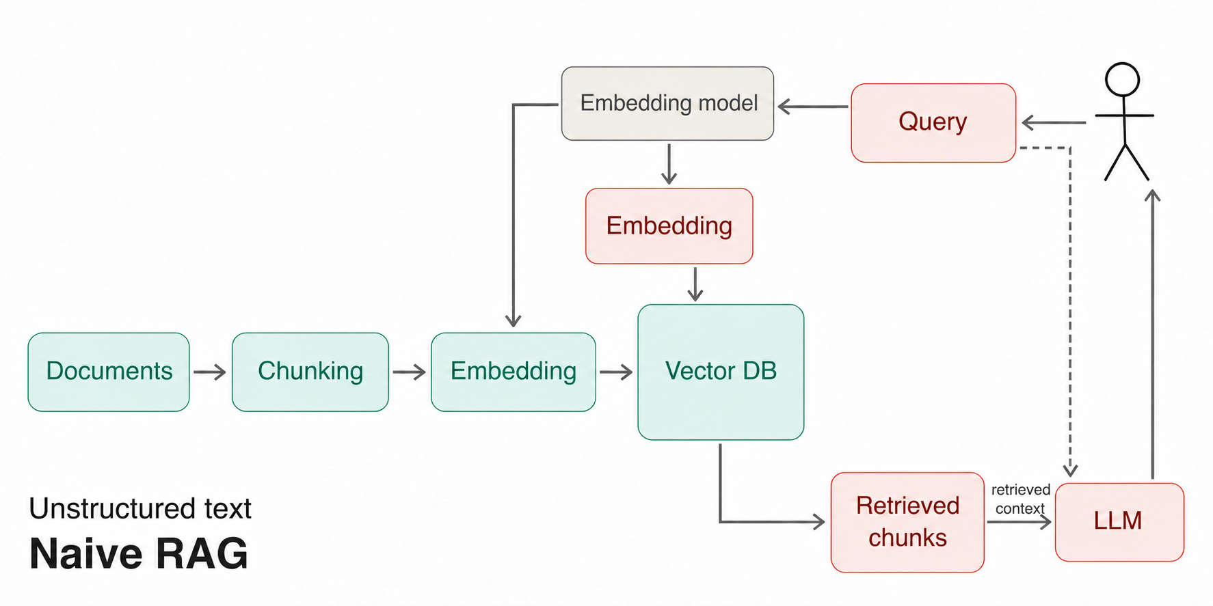
“What help is available if I need an expensive dental procedure and want to minimize my out-of-pocket costs?”
Notes:
Naive RAG on unstructured text. Take a real member question: what help is available if I need an expensive dental procedure and want to minimize out-of-pocket costs? The answer is spread across plan options, coinsurance, annual maximums and discount programs. A single vector search over chunks tends to return fragments of each without the rules that connect them.

Slide 16
A Review of RAG architectures
Structured search: tables where rows should be filtered. Do the filtering in the db and let the tool present a single result like tavily search.
For unstructured data, doesnt support keywords like a drug code: add BM25
If short query creates too many chunks which are irrelevant the short query has been padded with nose. Try HyDe.
underspecified query,
a query–document wording gap:
the wrong retrieval method:
genuinely missing corpus evidence. HyDE only addresses some of those cases.
Notes:
A quick map of which fix fits which problem. Structured data such as tables should be filtered in the database and returned as a single result, the way a search tool returns one answer. Vector search misses exact keywords like drug codes, so add BM25. When a short query pulls many irrelevant chunks, try HyDE. But HyDE only helps some cases: underspecified queries, wording gaps between question and document, the wrong retrieval method, and evidence that is simply not in the corpus each need a different fix.

Slide 17
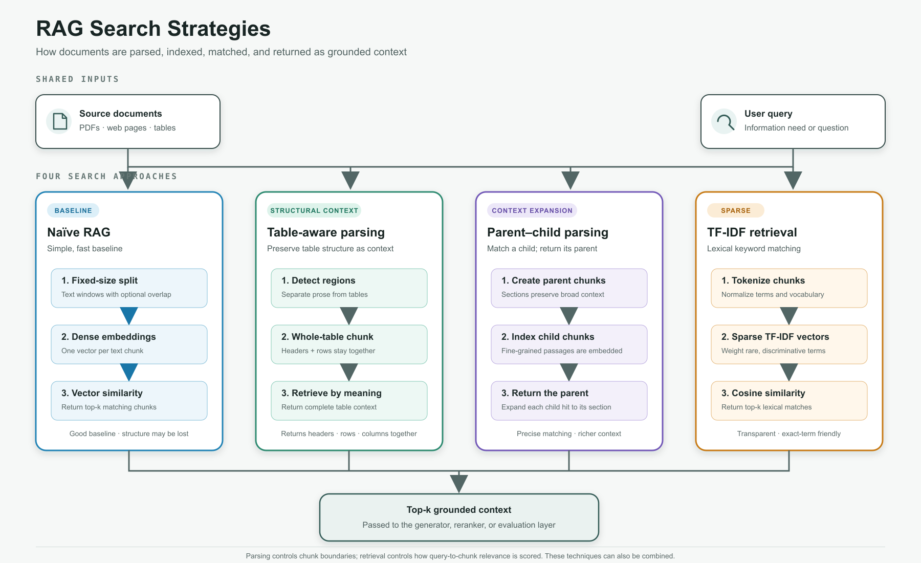
LANGCHAIN PROVIDED
BASELINE
Parent-child parsing
BM25 retrieval
Match a child; return its parent
Lexical relevance scoring
1. Create parent chunks
1. Tokenize chunks
Sections preserve broad context
Normalize terms and vocabulary
2. Index child chunks
2. Score with BM25
Fine-grained passages are embedded
Balance term frequency and rarity
3. Return the parent
3. Rank lexical matches
Expand each child hit to its section
Return top-k keyword matches
Precise matching · richer context
Transparent · exact-term friendly
Notes:
Slide 14 compares four search strategies. The parent-child strategy is shown in blue and labeled LangChain provided because LangChain supplies the ParentDocumentRetriever pattern used as the baseline implementation.
The lexical baseline is BM25, not generic TF-IDF. BM25 uses term frequency, inverse document frequency, and document-length normalization to rank exact-term matches.
The blue treatment identifies the two baseline implementations being compared with the green table-aware parsing path.

Slide 18
Hierarchy-aware retrieval fixes fragments that flat chunking cannot
Current state: full-document Docling and HybridChunker are complete. Table parent/row-child retrieval works separately. Figure and section parent expansion remain to be integrated.
IMPLEMENTATION STATUS
EVALS THE UNIFIED DESIGN SHOULD IMPROVE
Full PDF → DoclingDocument
Parent hit@k
A matching child expands to the correct table, figure or section parent.
Normal text
HybridChunker
Evidence completeness
The assembled context contains every fact needed to answer the query.
COMPLETE
Tables
table parent + row children
Table and figure coverage
A row or caption hit returns headers, sibling rows and visual description.
WORKING SEPARATELY
Figures
parent + caption / OCR / description children
PARTIAL
Fragment rate
Fewer top-k results begin mid-sentence or contain detached values and captions.
Sections / lists
section parent + text / list children
PARTIAL
ACTUAL FLAT-CHUNK FAILURES FROM THE COMPLETED CORPUS
QUERY What factors contributed to higher premiums?
QUERY How does BRG calculate MA payments?
QUERY What is the state’s overall health ranking?
RETURNED ‘very little’ to higher premiums…
RETURNED Figure 4. BRG MA Payment Model Methodology
RETURNED 0.015. Overall, U.S. Value =
Orphan continuation without the preceding category or response scale.
Caption-only result. The diagram content never reaches the answer context.
Detached number without the state, measure, headers or ranking context.
Notes:
This slide corrects the earlier architecture claim. The completed corpus run converts full PDFs into DoclingDocument objects and applies HybridChunker. TableRAG separately embeds row children and returns the complete parent table. Figures are extracted with captions, native text and optional descriptions, but they are not yet indexed as a figure parent with searchable children. Section and list hierarchy exists in Docling metadata, but the retrieval layer still stores flat chunk records.
Evaluate the unified design against the same queries and corpus using parent hit@k, evidence completeness, table sibling-row coverage, figure grounding coverage, and fragment rate. Compare downstream answer correctness and faithfulness only after confirming that the required evidence reached the context.
The saved TableRAG parent-child evaluation passed 11 of 12 cases with the expected parent ranked first in 11 of 12. The three quoted fragments on this slide come from the completed hybrid_chunker_fulldoc corpus artifacts.

Slide 19
LangChain ParentDocumentRetriever stops at generic text windows
The child-hit-to-parent pattern is useful. Advanced RAG needs typed evidence, durable relationships and type-specific context assembly.
LANGCHAIN BASELINE
DOCLING IMPLEMENTATION
Anonymous hierarchy
Parent and child records remain generic text Documents.
Typed records
Section, table, figure, list and text parents have explicit child types.
Splitter-defined parents
Chunk size creates the relationship, not tables, figures or sections.
Document-defined hierarchy
Docling structure creates parent-child relationships before indexing.
Persistence left to the app
Examples often use InMemoryStore; durable joins require extra design.
Durable parent store
document_id and parent_id support stable lookup, retry and re-indexing.
Generic expansion
A hit returns parent text without row, caption or sibling-aware assembly.
Type-aware expansion
Rows regain headers; captions regain figures; list items regain their section.
Metadata carries semantics
Types, pages and provenance depend on optional metadata conventions.
Shared retrieval contract
BM25, vector, hybrid and reranking return the same evidence objects.
ADVANCED_RAG RECORD FLOW
DoclingDocument
Typed parents
section table figure list
Searchable children
text row caption OCR
Retrieve child
Expand by parent type
Role in advanced_rag: keep ParentDocumentRetriever as the evaluation baseline and compatibility adapter. Use the typed Docling schema as the production data model.
Notes:
LangChain ParentDocumentRetriever proves the basic pattern: index smaller child chunks, then return a larger parent when a child matches. That makes it a useful baseline for retrieval evaluation.
The limitation is the data model. LangChain treats parents and children as generic Documents created by text splitters. It does not define table parents with row children, figure parents with caption and OCR children, or section parents with paragraph and list-item children. Teams must encode those relationships in metadata and implement persistence and expansion themselves.
Our implementation starts from one full-PDF DoclingDocument, writes typed parent and child records to durable stores, searches the children, and assembles context according to parent type. This preserves headers for table rows, visual evidence for captions, and section context for list items and paragraphs. The same typed evidence contract can serve BM25, vector, hybrid and reranked retrieval.

Slide 20
RAG failures require stage-specific diagnosis
A failed answer can originate before retrieval, while assembling context, during generation, or in the evaluation itself.
1 RETRIEVAL
2 AUGMENTATION
3 GENERATION
Did search return the required child and parent?
Did context assembly preserve the required relationship?
Did the model apply the query constraint to the evidence?
FAILURE SIGNALS
FAILURE SIGNALS
FAILURE SIGNALS
Wrong document or table
Missing required row
Expected parent below top-k
Detached value and header
Required sibling omitted
Whole parent adds distractors
Wrong row selected
Extra products listed
Unsupported relationship stated
VERIFY WITH
VERIFY WITH
VERIFY WITH
child hit@k
parent hit@k
BM25 and vector ranks
evidence completeness
rows sent versus needed
distractor ratio
gold-value coverage
extraneous claims
exact-code compliance
Q5157 CASE DIAGNOSIS
RETRIEVAL
AUGMENTATION
GENERATION
LLM JUDGE
Preference table ranked first; both Q5157 rows reached context.
Full parent table also supplied unrelated denosumab rows.
The answer selected sibling rows instead of filtering to Q5157.
It treated Xtrenbo as Q5157; the source assigns Xtrenbo to J3590.
PASS
RISK
FAIL
INVALID
Conclusion: the historical screenshot combines a generation selectivity error with an evaluation error. Retrieval ordering succeeded for the current row-child TableRAG path.
Notes:
Use this slide before changing ranking or chunking. First determine whether the required evidence was retrieved. Then inspect the exact context sent to the model. Finally compare the generated answer with the supplied evidence. Evaluate the judge separately because an LLM judge can also be wrong.
For the Q5157 example, current row-child retrieval ranks the drug preference table first and hierarchical context contains both expected rows: Denosumab-bmwo Osenvelt and Denosumab-bmwo Denosumab-Celtrion. Parent expansion also includes unrelated sibling rows, so the answer model must apply the HCPCS filter after expansion. The historical screenshot shows that filtering failure.
The judge statement about missing Xtrenbo is invalid. The verified source assigns Xtrenbo to J3590. Q5157 maps only to Osenvelt and Denosumab-Celtrion. This makes the screenshot a combination of generation and evaluation errors, not evidence of a retrieval-order failure.

Slide 21
TableRAG improves evidence assembly, with a token cost
Results across 59 table-relation queries using the same BM25 and pgvector retrieval stack
Flat hybrid chunks
TableRAG parent expansion
Why TableRAG wins
Judge pass rate
31%
Search row children
higher is better
1
64%
Precise row text keeps codes, names, and values searchable.
Answer complete
41%
higher is better
69%
2
Group by table identity
A child hit retains the table and source-page relationship.
Context complete
41%
higher is better
69%
3
Expand the parent table
Assembly error
59%
Headers and sibling rows reach the answer model together.
lower is better
27%
ADVANTAGE
TableRAG cuts assembly errors from 59% to 27% because row hits recover their headers and table context.
Tradeoff: average context grows from 299 to 476 tokens (+59%).
Boundary: parent-table expansion alone does not solve qualifier questions. Those cases need table notes or richer parent records.
Notes:
This slide compares flat hybrid chunks with the hierarchical table-parent configuration called TableRAG. Both approaches use BM25 plus pgvector with reciprocal-rank fusion. The benchmark contains 59 completed table-relation queries.
Overall results: judge pass rate improves from 30.5% to 64.4%. Answer completeness and context completeness improve from 40.7% to 69.5%. Cases with assembly error fall from 59.3% to 27.1%. Grounded rate improves from 62.7% to 79.7%.
The cost is more context. Average context tokens rise from 299 to 476, approximately 59%. Table parent expansion remains weak for qualifier questions when the qualifier appears in notes outside the basic parent table. The richer hierarchical-notes configuration addresses that gap, but it adds still more context.
Source: /Users/dc/geha/context_assembly_benchmarks/chunking_judge_results.json. Metrics are rounded to the nearest whole percentage point on the slide.

Slide 22
Judge failure: Xtrenbo was incorrectly assigned to Q5157
The judge introduced a false requirement while grading the Xgeva policy answer
VERIFIED SOURCE
JUDGE CLAIM
EVALUATION EFFECT
Drug-to-code relationship
False gold requirement
False negative
DRUG NAME
HCPCS
“
NO
Denosumab-qbde (Xtrenbo)
J3590
The answer omits Xtrenbo from the Q5157 products.
The judge penalizes the answer for missing a product that the source does not associate with Q5157.
Denosumab-bmwo (Osenvelt)
Q5157
Denosumab-bmwo (Denosumab-Celtrion)
Q5157
ERROR
Xtrenbo belongs to J3590.
CONTROL THE JUDGE
1
Deterministic key check
2
Evidence-bound rubric
3
Disagreement review
Validate HCPCS-to-drug mappings before the LLM score is accepted.
Send the verified source rows and require a citation for every claimed omission.
Flag conflicts between deterministic checks and the LLM judge for adjudication.
Diagnosis: the historical result contains a generation error and a separate judge error. The judge error must not drive retrieval changes.
Notes:
The verified Xgeva policy source assigns Denosumab-qbde, brand Xtrenbo, to HCPCS J3590. It assigns Q5157 to Denosumab-bmwo Osenvelt and Denosumab-bmwo Denosumab-Celtrion.
The historical LLM judge said the candidate answer failed because it omitted Xtrenbo from Q5157. That criticism introduces a false gold requirement. The candidate answer still had a real generation problem because it included unrelated sibling rows, but the judge's Xtrenbo reason was invalid.
This example shows why an independent LLM judge still needs deterministic validation for exact identifiers. Require the judge to cite the source row for every claimed omission. Route disagreements between the deterministic mapping and the judge to manual adjudication instead of changing retrieval.
Sources: /Users/dc/geha/crawl_dir/verified/coverage-policies/geha-coverage-policy-xgeva/geha-coverage-policy-xgeva.docling.md and /Users/dc/geha/context_assembly_benchmarks/table_relation_evals.json.

Slide 23
LLM Judges can be wrong
Q5157 received the right NO verdict, but the judge rationale was partially hallucinated
QUERY
For Xgeva policy code Q5157, which denosumab drug names are listed and what are their preference and prior authorization status?
CANDIDATE ANSWER
LLM JUDGE
VERIFIED GOLD
Contains extra products
Adds a false requirement
Only two Q5157 rows
The response includes Q5157 rows, but also lists products assigned to other HCPCS codes, including Xgeva (J0897) and Bomyntra (Q5158).
“The candidate answer ... omits Denosumab-qbde (Xtrenbo).”
Osenvelt
Non-Preferred | Prior auth: Yes
Denosumab-Celtrion
Non-Preferred | Prior auth: Yes
PARTIALLY HALLUCINATED
VALID FINDING
Xtrenbo maps to J3590, not Q5157.
The answer fails the exact Q5157 filter.
Xtrenbo: J3590
CORRECT VERDICT
NO
The candidate answer is incorrect because it includes drugs outside Q5157.
The outcome stays NO, but the judge rationale is partially hallucinated because Xtrenbo belongs to J3590.
Store two labels: ANSWER = FAIL and JUDGE RATIONALE = PARTIALLY HALLUCINATED
Notes:
The candidate answer should receive NO because it lists denosumab products assigned to codes other than Q5157. The correct Q5157 rows are Denosumab-bmwo Osenvelt and Denosumab-bmwo Denosumab-Celtrion. Both are Non-Preferred and require prior authorization.
The judge's statement that the answer omitted Xtrenbo is wrong. The source assigns Xtrenbo to J3590. The judge rationale is partially hallucinated, but that does not turn the candidate answer into a pass because the candidate still includes unrelated products.
Evaluation should therefore store two separate results: answer correctness equals FAIL, while the judge rationale equals PARTIALLY HALLUCINATED. A single binary judge score hides this distinction and can send engineers toward the wrong retrieval fix.
Sources: /Users/dc/geha/crawl_dir/verified/coverage-policies/geha-coverage-policy-xgeva/geha-coverage-policy-xgeva.docling.md and /Users/dc/geha/context_assembly_benchmarks/table_relation_evals.json.

Slide 24
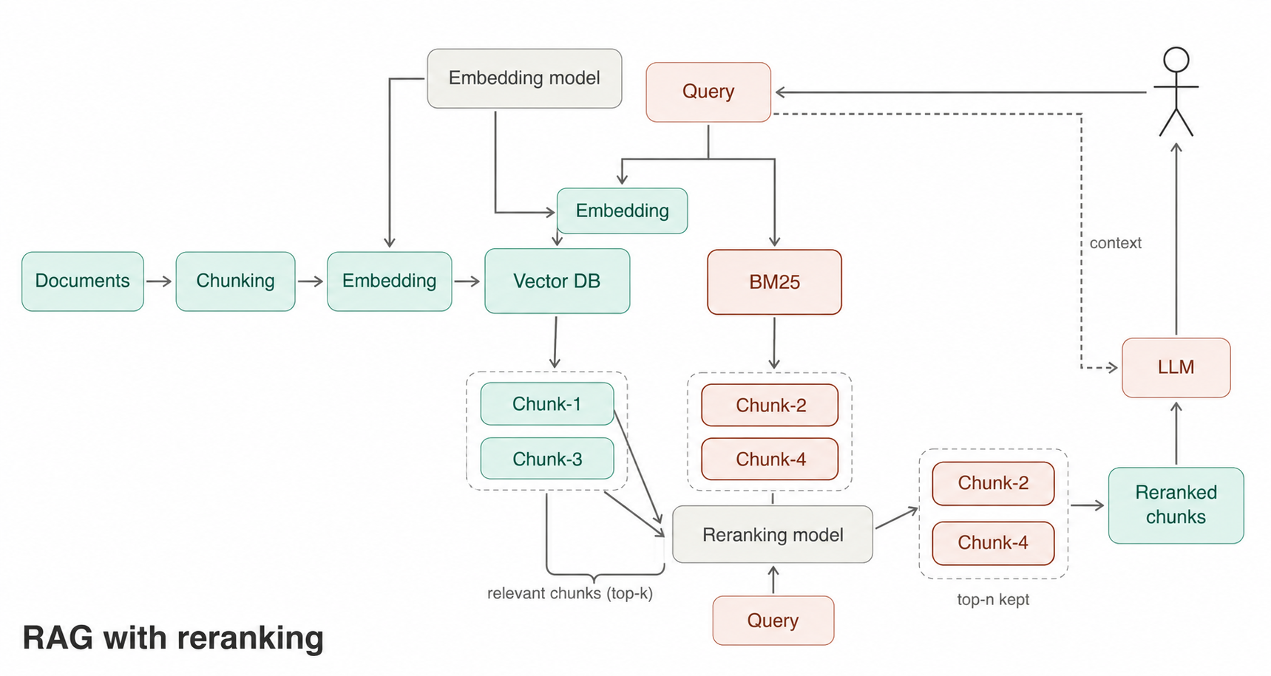
Initial hybrid retrieval: top 150 chunks
Reranker scores those 150 chunks with the query
Retain top 20 chunks
Pass those 20 chunks to the LLM
Notes:
The same architecture with concrete numbers from the demo: hybrid retrieval returns the top 150 chunks, the reranker scores all 150 against the query, the top 20 are kept and passed to the LLM. Rerankers have a practical limit; pass too many candidates and the right chunk can still fall below the cutoff.

Slide 25
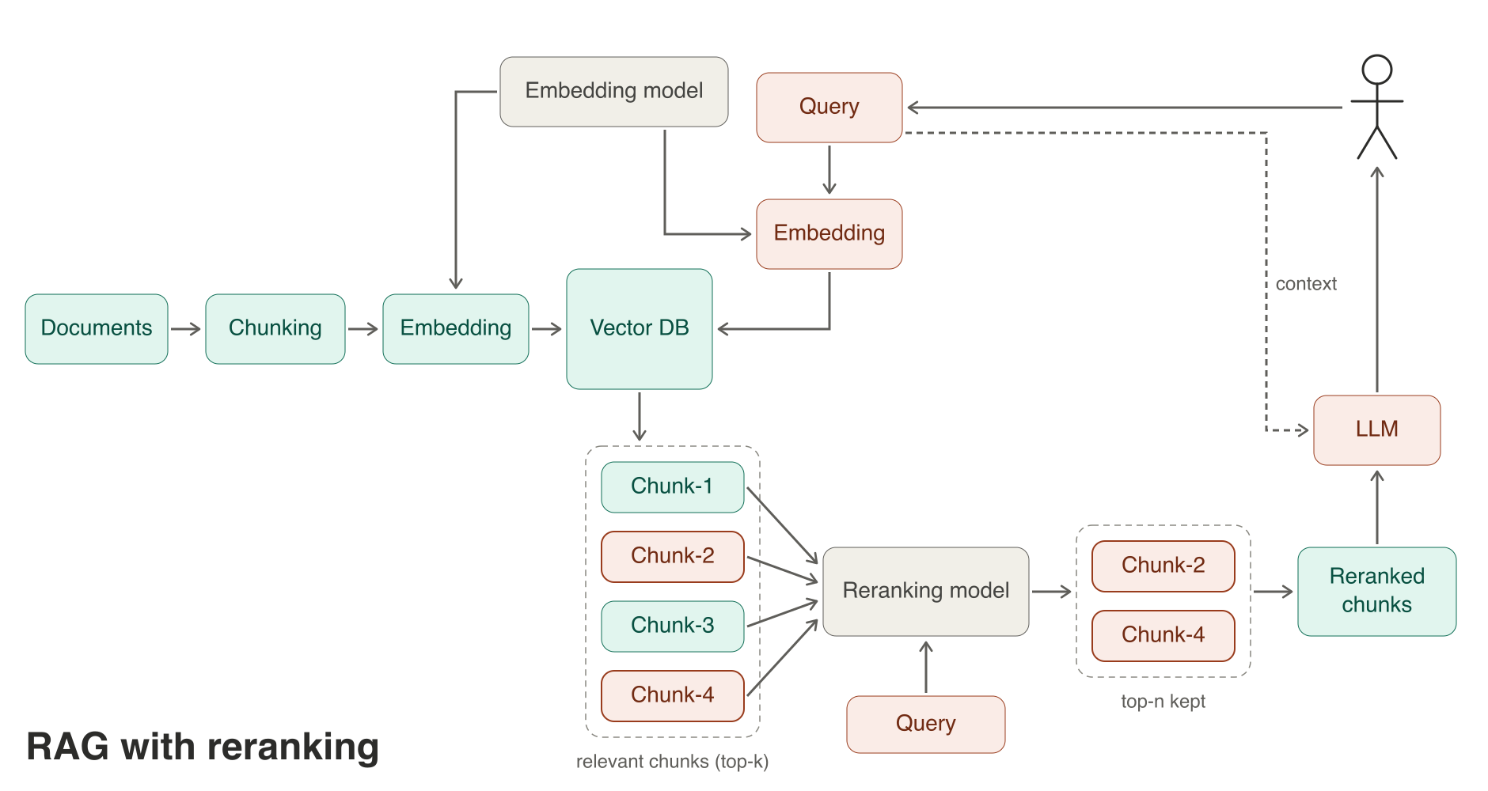
Notes:
Reranking on top of plain vector search. The vector index returns the top-k candidates, and a cross-encoder reranker reorders them by reading the query and each chunk together, which is more accurate than comparing two independent vectors. It cannot recover a chunk that never made the candidate list.

Slide 26
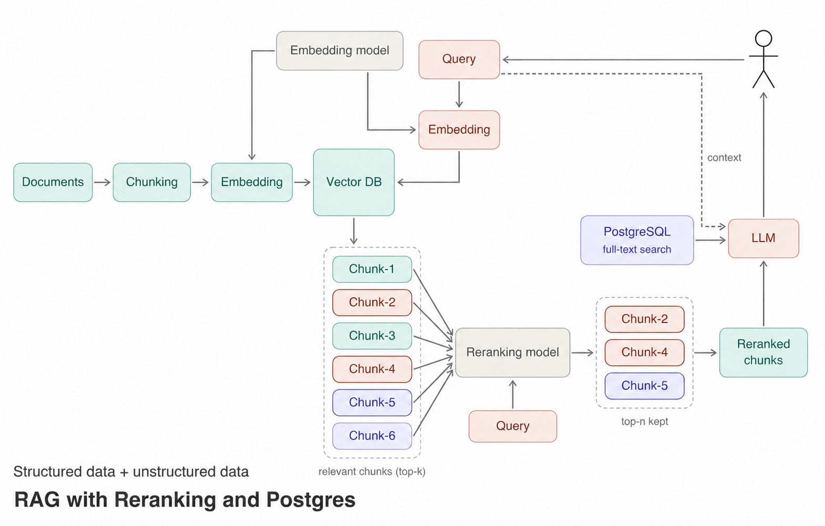
Notes:
Adding structured data. Alongside the vector index, PostgreSQL full-text search over structured records contributes candidates. The reranker merges unstructured chunks and structured rows before the LLM sees them. This is a step toward treating tables as data rather than text.

Slide 27
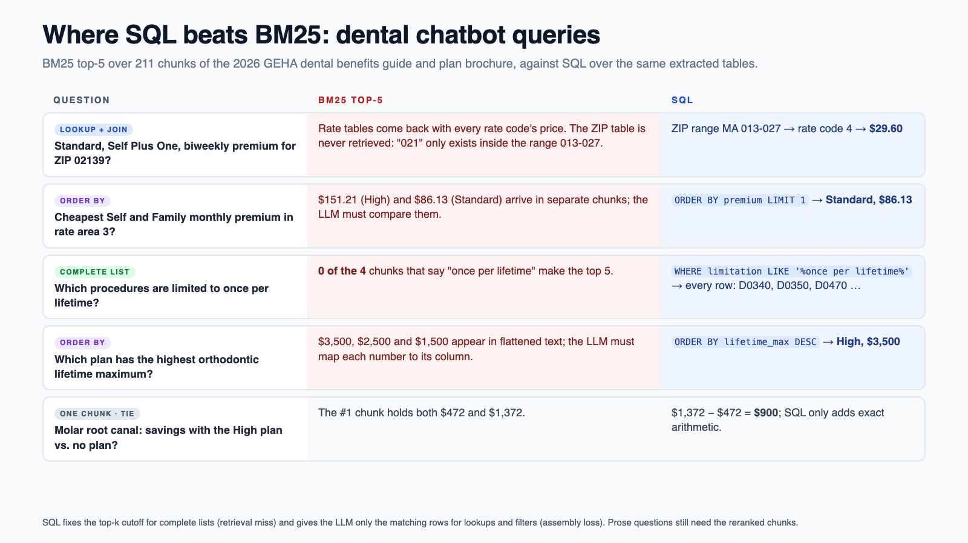
Notes:
Where structured search beats BM25, measured on our own dental data. BM25 top-5 over the 211 chunks of the 2026 GEHA dental benefits guide and plan brochure, against SQL over the same extracted tables. Lookups and joins: a premium for ZIP 02139 needs the ZIP-range table, which BM25 never retrieves because 021 only exists inside the range 013-027; SQL maps it to rate code 4 and returns $29.60. Ordering: the cheapest Self and Family plan or the highest orthodontic lifetime maximum are an ORDER BY, not a ranking of chunks that the LLM then has to compare. Complete lists: none of the four chunks that mention once per lifetime reach the top 5, while a WHERE clause returns every row, so SQL removes the top-k cutoff. When the answer sits in one chunk, like the root canal savings, BM25 is fine and SQL only adds exact arithmetic. Prose questions still need the reranked chunks, which is why the previous slide merges both.

Slide 28
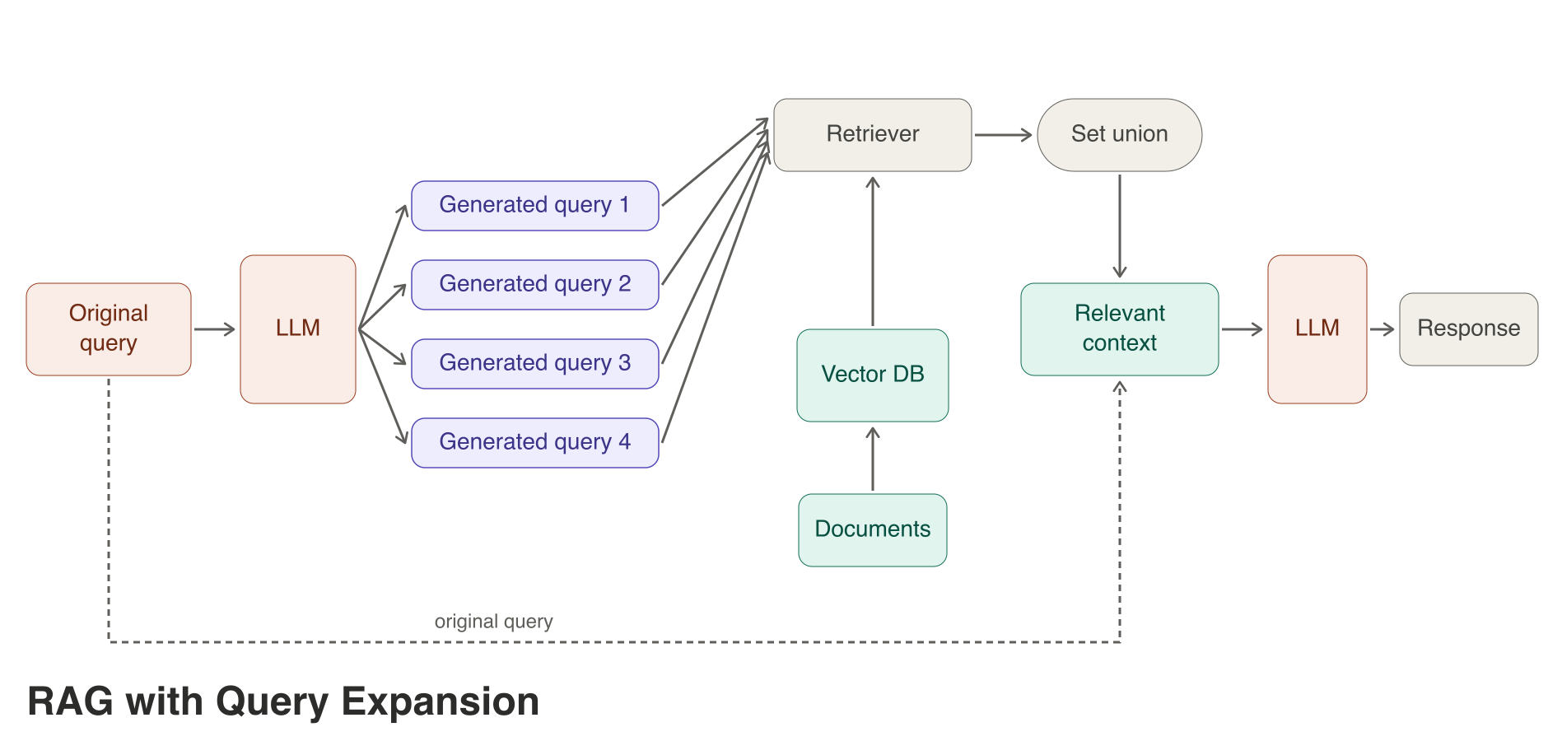
Notes:
Query expansion: an LLM rewrites the original question into several variants, each variant is retrieved separately, and the union of results becomes the context. It helps when the user’s wording does not match the document’s, at the cost of extra LLM calls and more candidates to rank.

Slide 29
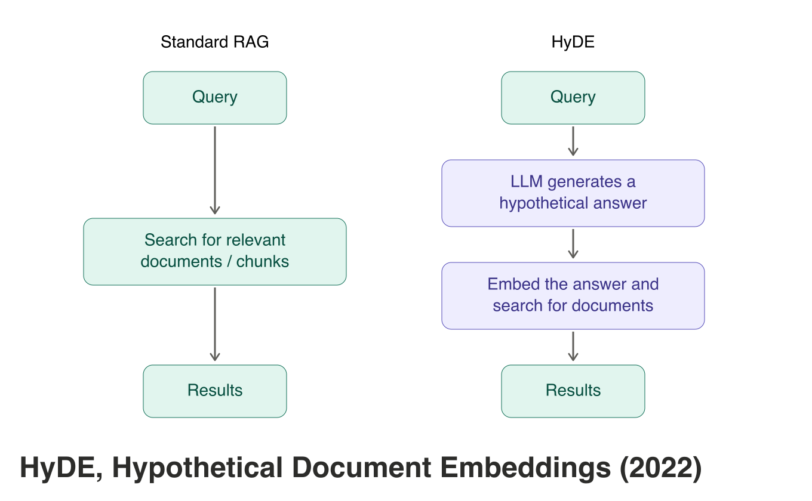
Notes:
HyDE, Hypothetical Document Embeddings, from 2022. Standard RAG embeds the question. HyDE first has an LLM write a hypothetical answer, embeds that, and searches with it. The idea is that a fake answer looks more like the real document than the question does.

Slide 30
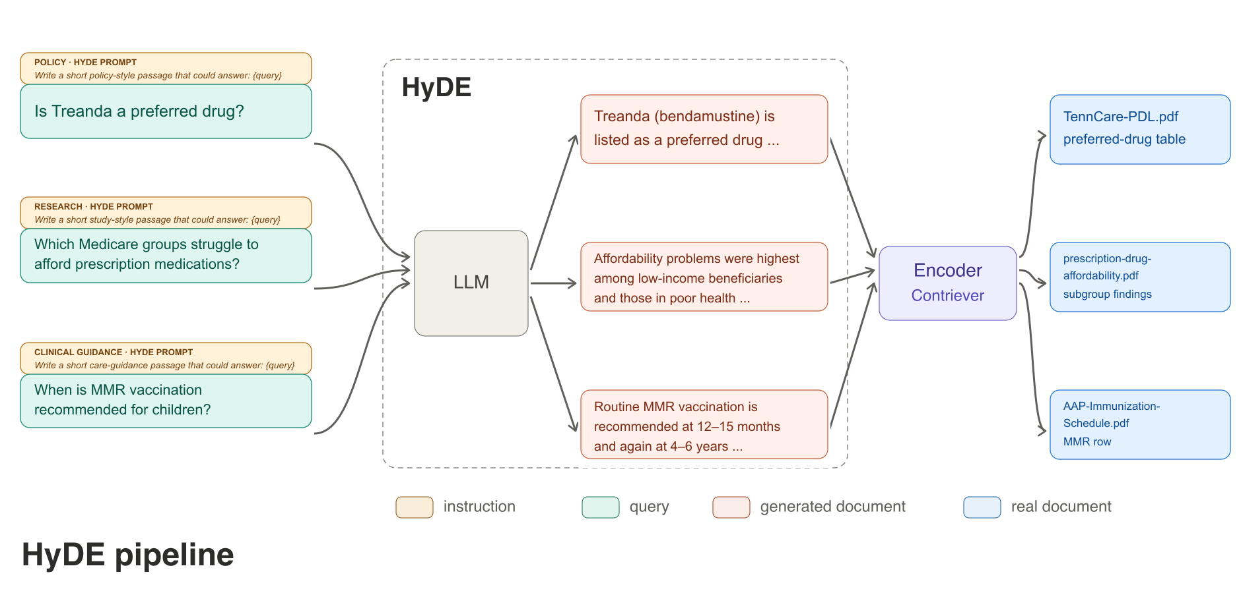
Notes:
HyDE on our policy data. A short question like is Treanda a preferred drug is turned into a policy-style passage, encoded, and matched against the real bendamustine PDF pages: the preference table, the prior-authorization page or the dosing page. The generated text is only a search key; it is never evidence for the answer.

Slide 31
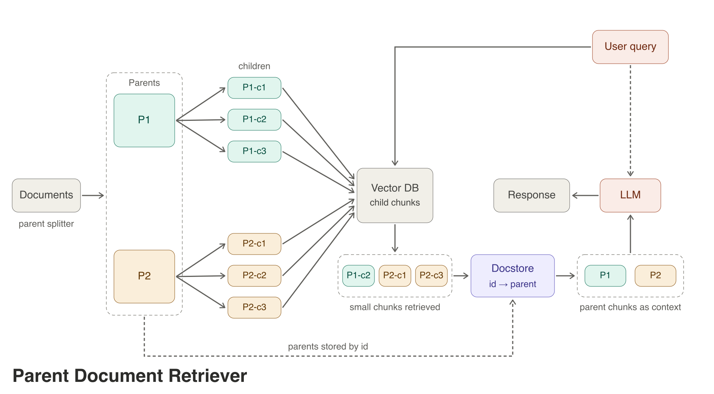
Notes:
Parent document retriever: documents are split into large parents and small children. Only the children are embedded, because small chunks match precisely. When a child matches, the system looks up its parent by ID and passes the whole parent to the LLM, so the answer has full context. Precise matching, rich context.

Slide 32
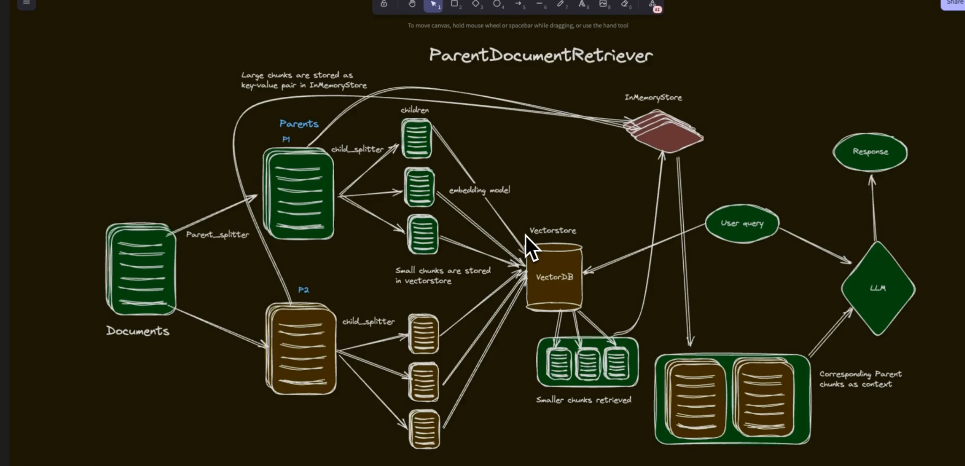
Notes:
A hand-drawn version of the same idea, the LangChain ParentDocumentRetriever: large parent chunks in an in-memory store, small child chunks in the vector store, children retrieved and their parents returned as context.

Slide 33
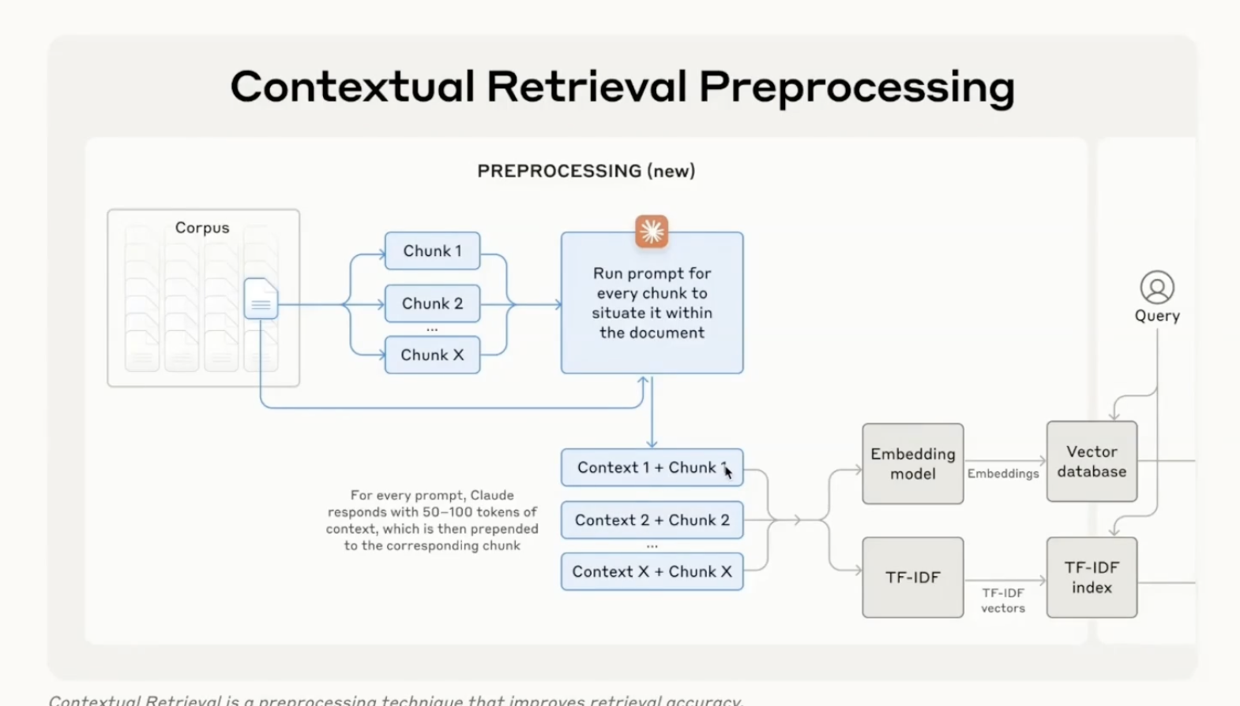
Notes:
Anthropic’s contextual retrieval: before indexing, an LLM reads the whole document and writes 50 to 100 tokens of context for every chunk, which is prepended to the chunk. Both the embedding index and the BM25 or TF-IDF index see the contextualized text. It fixes chunks that make no sense alone, such as a table row without its table title. With prompt caching the cost per chunk is low.

Slide 34
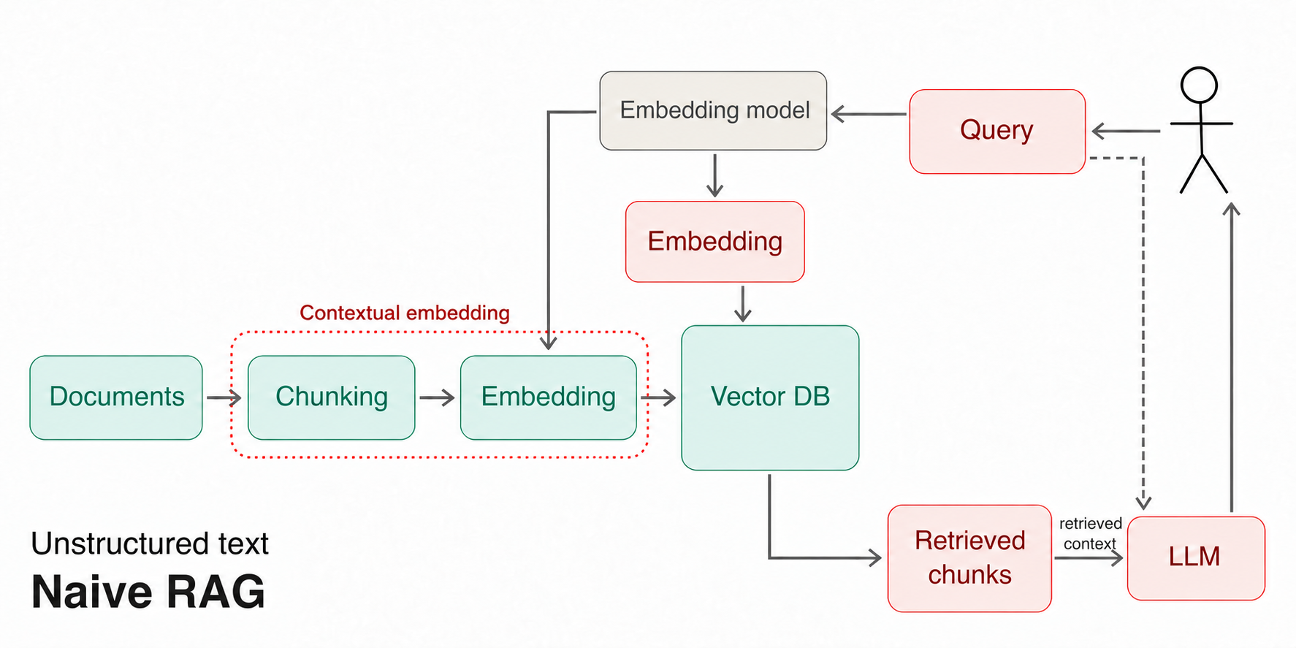
Notes:
Where contextual embedding sits in the naive pipeline: the chunking and embedding steps, highlighted in red. Everything downstream stays the same; only what gets embedded changes.

Slide 35
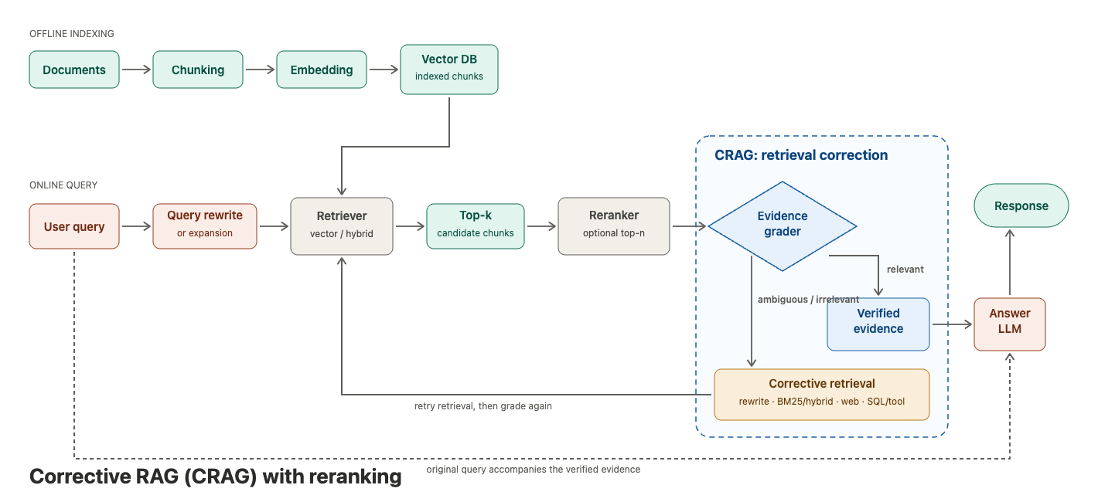
Notes:
Corrective RAG, CRAG. After retrieval and reranking, an evidence grader judges whether the retrieved passages actually answer the question. Relevant evidence goes to the answer LLM; ambiguous or irrelevant evidence triggers corrective retrieval, such as a query rewrite, BM25 or hybrid search, web search or a SQL tool, and the new results are graded again.

Slide 36
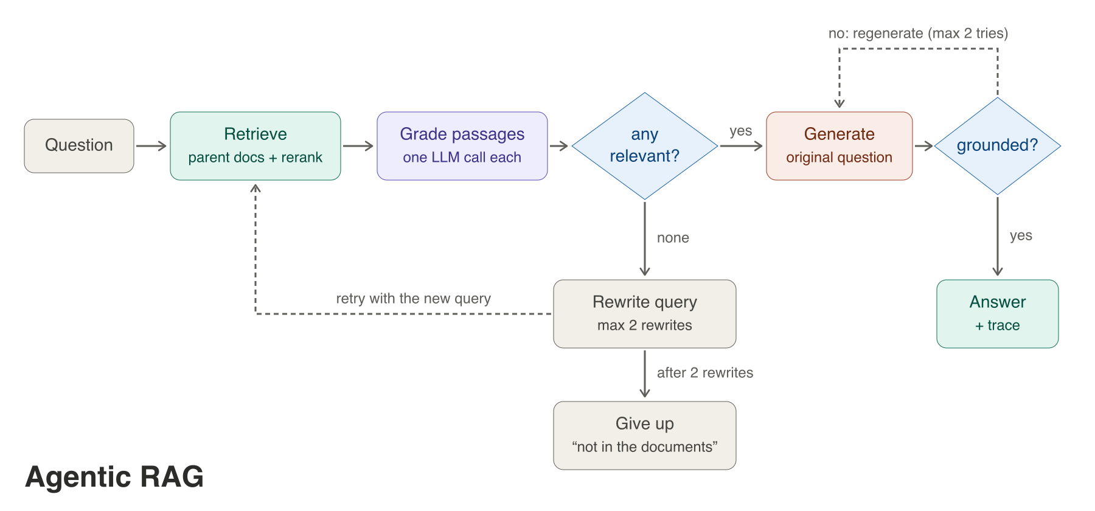
Agentic Search
Notes:
Agentic RAG as a loop: retrieve parent documents with reranking, grade each passage with one LLM call, and if nothing is relevant rewrite the query and retry up to twice before answering not in the documents. Generated answers are checked for grounding and regenerated up to twice. Every step is visible in the trace.

Slide 37
Where it breaks first: extraction, chunking and context
Notes:
Most production RAG failures start before retrieval: in PDF extraction, chunk boundaries and missing context. This section shows bad and good extraction of the same figures, table and form problems, and how table-aware, parent-child retrieval keeps the evidence intact.

Slide 38
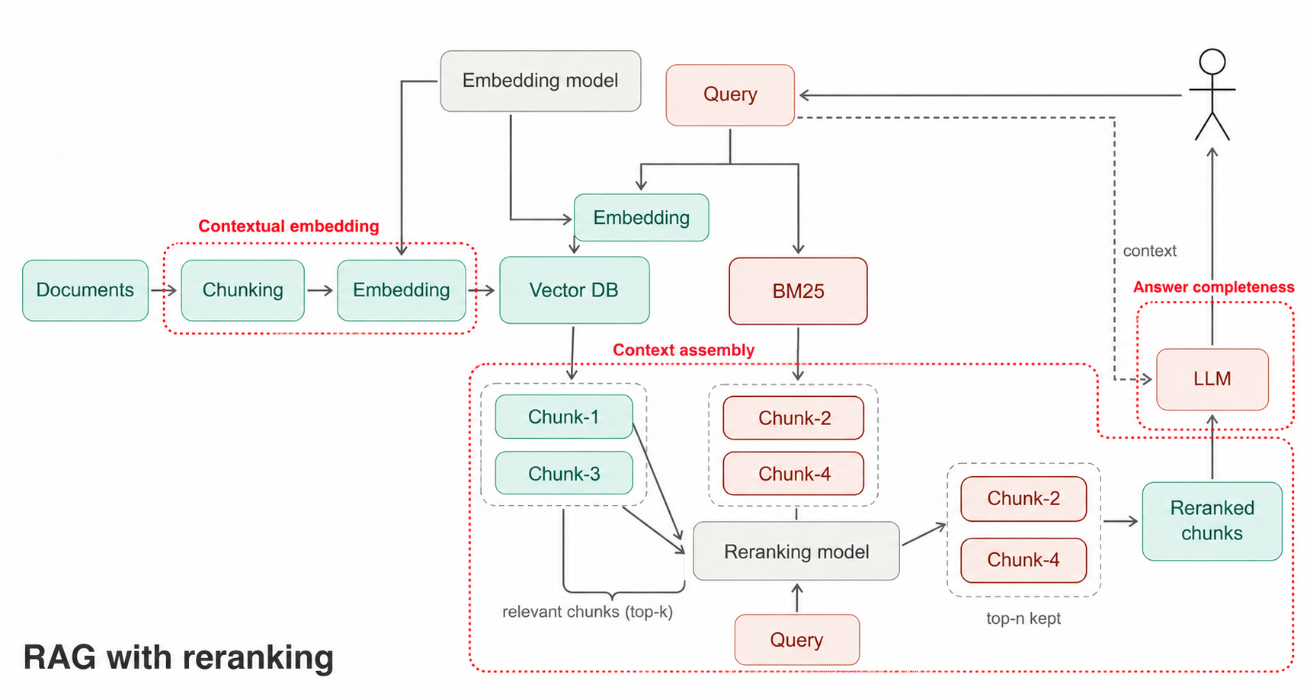
Notes:
This is the map for the rest of the talk. Errors can enter at three places: contextual embedding at indexing time, context assembly when retrieved chunks are reranked and packed into the prompt, and answer completeness at generation. Each needs its own measurement, and fixing the wrong stage wastes effort.

Slide 39
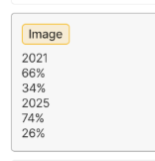
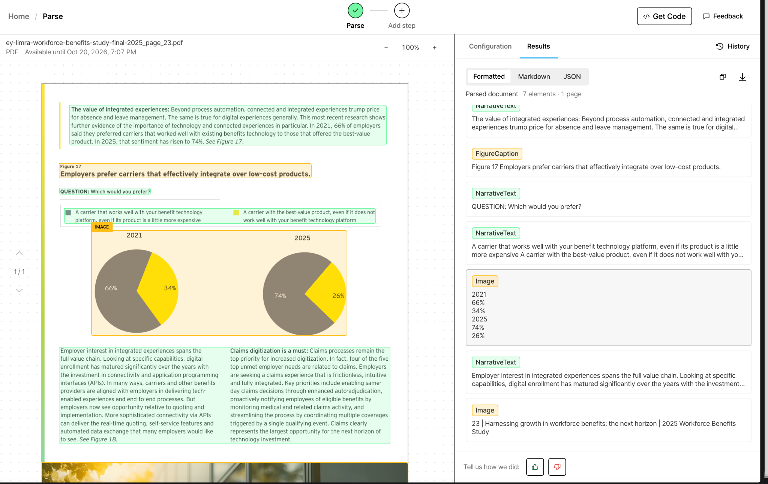
Bad Extraction
Should be converted to table, gibberish, random string
unstructured, used by langchain
at scale pollutes bm25 and vector db
Notes:
Bad extraction, using the default unstructured parser that LangChain uses. A pie chart comparing 2021 and 2025 comes out as a loose list of numbers with no labels: 2021, 66 percent, 34 percent, 2025, 74 percent, 26 percent. Indexed at scale, fragments like this pollute both the BM25 and the vector index.

Slide 40
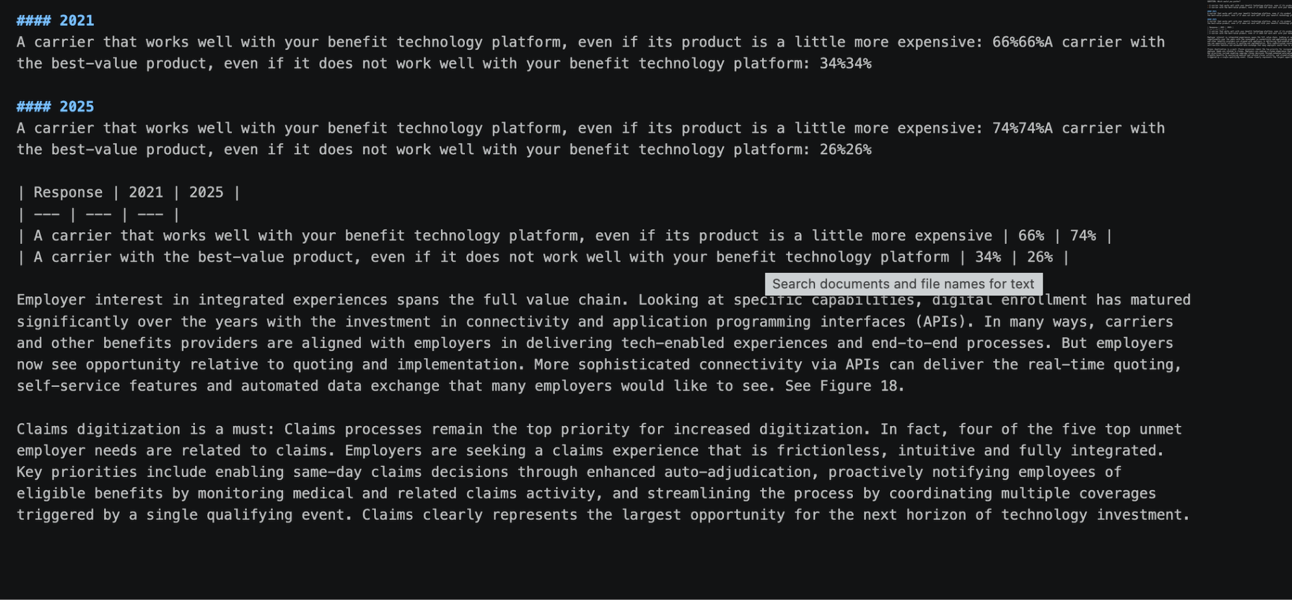
What it should look like, llamaparse, reducio, our demo code
Notes:
What the same page should look like: the chart converted to a proper markdown table with response, 2021 and 2025 columns, followed by the surrounding prose. LlamaParse, Reductio and our own demo code all produce this.

Slide 41
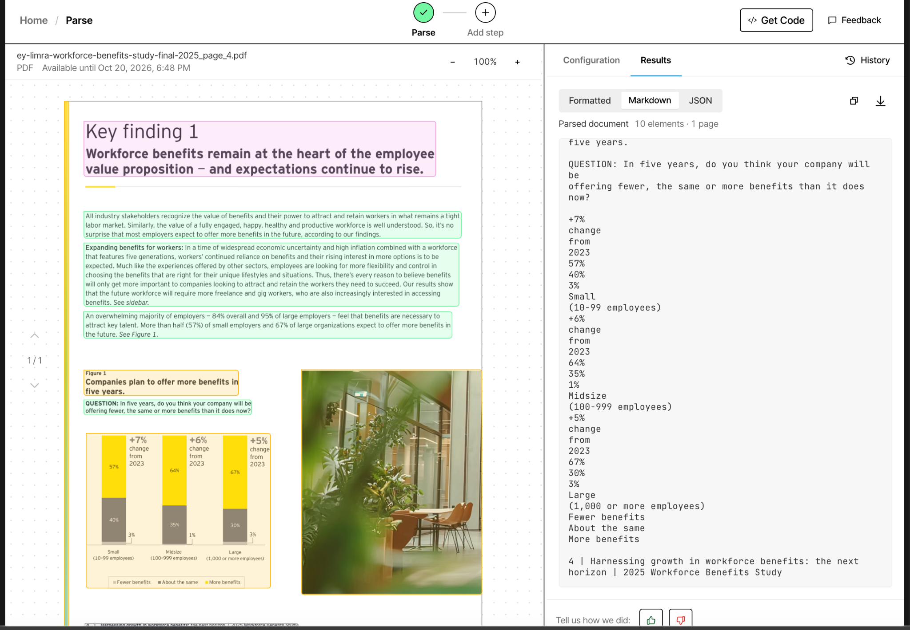
Langchain parse error
Single string no table
Notes:
Another LangChain parse failure: a stacked bar chart from the workforce benefits study becomes one long string of numbers and labels with no table structure, so no question about company size or year can be answered reliably from it.

Slide 42
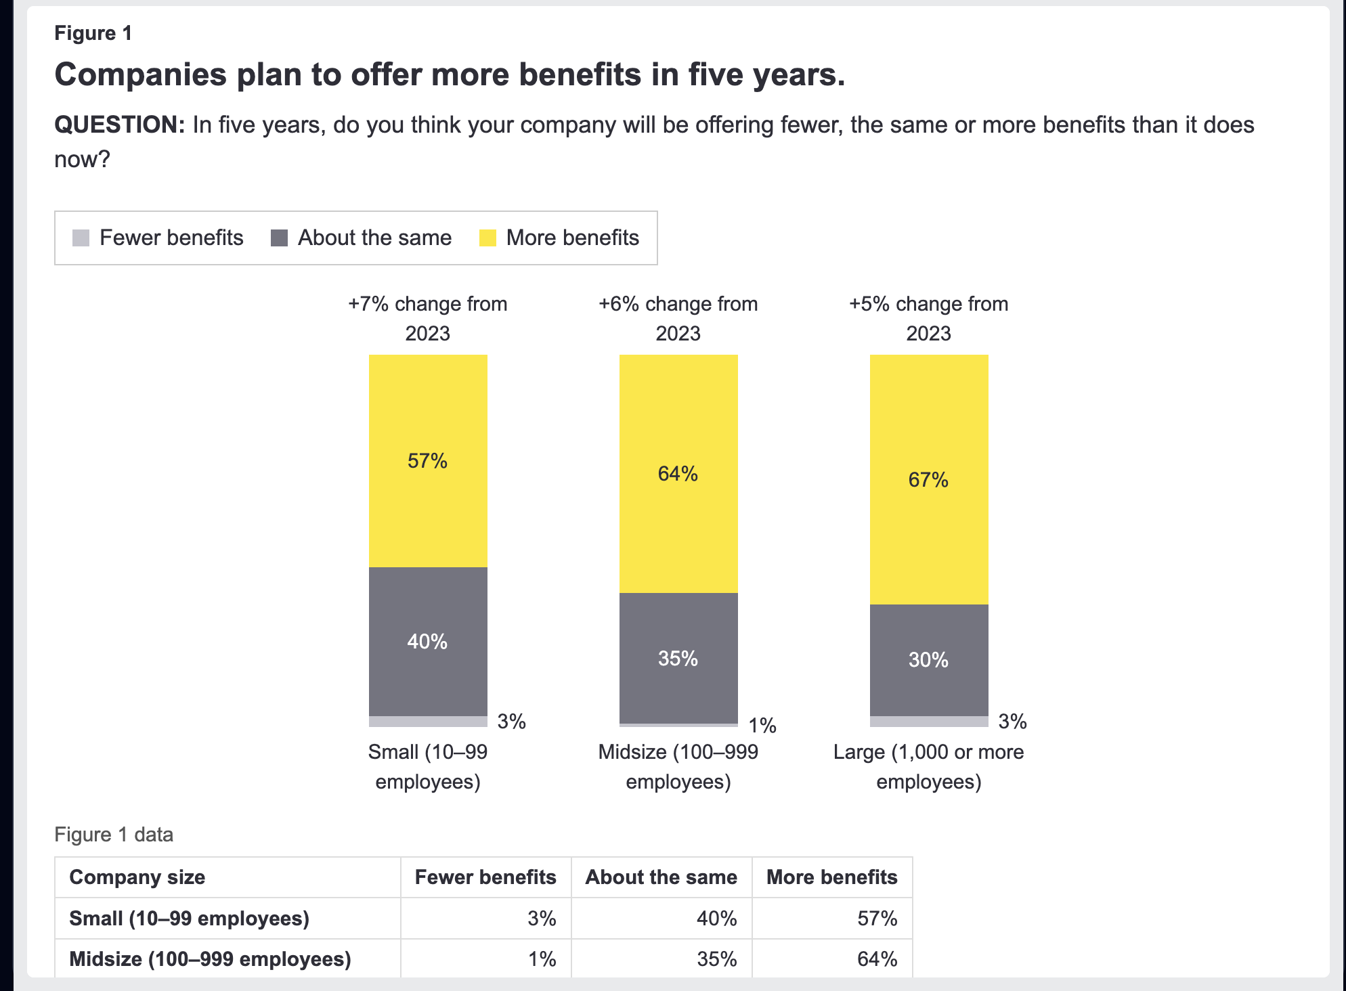
Correct, llamaparse, reductio, our code
Correct, table matches bar chart,
Notes:
The correct version of the same figure: the table matches the bar chart exactly, small, midsize and large employers by fewer, the same or more benefits. With the data as a table it can be indexed, filtered and cited.

Slide 43
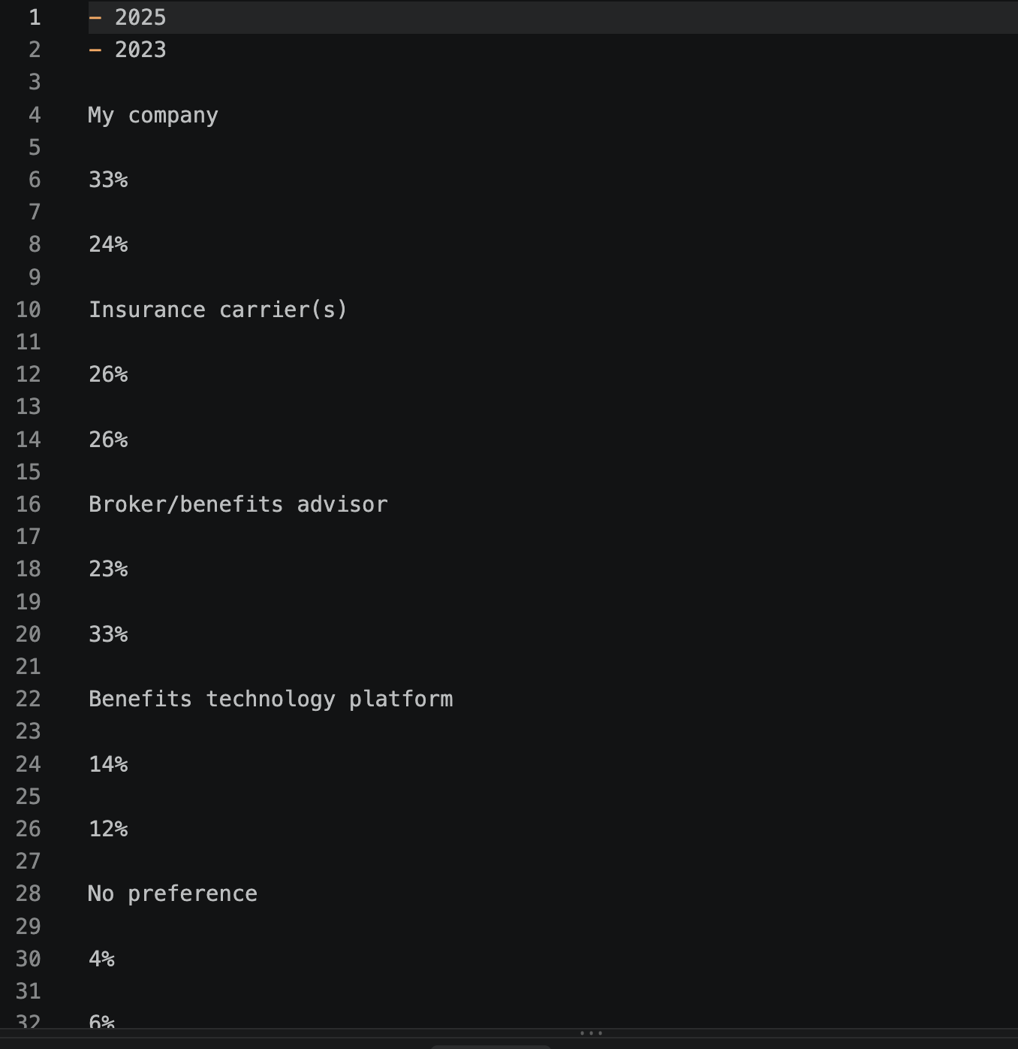
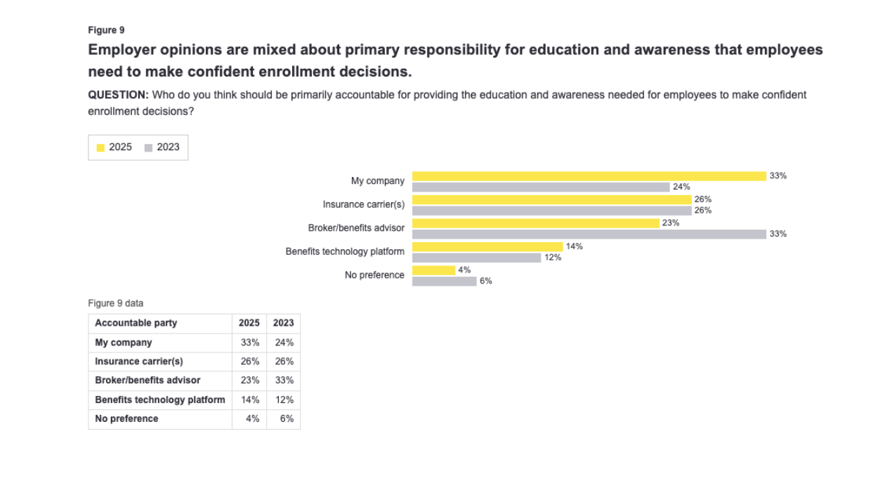
Fig Output of Docling Parser
Figures and tables in pdfs. Extract as 1 unit/(Figs)
Notes:
Figures and tables should be extracted as one unit. On the right is Docling’s raw output for the figure: every label and value on its own line, in reading order, with the relationship between employer type and percentage lost.

Slide 44
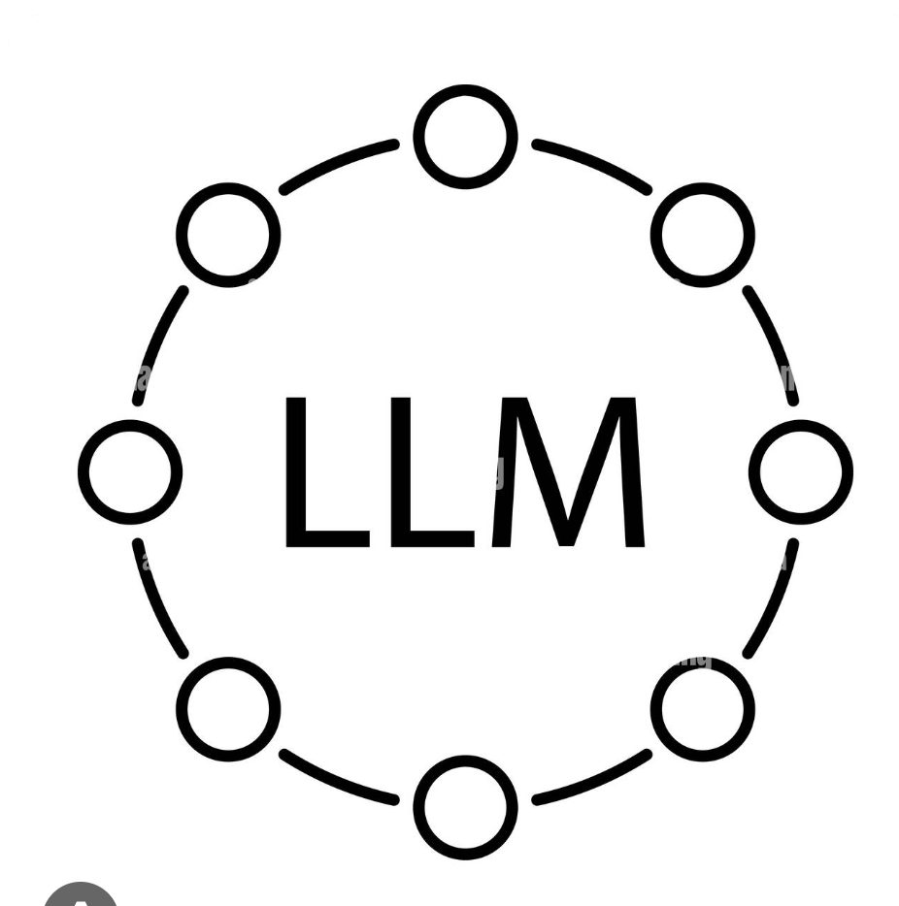

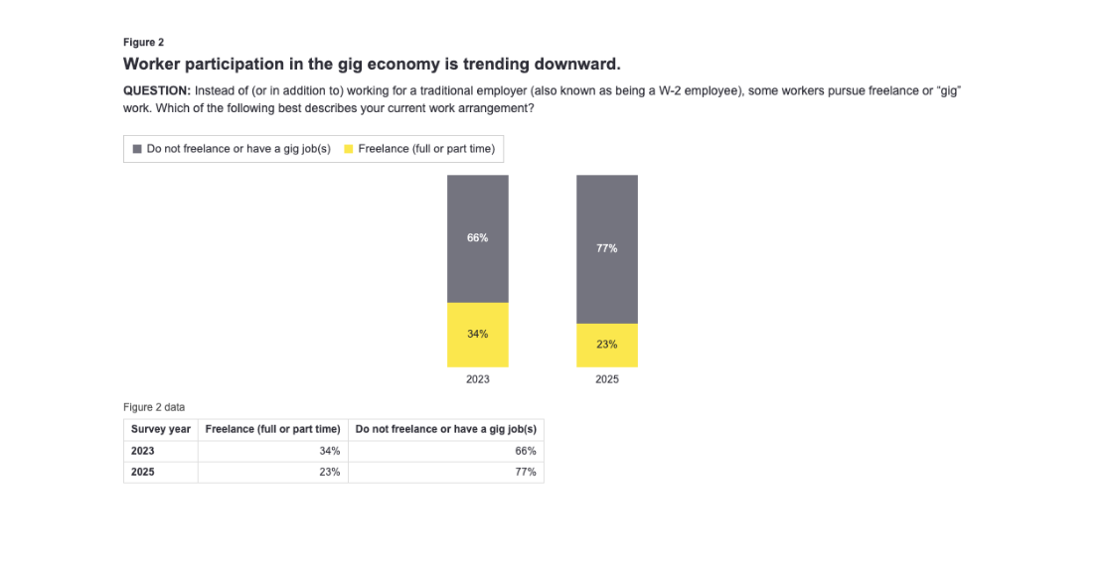
This is Figure 2 on page 5 of the "Harnessing growth in workforce benefits: the next horizon" report (2025 Workforce Benefits Study). It sits in the section on the gig economy stabilizing post-pandemic, and Figure 3 on employer use of freelancers appears beside it. The figure is a stacked bar chart of worker participation in freelance or gig work, comparing the 2023 and 2025 surveys. It splits workers into those who freelance full or part time (34% in 2023, 23% in 2025) and those who do not freelance or have a gig job (66% in 2023, 77% in 2025). The survey question asks about current work arrangement beyond or instead of traditional W-2 employment. The page text uses the figure to show gig participation trending downward.
LanceDB
There is png and html. Why did we bother to extract to html? Because we can reorder the rows in html.
We can add charts and figs to a db as a structured object and
use structured search.
Translate to table 2nd part of fig. Tables can be used in structured search
Notes:
One fix for figures: send the PDF page and the figure to an LLM and have it write a description with its context: which report, which page, which section, what the chart compares and what it shows. We also convert the figure to HTML, because a table in HTML can be reordered, stored as a structured object, and searched with structured queries, for example in LanceDB.

Slide 45
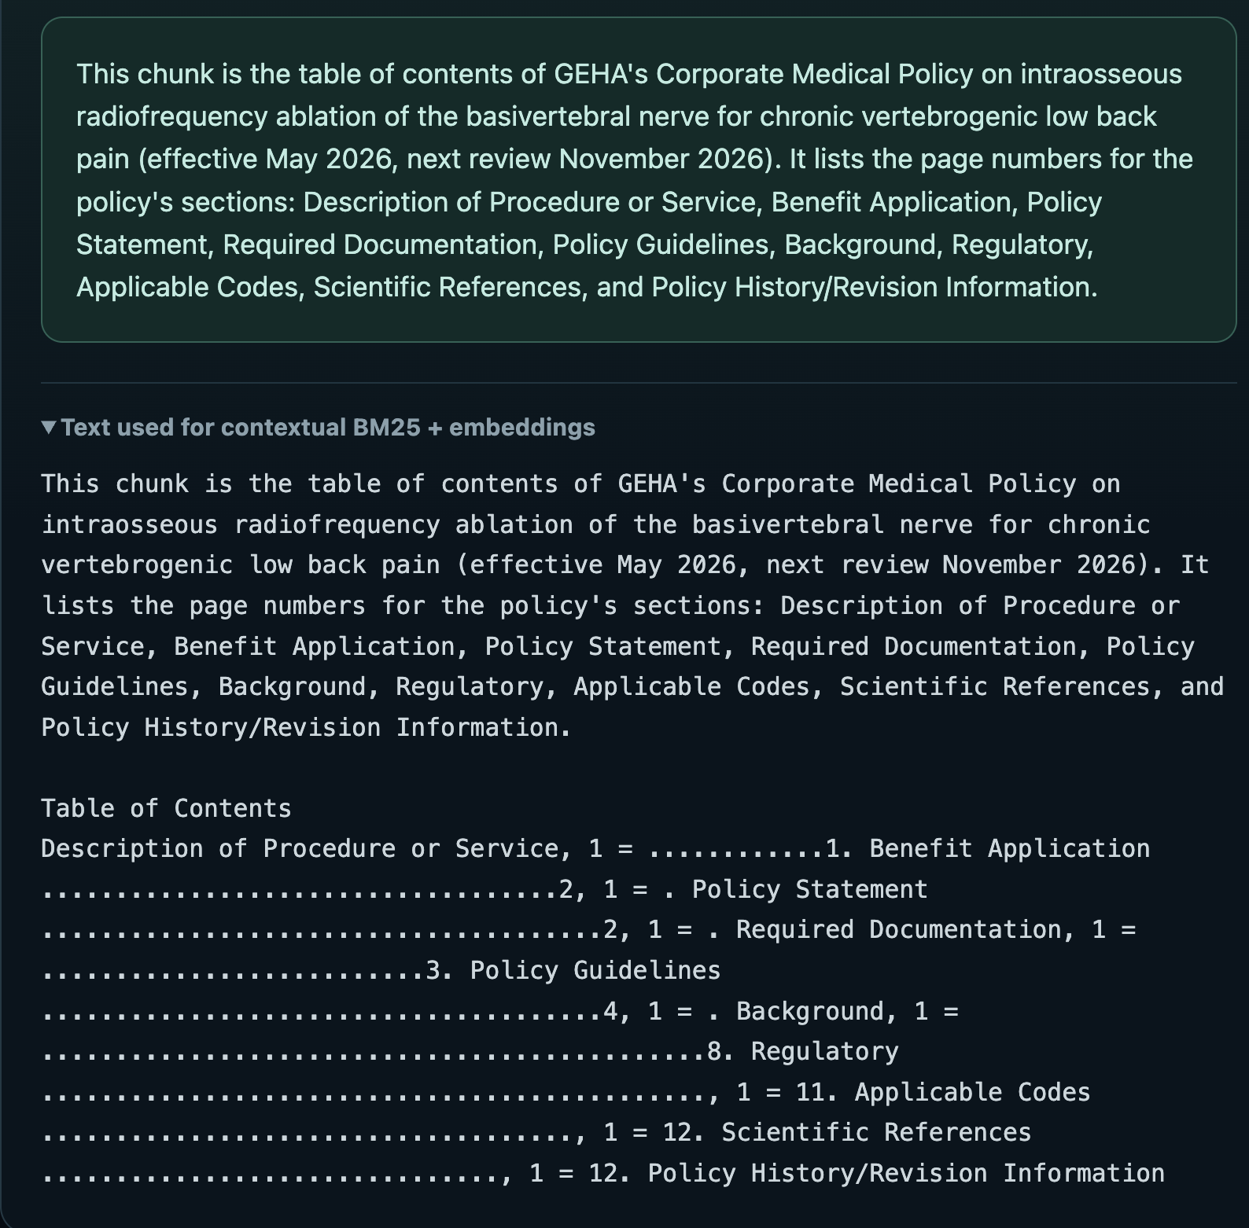
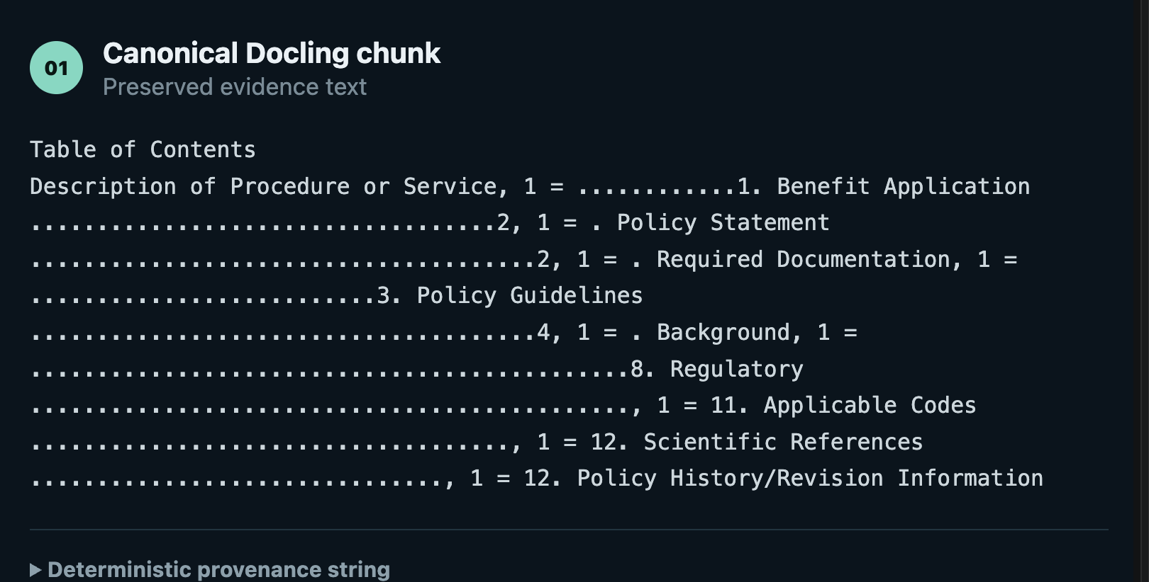
PDF+Chunk =>LLM=> annotated with summary. Does this work? No
Notes:
Does adding an LLM summary to every chunk help? Not for every chunk. Here a table-of-contents chunk gets a fluent summary prepended, but the chunk itself carries no answerable facts, so the summary only makes the noise more searchable.

Slide 46
WHY?
Why do we do this in the first place?
Because many documents have TOC or Index sections
They are all the same
Boilerplate has no new information. Noise in index. Many TOC entries in the end or beginning of the db index which can translate to the beginning or end of LLM context window.
Notes:
Why filter table-of-contents and index pages at all? Many policy documents have them, they look alike across documents, and they contain no new information. In the index they are noise; in the context window they take up space at the start or end, exactly where the model pays most attention.

Slide 47
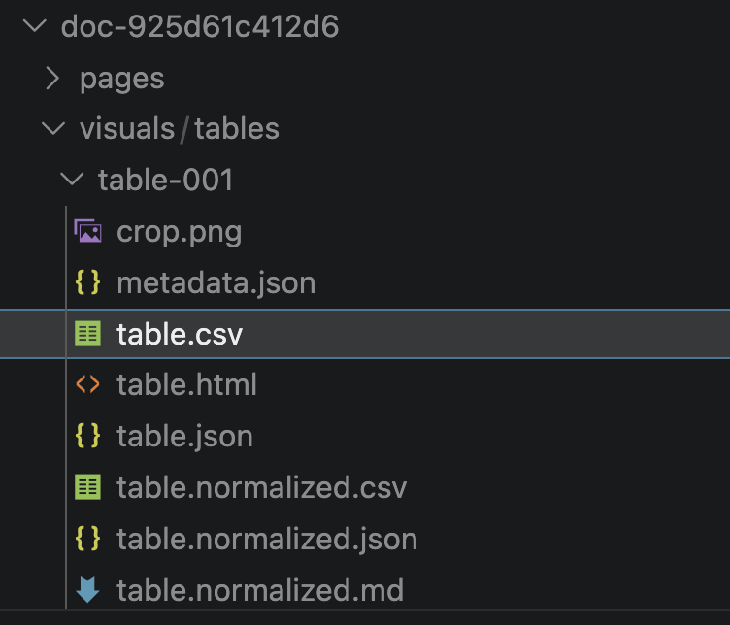
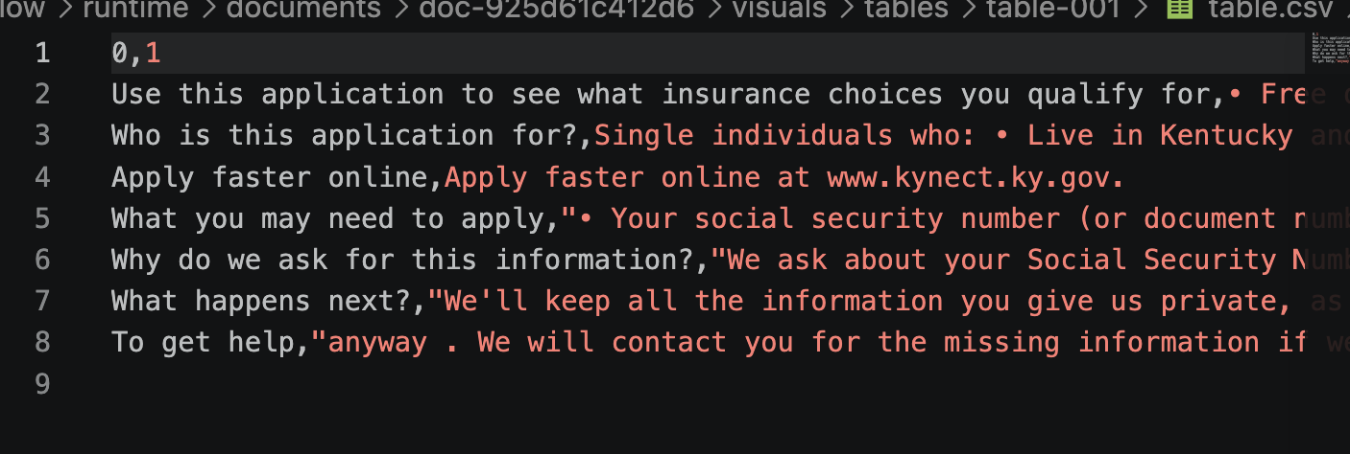
bad headers
Notes:
Forms extract badly. In this Kentucky Medicaid application the table parser produced a CSV with meaningless column headers, 0 and 1, and instructions split across cells. Headers are what give rows their meaning, so losing them breaks retrieval for every row.

Slide 48
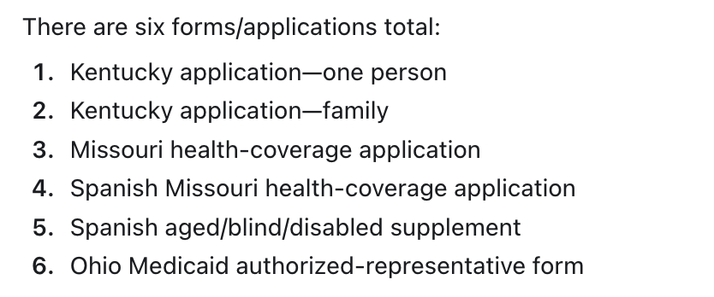
forms do not chunk
doc-925d61c412d6 — Kentucky application, one person
doc-cfb6d2204f32 — Kentucky application, family
doc-3409df3900e3 — Missouri health-coverage application
doc-08754ed1a8a8 — Spanish Missouri health-coverage application
doc-e7bd4b9ae4bf — Spanish aged/blind/disabled supplement
doc-b1682e9dbc26 — Ohio Medicaid authorized-representative form
Notes:
Forms do not chunk. The corpus has six forms and applications: Kentucky applications for one person and for a family, a Missouri health-coverage application and its Spanish version, a Spanish aged, blind and disabled supplement, and an Ohio Medicaid authorized-representative form. They are mostly fields and checkboxes, so chunk-and-embed has little to work with; they need routing and structured handling.

Slide 49
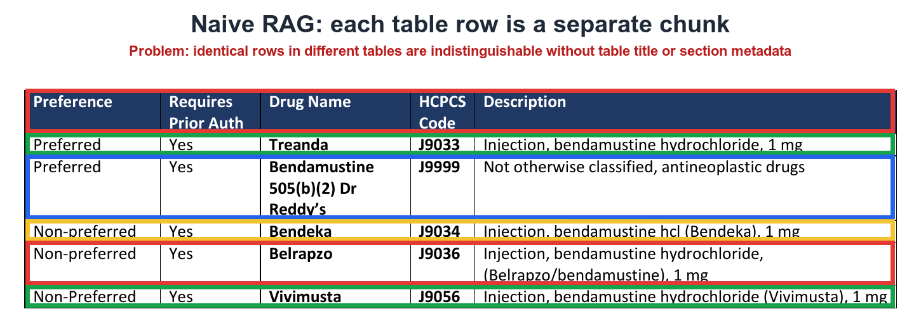
Notes:
Naive RAG on a policy table: each row becomes its own chunk. The problem is in red: identical rows in different tables look the same without the table title or section metadata. A row saying Preferred, Yes, Treanda, J9033 means nothing if you cannot tell which policy and which condition it belongs to.

Slide 50
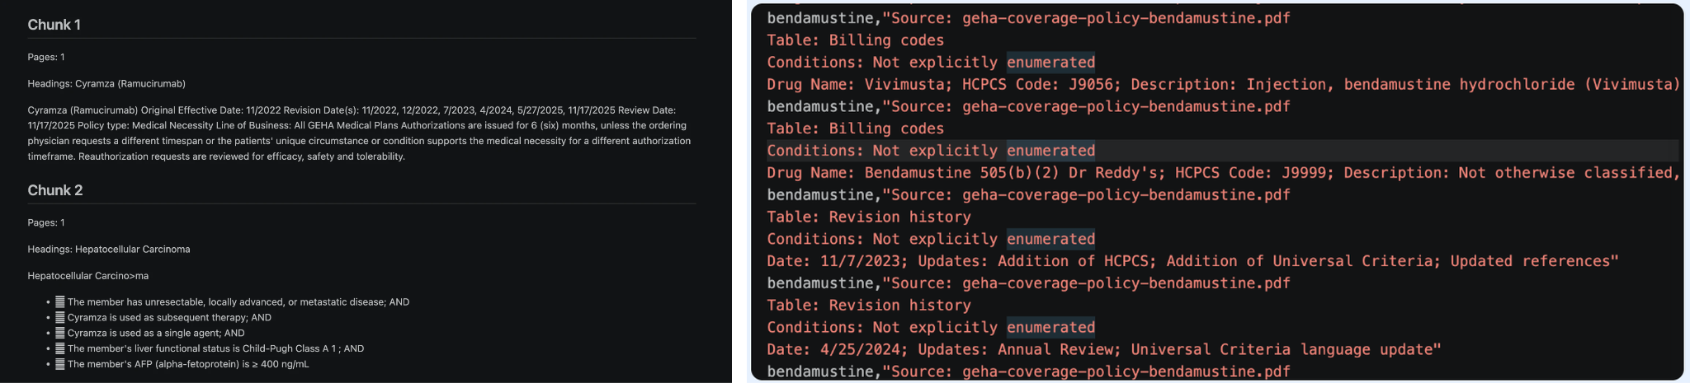
Notes:
What the row-level chunks actually contain once metadata is added: each bendamustine row carries its source file, table name and conditions alongside the drug name, HCPCS code and description. This is the minimum context a row needs to be retrievable on its own.

Slide 51
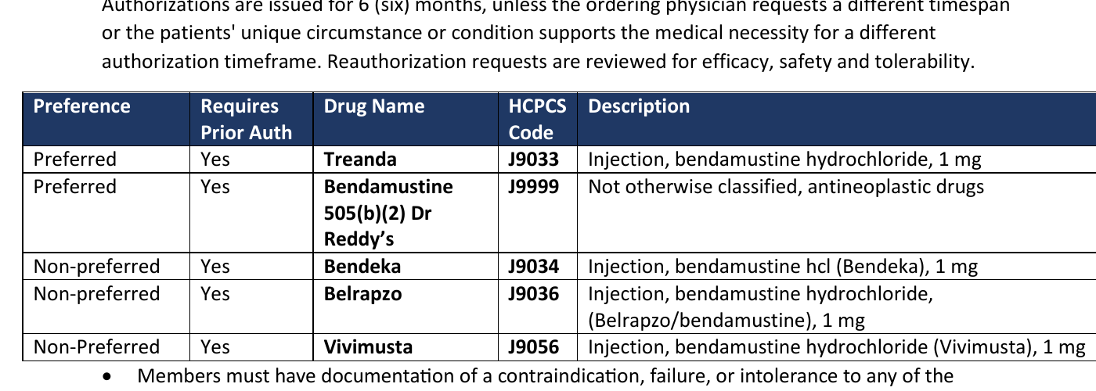
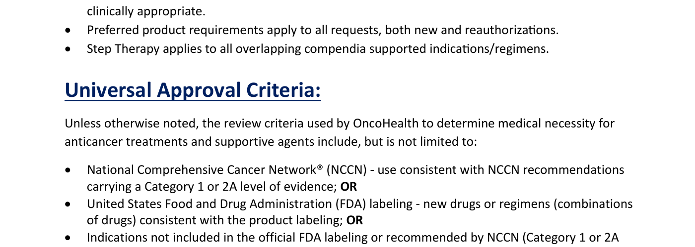
Structural context and context expansion
The same policy page produces different retrieval boundaries
STRUCTURAL CONTEXT
CONTEXT EXPANSION
Whole table returned
Parent section returned
Table-aware parsing keeps the header and all rows in one retrieval unit. The relationships among preference, drug, code, and description remain intact.
Parent-child retrieval can match a small passage about NCCN or FDA guidance, then return the full Universal Approval Criteria section as context.
Ambiguity risk
Duplicate or similar tables can repeat the same Treanda - Preferred rows for another condition. Without table-level context, retrieval may return the wrong result. This failure is unlikely to appear in the current small dataset.
Lesson
Returning the parent adds useful context, but every added passage consumes tokens and reduces the remaining context-window budget.
Source: GEHA Coverage Policy: Bendamustine, page 1
Notes:
Source: geha_cloud_reliability/downloads/coverage-policies/geha-coverage-policy-bendamustine.pdf, page 1. The red boxes illustrate retrieval boundaries and do not alter the source document.

Slide 52
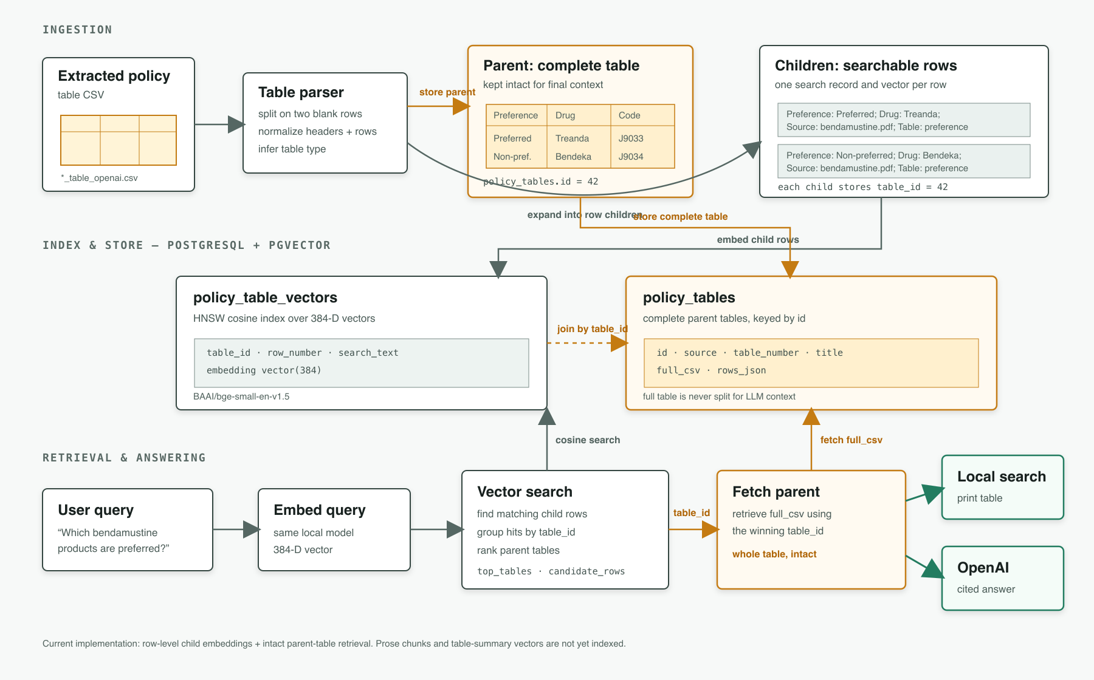
table aware rag
Notes:
The table-aware RAG pipeline we built. Ingestion parses each policy table, keeps the complete table as a parent and creates one searchable child record per row. Both go into PostgreSQL with pgvector, with 384-dimension bge-small vectors on the rows. At query time the system finds matching rows, groups them by table, fetches the full parent table, and passes the whole table to the model to answer with citations.

Slide 53
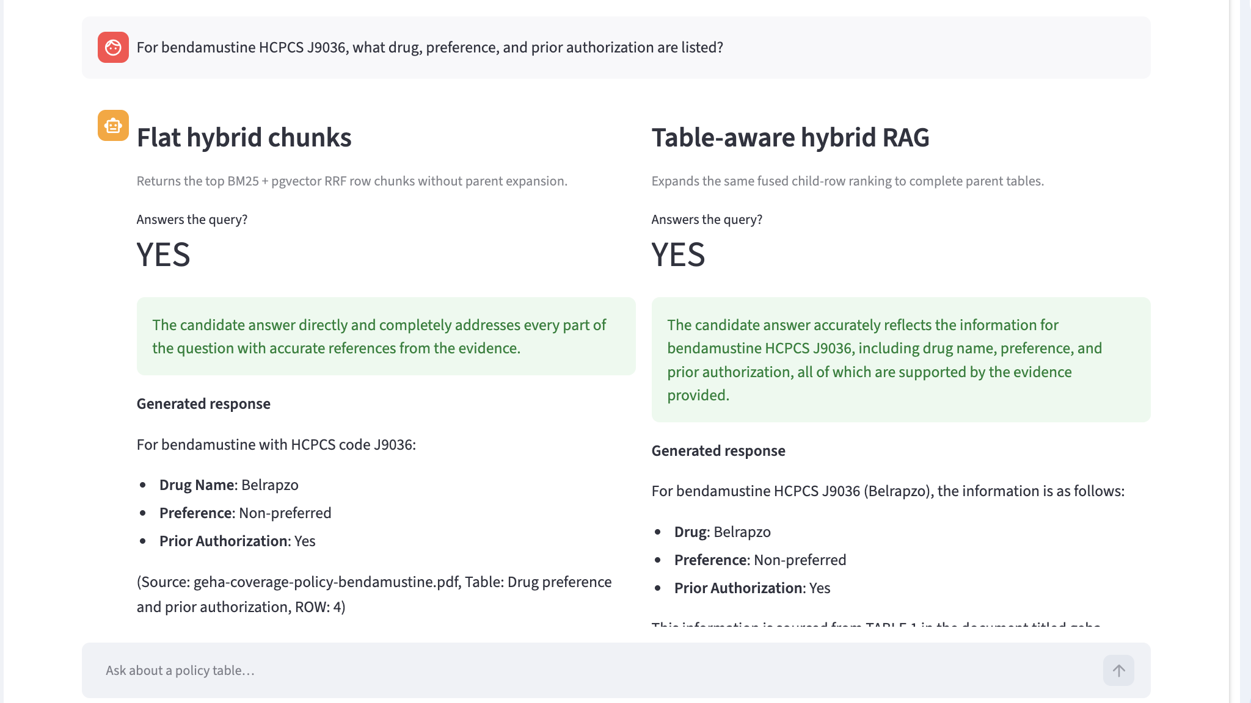
Notes:
Demo: the same bendamustine J9036 question against flat hybrid chunks and against table-aware hybrid RAG. On this simple question both answer correctly: Belrapzo, non-preferred, prior authorization required. Simple lookups do not separate the architectures; questions that need several rows or qualifiers outside the table do.

Slide 54
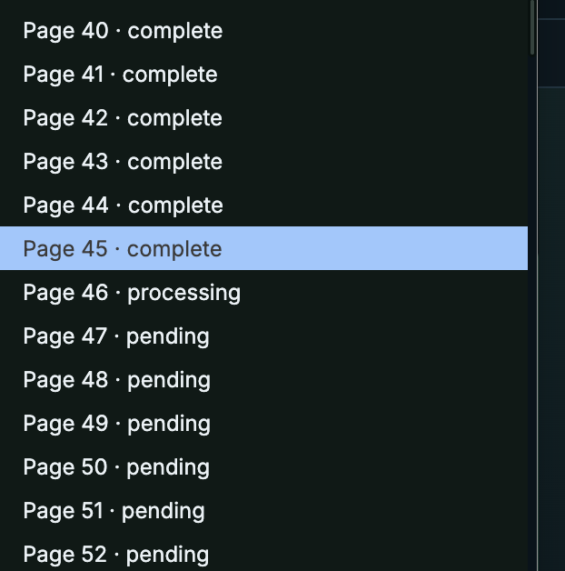
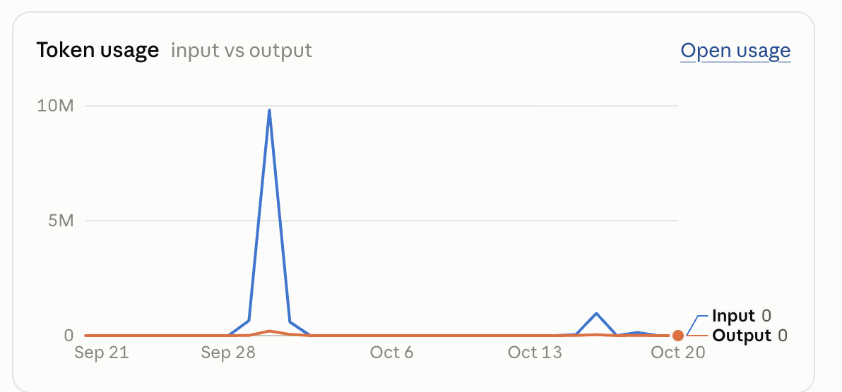
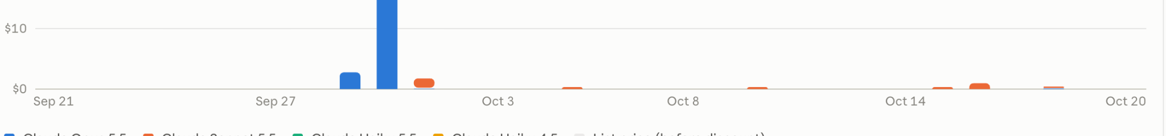
adding context
Notes:
Adding context is not free. On the left, page-by-page contextualization in progress; on the right, token usage spikes when every page of a large corpus is processed. Prompt caching and processing only the pages that need context keep this affordable.

Slide 55
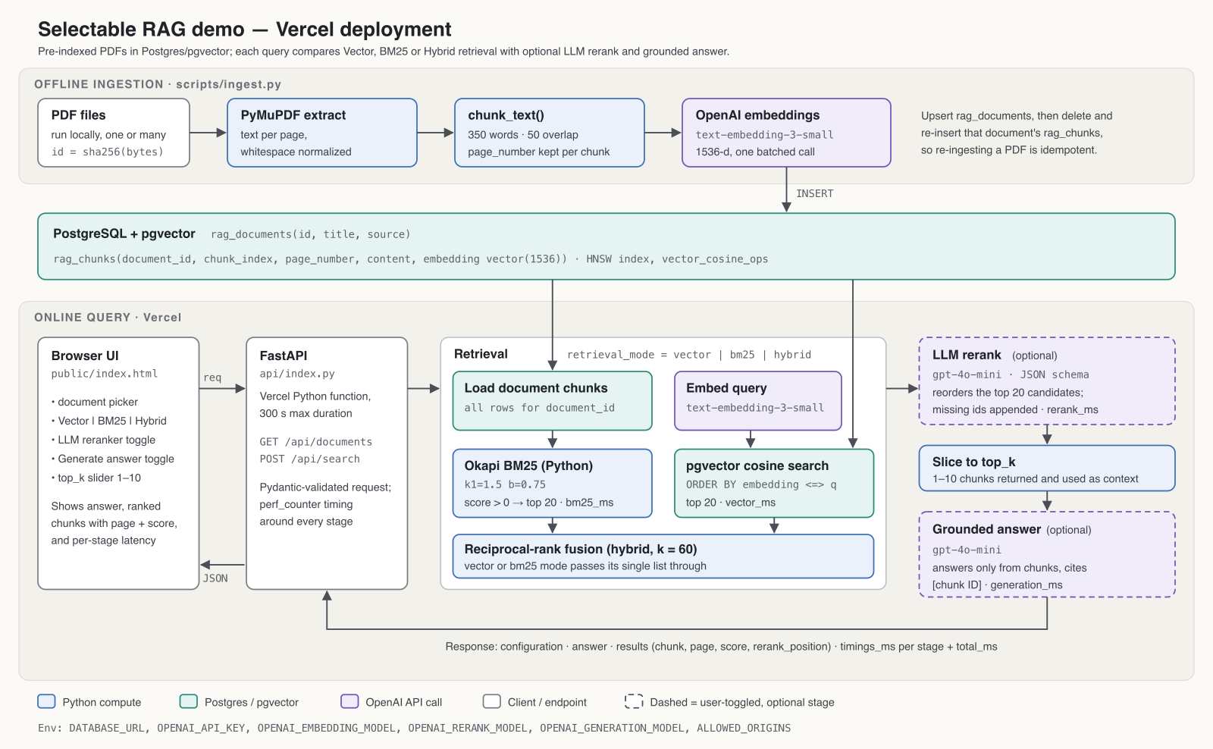
Notes:
The selectable RAG demo on Vercel. PDFs are extracted with PyMuPDF, chunked at 350 words with 50 words of overlap, embedded with OpenAI text-embedding-3-small and stored in Postgres with pgvector. At query time you choose vector, BM25 or hybrid retrieval with reciprocal-rank fusion, optional LLM reranking, top-k and a grounded answer, and every stage reports its latency.

Slide 56
Matching each technique to the failure it fixes
Notes:
A small demonstration corpus with one question per failure mode: exact codes for BM25, paraphrases for vector search, mixed signals for hybrid, buried evidence for reranking, style mismatch for HyDE, missing evidence for CRAG, and dependent lookups for agentic search. Then a reality check: on our data, retrieval is already near its ceiling.

Slide 57
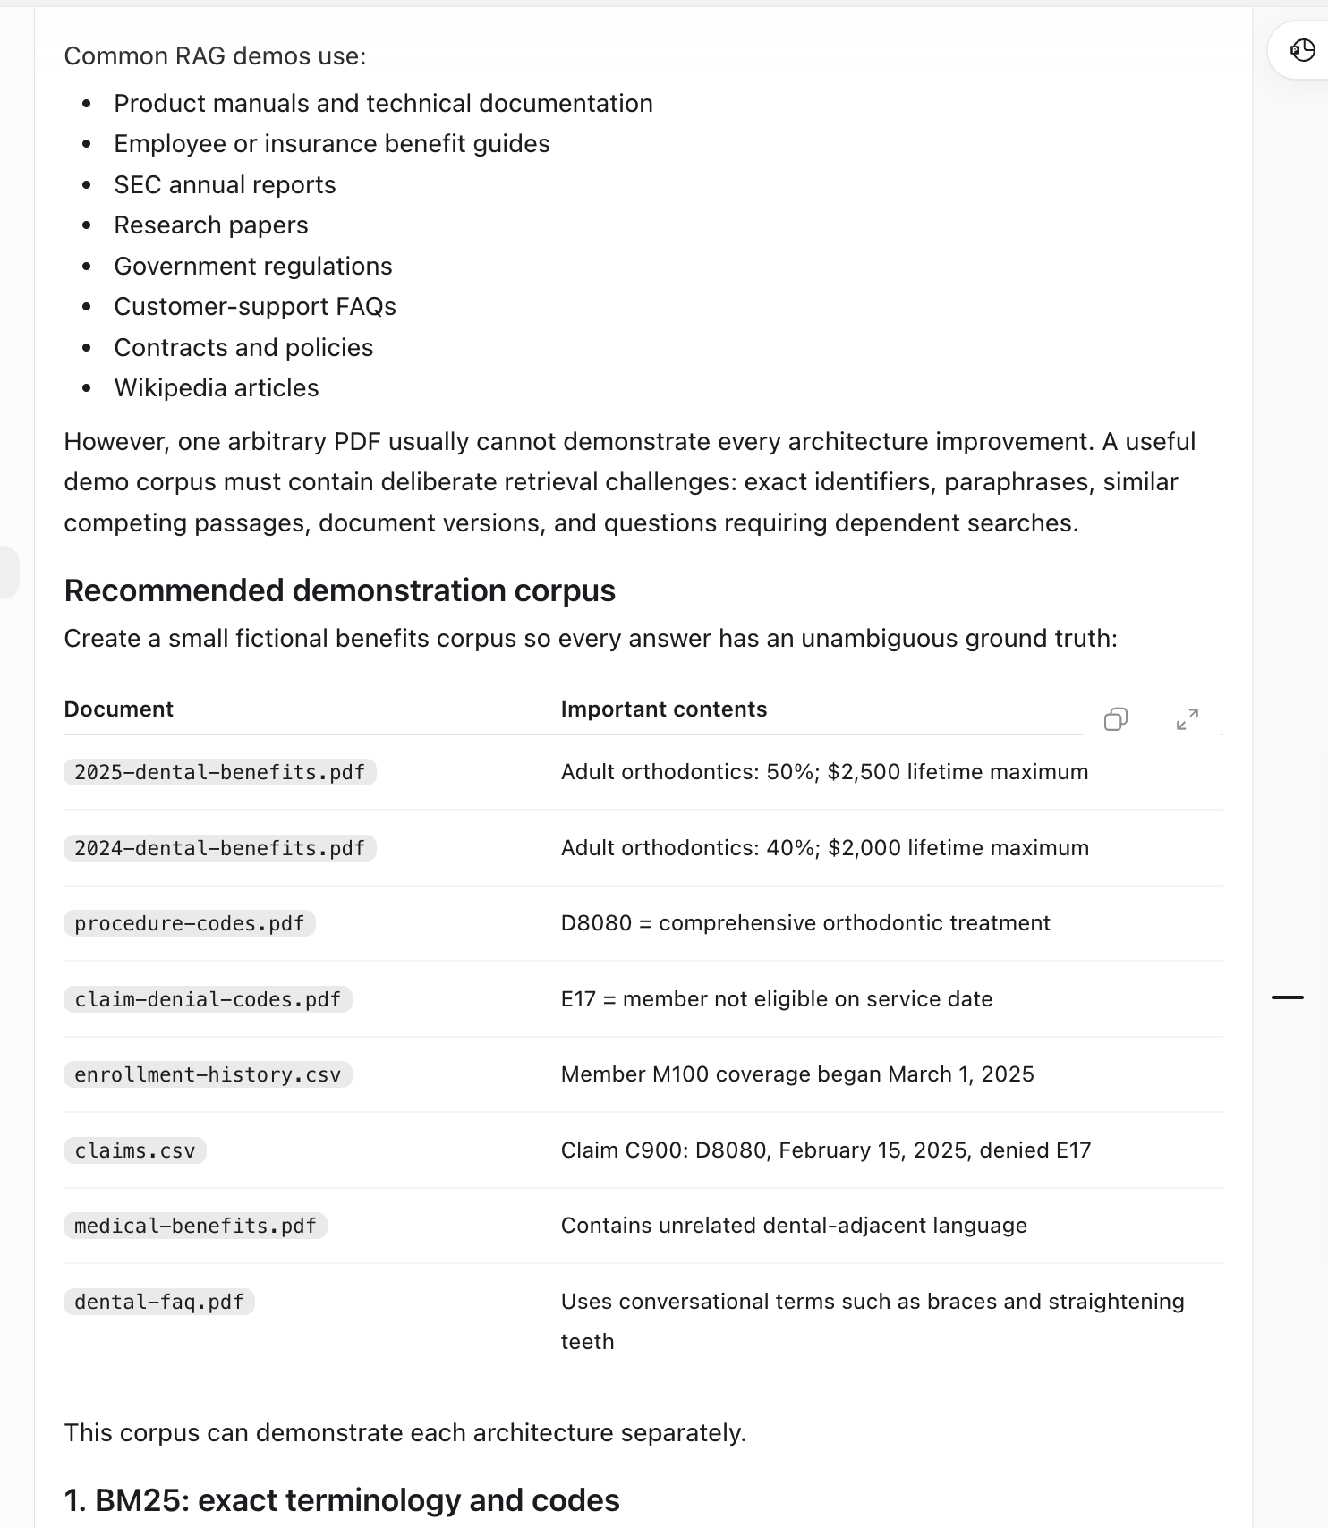
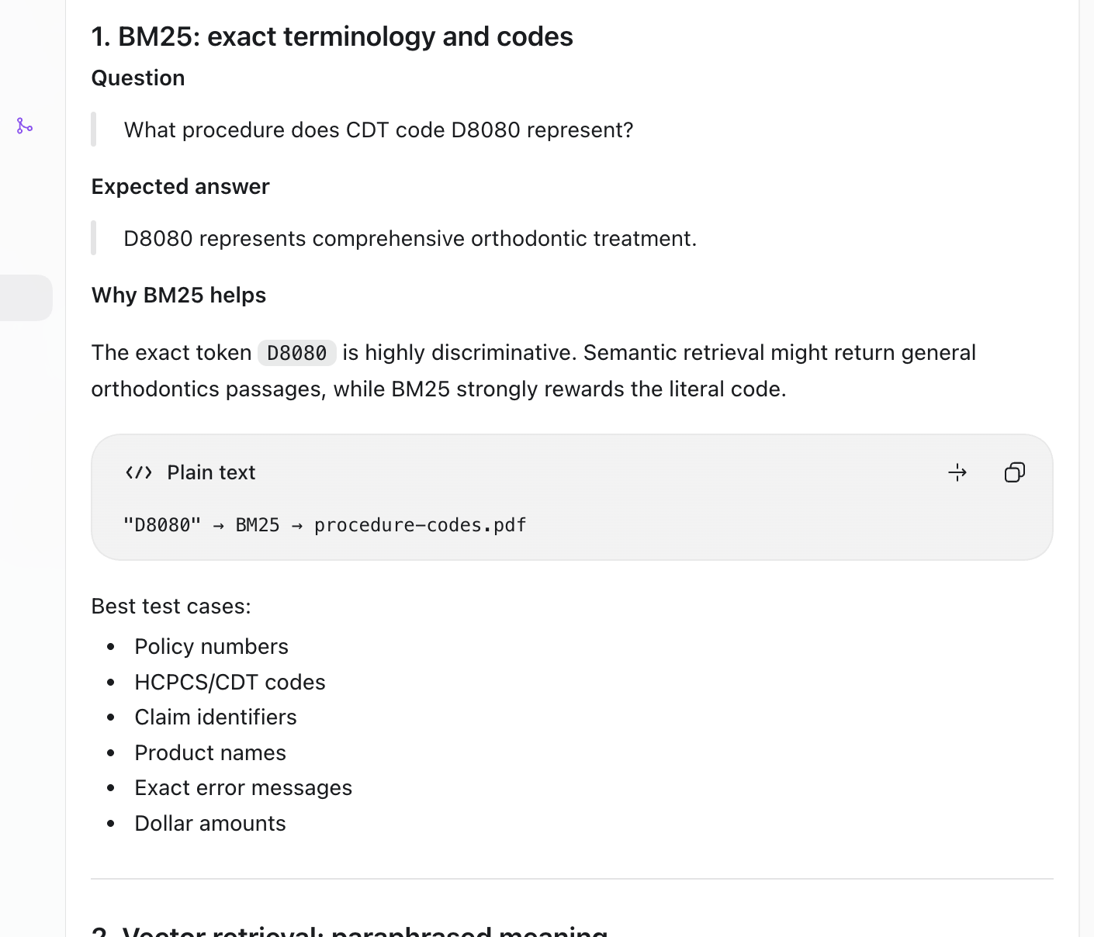
Notes:
To show what each technique fixes, you need a corpus built for it. Typical demo corpora rarely contain the hard cases, so we propose a small fictional benefits corpus: 2024 and 2025 benefit PDFs, procedure codes, claim-denial codes, enrollment history, claims, a medical plan and a dental FAQ. First case, BM25: what procedure is CDT code D8080? The exact token is highly discriminative, so keyword search wins.

Slide 58

Notes:
Vector retrieval: does the plan help pay for braces for a grown-up? The document says adult orthodontic services. The words differ but the meaning matches, which is exactly where BM25 fails and embeddings succeed.

Slide 59

Notes:
Hybrid retrieval: for D8080, how much does the 2025 plan pay for an adult? The question has two signals, the exact code for BM25 and the adult-coverage meaning for vector search. Fusing both with reciprocal-rank fusion beats either one alone.

Slide 60

Notes:
Reranking: what are the current adult orthodontic benefits? Retrieval finds the right passage, but 2024 benefits, pediatric orthodontics and dental-injury coverage compete with it. A query-aware reranker should put 2025 over 2024, adult over pediatric and orthodontics over injuries. This is the clearest case of evidence that was found but ranked too low.

Slide 61

Notes:
Another reranking case from the real policies: which denosumab product tied to policy Q5157 is preferred, and what is its prior-authorization status? BM25 favors the exact code, vector search favors general denosumab text, and a reranker that reads the whole query moves the complete Q5157 table to the top. A ranking problem, not a multi-hop one.

Slide 62

Notes:
HyDE: if I am 42 and want my teeth straightened, is any of it paid for? The source uses formal language about orthodontic appliances for members 19 and older. HyDE writes a document-like passage, searches with it, and finds the formal text. The generated passage is a search key, never evidence.

Slide 63

Notes:
When HyDE helps and when it does not. It helps with natural-language mismatches such as can adults get braces. It does not help with internal policy codes, HCPCS or CDT codes, member-specific eligibility, exact dollar amounts or new product names. So route: exact codes and entities to BM25 and structured lookup, conceptual questions to HyDE plus vector search. Also mind privacy: queries sent to an external LLM leave your boundary.

Slide 64

Notes:
CRAG: did adult orthodontic benefits improve in 2025 compared with 2024? If retrieval finds only the 2025 passage, a corrective system should notice it cannot compare without 2024 evidence and issue a targeted search for it. The fix is diagnosis and a second search, not better ordering.

Slide 65

Turn on multiquery when you have a retrieval error. Cant get the right chunk
Turn on CRAG when have retrieval error
Turn on KIND
Notes:
When to turn things on: multi-query when you have a retrieval error and cannot get the right chunk; CRAG when the first retrieval is incomplete or contradictory, as in this example where a 2024 page, a partial 2025 page and an unrelated medical limit come back for one orthodontics question. A reranker cannot fix evidence that was never retrieved.

Slide 66


Notes:
Agentic search: why was member M100’s orthodontic claim C900 denied when the plan covers adult orthodontics? No single search can answer it. The agent looks up the claim, the procedure code, the 2025 benefit, the denial code and the member’s enrollment, then compares dates: the service preceded the coverage start. Each result decides the next lookup. That is genuine multi-hop search.

Slide 67

Notes:
Summary of what each demo proves: BM25 fixes missed exact identifiers, vector search fixes missed paraphrases, hybrid handles both, reranking fixes buried evidence, HyDE fixes style mismatch, CRAG fixes missing evidence, agentic search fixes dependent lookups. A convincing presentation runs every question against a baseline and the enhanced architecture and shows ranks, correctness, citations, latency and tokens.

Slide 68

Notes:
A reality check on our own data. Retrieval is already near its ceiling: Recall@5 of 1.00 on the 14-question fixture, the right policy at top-1 91 percent and top-5 100 percent for table RAG, and the agentic loop never rewrote a query. Exact terms like drug names and codes make retrieval easy. The real errors are in completeness and assembly: the right document, an incomplete answer.

Slide 69

Notes:
Why CRAG and reranking were hard to justify: we built a CRAG-style workflow with grading, rewriting and optional reranking, but could not produce enough genuinely complex multi-document questions to show a benefit. Questions mostly asked to retrieve each paper and compare. True multi-hop needs evidence from one source to decide the next search. That is why the fraud investigator became the better agentic demonstration.

Slide 70
Measuring the right errors
Notes:
If retrieval is mostly solved, where do answers go wrong? This section separates retrieval misses from context-assembly losses, shows the measured gap, and covers how evals map to system architecture, including fixing synthetic RAGAS questions and query routing.

Slide 71

index ──► retrieve / rerank ──► top-k ──► assemble context ──► [context] ──► LLM
(A) retrieval miss: (B) assembly loss:
right chunk not in top-k right chunk/table WAS found,
but the fact still isn't in the context
Notes:
Two different errors that look the same to the user. Retrieval miss: the right chunk was ranked below the cutoff or never a candidate; measured with hit@k, recall@k and MRR; fixed with better embeddings, BM25 or hybrid, or reranking. Assembly loss: the right chunk or table was found, but the fact did not make it into the context, because a top-5 cut dropped sibling rows, a qualifier lived outside the table, or the token budget truncated it.

Slide 72

Notes:
Measured on our data, they are mostly not the same. Flat row chunks retrieved the right table 98.3 percent of the time but had every needed fact in context only 40.7 percent of the time. Table-aware RAG reached 100 and 69.5 percent. Attaching notes reached 100 and 100. Retrieval is close to solved; the lost facts happen after retrieval. Check, for each lost fact, whether it was in the candidates: if not, fix ranking; if yes, fix context building; if it was never indexed, fix ingestion.

Slide 73
Evals
Evals are hard because there are different levels of evals and each level corresponds to a different system architecture.
Hard because trying to match a set of evals with an incorrect system architecture means the RAG system won’t work
Hard because not all the failure modes or set of evals exist before the system is build. Constant iteration
Error analysis is hard and tedious.
LLMs can generate evals but by definition a RAG system has data which the LLM hasn’t seen before so any evals are from a similar distribution.
LLM evals only good for short horizon single document tasks
Have to look at data when other side is a real human. We cover that in policy chatbot demo.
Evals1: simple questions answered by a single document. For example: xx. All of the demos in the geha repo are of this type.
Evals 2: more complex questions requiring multi hop agentic search to solve them. This includes an agentic fraud investigator in ~/geha/hapi/fraud. These evals require combining queries against several datasources. The evals are common fraud patterns found in most of the common cases like duplicate claims, miscoding, etc..
Evals3: an eval requiring a long horizon task with exploration where the goal is not always clear like:
Notes:
Why evals are hard: each level of eval matches a different architecture, failure modes appear only after the system is built, and error analysis is slow. LLM-generated evals come from a distribution the model already knows, so they suit short, single-document tasks. Level 1: single-document questions, like all the GEHA repo demos. Level 2: multi-hop agentic questions across several data sources, like the fraud investigator. Level 3: long-horizon exploration where the goal is not clear up front.

Slide 74
Agents: context windows and memory
Notes:
Agentic systems hit a second limit: the context window. This section covers the agent loop versus the harness around it, why accuracy drops as context fills, how to keep large tool results out of context, subagents and compaction, and the four kinds of agent memory.

Slide 76
Production pattern: building small RAG,
requires a router. JEV vs LLM
Notes:
How the lessons land in a real application: state-machine RAG for enrollment, where the model only fills slots and never writes a number, and guarded hybrid retrieval for policy questions, with input and output gates and one bounded repair loop.

Slide 77
How to configure JEV
Natural-language routing policy + deterministic cluster signals
JEV ROUTER PROMPT
SIX-CLUSTER SIGNALS
def _jev_route(query: str) -> dict[str, Any]: # pragma: no cover - external API
question = Choice(
instructions=(
"Route the user's search query to exactly one"
" document cluster. Classify the requested"
" evidence, not the answer. Treat statistics"
" about employees, employer-sponsored plans,"
" plan sponsors, or their members as"
" benefits_research even when the topic is"
" prevalence, health outcomes, or SDOH."
" Use population_health only for general,"
" geographic, state, or national populations."
" Route insurer premium-dollar allocation,"
" medical-versus-administrative spending,"
" taxes, fees, cost containment, or insurer"
" profit to policy. Route employer premium"
" trends, employee contributions, and benefit"
" surveys to benefits_research. Route questions"
" about observed results from an empirical"
" study or named analysis to research,"
" including intervention outcomes and subgroup"
" affordability findings. Route requests for"
" treatment, screening, vaccination, or"
" patient-care recommendations to"
" clinical_guidance. Use population_health for"
" descriptive population prevalence,"
" demographics, geographic comparisons, and"
" state or national rankings."
),
criteria=CLUSTER_DESCRIPTIONS,
)
CLUSTER_SIGNALS = {
"policy": (
"coverage", "covered", "policy",
"prior authorization", "formulary",
"medical necessity", "criteria", "medicare",
"reimbursement", "benefit limit",
"premium allocated", "premium allocation",
"health care dollar", "health plan premium",
"spending categories", "medical spending",
),
"clinical_guidance": (
"vaccine", "vaccination", "immunization",
"clinical", "treatment", "exam",
"retinopathy", "dry eye", "patient",
"care recommendation", "schedule",
),
"population_health": (
"population", "public health", "state ranking",
"rankings", "older adults", "prevalence",
"mortality", "demographic", "state summary",
"health outcome",
),
"benefits_research": (
"employer", "employee", "workforce",
"benefits survey", "health benefits", "premium",
"caregiving", "open enrollment", "firms offer",
"workplace", "plan sponsor", "employer plan",
"employee health", "member population",
),
"forms_directory": (
"form", "application", "apply", "fillable",
"provider directory", "provider list", "submit",
"submission", "instructions",
"eligibility application", "enroll",
),
"research": (
"study", "report", "analysis", "findings",
"research", "cost", "utilization", "survey",
"evidence", "statistics", "comparison",
),
}

Slide 78
tuning ragas and jev
{"user_input":"What percentage of adults in the HAC employer-plan population have high SDOH risk, and how are these risks distributed among social isolation, housing, food, and financial factors?"}
What percentage of adults have high social determinants of health (SDOH) risk and how are these risks distributed? Supposed to be benefits research but is classified as population health.
underspecified ragas query
Notes:
Tuning the synthetic eval set and the router. RAGAS generated an underspecified question about the share of adults with high social-determinants-of-health risk. It should route to benefits research, but the JEV router classified it as population health. The question is the problem, not only the router.

Slide 79
tuning ragas and jev
how to fix jev routing errors: 1) Which groups of Medicare beneficiaries are most likely to experience problems affording prescription medications? routed as population health should be research, 2) What are the cardiovascular and metabolic benefits of playing Pickleball regularly for middle-aged and older adults? routed as clinical guidance should be research,
- Which groups of Medicare beneficiaries are most likely to experience
- problems affording prescription medications?
+ According to the ASPE data-point analysis, which groups of Medicare
+ beneficiaries are most likely to experience problems affording
+ prescription medications?
make queries research queries
Notes:
Two more routing errors: a Medicare prescription-affordability question routed as population health when it is research, and a pickleball benefits question routed as clinical guidance. The fix is to rewrite the generated questions as research questions that name their source, for example according to the ASPE data-point analysis.

Slide 80


Slide 81
tuning ragas and jev
- What are the cardiovascular and metabolic benefits of playing
- Pickleball regularly for middle-aged and older adults?
+ According to the ACE-sponsored six-week Pickleball study, what
+ cardiovascular and metabolic changes were observed in middle-aged
+ and older adults?
make queries research queries
Notes:
The pickleball question rewritten with its source: according to the ACE-sponsored six-week pickleball study, what cardiovascular and metabolic changes were observed in middle-aged and older adults? Grounding the question in its source document makes both routing and retrieval unambiguous.

Slide 82
Medicaid belongs in the routing metadata
One payer spans several document types, each with different retrieval behavior.
PAYER / DOMAIN
DOCUMENT TYPE
ROUTING EXAMPLES
Policy
Prior authorization criteria
Kentucky Medicaid PA
Medicaid
Medicaid + policy
Filter or route by payer
Forms & directory
Applications and provider lists
Apply for KY Medicaid
Medicaid + forms
Clinical guidance
Care and treatment guidance
Adult optical providers
Medicaid + directory
Research
Studies and evidence
Recommended architecture: keep one document-type index and attach payer metadata. Add a dedicated Medicaid index only when corpus size or access rules require it.
Notes:
Should Medicaid be its own cluster? No. Medicaid is a payer, and one payer spans several document types: prior-authorization policies, applications and forms, care and treatment guidance, and research. Each behaves differently in retrieval. Recommended: keep one index per document type and attach payer metadata, so Medicaid becomes a filter.

Slide 83
The six document-type clusters
Current reference set: 50 documents
Policy
5 docs
Why don’t we make Medicaid a cluster?
Clinical guidance
10 docs
A Medicaid cluster would mix very different material:
Population health
7 docs
EXAMPLES
• Kentucky prior-authorization criteria → policy
• TennCare preferred drug list → policy
• Kentucky Medicaid application → forms_directory
• Washington Medicaid optical providers → forms_directory
• Medicaid utilization research → research
Benefits research
7 docs
Forms & directory
7 docs
Research
14 docs
Putting everything into one Medicaid cluster could reduce retrieval precision.
Use Medicaid as a payer filter, then route by document type.
Notes:
The six document-type clusters in the 50-document reference set: policy 5, clinical guidance 10, population health 7, benefits research 7, forms and directory 7, research 14. A Medicaid cluster would mix very different material, for example Kentucky prior-authorization criteria, a Kentucky application, a provider directory and utilization research, and would lower precision. Filter by payer, then route by document type.

Slide 84
Production pattern: the GEHA dental chatbot
Notes:
How the lessons land in a real application: state-machine RAG for enrollment, where the model only fills slots and never writes a number, and guarded hybrid retrieval for policy questions, with input and output gates and one bounded repair loop.

Slide 85

Most build a vector/bm25 index and expect an dental enrollment chatbot to work. It will never work. Start with state then lookup plan code.
Notes:
State-machine RAG for enrollment questions. Extract slots from the message with rules or an LLM and a schema: ZIP, status, enrollment, plan. If information is missing, ask the next question; when ready, do an exact structured lookup by key and reply with a template plus the looked-up values. The tables are parsed from the benefits guide at startup: rate codes on page 10, premiums on page 11, benefits on page 5. No embeddings, no similarity search, and the LLM never writes a number.

Slide 86

Notes:
The same idea extended to dental and medical together. Shared slots for status and enrollment are asked once; a router sends the member to the dental sub-machine, the medical sub-machine or both, and the result is a combined quote for the same pay period. All values come from structured tables parsed from the dental guide, the medical guide and five standard summaries of benefits.

Slide 87

Notes:
The GEHA dental chatbot combines both patterns. The enrollment tab is state-machine RAG: DSPy normalizes member language into allowed labels, and deterministic LangGraph state and authoritative tables make the decisions. The policy Q and A tab uses guardrails plus one conditional self-correction: a clean answer is returned as is, while a draft that adds an unsupported claim, like the Walmart glasses example, gets exactly one bounded repair and a recheck, otherwise a refusal.

Slide 88

Notes:
Where the JEV safety classifier runs. In dental policy Q and A it is Gate 1: it classifies the member’s question before any generated answer can be released, while retrieval and the DSPy draft run in parallel; Gate 2 checks the answer against the retrieved pages. In the enrollment tab JEV is off and the deterministic state machine handles everything.

Slide 89

Notes:
The retrieval architecture behind policy Q and A. Offline, Docling turns each page into markdown and builds a BM25 index and a BGE vector index, cached. Online: Gate 1, query preparation with vocabulary expansion and an exact-code BM25 path, BM25 and vector retrieval fused with reciprocal-rank fusion, top page evidence, SQLite enrichment with exact benefit rows, context assembly, the DSPy generator and Gate 2. Note that the current reranking is rank fusion; a learned reranker exists but is not wired in.

Slide 90

Notes:
The grounded hybrid architecture in one view. Structured facts come from SQLite; BM25 and BGE supply supporting document evidence; the models interpret and explain but never invent benefit values. Input safety and answer preparation run concurrently, a release gate and an output guard check the draft, and anything unsafe, unsupported, timed out or erroring fails closed to a refusal.

Slide 91
Agents: context windows and memory
Notes:
Agentic systems hit a second limit: the context window. This section covers the agent loop versus the harness around it, why accuracy drops as context fills, how to keep large tool results out of context, subagents and compaction, and the four kinds of agent memory.

Slide 92

Notes:
Agent loop versus harness. The loop is the model calling tools, here OCR, get text, get tables, save HTML and screenshot, comparing the screenshot to the HTML and looping until they match. The harness is everything that keeps that loop healthy over many turns: a context manager that trims and compacts to a window budget, and a sandbox where tool runs are isolated. In our runs a single-page PDF worked while the full PDF produced errors.

Slide 93

Notes:
Why long runs degrade: the context window is re-sent in full on every call. A full-PDF OCR result of 29,694 characters, tool results and tool schemas pile up turn after turn, and error rates rise as the window approaches its limit, in this run around 40 turns.

Slide 94

Notes:
The needle-in-a-haystack test on Claude 2.1 with a 200K context. A fact was placed at different depths in documents of different lengths, and the model was asked to retrieve it. Green is correct, pink is a miss. Accuracy degrades as context length grows, especially for facts in the middle and toward the bottom.

Slide 95
Not all tokens used
Horizontal axis: context length, from 1,000 to 200,000 tokens.
Vertical axis: where the hidden fact—the “needle”—was placed in the document.
Top = beginning of the prompt.
Bottom = end of the prompt.
Green: the model retrieved the fact correctly.
Yellow: partial accuracy.
Pink: retrieval failed.
RAG:
Retrieving more documents <<< Giving the LLM a better answer context
DOTTED LINE
Context lengths are roughly 83K–200K tokens.
Most cells are pink, indicating 0% retrieval accuracy.
The diagonal boundary expands downward as context length increases.
Notes:
How to read the chart: horizontal is context length from 1,000 to 200,000 tokens, vertical is where the fact was placed. Past the dotted line, roughly 83K to 200K tokens, most cells are pink, and the failure zone expands as context grows. The lesson for RAG: retrieving more documents is far less useful than giving the model a small, correct context.

Slide 96

Notes:
Large tool results: context or sandbox. If an OCR result of 29,694 characters goes into the context window, it is re-sent on every later call. Above a size threshold, write it to a sandbox file instead and let the agent search it, for example grep for Treanda, loading only the relevant lines.

Slide 97

Notes:
Two more ways to manage context. Subagents get a fresh window, do a delegated task such as reading pages or searching, and return only a short result. Compaction replaces old turns with a summary, which frees room but is lossy: exact table values, raw OCR output, early decisions and why a fix failed can all disappear in the summary.

Slide 99

Agent Memory
Why? Store the prompt, store skills.md, user.md, xx.md, store RAG chunks, all of these have different memory requirements.
Notes:
Agent memory, using the CoALA framework from Sumers and colleagues, 2024. An agent stores prompts, skill files, user files and RAG chunks, and each has different memory requirements. CoALA separates procedural memory, semantic memory, episodic memory and working memory, each connected to the decision procedure through retrieval and learning.

Slide 100

All the .md files take up context memory
Notes:
Procedural memory: the rules applied to working memory that determine the agent’s behavior, essentially its skills and the knowledge of how to complete tasks. A SKILL.md file with brand guidelines is an example. Every one of these markdown files takes up context when loaded.

Slide 101

RAG systems select data from documents not crawled by bots and add to context window. Can fine tune into model
Notes:
Semantic memory: facts about the world and about the user, such as preferences, which is what most people mean by chatbot memory. RAG is semantic memory over documents the model never saw in training; the alternative is to finetune that knowledge into the model.

Slide 102

Logs, records traces. path of agent.
Notes:
Episodic memory: sequences of the agent’s past behavior. In chatbots it is the store of prior conversations; in agents it is the raw logs, records and traces of the path the agent took, like this memory stream.

Slide 103

Notes:
Working memory: typically the context window, what the agent currently sees and reasons over, including observations, goals, user input and internal reasoning. It is the scarcest of the four, which is why context management matters so much.

Slide 104

Notes:
Recursive self-improvement without changing weights. A larger teacher model reads the student’s failed transcripts and scores, diagnoses why it failed, and rewrites the student’s system prompt one change per round. The new prompt is kept only if the held-out score improves by more than the noise; otherwise it is reverted. The loop runs until the score stops improving or the budget runs out.

Slide 105
Agents that drive applications
Notes:
A worked example of an LLM operating an application: drawing bounding boxes on a bill of lading, and why self-correction needs a fixed rendering contract rather than free-form HTML.

Slide 106

LLM controls the app
Automating drawing
bounding boxes
Notes:
Demo: the LLM controls the bounding-box application, automating the drawing of boxes on a document page. Play the recording here.

Slide 107

LLM controlling App
to create bounding
boxes
Notes:
Second demo clip: the LLM driving the same app to create bounding boxes, showing each action it takes in the interface. Play the recording here.

Slide 108

Notes:
The instruction the model was given: a detailed description of how to split a bill of lading into horizontal blocks with red lines that follow the black lines on the page, block by block, from the Meridian Shipping header down to the freight charges. Precise spatial instructions like this are what the agent has to turn into drawing actions.

Slide 109


Notes:
The result: on the left the original Meridian Shipping bill of lading, on the right the authoritative source with the requested red segmentation drawn over it. Each block is now a region that can be extracted and checked separately.

Slide 110
Figure specification
↓
Deterministic SVG or fixed-size HTML canvas
↓
PNG rendered at fixed dimensions
↓
Visual comparison
↓
Correct the specification—not arbitrary HTML
The model should only modify the JSON specification:
Ordinary responsive HTML is a poor target for pixel-level self-correction because the output depends on:
Browser viewport and device scale
Fonts and font availability
CSS layout and text wrapping
Browser engine and version
Default margins and rendering behavior
Screenshot dimensions
For a stable correction loop, use a fixed rendering contract:
{
"canvas": {"width": 1530, "height": 1980},
"series": [...],
"categories": [...],
"elements": [
{
"type": "text",
"x": 120,
"y": 80,
"width": 900,
"font_size": 28
},
{
"type": "bar",
"x": 620,
"y": 340,
"width": 480,
"height": 28,
"segments": [...]
}
]
}
Source figure
↓
Argon extracts semantic spec
↓
Deterministic SVG renderer
↓
Compare source and render
↓
Structured corrections:
values → labels → structure → geometry → styling
Notes:
Why self-correction needs a fixed rendering contract. Ordinary responsive HTML renders differently with viewport, fonts, CSS, browser engine and screenshot size, so pixel comparison is unreliable. Instead, extract a semantic figure specification, render it deterministically to SVG at fixed dimensions, compare it with the source, and correct in order: values, labels, structure, geometry, styling. The model may only edit the JSON specification.

Slide 111
Finetuning small models for one job
Notes:
The last lever: finetune small models for a narrow task. First the motivation and instruction finetuning, then our two experiments: the retriever embedding model and the LoRA-tuned answer generator.

Slide 112

Notes:
Why finetune at all? Tiny specialized models can beat large general ones on a narrow task when you have a self-improving data flywheel. Shopify reports a 0.8-billion-parameter model scoring above a frontier model on their buyer-profile task, with a much shorter prompt and far higher throughput.

Slide 113

Notes:
Instruction finetuning, from the FLAN paper. A model is trained on many tasks phrased as instructions, both direct answers and chain-of-thought rationales, and then generalizes to unseen tasks. This is the method we applied to the GEHA answer generator.

Slide 114


Embedding Fine Tuning
Notes:
Our first experiment: finetuning the embedding model that does retrieval. On 41 held-out brochure questions, Recall@5 rose from 64.63 to 68.70 percent, nDCG@10 from 67.74 to 70.01 and MRR@10 barely moved. These are from a single run; the README calls them preliminary until repeated with more seeds and documents.

Slide 115
Teaching the answer model to read our passages
GEHA DENTAL RAG · GENERATOR FINETUNING
LoRA instruction finetuning of Qwen2.5‑1.5B‑Instruct on direct and chain‑of‑thought examples
October 2026 · experiment log · results from the Colab A100 run, 21 Oct
Notes:
This deck covers the generator half of RAG finetuning: what we train, on what data, the Mac attempt and the Colab A100 run, what improved on an unseen document, and the answer to whether it is overfit.

Slide 116
Two places to finetune a RAG system
RETRIEVER · DONE EARLIER
GENERATOR · THIS DECK
Which chunks the LLM sees
How the LLM answers from them
bge‑base‑en‑v1.5 embedding model, contrastive loss on question → chunk pairs.
Qwen2.5‑1.5B‑Instruct chat model, LoRA instruction finetuning on passage + question → answer.
Recall@5: 64.6% → 68.7% on the held‑out brochure
Answer F1: 0.51 → 0.57 on the held‑out brochure
The slide that started this: instruction finetuning with direct and chain‑of‑thought data (FLAN, arXiv 2210.11416)
Notes:
The retriever work changed which chunks reach the model. This work changes the model that writes the answer. The two are independent: the retriever result came from an earlier experiment in the finetuning folder; the generator number is the Colab A100 run, scored on the same held-out plan brochure.

Slide 117

The pipeline, end to end
01
02
03
04
QA pairs
SFT builder
LoRA training
Held‑out eval
Synthetic RAGAS questions + reference answers from the GEHA dental PDFs
Gold passage + 2 distractors, shuffled. One direct and one chain‑of‑thought target each
Loss on answer tokens only. Keep the adapter with the lowest validation loss
Unseen plan brochure. Base vs tuned, same prompts; only the adapter differs
Why distractors: retrieval is never perfect, so the model must learn to ignore irrelevant chunks (the RAFT recipe).
Why two formats: mixing direct and chain‑of‑thought targets in one run is the FLAN multi‑task recipe.
prepare_sft.py → train_lora.py → plot_loss.py → eval_generator.py
Notes:
Four steps, each a script in finetuning_LLM_LORA. The base and tuned models are evaluated in the same process with the adapter switched off and on, so prompts and decoding are identical.

Slide 118
One question becomes two training examples
PROMPT · masked, not trained on
DIRECT TARGET · trained on
[1] guide p.6 · Plan features (distractor)
[2] guide p.2 · Contact us (gold)
[3] guide p.4 · Both plans include (distractor)
You can reach a FedViser … by calling 1‑855‑572‑1636 Monday through Friday from 8 a.m. to 8 p.m. Eastern time.
Question: What is the phone number to contact a FedViser for GEHA dental benefits?
CHAIN‑OF‑THOUGHT TARGET · trained on
Evidence:
- [2] “Reach a FedViser Monday‑Friday from 8 a.m.‑8 p.m.”
Answer: You can reach a FedViser … 1‑855‑572‑1636 …
Real example ragas‑0002 (abridged). Evidence is extractive: the gold sentences that overlap the reference answer most.
Notes:
Each of the 78 training questions produces a direct example and a chain-of-thought example: 156 in total. The rationale is extractive, not written by a model, which is cheaper but imperfect: in this very example the extracted evidence lines miss the line with the phone number, because that line shares few words with the answer. Worth improving with an LLM-written rationale later.

Slide 119

Data splits: the test set is a different document
 | train | validation | test
Document | guide | guide | brochure
Sections | 22 | 6 | 72
QA pairs | 78 | 24 | 41
SFT examples | 156 | 48 | 82
Distractor pool | 34 | 8 | 167
Prompt tokens, mean | 990 | 702 | 1,251
Answer tokens, mean | 135 | 120 | 199
Leakage checks: 5 of 5 pass
No shared chunk IDs
Train/val sections disjoint
Test document unseen
No repeated questions
Sources inside own split
Guide = 2026 GEHA dental benefits guide · Brochure = 2026 plan brochure · Report: results/data_splits.md
Notes:
Train and validation come from the same guide but different sections, so validation loss tells us about unseen text in a familiar document. The test set is the plan brochure, a document the model never trains on, so it measures transfer. split_stats.py fails the run if any of the five checks fails.

Slide 120
The model: a frozen 1.5B base with a small adapter
1.5B
18.5M
20
74 MB
frozen weights in Qwen2.5‑1.5B‑Instruct
trainable LoRA weights, about 1.2% of the model
optimizer steps per epoch (156 examples ÷ batch 8)
adapter file on disk, vs about 3 GB for the base
LoRA | Targets | Optimizer | Selection
rank 16, alpha 32, dropout 0.05 | q, k, v, o, gate, up, down | AdamW 2e‑4, warmup + cosine | lowest validation loss
Adapter size measured from adapter_model.safetensors (fp32); base size is the bf16 checkpoint
Notes:
LoRA freezes the base model and learns low-rank updates on every attention and MLP projection. Only 18.5 million weights train, which is why the saved adapter is 74 MB. With only 156 examples, an epoch is just 20 optimizer steps, which matters for the question of how many epochs to run.

Slide 121



On the Mac: 4 h 41 min, one finished epoch
02:53
03:57
06:39
07:34
Start on an M1 Pro, 32 GB, fp32 on the GPU (MPS)
Epoch 1 done in 56 min. Validation loss 0.626 → 0.517; adapter saved
Battery at 1%: the Mac hibernates for 12 min, epoch 2 still unfinished
Stopped. Full run moves to a Colab GPU
No bf16 on M1. fp32 doubles memory and compute compared with a bf16 GPU.
Ran on battery. macOS throttled the job, then hibernated it.
Memory pressure. 15.8 of 17 GB swap in use slowed every step.
Times are local (PDT), 21 Oct 2026, from the training log and macOS power log
Notes:
Epoch 1 took 56 minutes, about 21 seconds per training example. Epoch 2 ran for three and a half hours without finishing because of battery throttling, a 12-minute hibernation and heavy swapping. That is why the full run moves to a Colab GPU.

Slide 122
On a Colab A100: all 3 epochs in 3.5 minutes
56 min
71 s
≈47×
one epoch on the M1 Pro, fp32 on MPS
one epoch on an A100‑SXM4‑40GB, bf16, validation included
faster per epoch, same code and data
Colab stage | Time | Output
Training: 60 steps, 7 validation passes | 3.5 min | train_log.jsonl, best adapter
Eval: 82 examples × 2 models | ≈23 min | generator_comparison.json
Training time from train_log.jsonl (elapsed_s = 212); eval time from result file timestamps
Notes:
Same code, same data, same hyperparameters. The A100 trains in bf16 and has far more compute and memory bandwidth, so a full epoch took 71 seconds including validation, against 56 minutes on the Mac. The eval is now the slow part, because it generates 164 answers one token at a time with batch size 1.

Slide 123
Validation loss bottoms out after one epoch, then climbs
0.627
0.601
0.607
0.576
0.535
0.517
0.541
Best at epoch 1 (step 20): 0.517, down 17% from 0.627 before training.
Epochs 2–3: validation loss climbs back to 0.607 while train loss keeps falling to about 0.11.
Kept: only the epoch‑1 adapter, so the later epochs never reach the eval.
0
0.5
1
1.5
2
2.5
3
epoch
Validation = 24 questions × 2 formats from guide sections never trained on · Colab A100 run · bars start at zero
Notes:
Validation loss is checked every 10 steps. It falls for the first 20 steps, an epoch, and then rises for the remaining 40 while training loss keeps dropping. That is the textbook overfitting pattern. The trainer saves only the lowest-validation checkpoint, so the adapter that was evaluated is the epoch-1 one.

Slide 124
Is it overfit? Yes after epoch 1, and the kept adapter avoids it
EPOCH 3
EPOCH 1 (KEPT)
UNSEEN DOCUMENT
train ≈0.11
val 0.607
val 0.517
On the brochure the kept adapter beats the base model: answer F1 +0.06, gold citations +0.12.
Lowest validation loss of the run. Best‑checkpoint selection saved this adapter, and it is the one evaluated.
The gap between validation and recent training loss grows from −0.07 to +0.48: the model memorizes the 78 training answers.
So it generalizes, but the margin is small and part of it is style.
Your 1–2 epoch instinct was right for this data: 20 optimizer steps were enough
Notes:
Yes, it overfits if you keep training: after epoch 1, validation loss rises every pass while training loss heads towards 0.1. But the run only keeps the lowest-validation adapter, so the model we use is the epoch-1 one, and on a document it never saw it still beats the base model. For the next run, train 1 epoch or turn on early stopping with patience 2 to save the wasted compute.

Slide 125
On the unseen brochure, the tuned model answers better
Metric (41 questions each) | Base | Tuned | Change | 95% CI | Better / worse
Answer F1, direct | 0.51 | 0.57 | +0.06 | +0.002 to +0.109 | 27 / 14
Answer F1, chain of thought | 0.49 | 0.54 | +0.06 | +0.000 to +0.108 | 29 / 11
Cites the gold passage | 0.72 | 0.84 | +0.12 | −0.008 to +0.240 | 15 / 4
Quotes found in passages | 0.87 | 0.87 | 0.00 | −0.104 to +0.097 | 7 / 7
CoT format followed | 1.00 | 1.00 | 0.00 | – | –
Answer length, words | 62 | 88 | +26 | reference: 107 | –
Real gain: better on about two‑thirds of questions, and cites the gold passage over a distractor more often.
Read with care: the intervals almost touch zero, and longer answers closer to the reference length also raise F1.
Epoch‑1 adapter vs base, same prompts, greedy decoding · paired bootstrap over questions, 5,000 resamples · one training seed
Notes:
Both models saw identical prompts: the gold passage plus two distractors. Answer F1 rose about 0.06 in both formats, and the tuned model was better on 27 of 41 direct questions and 29 of 41 chain-of-thought ones. Citation precision rose 0.12. Quote grounding did not change, and the base model already followed the evidence format. Two cautions: the confidence intervals nearly reach zero with 41 questions and one seed, and the tuned answers are 26 words longer, closer to the 107-word references, which by itself lifts token F1.

Slide 126

The whole run on one page
Notes:
Produced by plot_metrics.py from train_log.jsonl and generator_comparison.json. Top row: loss, the generalization gap, which crosses zero just before epoch 1 and keeps rising, and the learning-rate schedule. Bottom row: gradient norm staying under the clip, wall clock at about 3.4 seconds per step on the A100, and the base-versus-tuned eval.

Slide 127
What we learned, and what to run next
One epoch is enough here
The gain is real but modest
With 156 examples, 20 steps reach the best validation loss. Next run: --epochs 1, or --patience 2.
+0.06 answer F1 and +0.12 gold citations on an unseen document, from one seed and 41 questions.
Repeat across seeds
Grade beyond token F1
Three to five seeds at about 30 minutes each on an A100 tell us whether +0.06 holds.
Add an LLM‑judge or human check for correctness, and LLM‑written rationales instead of extractive ones.
finetuning_LLM_LORA/ · results/ · PR dougc333/geha#101
Notes:
Four points. One epoch is the right length for this dataset; anything more memorizes. The improvement on an unseen document is genuine but small and comes from a single seed. Repeat the run over several seeds before relying on it. And grade answers for correctness, not just word overlap, since part of the F1 gain comes from longer answers.

Slide 128
Backup slides
Notes:
Alternate versions of slides shown earlier, kept for questions.

Slide 129
Notes:
Backup: the reranking-with-Postgres diagram, a duplicate of the version shown in the architectures section.

Slide 130
Notes:
Backup: the CRAG worked example on its own, the same text as the CRAG slide shown with the when-to-turn-it-on guidance.

