Slide 1
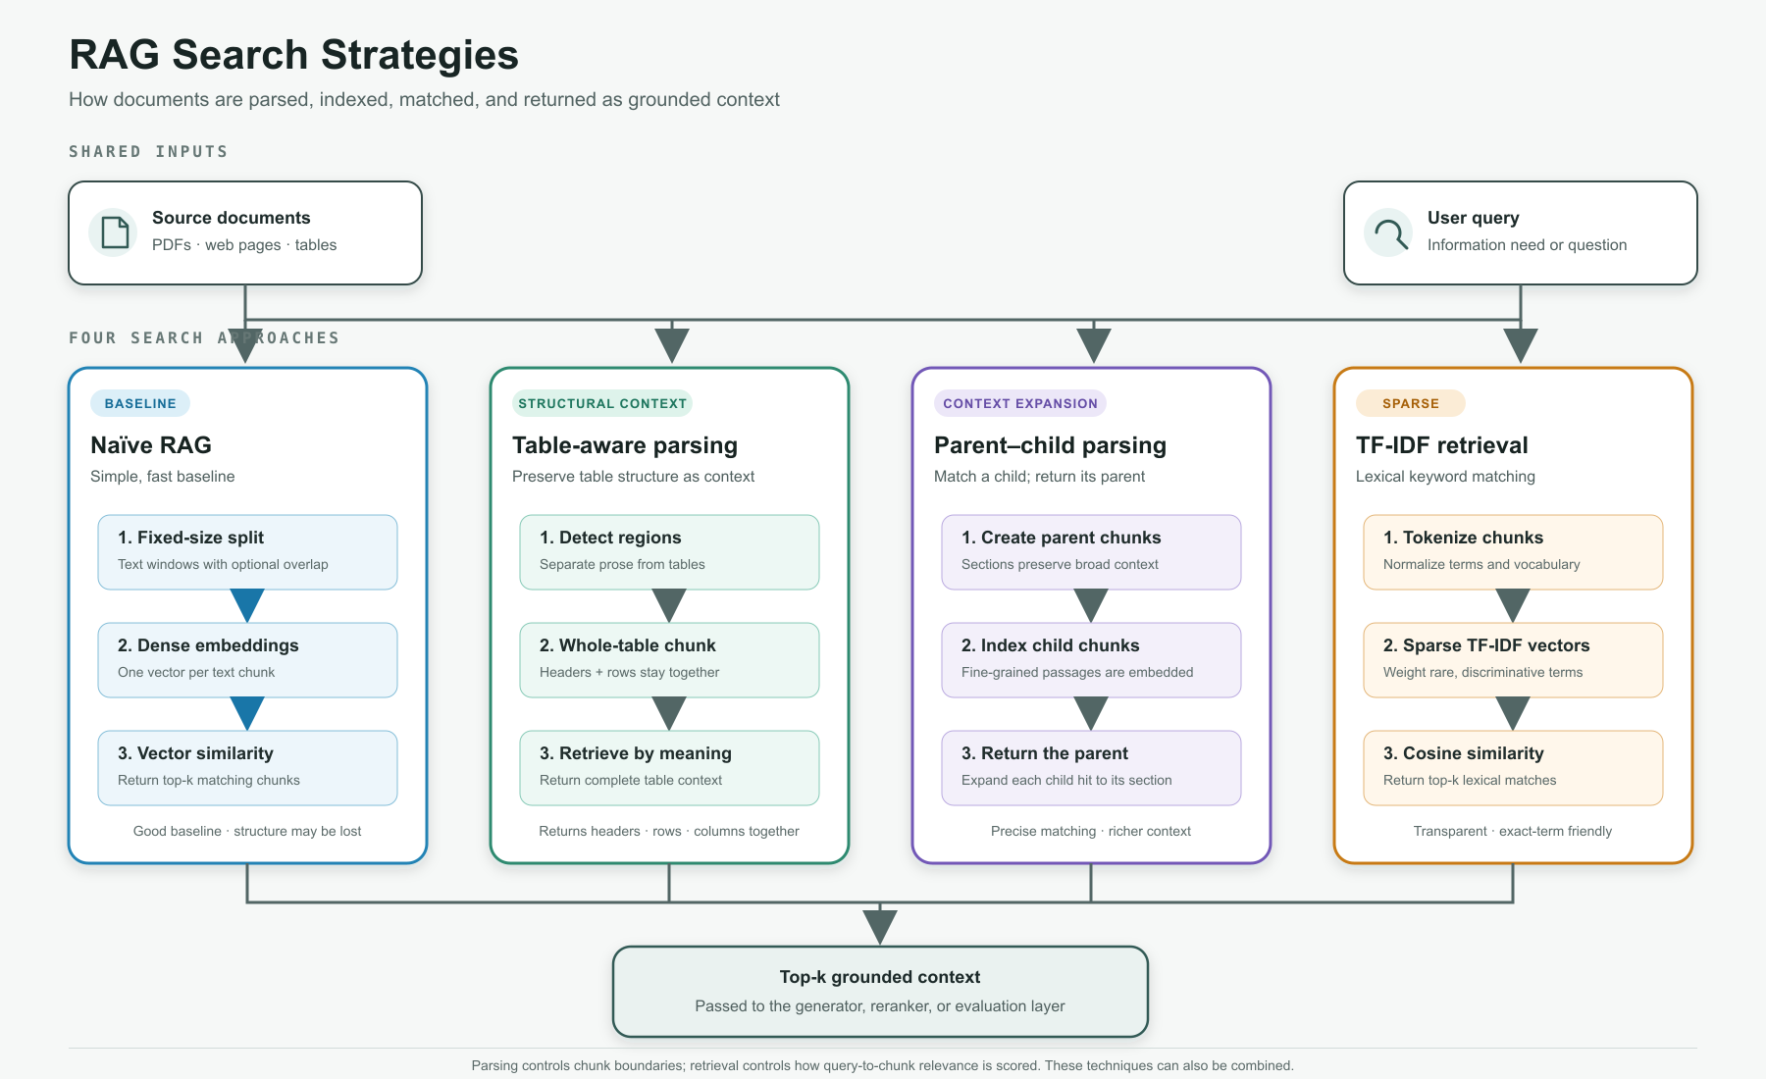
Notes:
RAG Search Strategies figure from the local GEHA reliability workspace.

Slide 2
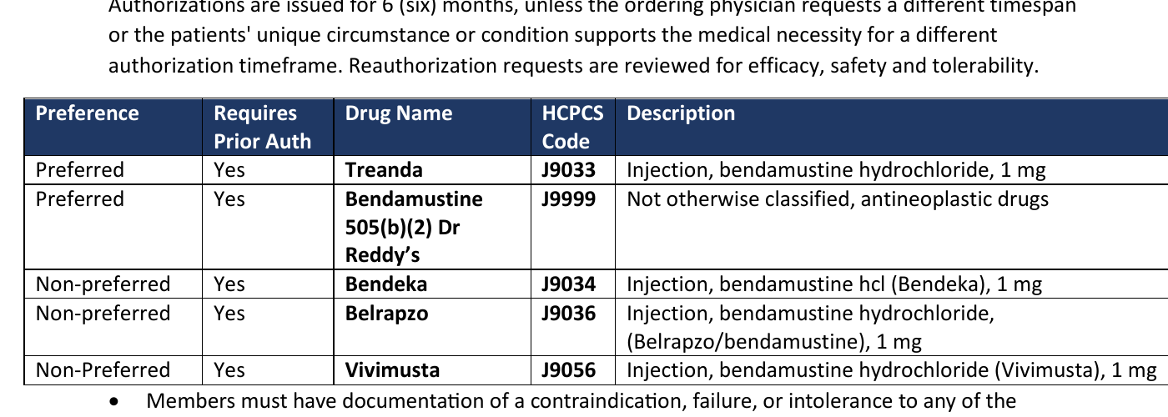
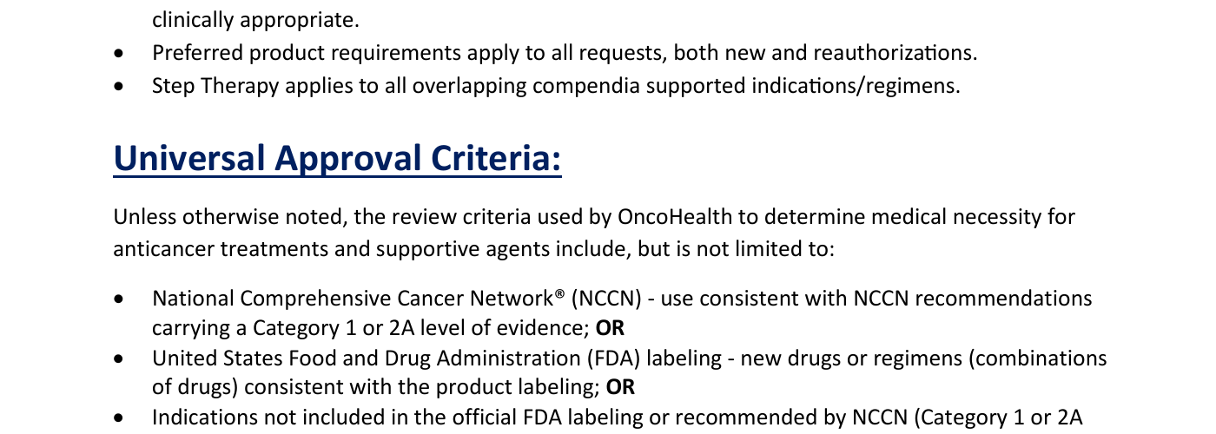
Structural context and context expansion
The same policy page produces different retrieval boundaries
STRUCTURAL CONTEXT
CONTEXT EXPANSION
Whole table returned
Parent section returned
Table-aware parsing keeps the header and all rows in one retrieval unit. The relationships among preference, drug, code, and description remain intact.
Parent-child retrieval can match a small passage about NCCN or FDA guidance, then return the full Universal Approval Criteria section as context.
Source: GEHA Coverage Policy: Bendamustine, page 1
Notes:
Source: geha_cloud_reliability/downloads/coverage-policies/geha-coverage-policy-bendamustine.pdf, page 1. The red boxes illustrate retrieval boundaries and do not alter the source document.

