Slide 1
GEHA demos
MCP Servers – workflow not REST or RPC
Why RAG doesn’t work
Data Quality – OCR, langgraph automation
Dashboard existing data
Automated table correction
Context, Tables break RAG
Blending Results
LLMs - Running Open source models/weights in Runpod

Slide 2
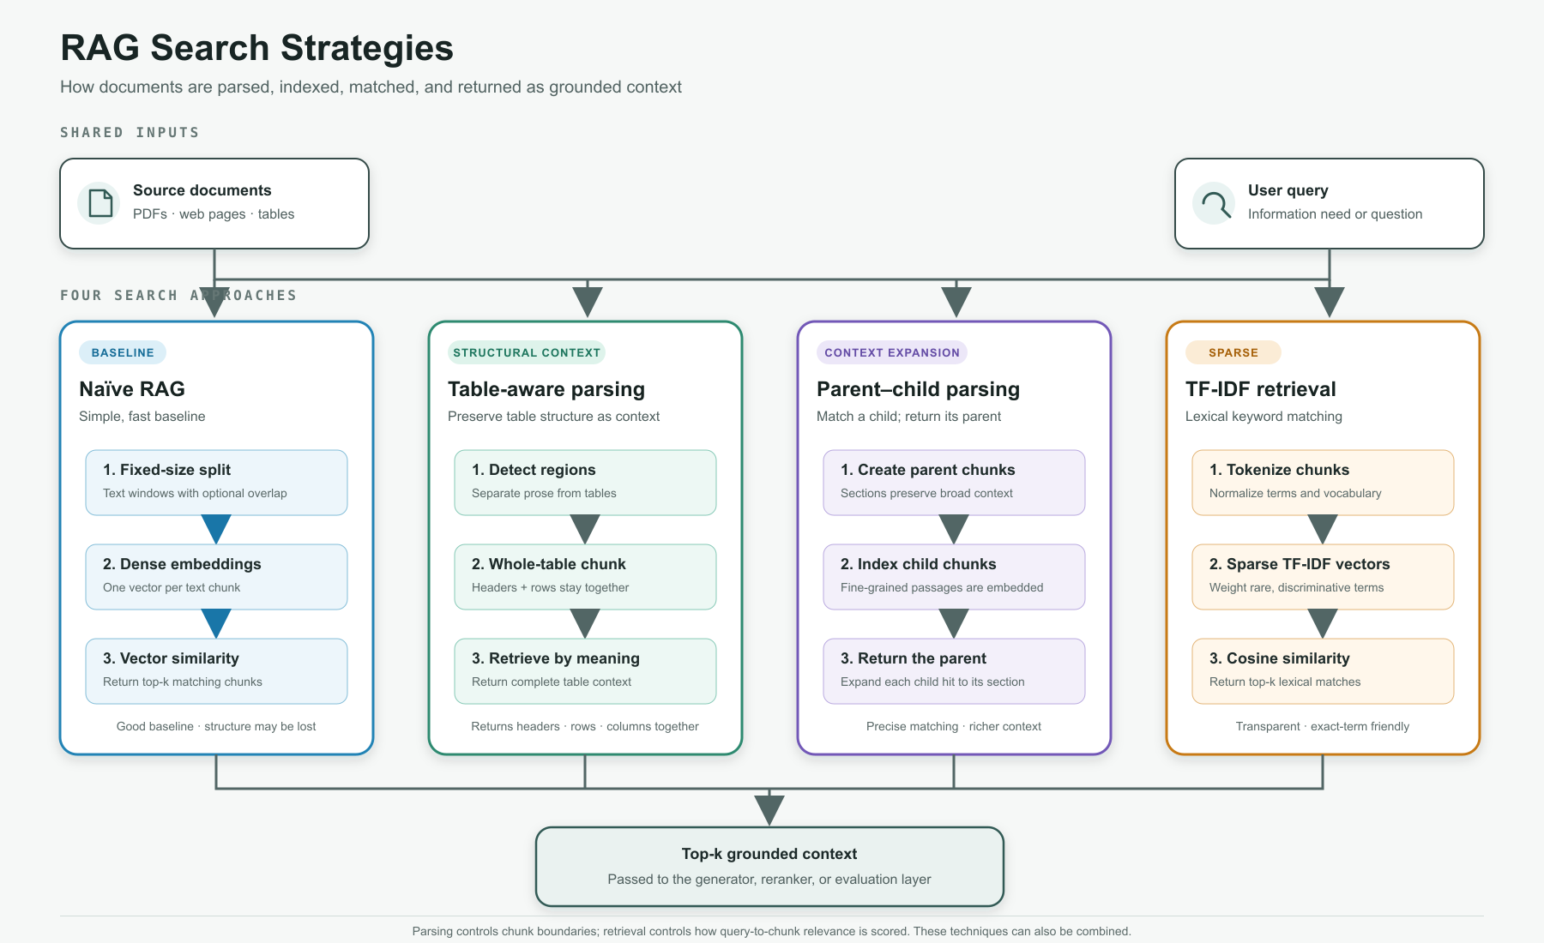
Notes:
RAG Search Strategies figure from the local GEHA reliability workspace.

Slide 3
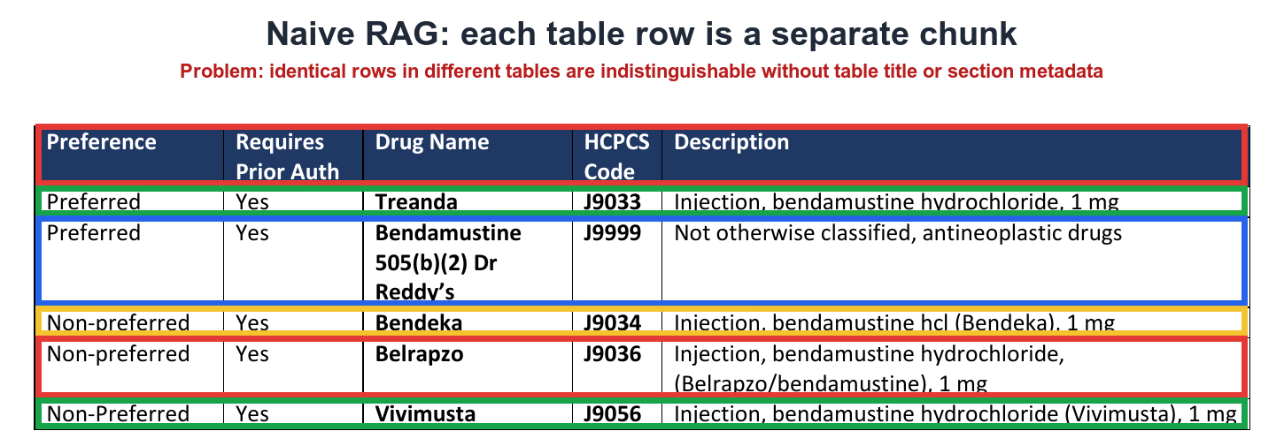

Slide 4
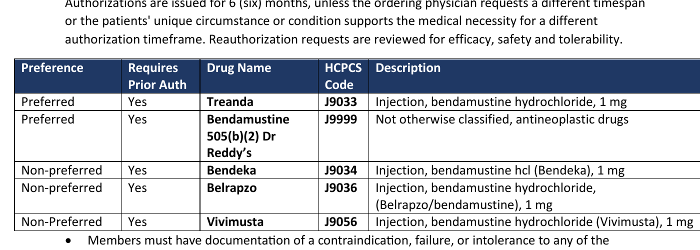
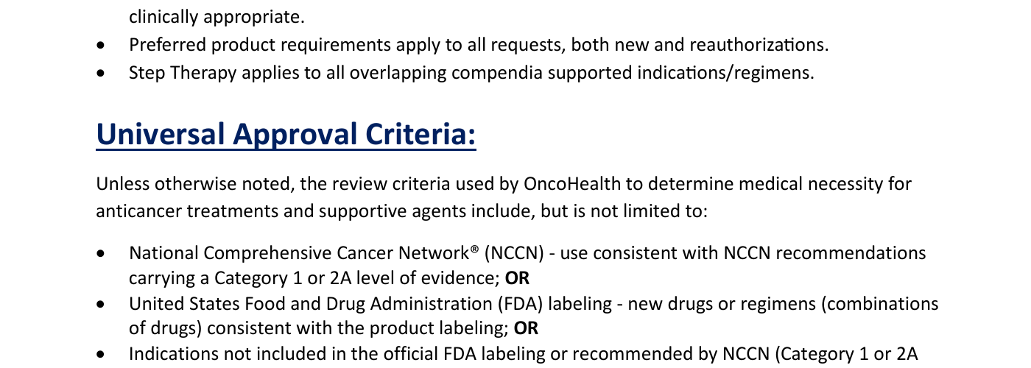
Structural context and context expansion
The same policy page produces different retrieval boundaries
STRUCTURAL CONTEXT
CONTEXT EXPANSION
Whole table returned
Parent section returned
Table-aware parsing keeps the header and all rows in one retrieval unit. The relationships among preference, drug, code, and description remain intact.
Parent-child retrieval can match a small passage about NCCN or FDA guidance, then return the full Universal Approval Criteria section as context.
Ambiguity risk
Duplicate or similar tables can repeat the same Treanda - Preferred rows for another condition. Without table-level context, retrieval may return the wrong result. This failure is unlikely to appear in the current small dataset.
Lesson
Returning the parent adds useful context, but every added passage consumes tokens and reduces the remaining context-window budget.
Source: GEHA Coverage Policy: Bendamustine, page 1
Notes:
Source: geha_cloud_reliability/downloads/coverage-policies/geha-coverage-policy-bendamustine.pdf, page 1. The red boxes illustrate retrieval boundaries and do not alter the source document.

Slide 5
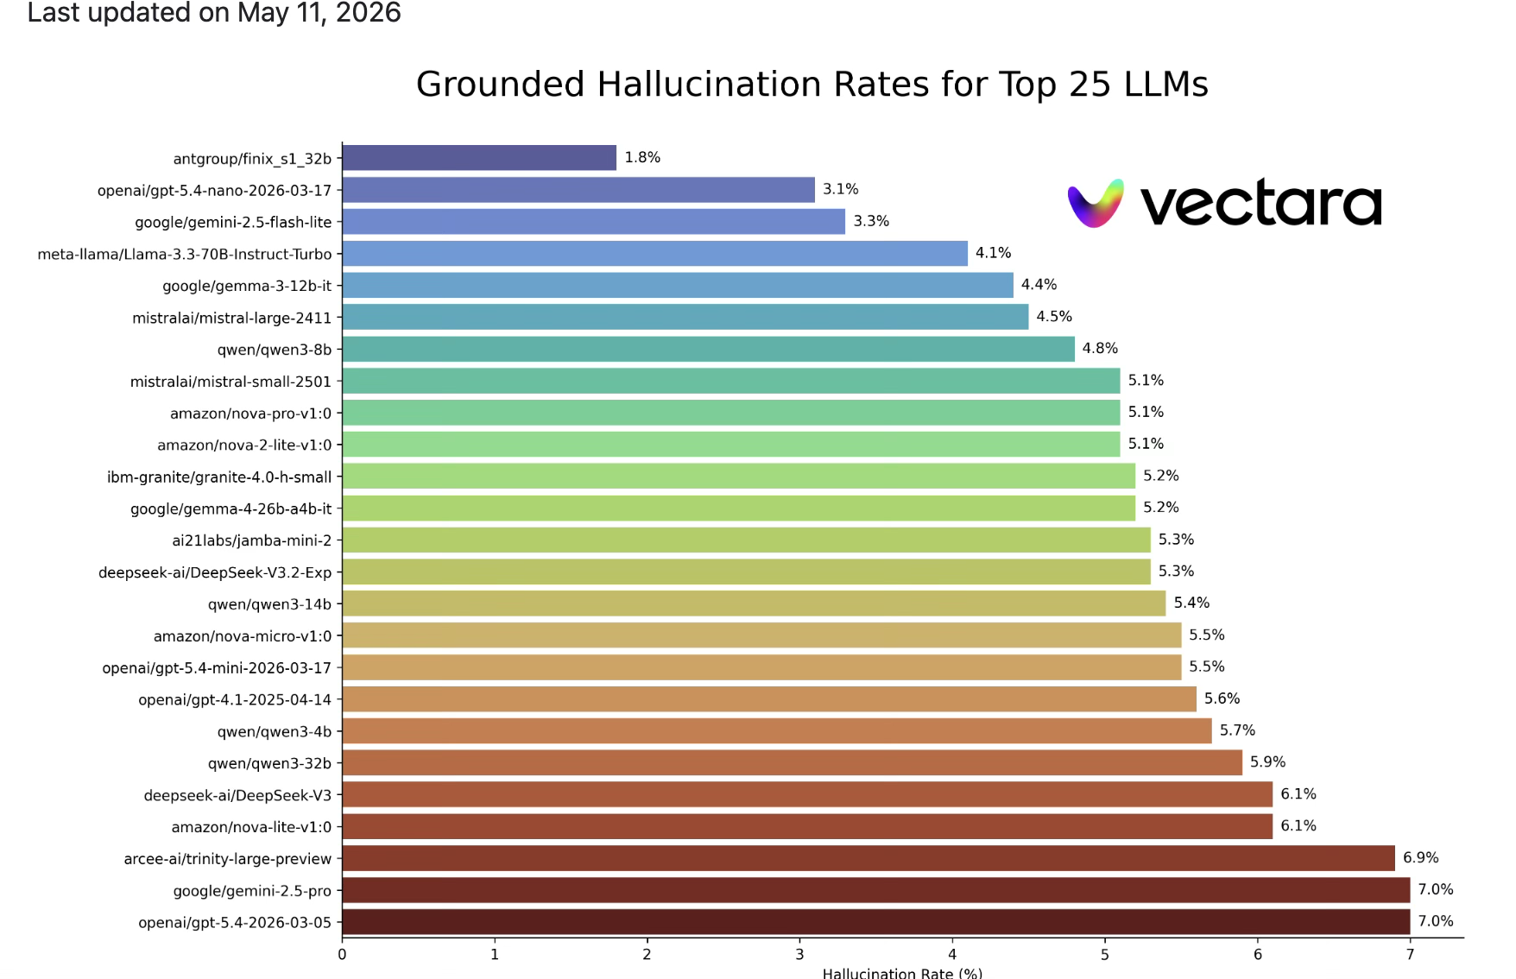
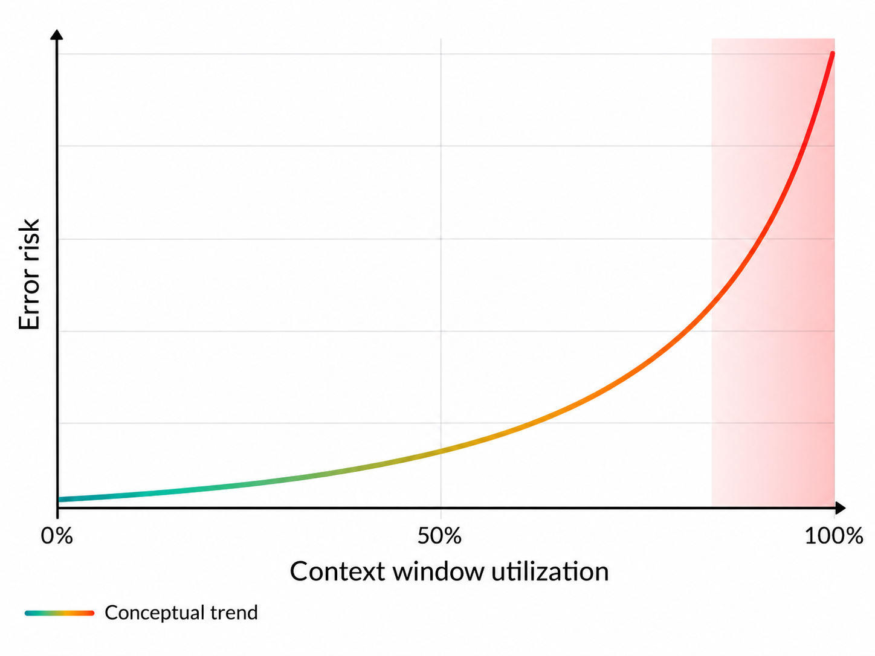
An error rate of 1.8–7% can remain invisible in prototypes and surface only at production scale.
These failures are difficult to simulate before launch.

Slide 6
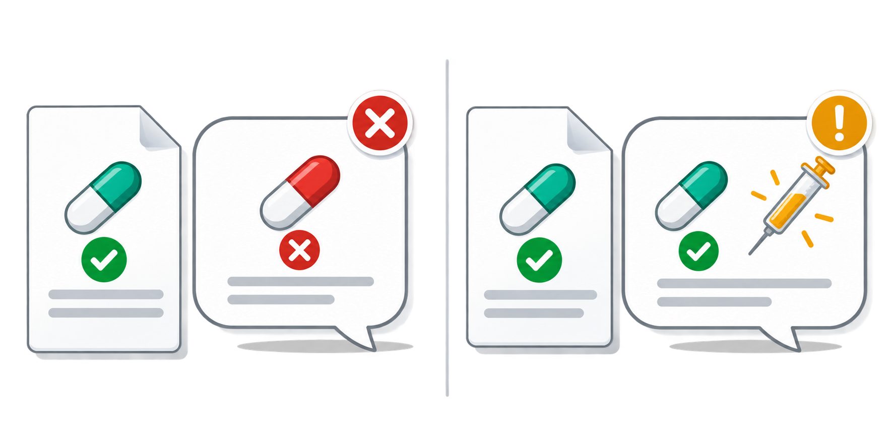
Intrinsic and extrinsic hallucinations
Both are grounding failures, but they fail in different ways
Intrinsic hallucination
Extrinsic hallucination
Contradicts the retrieved evidence
Adds a claim absent from the evidence
The answer changes a fact that appears in the source.
The answer introduces a fact the source never establishes.
Evidence
Coverage requires prior authorization.
Evidence
The policy lists covered drug codes.
Answer
No prior authorization is required.
Answer
The policy guarantees same-day approval.
Evaluation question: Does the answer contradict the context, or does it go beyond the context?
Notes:
create a slide with

Slide 7
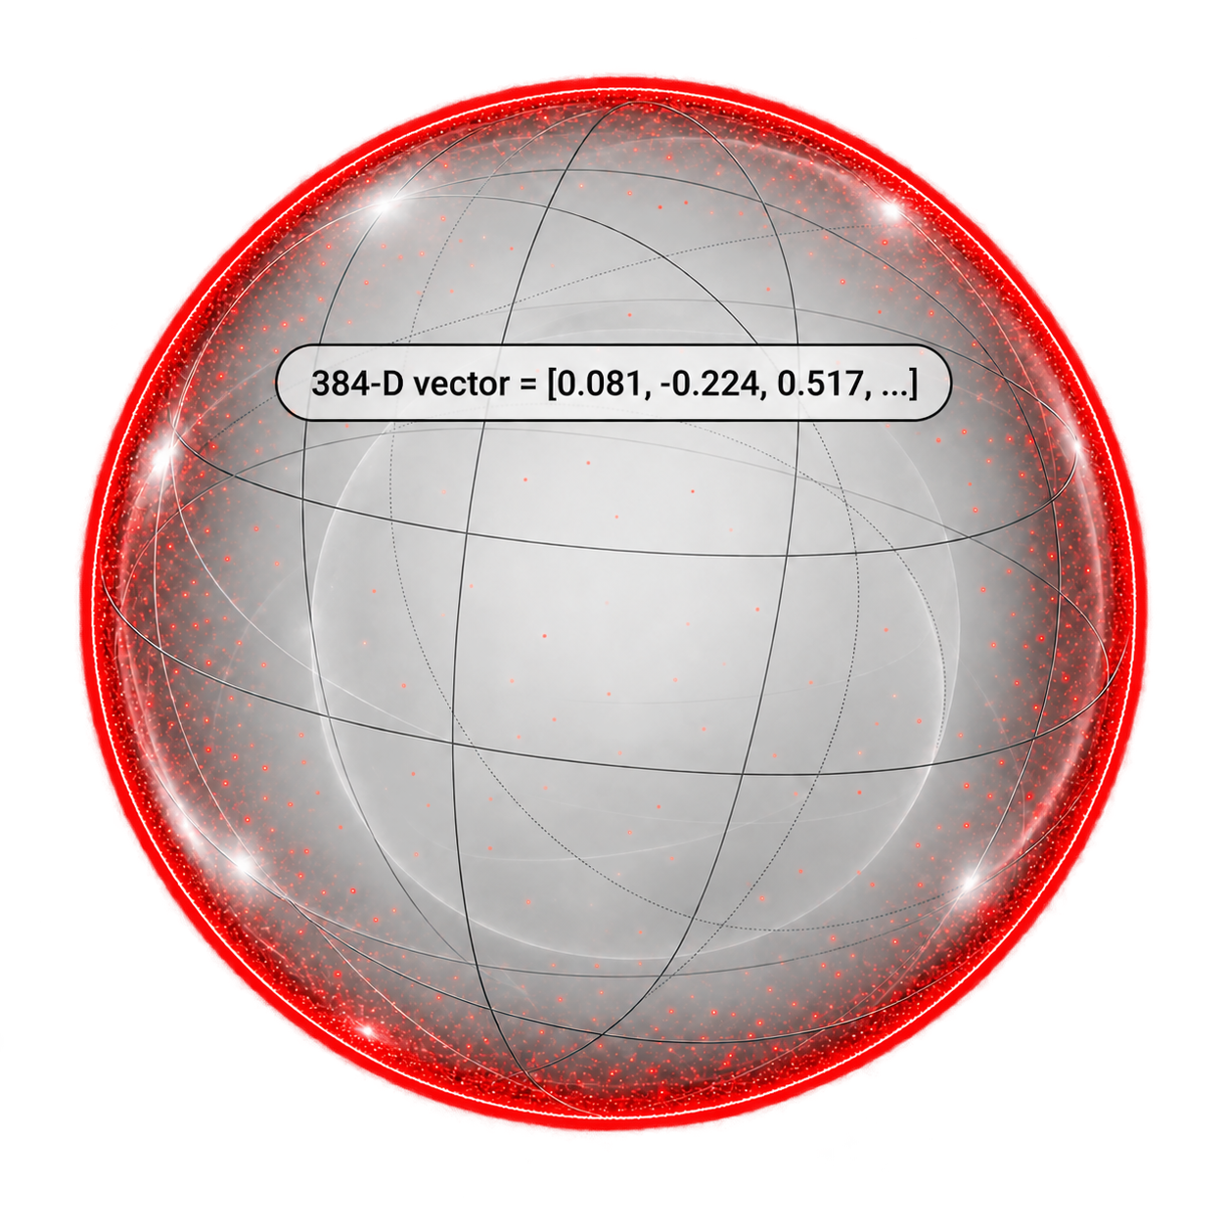
Cosine similarity in 384-dimensional space
The embedding model maps a query and every chunk to 384 floating-point coordinates
1 Query embedding
2 Embedding space
3 Compare direction
“Which policy covers thrombocytopenia?”
cos(q, c) = (q · c) / (‖q‖ × ‖c‖)
chunk B
dot product ÷ vector lengths
Vector length = 384
One coordinate per dimension
Illustrative normalized vectors
chunk A
query q
Chunk A Universal criteria
0.92
The image shows three values.
The ellipsis represents the remaining 381.
closest direction
Chunk B Billing codes
0.41
partial relation
chunk C
Chunk C Revision history
0.08
weak relation
Thin red shell: most probability mass
Highest cosine score
Pale center: very little probability mass
Chunk A becomes the top retrieval match
Cosine similarity ranges from -1 to 1. Higher values indicate more aligned vector directions.
Notes:
Illustrative explanation of the 384-dimensional embeddings used by BAAI/bge-small-en-v1.5 in the table RAG. The embedded image shows the abbreviated vector [0.081, -0.224, 0.517, ...]; the three coordinates and cosine scores are examples, not values from a production query. The monochrome ball is a three-dimensional metaphor for a 384-dimensional space. For a high-dimensional unit ball, most volume lies close to the boundary, represented by the thin red shell; the center contains comparatively little volume.

Slide 8
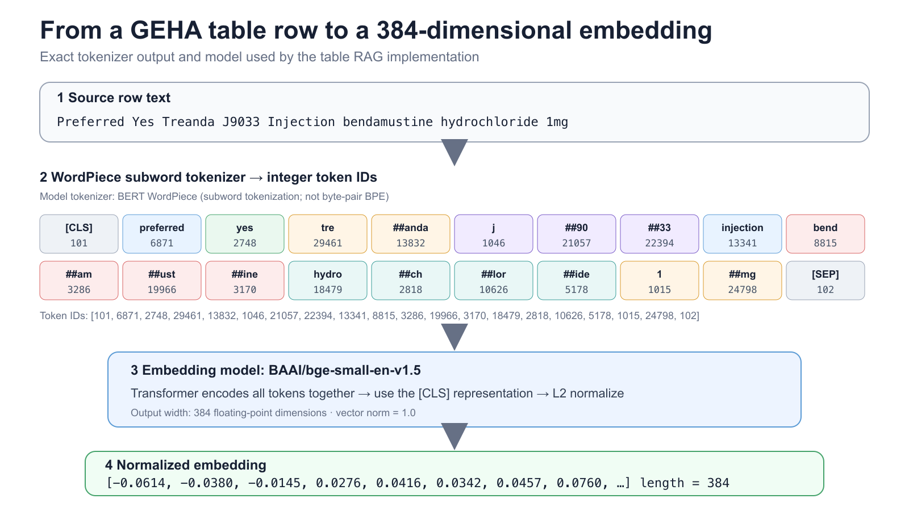
Notes:
Why is this important? Desire to match this processing to the LLM we are using. Google

Slide 9
Match the tokenizer to the embedding checkpoint
EmbeddingGemma · 768D
One model ID must govern subword segmentation, pooling, projection, and vector size.
1 Pair AutoTokenizer with the exact checkpoint
2 Load the complete embedding pipeline
MODEL_ID = "google/embeddinggemma-300m"
from transformers import AutoTokenizer
tokenizer = AutoTokenizer.from_pretrained(
MODEL_ID,
use_fast=True,
)
ids = tokenizer(
"Preferred: Treanda J9033",
truncation=True,
max_length=2048,
)["input_ids"]
from sentence_transformers import SentenceTransformer
embedder = SentenceTransformer(
MODEL_ID,
truncate_dim=768,
)
q = embedder.encode_query(question)
docs = embedder.encode_document(chunks)
scores = embedder.similarity(q, docs)
print(q.shape) # (768,)
Vocabulary + SentencePiece rules come from MODEL_ID.
Includes mean pooling → dense layers → L2 normalization.
ONE MATCHED PIPELINE
same MODEL_ID
→
subword tokenizer
integer token IDs
→
Gemma 3 encoder
token vectors
→
mean pool + dense
projection
→
L2-normalized
768-D vector
Do not mix checkpoint IDs. AutoModel alone omits EmbeddingGemma’s pooling/projection head; use SentenceTransformer for retrieval embeddings.
Source: Google DeepMind — google/embeddinggemma-300m · 2,048-token context · 768 dimensions (MRL: 512 / 256 / 128)

