Slide 1
Self Training Apache Contributors
CloudCamp 2012
Silicon Valley Hands On Programming Events
Doug Chang dougchang25@gmail.com
Roman Shaposhnik
roman@shaposhnik.org
@dougc333

Slide 2
2 Things
AUDIENCE: JAVA PROGRAMMER WANT TO BE A HADOOP ECOSYSTEM APACHE CONTRIBUTOR
AUDIENCE: WANT TO START NEW MATERIAL(JAVASCRIPT) OR WANT TO SPONSOR
1) WHAT WE HAVE: APACHE BIGTOP/ JAVA CONCURRENCY/DATA MINING MACHINE LEARNING
2) SPONSORSHIP, RUN THESE MEETINGS THIS AT YOUR COMPANY. BETTER RESULTS?

Slide 3
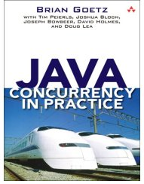
What Group?
Silicon Valley Hands on Programming Events, Meetup to help train unemployed engineers starting in 2008.
Career Accelerator 4+ years to get the template right
Best class was cs229 Clone ML/2009, Peter & Tyler
Best success = hard
MARSHALL PIERCE: JAVA CONCURRENCY
CHARLES NAINEN: MACHINE LEARNING
ROMAN SHAPOSHNIK: APACHE BIGTOP

Slide 4
Need, Programmers/Apache
WHAT STRUCTURE?
Java Programmers wanting to become Apache Bigdata contributors
Won’t happen by going to HUG meetups
Apache Hadoop* projects which are asking for contributors at each meetup. Reference: Michael Stack asking for Hbase contributors

Slide 5


What Project?
Jumping into Hadoop was too complex
Need corporate sponsor for higher technical difficulty, tried 2x. First person I askeed left…

Slide 6
Bigtop for building Stable Scalable Hadoop Clusters
Roman’s Idea
Working group meeting for Apache Bigtop
Members demo, ask questions, work on mini projects. Integration testing, Hama/Nutch Port
Need 2 to run it, architect+techlead
Get everything a new Cloudera employee gets
Bigtop: Cloudera assembled collection of Hadoop components. Administration & Maintenence

Slide 7

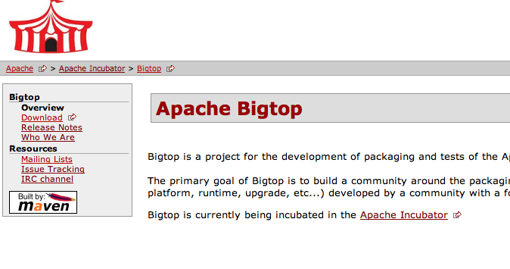
http://incubator.apache.org/bigtop/

Slide 8
Bigtop
Good to start early in incubation stage
No documentation, creating Docs as we go. Ken Krugler: “Make Docs”
Bring a computer!!!
Do the labs
Hadoop, Hbase, Pig, Hive, Flume, Sqoop, Mahout, Oozie, Zookeeper
bigtop-0.3.0-incubating

Slide 9
How to get Better than GSOC?
Get others involved
Tech Leads
Other Open Source Projects. Integrate Dynamo DB?
Add Nutch
Add Cassandra to Bigtop
Come to the Saturday Meetings

Slide 10
Programming Skills Market Changing
Less J2EE, Cloud Unstructured Data, administration/maintainence
Tom White, Cloudera 1H compared to 3+ months for newbies to port Hama to Bigtop
How are we different from the Stanford Classes?
Not Free/Focus on 90% required to ship s/w.
College Grad: IF it works in Eclipse I’m done

Slide 11
Apache Working Group
Everything but Java/Eclipse
Maven, Ant
Bash Shell
Groovy, iTest, Testing at Runtime
Puppet, AWS Cluster administration
Linux (both flavors) Administration, ssh, kerberos, billing
Unit Tests

Slide 12
Past Failures
2008: Javascript Class
Response to high unemployment, not free, developed materials and created assignments with 1 person
Success: 10% found jobs, 2-3/15; most did the h/ws. Repeatable
Failures: too much work for 1 person, 3 months. Every week for 1-2h lecture style.

Slide 13
Past Failures
2009 ago started a variant of Professor Andrew Ng’s cs229 class at HackerDojo. Coteaching (did hws).
Structure
Homeworks from cs229 class
Not free, requirement to join Dojo at $100/month
Success: 15-30 in class. Tried to do homeworks. Never got past 2nd assignment. 2-3 went on to bigger things from that class, Tyler, Peter, xx.
Failure: not repeatable, original material from Stanford was too hard and not applicable to people looking for jobs, lets try something more practical but still hard and you cant get from anywhere else.
Failure: 2 lectures were hijacked
Next version Mike Bowles went to Stat202 type class

Slide 14
Past Failure
2010: Java Concurrency class using Brian Goetz’s JCIP as a guide. More modern than learning concurrency from Nachos or writing an OS.
Structure
Defined own labs/homeworks
Free
Success:
15-30 attended
Failure:
Nobody did the homeworks, maybe 1 person besides me. No demonstration of skill by participants
All Lectures were hijacked by strong personalities.
Not repeatable

Slide 15
Metrics

Slide 16
Lessons Learned
Structure:
Not free, join as member of Biocurious $100.00/month. Free doesn’t work, hijack class, collect free things
Create self paced labs (Roman’s idea) which are the same as what you get as a new employee at Cloudera
Was too fast, slow down, 2 weeks
Started 11/2011, code coming after 4.5 months
Integration Testing – where stuck?
Individuals working on porting Hama – where stuck?
DEMOS

Slide 17
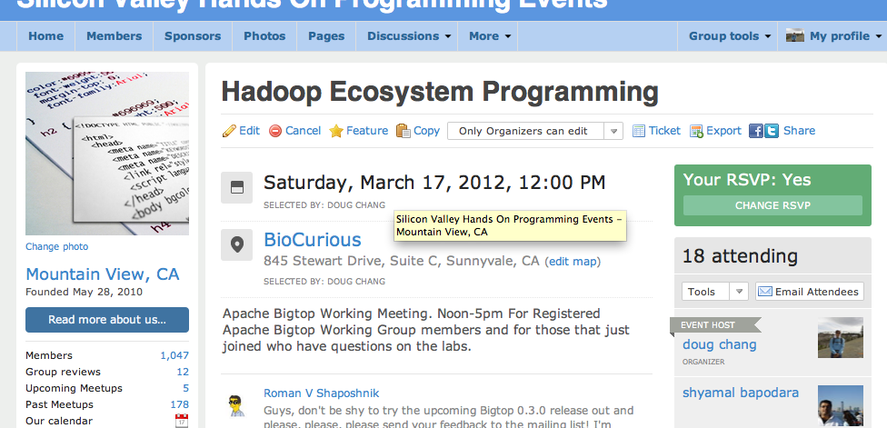
Come Check it out

Slide 18
What to do?
NOT A CLASS!! WE DON’T DO A GOOD JOB MAKING THIS PAIN FREE. MAYBE EASIER BUT STILL A LOT OF WORK
4+ Labs, do a demo in front of the group, ASK questions when stuck
Install Bigtop
Build Bigtop on Ubuntu DEB, OpenSuSE RPM
Write a Map Reduce Program
Write an Integration Test
Integrate a module (Hama/Nutch)
Use Puppet to deploy and test in the cluster

Slide 19
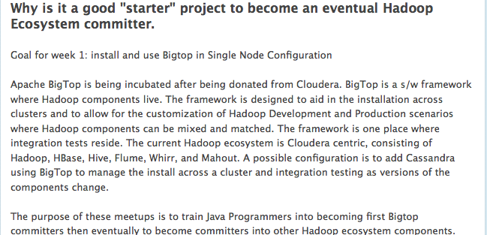
http://apachebigtop.pbwiki.com

Slide 20
Corporate/Personal Sponsors
Amazon AWS, cluster credits
JetBrains , Full IntelliJ license
Cloudera
Roman Shaposhnik

Slide 21
Thanks
Amr Awadallah, CTO Cloudera
Roman Shaposhni, Cloudera
Rodica Buzescu, Amazon
Michael Quintieri, JetBrains
Nick Tran Salesforce.com
Kavindra Patel Salesforce.com
Katie Penn Salesforce.com

