Slide 1
ASB
Code Review 4/5/2013
Demo Jetty/Java WS/Spring
Demo ASB, goal to show difference between Storm and Server. Why do we need Storm in ASB?

Slide 2
ASB J2EE/Jetty Demo
MVC pattern w/o using Spring containers, uses the Spring annotations, not on web
Coding
  Convention: No concrete classes in the services/interfaces, Domain Objects/ only setters/getters
ASB server code as embedded app vs. educational demo. https://github.com/dougc333/jettyj2ee
Next Tech Talk/ JAX/RS w/ DI?
sudo /usr/bin/mysqld_safe --skip-grant-tables
mvn jetty:run

Slide 3
ASB, (Storm, Redis, WebServer)
Dumbest possible implementation
WebServer
Storm
Redis

Slide 4
Dumbest possible design
Data Model requires iterations:
Copy CCData tables into Redis. vwDDDeviceGroup, vwDDDevice
  .910MB, 1.12MB, 1.14MB
  Duplicate data structures, may not need it. Memory fast, iterate
Why not create Domain Objects? Redis gives metrics on memory space, when to refactor, when to add more nodes, no memory stats
Going from rows->objects w/more data, key = accountID vs. ESN

Slide 5
A:
Domain objects live in JVM memory, if you put objects inside the JVM heap you won't be able to scale across a cluster. This creates a fat server process
Redis is a distributed K/[data structure] store

Slide 6
Time vs. Space tradeoff
Do DB queries at page load time. May be able to simplify to one accountID followed by all fields
HashMap in previous slide no difference
The data model starts w/accountID

Slide 7
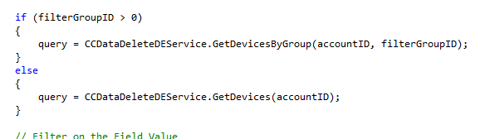
Where is this in the code?

Slide 8
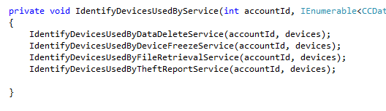
Working on

Slide 9
Redis, Not a Database!!!!
But people still use it as a database which leads to poor design. Put all objects in Redis for lifetime of app. Don't do this. Only on transitions
Enforce some possible conventions
  Flush the db before/after each user web page transition, why?
  Bad design: fit all the db objects into a redis object and put all the objects in memory then use them for only a short time in the application lifecycle.
  Error: If you don't see a dbFlush() in the code and a load/store into some data store.

Slide 10

ASB Semaphore Unit Architecture
Spouts wait for semaphore to start. Replicate the spouts so there is always one waiting. There is never any blocking. This is very different than an application/server process
messages to start spouts;autoreg, can replace w/HTTP messages(more code)

Slide 11
Difference w/Server(CH)
Redis + Storm differences, Capacity is reserved for taskX
Waiting Tasks=ASB
Wait 1
Redis
Wait 1
Wait 2

Slide 12
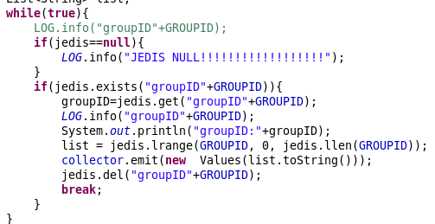
Each Spout waits for a message to start, groupID555 or groupID60

Slide 13
What else is different?
Implies easy to add capacity (need to do additional demo)
Questions on timeout messages or fault recovery (need to do demo)
Open source requires more demos. Can't read web posts for info.

Slide 14
Demo:
Copy table vwDDDeviceGroups, vwDDDevices to Redis from file on server init(). Build Redis DataStructs.
Request groupId DD for group of ESNs.
Add more Bolts/Spouts to simulate users
See writes into BulkRequestTable

Slide 15
Demo:
Copy table vwDDDeviceGroups, vwDDDevices to Redis from file on server init(). Build Redis DataStructs.
Request groupId DD for group of ESNs.
Add more Bolts/Spouts to simulate users
See writes into BulkRequestTable

Slide 16
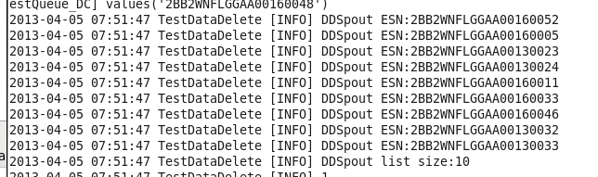
Demo Screenshot. ESNs for GroupID 555 writing to DB

Slide 17
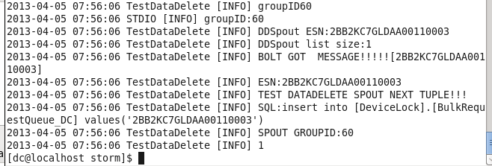
Demo Screenshot. ESNs for GroupID 60 writing to DB

Slide 18
3 weeks work
Lost 1 week MongoDB w/Redis; not just Mongo. Pick and choose components. Index is slow, don't use it.
Thanks SS, Time w/Slawomir setting up VS & C# for DD

