Slide 1
ASB/Storm 6/1/2013
1. High level Architecture diagram
2. Zookeeper recovery snapshots
3. IPTables
4. Monit control scripts

Slide 2
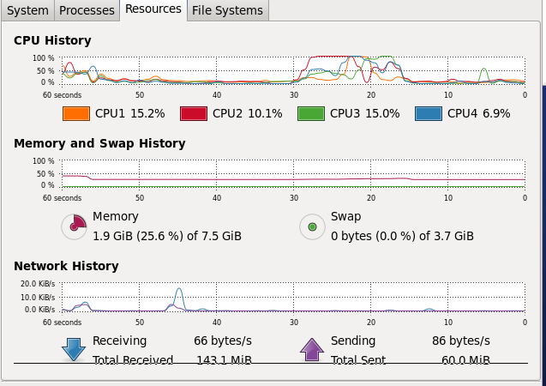
HighLevelStormITDoc
Simulate users, vary number of messages/user and vary number of users. Look at perf of system

Slide 3
Goals
Use the performance graph and keep memory and cpu utilization to 25-30% for average. Peak at 50%
How do we measure this?
Using graph have to eyeball. No peak and average. Have to write our own metrics in the topology

Slide 4
System metrics
>mpstat -P 2 5
[dc@localhost lib]$ mpstat 2 5
Linux 2.6.32-358.6.1.el6.x86_64 (localhost.localdomain) 06/07/2013 _x86_64_ (4 CPU)
06:25:17 AM CPU %usr %nice %sys %iowait %irq %soft %steal %guest %idle
06:25:19 AM all 43.95 0.00 1.75 0.12 0.12 0.00 0.00 0.00 54.06
06:25:21 AM all 50.82 0.00 1.25 0.00 0.13 0.00 0.00 0.00 47.80
06:25:23 AM all 60.15 0.00 1.88 0.00 0.13 0.00 0.00 0.00 37.84
06:25:25 AM all 73.97 0.00 1.50 0.00 0.13 0.13 0.00 0.00 24.28

Slide 5

Do this in code
http://www.hyperic.com/products/sigar
Problems:
  Maven repo,
  JNI, not a JAR, copy .so files into the LD_LIB or link path. In Java storm sets this:

Slide 6
Maven
<repository>
<id>thirdparty-uploads</id>
<name>JBoss Thirdparty Uploads</name>
<url>https://repository.jboss.org/nexus/content/repositories/thirdparty-uploads</url>
</repository>

Slide 7
maven2
<dependency>
<groupId>org.hyperic</groupId>
<artifactId>sigar</artifactId>
<version>1.6.5.132</version>
</dependency>

Slide 8
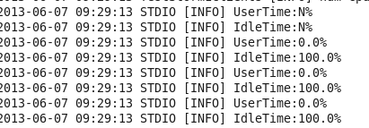
Metrics

Slide 9
Measure load is funny
Performance is function of number of bolts/spouts on a node. Doesnt matter if the spout does nothing. Find average and peak...
Confused here. I can add messages to users an d put them in bolts/spouts. Wont make a difference what they do. Unless you drop messages?
1 bolt/spout per node, add custom scheduler to load balance.

Slide 10
Load balancing vs. capacity planning
Load balance the supervisor ports, ie. put 2 slot ports on the nimbus node and 6-10 on the other supervisor nodes.
How do we know how many ports? By the total system memory. ½ for OS, ½ for storm. 64Gb machine =>32 ports at 1GB/JVM. Use 25% of the ports, 8 per machine. Gives room to grow JVM -Xmx size.

Slide 11
Doing now
Measure message size/#clients per -Xmx heap size per JVM. Number of clients and max size of messages per 1-4GB. What ever this number turns out to be.. it won't make a difference?
As load increases may get higher frequency of peaks.

Slide 12
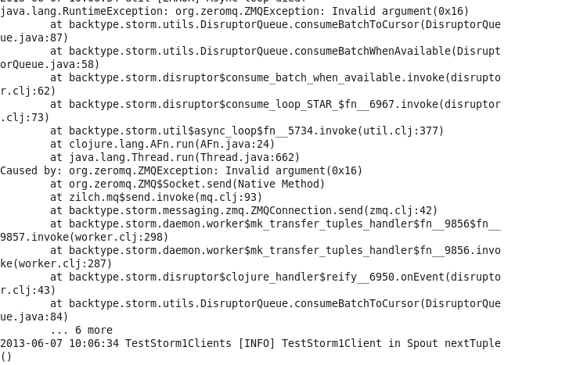
Why?

Slide 13
Need more data on servers
#Users/given message size, number of messages = number of 64GB 4 quad core cpus. Can estimate this.
Is one 64GB quad core cpu server better than 2 32GB machines? Prob because of power. Cost/power tradeoff if topologies scale linearly.
Do web search. Low priority for now.

Slide 14
Zookeeper Recovery
Cant find it from web search. Not on the Zookeeper docs.
At the application level. Like POS Cassandra...
From Netflix:
Backups in a ZooKeeper ensemble are more complicated than for a traditional data store (e.g. a RDBMS). Generally, most of the data in ZooKeeper is ephemeral. It would be harmful to blindly restore an entire ZooKeeper data set. What is needed is selective restoration to prevent accidental damage to a subset of the data set. Exhibitor enables this.
Exhibitor will periodically backup the ZooKeeper transaction files. Once backed up, you can index any of these transaction files. Once indexed, you can search for individual transactions and “replay” them to restore a given ZNode to ZooKeeper.

Slide 15
Zookeeper Recovery status
Built and Ran exhibitor. Turns out it can do log clean and purge and distribute zoo.cfg across nodes. Replaces monit for zookeeper.
Did not extract code, just ran. Did not test how application recovery works for zookeeper znodes. Low priority till 1) done

Slide 16
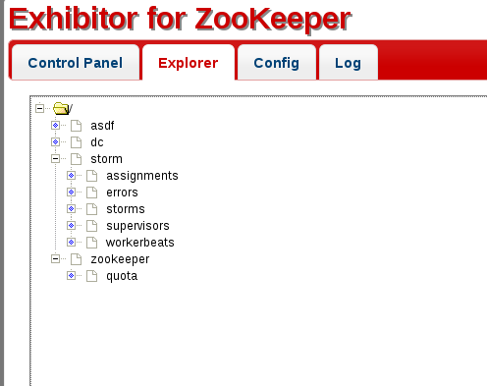
Exhibitor/ znode dir struct

Slide 17
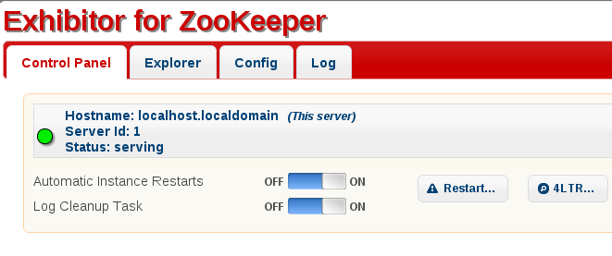
Exhibitor conflicts w/8080. Rebuild.

Slide 18
IPTables
Hard to debug. Most people just enter in ports. This won't work. Takes forever and you cant test.
Use netstat. >sudo lsof -nP | grep java
| grep IP | grep LISTEN to get ports. (not on web)
Log the iptables actions using ICMP packets (ping). Not tested yet... this tests all the rules w/test traffic.

Slide 19
Monit
Write the bash script to turn on monit on power on. 6 lines on top have certain format.
Chkconfig on... forgot .. in document in sharepoint.

Slide 20
