Slide 1
Sample Presentation
Your Name

Slide 2
Welcome to Our Presentation
This is the title slide of our sample presentation.

Slide 3
Agenda
Introduction
Key Points
Data Overview
Conclusion
Questions & Discussion

Slide 4
What is Pandoc?
Pandoc is a universal document converter that can:
Convert between many markup formats
Generate presentations from markdown
Support custom templates and styling
Handle complex document structures

Slide 5
Key Features
Input Formats: - Markdown - LaTeX - HTML - Word documents
Output Formats: - PowerPoint - PDF - HTML slides - Beamer

Slide 6
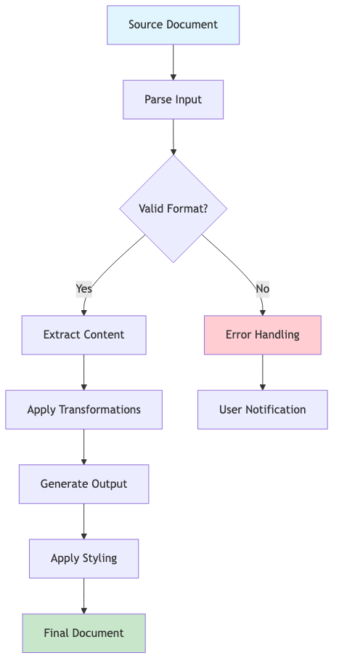
Process Flow
Document Conversion Workflow:
Input Processing
Parse source document
Extract content and metadata
Validate structure
Transformation
Apply formatting rules
Convert syntax elements
Handle special features
Output Generation
Render final format
Apply styling/templates
Export final document
Mermaid Diagram

Slide 7
Sample Data
Product | Q1 Sales | Q2 Sales | Growth
Widget A | $10,000 | $12,000 | +20%
Widget B | $8,500 | $9,200 | +8%
Widget C | $15,000 | $18,500 | +23%

Slide 8
Code Example
Here’s a simple Python function:
def calculate_growth(old_value, new_value): """Calculate percentage growth between two values.""" if old_value == 0: return 0 return ((new_value - old_value) / old_value) * 100 # Example usage growth = calculate_growth(10000, 12000) print(f"Growth rate: {growth}%")

Slide 9
Key Insights
“The best way to predict the future is to create it.”
— Peter Drucker
Notes:
Speaker notes: This quote emphasizes the importance of taking action rather than just planning. Remember to discuss the proactive approach our team has taken this quarter.

Slide 10
Important Points
First point appears first
Second point appears on click
Third point appears last
All points build the narrative

Slide 11
Image Example
Figure 1: Pandoc conversion process
Pandoc Logo

Slide 12
Lists and Formatting
Bold text and italic text for emphasis
First numbered item
Second numbered item
Nested bullet point
Another nested point
Third numbered item

Slide 13
Mathematical Expressions
When we need to show formulas:
Simple inline math: $E=mc^{2}$
Display math:
$$\sum_{i=1}^{n}{x_{i}}=x_{1}+x_{2}+⋯+x_{n}$$

Slide 14
Conclusion
Summary
Pandoc makes presentation creation easy
Markdown syntax is simple and powerful
Version control friendly
Highly customizable output
Next Steps
Try creating your own markdown presentations
Explore pandoc templates
Customize styling as needed

Slide 15
Thank You!
Questions & Discussion
Contact Information: - Email: your.email@example.com - GitHub: @yourusername - LinkedIn: /in/yourprofile

Slide 16
Appendix
Additional Resources
Pandoc User Guide
Markdown Syntax
PowerPoint Templates
Technical Notes
This presentation was created with pandoc
Source files available in version control
Reproducible and maintainable

